Slide 1
12 Research Drive, Stamford Proposed Medical Marijuana Dispensary
Stamford Zoning Board Presentation
April 26, 2021

Slide 2
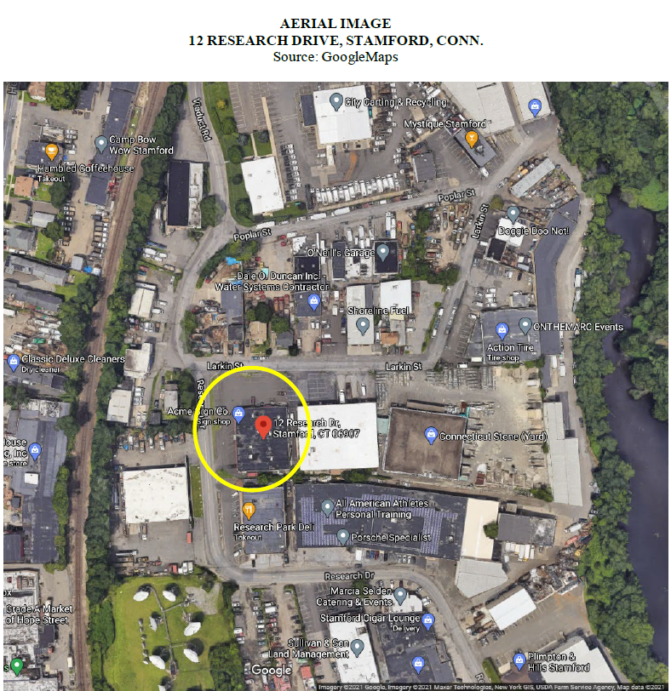
Zone: General Industrial (“M-G”)
Master Plan: Category 13 (General Industrial)
Size: 27,081± SF (0.62 acres)

Slide 3
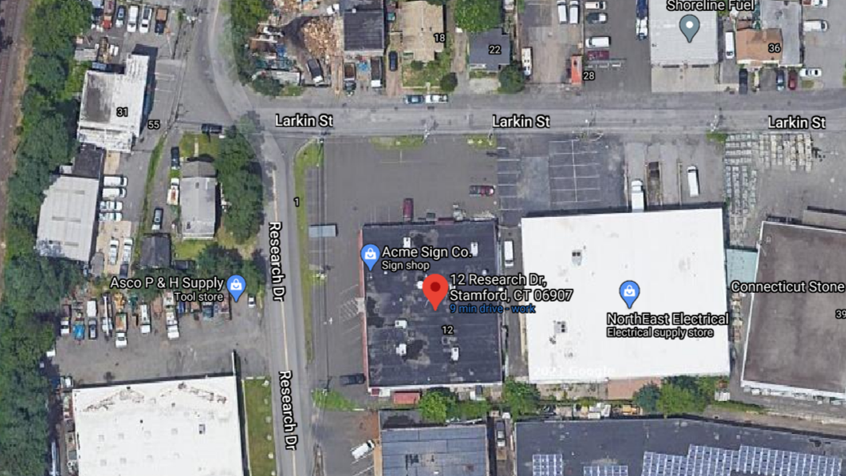

Slide 4
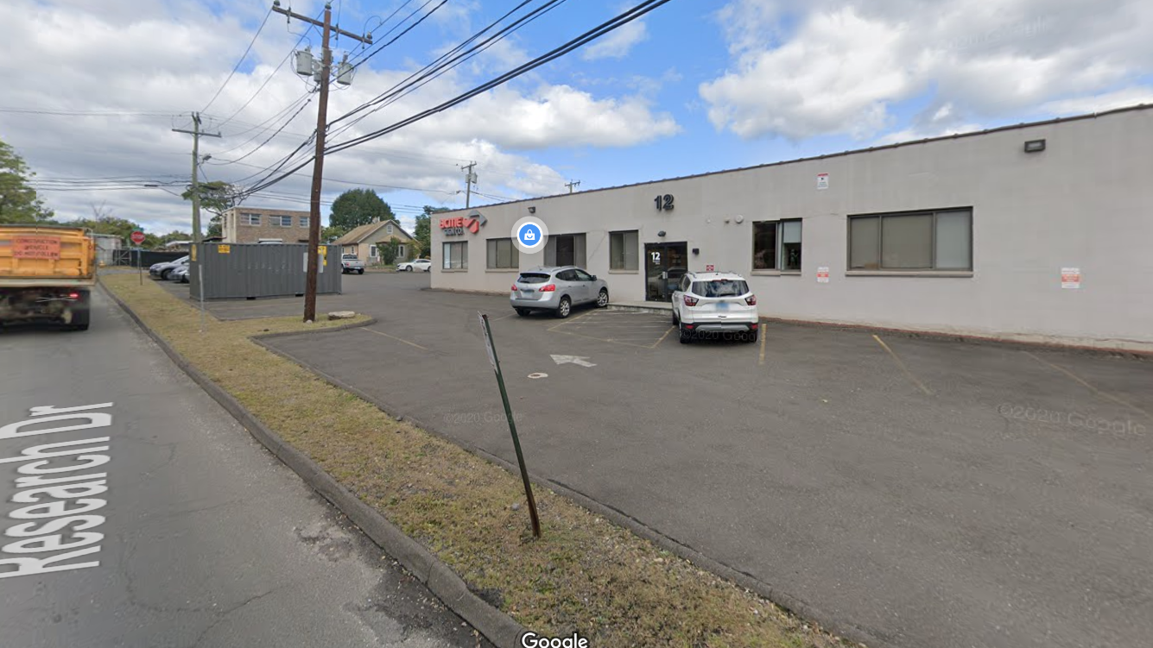

Slide 5
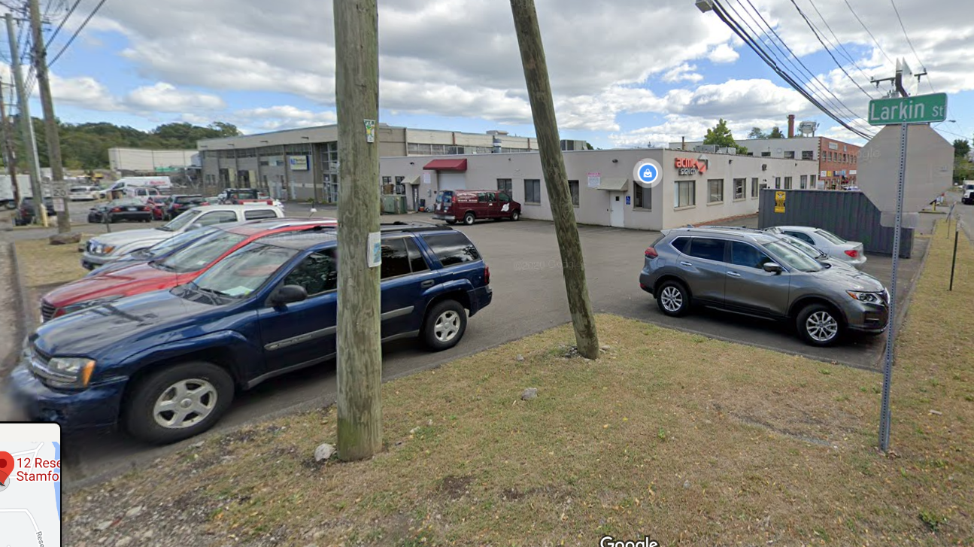

Slide 6
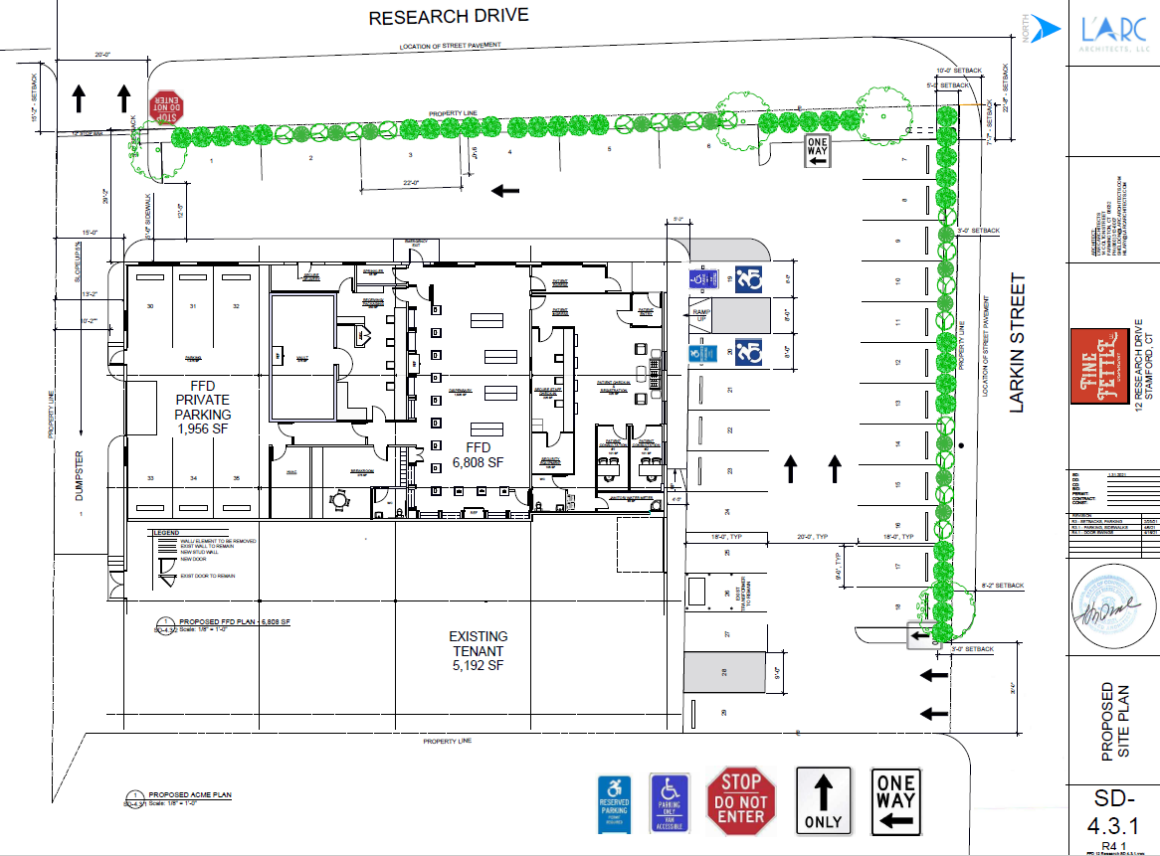

Slide 7
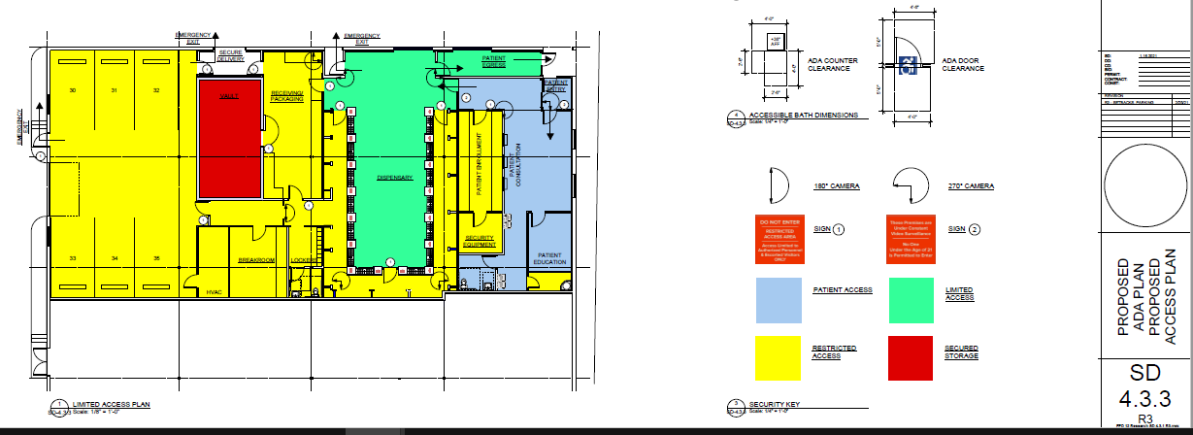

Slide 8
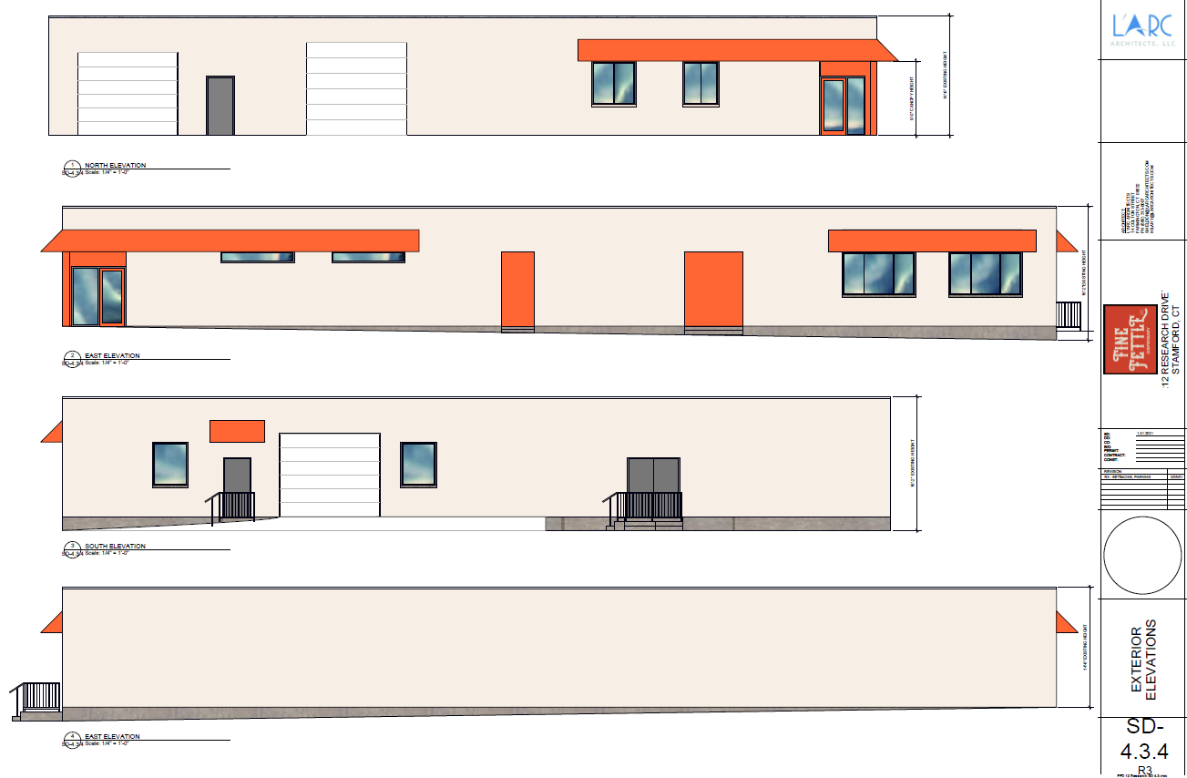

Slide 9
