Slide 1
Board of Finance
Stamford Enterprise Resource Planning Project Update
February 10, 2022
Innovating Since 1641

Slide 2
Agenda
Discuss progress-to-date
Review decisions-to-date
Review Open Issues and Risks

Slide 3
Progress-to-date

Slide 4
Nov 2021 – Feb 2022
Jan 2022 – Aug 2022
Apr 2022 – Dec 2022
Nov 2022 – Jan 2023
Jan 2023 – Feb 2023
Project Management
Organizational Readiness
Calibrate
Configure
Validate
Transition
Realization
Focus
System Orientation
Business Process Discussion
Requirements
Confirmation and Traceability Matrix
Identify Conversion and Integration Data
Stamford Begins:
Gathering Conversion Data
Evaluating Business Processes
Chart of Accounts Redesign
Focus
Build Data Conversions and Interfaces
Configure System Business Processes
Configure User Profiles
Stamford Reviews and Approves:
System Configuration and Data Values
Focus
Run Data Conversions and Interfaces
Develop Reports
End-to-End Process Validation
Develop Training Materials
Stamford Executes:
Business Process Test Scripts
Updates Training Materials Based on Testing
Focus
Validate Production System Configuration
Run Data Conversions and Activate Interfaces
Turn on User Access
End-to-End Process Validation
Full Review and Approval
Go –live!
Stamford Prepares:
Train End Users
Validate Conversion and Interface Data
Start Daily Use of Oracle Cloud ERP
Focus
User and System Support
Completion of Knowledge Transfer
Quality Review
Consultants Onsite and Remote
Stamford Conducts Business:
Day-to-Day Operations with Support From Sierra-Cedar

Slide 5
City of Stamford ERP Project Timeline
NOV 21
DEC 21
JAN 22
FEB 22
MAR 22
APR 22
MAY 22
JUN 22
JUL 22
AUG 22
SEP 22
OCT 22
NOV 22
DEC 22
JAN 23
FEB 23
Project Management
Organizational Readiness and Communications
Calibrate
44 of 44
Design
Workshops
Completed
Configure
Go-live
Today
Validate
Transition
Realization

Slide 6
Monthly Project Status Summary: January 2022
Overall Project Status:
G
Project Management Summary & Highlights
Project initiation tasks are complete. Functional Design workshops and Technical discussions are well under way.
Workstream | Status | Current Month Accomplishments | Next Month Focus Areas
PMO |  | Conducted weekly project team meetings Conducted weekly PMO meetings | Conduct weekly project team meetings Conduct weekly PMO meetings
Functional Team |  | Conducted the following Design Workshops: Payables Expenses PPM HCM support for ERP | Conduct the following Design Workshops: Fixed Assets Cash Management
Technical Team |  | Conducted Technical / Data Conversion Workshop | Conduct Technical / Data Conversion Workshops
Organizational Readiness Team |  | Start Change Management Strategy and Communication Plan deliverables Conducted Stakeholder interviews Conducted Stakeholder surveys | Continue Change Management Strategy and Communication Plan deliverables
Upcoming Milestones | Date | Status
Conduct Design Workshops | Feb 3 | On Target
Update Requirements Traceability Matrix | Feb 17 | On Target
Environment Management Strategy | Jan 26 | On Target
Data Conversion Strategy | Feb 16 | On Target
Integration Strategy | Mar 10 | On Target
Influential Stakeholder Interviews | Jan 13 | On Target
Change Management Strategy and Communications Plan | Mar 2 | On Target
G
G
G
 | Project/Wave is on target with no impact to critical path
 | Project/Wave is late and at risk of impacting critical path
 | Project/Wave is late and off plan with severe issues; impacting critical path
G

Slide 7
ERP Cloud Functional Component Progress
Activity | Overall Status | Questionnaire Status | Agenda Status | Workshop Status | Comments
General Ledger | ● | Complete | Complete | Complete
Receivables | ● | N/A | Complete | Complete
Procurement | ● | Complete | Complete | Complete
Grants / Projects | ● | Complete | Complete | Complete
Expenses | ● | Complete | Complete | Complete
Payables | ● | Complete | Complete | Complete
Fixed Assets | ● | Distributed | In Process | Scheduled | Session scheduled for week of 1/31/2022.
Cash Management | ● | Distributed | In Process | Scheduled | Session scheduled for week of 1/31/2022.
Issues
Risks
Supporting Activities
Rollout 1 Deliverables
No issues reported as of this period.
No risks reported as of this period.
Develop upcoming design workshop materials
Conducted workshops
Payables
HCM to support ERP
Updates to RTM
Total requirements - 989
Evaluated - 456
D6 Requirements Traceability Matrix

Slide 8
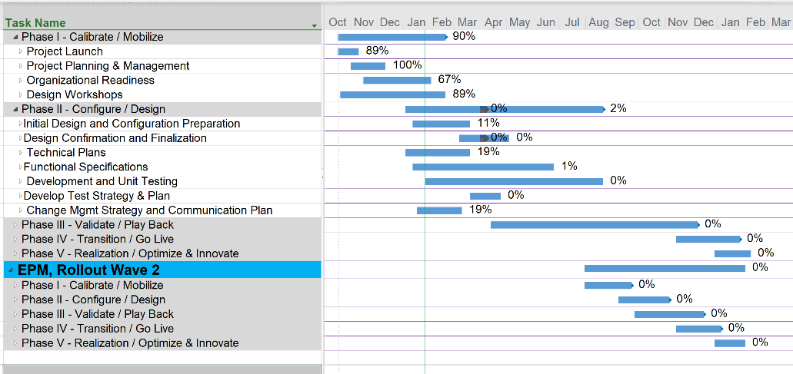
High Level Timeline

Slide 9
Decisions-to-date

Slide 10
Key Configuration Decisions
ID | Description | Priority | Due Date | Governance Level | Assigned To | Status
1 | Process Changes: The City has decided to distribute work using automated functionality in ERP Cloud. This could include distribution of data entry and approvals for the various modules. It will also include changes in how projects are managed. The details will be defined as we move through the design sessions. | High | 2/3/2022 | TBD | Sandy Dennies | In Progress
2 | Receivables: The City has decided to continue maintaining customers, billing, receipts and aging in external billing systems. Receipts will be interfaced to ERP Cloud for recording in the general ledger. However, some customer, billing, receipts and aging will be done in ERP Cloud. This will be done for projects and grants as well as miscellaneous billings that are not managed through external systems. The City will determine which types of billings and related customers need to be maintained in ERP Cloud. | High | 1/28/2022 | PMO | Sandy Dennies | In Progress
3 | Historical Data Retention: How much historical data is required and where will it be retained? This question should be answered by area. | High | 2/10/2022 | TBD | TBD | In Progress

Slide 11
Risks and issues

Slide 12
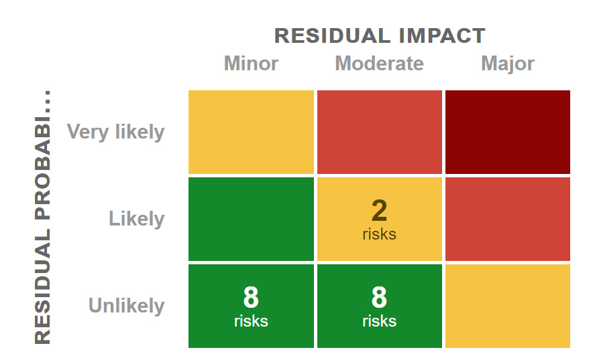
Key Risks and Issues
ID | Description | Mitigating Actions | Impact | Due Date | Likelihood | Assigned To | Status
1 | The Source systems are proprietary and existing staff has limited knowledge of data structures. Thus, extracts cannot easily be created at this time. Further existing staff does not have the bandwidth to perform all of the extract functions along with their regular jobs. | 1. The City will reach out to HTE to identify potential support. 2. An internal resource, Vivian Perng has been assigned as the lead for data conversion. She will be assisted by Anthony Romano, who has used the HTE catalog to create data extracts using a COGNOS business intelligence tool. 3. Two new positions are being filled to assist with extracts. 4. ISG is providing a resource to assist with this effort starting 1/31/2022. 5. With regards to Projects, the City team will reach out to engineers, Budget Analysts (Anthony Romano), Facilities Management (BOE) and Public Works to discuss where the data resides and how much data needs to be in the new system. | Major | 01-31-22 | Likely | Isidore Sobkowski | Treated
2 | The Source systems are proprietary and existing staff has limited knowledge of data structures. Thus, extracts cannot easily be created at this time. Further existing staff does not have the bandwidth to perform all of the extract functions timely. | 3. Two new positions are being filled to assist with extracts. 4. ISG is providing a resource to assist with this effort starting 1/31/2022. | Medium | 01-31-2022 | Likely | Isidore Sobkowski | Treated

Slide 13
Questions and Discussion

