Slide 1
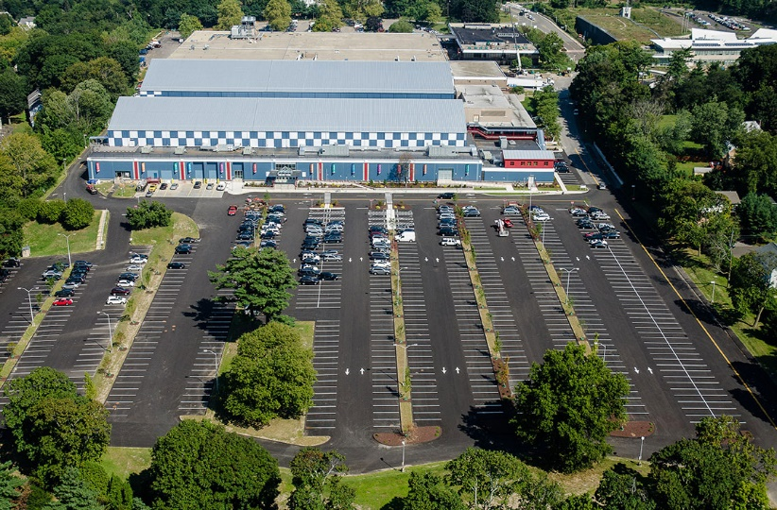
Office of administration-Administration
March 9th
^{Sandy Dennies}

Slide 2
Department Overview

Slide 3
Office of administration
Director of Administration
Office of Policy and Management
Tax and Collection
Purchasing
Risk Management Fund
Grants Administration
Assessment
Controller
Anti-Blight Fund

Slide 4
Current staff

Slide 5
Office of administration - Administration
Director of Administration
Executive Secretary

Slide 6
Fiscal year 2022-23

Slide 7
Office of Administration (Admin) FY 2022-23 Requested Budget (Full Time Salary)
 | FY 21/22 | FY 22/23 | FY 22/23
Job Title | Pos Count Adopted Budget | Pos Count Department Request | Funded Mayor’s Pos $Var %Var Pos Count Proposed Var Adpt. Adpt.
Dir of Administration | 1 $176,949 | 1 $180,843 | 1 $180,843 0 $3,894 2.2%
Executive Secretary | 1 $76,146 | 1 $79,997 | 1 $79,997 0 $3,851 5.1%
Total | 2 $253,091 | 2 $260,840 | 2 $260,840 0 $7,745 3.1%

Slide 8
Debt service

Slide 9
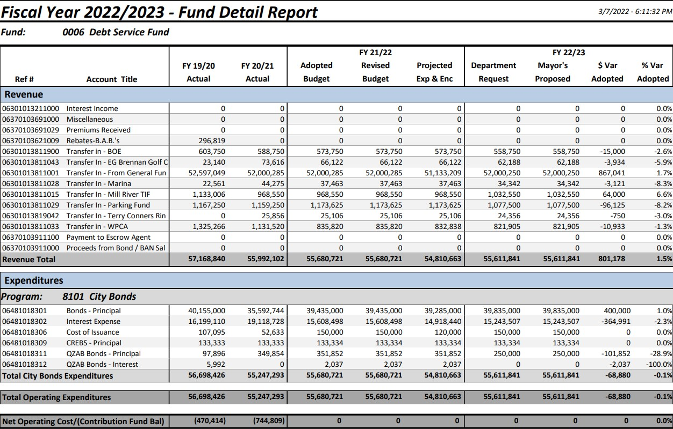
Debt Service

Slide 10
Capital Budget Item Request

Slide 11
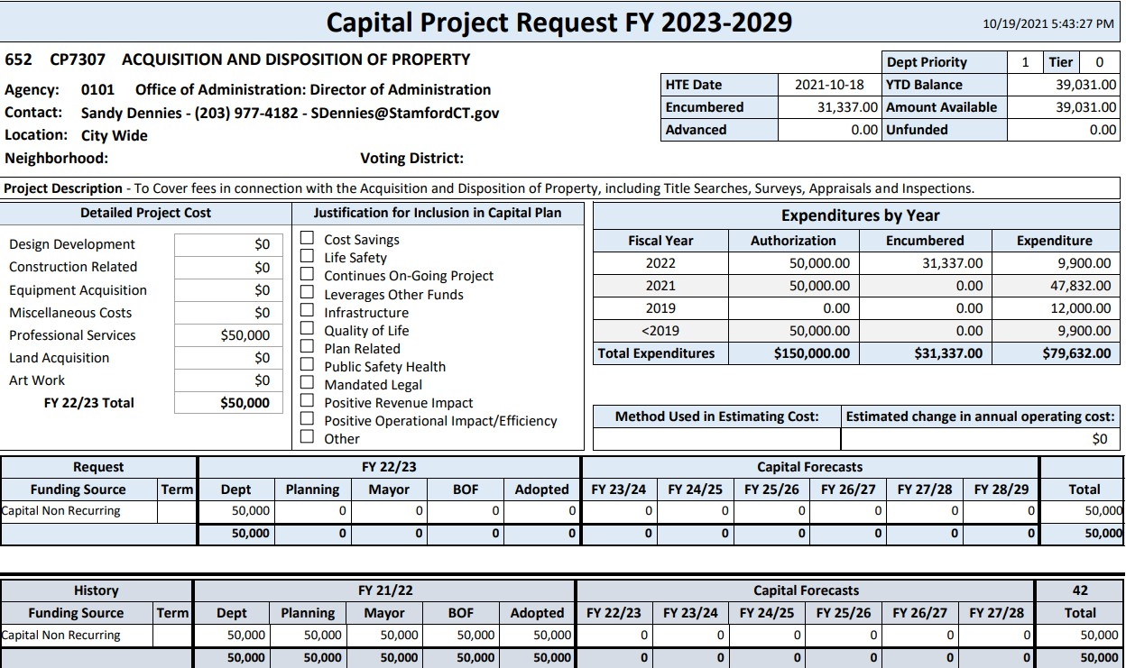
Capital budget items

Slide 12
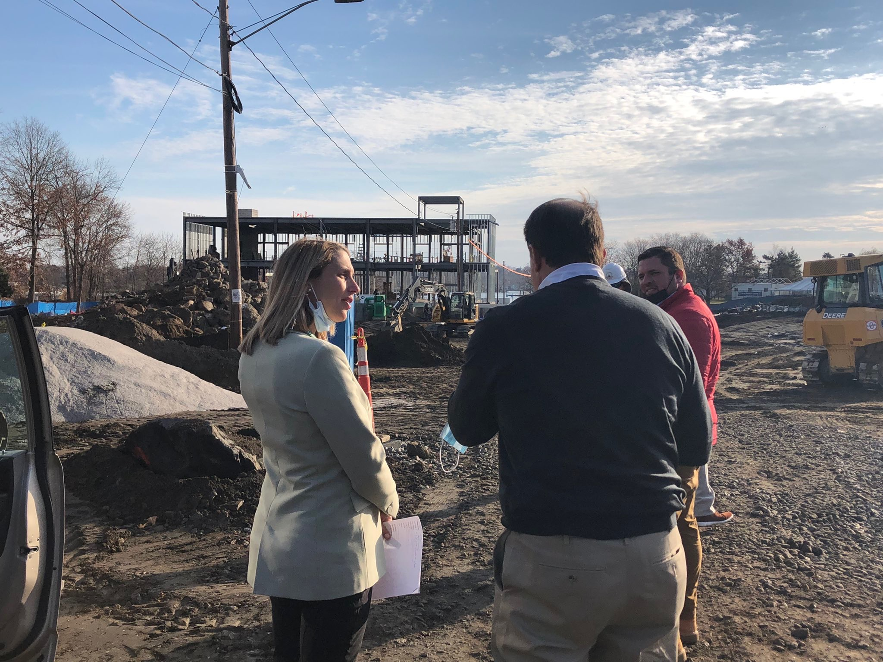
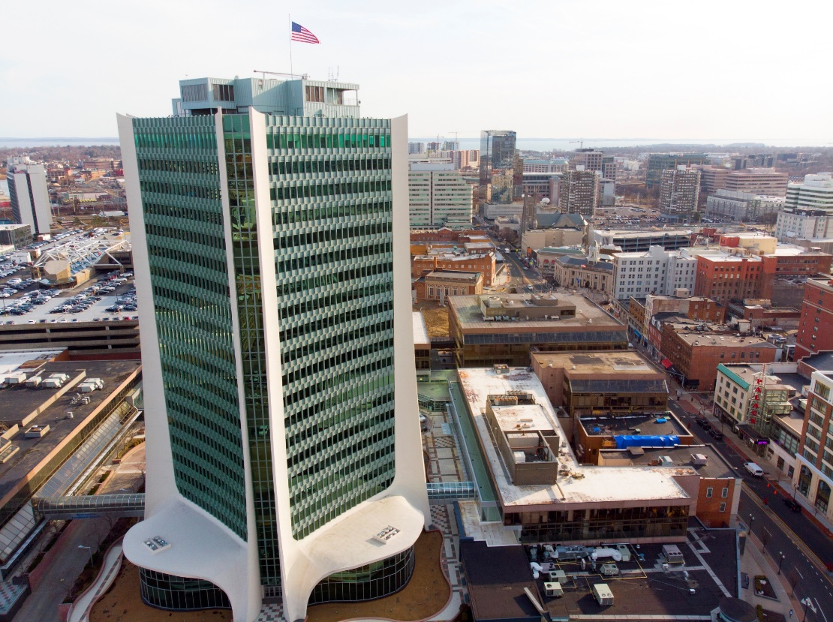
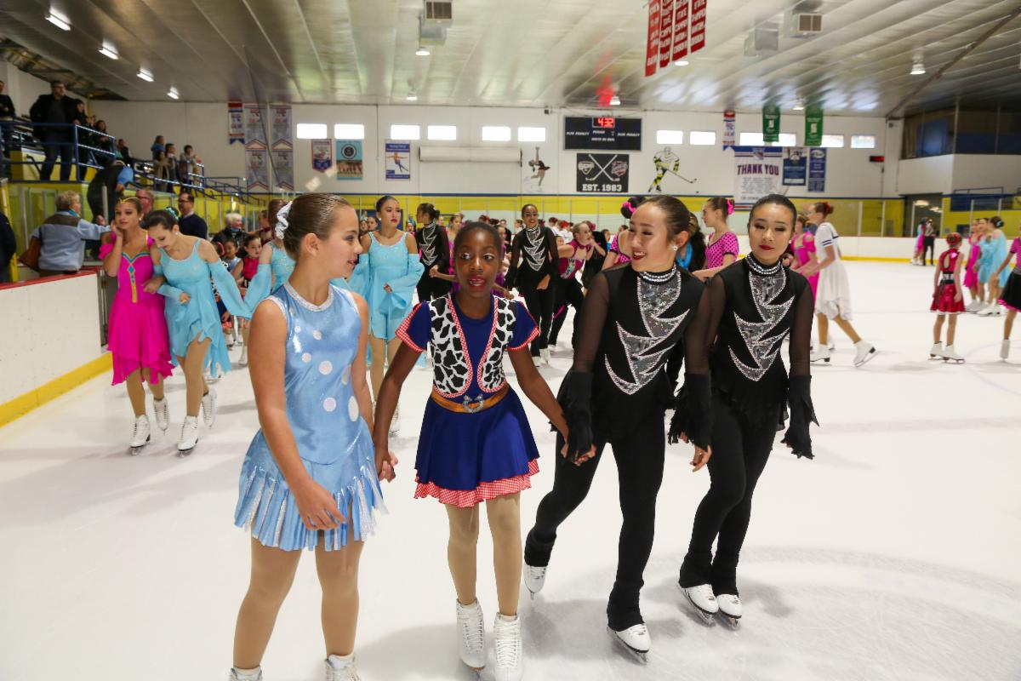
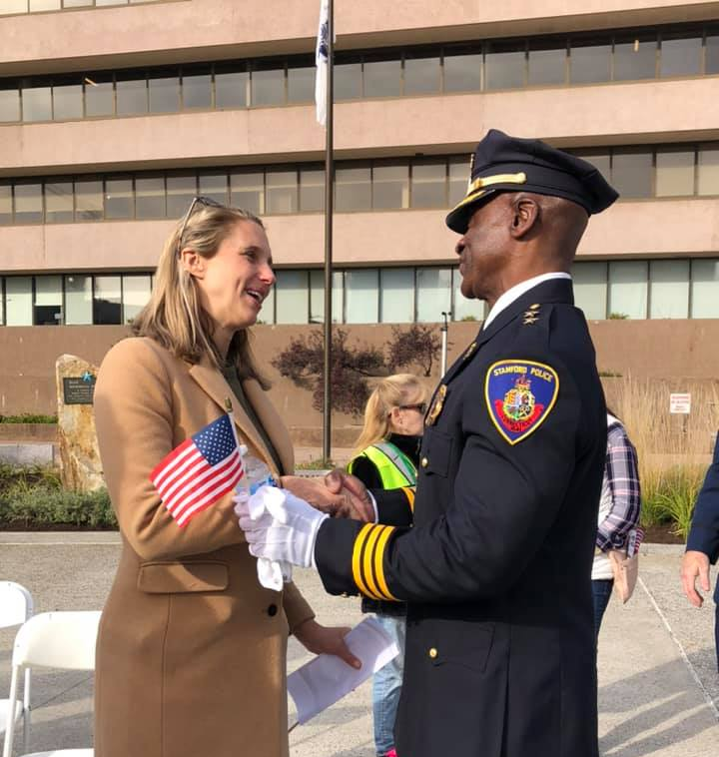
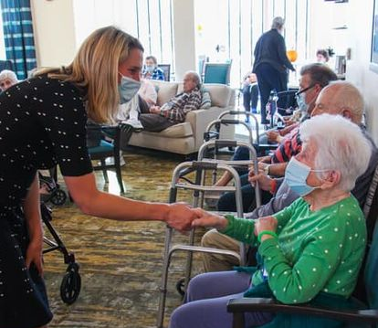
STAMFORD, CT

