Slide 1
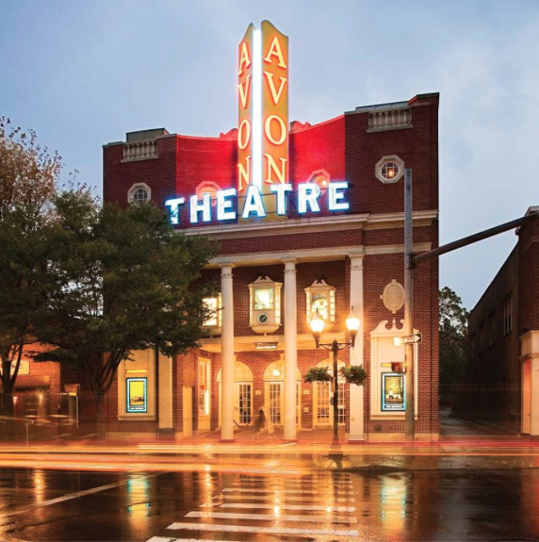
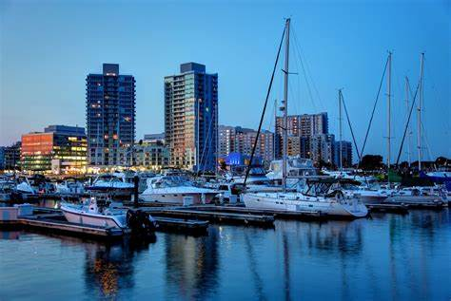
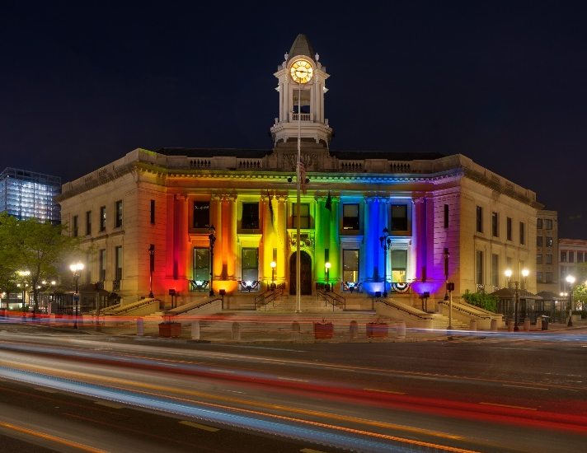
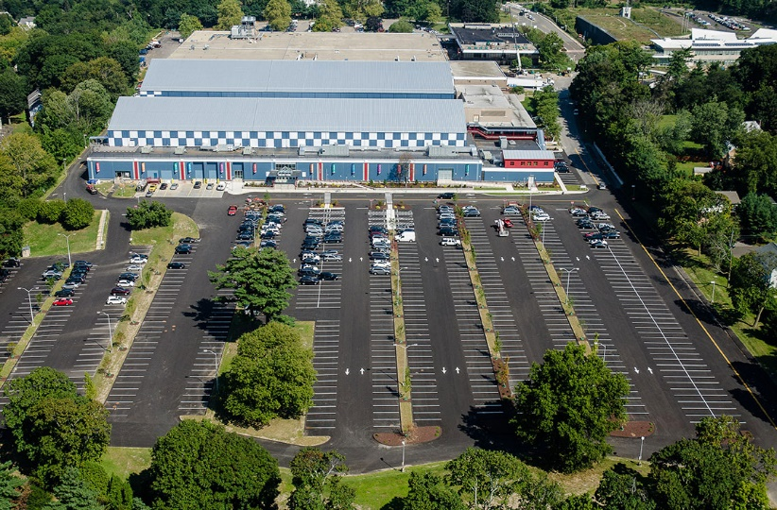
City of Stamford
March 9th
Bridget Fox

Slide 2
MAYOR’S OFFICE
Mayor’s Office
Office of Economic Development
Citizens Services Office
Youth Services Bureau

Slide 3
Mayor’s office Mission Statement
The mission of the Mayor's Office is to ensure the prosperity of Stamford residents living here today and for the generations that will be here tomorrow. We will foster a safe community that values diversity of cultures and ideas; maintains economic sustainability with sensible fiscal policy; and provides an excellent education system for our next generation. These pillars of prosperity and community act as the foundation for a high quality of life and the momentum that ensures Stamford continues to be the great city that it is now.

Slide 4
Mayor’s office Functions
The Mayor’s Office works closely with City departments, and elected and appointed boards and commissions, to set and carry out municipal priorities. The Mayor’s Office administers and leads a number of programs and initiatives in pursuit of established priorities. The Office also interfaces with businesses, State and federal agencies, non-profit and community organizations, and residents, and is always working to ensure a high level of service. As part of his/her responsibilities, the Mayor establishes the Annual Operating and Capital budgets, judiciously allocating resources to ensure fiscal control and good governance

Slide 5
Mayor’s Office Staff
Chief of Staff
Executive Secretary
Oversees day to day operations of the Mayor’s Office
Special Assistant to the Mayor – Director of Policy and Legislative Affairs
Provides critical administrative and secretarial support
Handles and coordinates with state and federal representatives on issues affecting Stamford
Works with leaders to support funding for city and with lobbyists. Serves as Mayor’s Office liaison to the Board of Representatives
Special Assistant to the Mayor for Communications
Sr. Admin Asst. to Mayor
Responsible for social media and digital content (including website) as well internal and external communications including The Works and Mayor’s Newsletter, draft production of talking points, attending and documenting events with the Mayor and other cabinet officials
Provides executive support to the Mayor and Mayor’s office including scheduling and correspondence.

Slide 6
Proposed additional Staff (Mayor’s Office)
Special Assistant to the Mayor – Press
Handles all press inquiries and responses, organizes press events, drafts media advisories and press releases and coordinates all interview requests.

Slide 7
Mayor’s Office FY 2022-23 Requested Budget (Full Time Salary)
 | FY 21/22 | FY 22/23 | FY 22/23
Job Title | Pos Count Adopted Budget | Pos Count Department Request | Funded Mayor’s Pos $Var %Var Pos Count Proposed Var Adpt. Adpt.
Chief of Staff | 1 $176,950 | 1 $160,750 | 1 $160,750 0 -$16,200 -9.2%
Mayor | 1 $190,758 | 1 $192,186 | 1 $192,186 0 $1,428 0.7%
Special Asst. to the Mayor | 0 $0 | 3 $279,129 | 3 $279,129 3 $279,129 100%
Executive Secretary | 1 $68,500 | 1 $74,015 | 1 $74,015 0 $5,515 8.1%
Sr. Adm Asst to Mayor | 1 $107,573 | 1 $115,133 | 1 $115,133 0 $7,560 7.0%
Total | 4 $543,781 | 7 $821,213 | 7 $821,213 3 $277,432 51.0%

Slide 8
Office OF ECONOMIC DEVELOPMENT Functions
Economic Development creates, implements and drives business and economic growth for the City; promotes business retention and increased business attraction of current and growth industries; supports the growth of small businesses, large companies, and entrepreneurs; promotes the growth and expansion of current and strategic industries; promotes inclusive economic development, including support of women-owned, communities of color-owned, and immigrant-owned businesses.

Slide 9
Economic Development STAFF
Director of Economic Development
Economic Development Analyst
Directs and manages all key initiatives and programs for City’s economic development office.
Envoy and representative for Mayor on economic development at city, regional, state, and federal level
Provides research and analysis for department and supports overall function of office.
Special Assistant to Mayor – Economic Development
Assists with business attraction/retention, marketing, small business support & works with Grant Administrator

Slide 10
Economic Development FY 2022-23 Requested Budget (Full Time Salary)
 | FY 21/22 | FY 22/23 | FY 22/23
Job Title | Pos Count Adopted Budget | Pos Count Department Request | Funded Mayor’s Pos $Var %Var Pos Count Proposed Var Adpt. Adpt.
Dir of Economic Development | 1 $159,053 | 1 $180,843 | 1 $180,843 0 $21,790 13.7%
Economic Dev Analyst | 1 $82,636 | 1 $92,038 | 1 $92,038 0 $9,402 11.4%
Special Asst. to the Mayor | 0 $0 | 1 $132,540 | 1 $132,540 1 $132,540 100%
Total | 2 $241,689 | 3 $405,421 | 3 $405,421 1 $163,732 67.7%

Slide 11
Citizen’s Services Office Functions
The mission of the Citizen's Service Center is to provide a convenient and effective mechanism for receiving and responding to complaints and services and information requests for residents and visitors to Stamford so that requests and complaints are resolved with speed, fairness and courtesy. The department works with the Mayor’s Office, Operations and Public Health and Safety to ensure that complaints are addressed in a timely fashion and that citizens are advised when a complaint has been closed. The department also tracks data on the number of complaints, the complaint status, and how quickly the City responds. The department researches and develops process enhancements and streamlined cloud-based solutions in order to increase efficiency and leverage technology to produce data that is accurate, timely, and effective for managers and department directors.

Slide 12
Citizen’s services Office STAFF
Special Assistant to the Mayor - Director of Partnerships and Community Engagement
Citizen’s Service Representative
Serves as a liaison between the Mayor’s office and local community, nonprofit and civic organizations in the city
Develops and executes robust community engagement strategy, oversees policy committees and councils with focus on education and affordable housing
Engages with residents to resolve issues and oversees activities of Citizen’s Services, including Fix It Stamford
City Services Representative, works in the city's centralized Citizen’s Service Center, which provides a single phone number for citizens to obtain basic information about City services and activities
As well as initiates service requests. Representatives will be responsible for handling calls, e-mails, chats and walk-in traffic requesting information and/or services

Slide 13
Citizen’s services FY 2022-23 Requested Budget (Full Time Salary)
 | FY 21/22 | FY 22/23 | FY 22/23
Job Title | Pos Count Adopted Budget | Pos Count Department Request | Funded Mayor’s Pos $Var %Var Pos Count Proposed Var Adpt. Adpt.
Customer Service Rep | 1 $67,984 | 0 $0 | 0 0 -1 -$67,984 -100%
Customer Service Spec | 0 $0 | 1 $67,060 | 1 $67,060 1 $67,060 100%
Special Asst. to the Mayor | 0 $0 | 1 $122,540 | 1 $122,540 1 $122,540 100%
Total | 1 $67,984 | 2 $189,600 | 2 $189,600 2 $121,616 178.9%

Slide 14
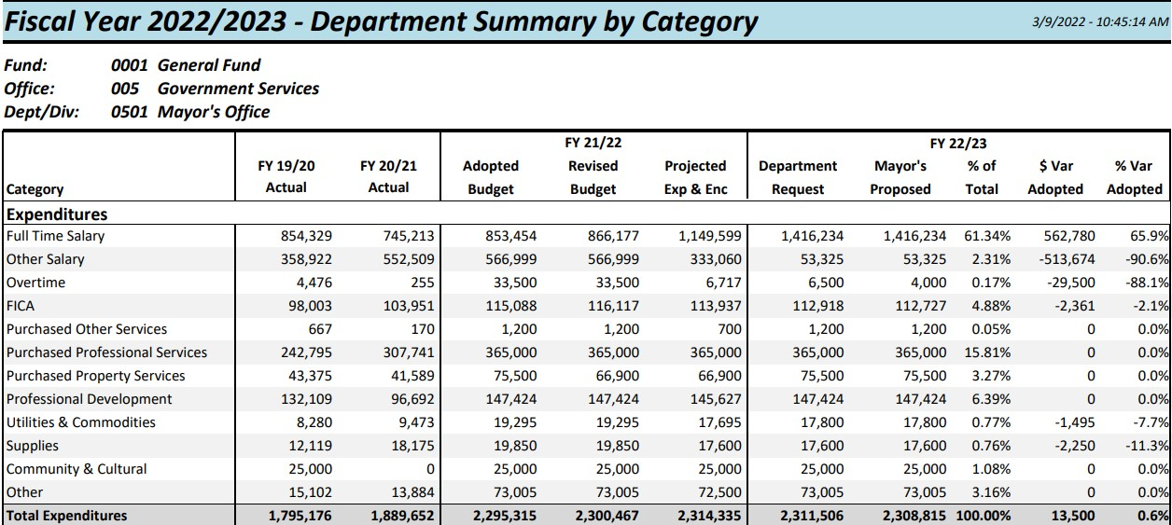
Full Mayor’s Office Budget

Slide 15
Youth Services Bureau office Functions
The Mayor’s Youth Employment Program provides students with “real world” jobs before they go into college, and helps improve their skills to make them better workers both for the job they receive from the program and any future jobs they may have.

Slide 16
Youth Services Bureau Staff
Director
Special Project Coordinator(s)-3
Under the general direction of the Mayor or designee, is responsible for the management and administration of the youth service bureau for the City of Stamford, which includes budget preparation and monitoring; grant management; program development, implementation and evaluation
Under the general direction of the Director of Youth Services, special project coordinators are responsible for coordinating all activities associated with projects

Slide 17
Youth Services Bureau FY 2022-23 Requested Budget (Full Time Salary)
 | FY 21/22 | FY 22/23 | FY 22/23
Job Title | Pos Count Adopted Budget | Pos Count Department Request | Funded Mayor’s Pos $Var %Var Pos Count Proposed Var Adpt. Adpt.
CHRGBK to GRANTS | 0 -$109,257 | 0 -$116,940 | 0 -$116,940 0 -$7,683 -7%
Director- Youth Serv Bur | 1 $101,493 | 1 $108,630 | 1 $108,630 0 $7,137 7%
Spec Proj Coord | 2 $142,542 | 2 $145,196 | 2 $145,196 0 $2,654 1.9%
Spec Proj Coord Res Justice | 1 $68,500 | 1 $70,364 | 1 $70,364 0 $162 0.2%
Total | 4 $204,980 | 4 $207,250 | 4 $207,250 0 $2,270 1.1%

Slide 18
Q&A

Slide 19
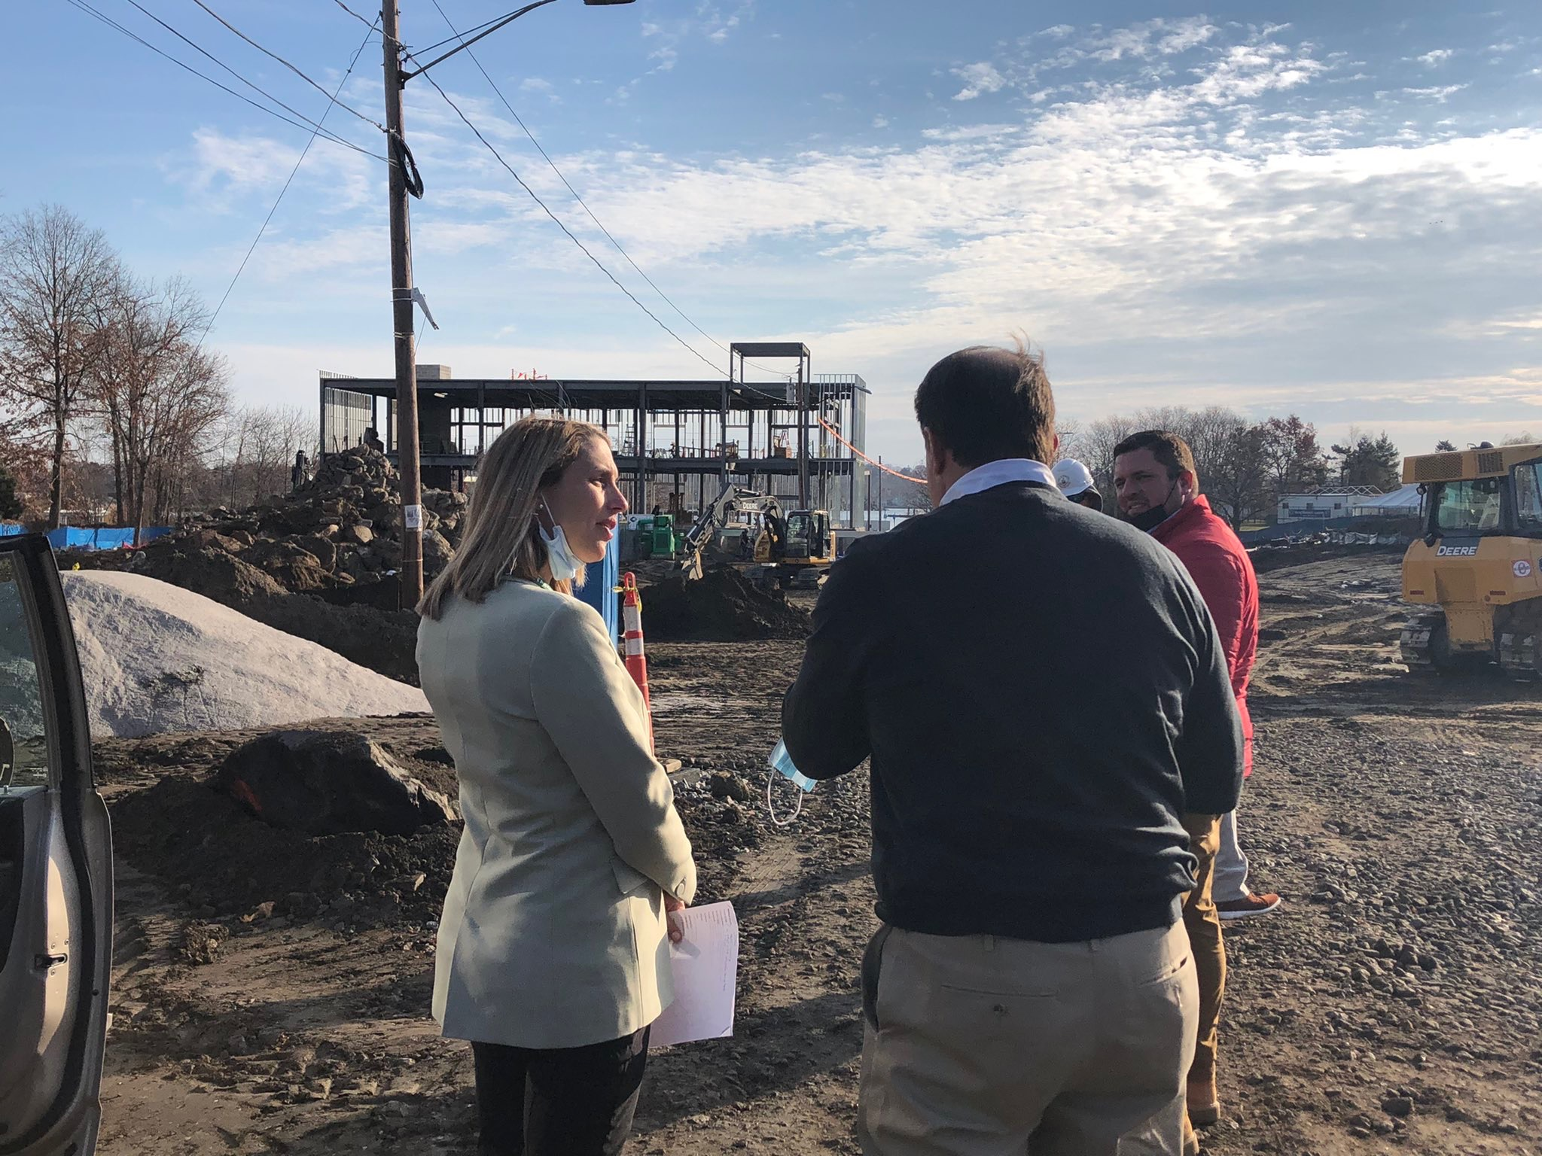
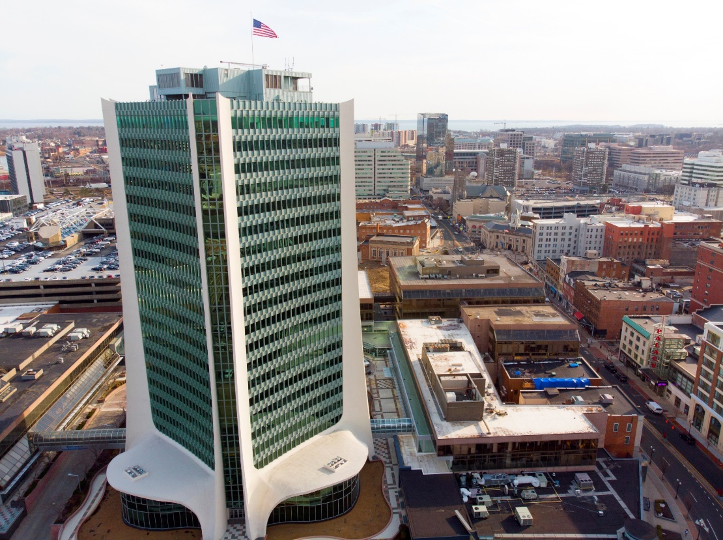
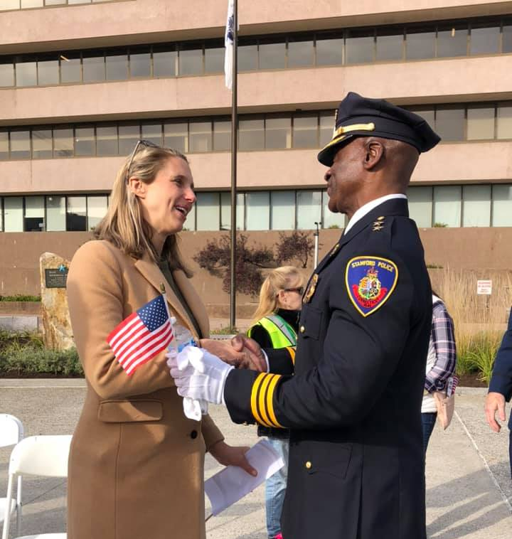
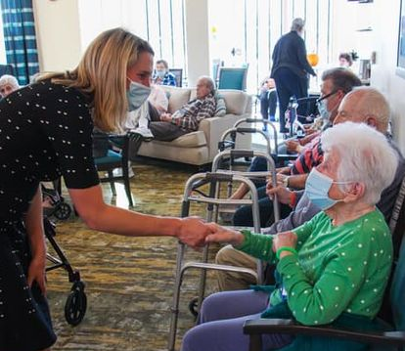
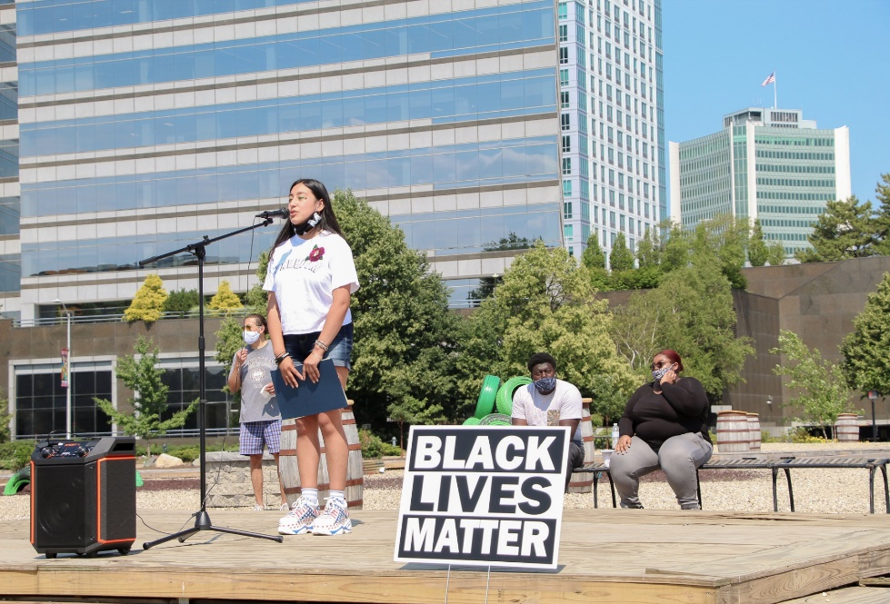
STAMFORD, CT

