Slide 1
City of Stamford
FY 21/22 and FY 22/23 Budget Highlights
March 22, 2022

Slide 2
Total (Active and Retiree)
Expenditures and Revenue
The initial FY 21/22 in force net budget was projected to be $43.1 million
We reprojected the FY 21/22 budget based on the following factors:
  The original budget included 6 unions that had already moved to the CT State Partnership Plan (SPP) effective Jan 21.
  An additional 4 unions (450 employees) elected to move to the SPP effective July 21 and Jan 22.
  This reprojection resulted in a 1.3% decrease to the FY 21/22 in force budget which is a projected savings of $559K
The FY 22/23 budget:
  We are expecting a 6.9% increase over the FY 21/22 reprojection, approximately $2.9 million
    This assumes that effective July 22 there will be an 8% increase to the CT State Partnership Plan Active, Under 65, and over 65 non-Medicare Premiums

Slide 3
Active
Expenditures and Revenue
The initial FY 21/22 in force net budget was projected to be $30.4 million
We reprojected the FY 21/22 budget based on the following factors:
  The original budget included 6 unions that had already moved to the CT State Partnership Plan (SPP) effective Jan 21.
  An additional 3 unions (382 employees) elected to move to the SPP effective July 21 and Jan 22.
  This reprojection resulted in a 1.6% decrease to the FY 21/22 in force budget which is a projected savings of $485K
The FY 22/23 budget:
  We are expecting a 2.7% increase over the FY 21/22 reprojection, approximately $800K
    This assumes that effective July 22 there will be an 8% increase to the CT State Partnership Plan Active Premiums
    Self funded active claims are running better than expected this year which helps offset the 8% from the SPP

Slide 4
Retiree
Expenditures and Revenue
The initial FY 21/22 in force net budget was projected to be $12.5 million
We reprojected the FY 21/22 budget based on the following factors:
  The original budget included 6 unions that had already moved to the CT State Partnership Plan (SPP) effective Jan 21.
  An additional 4 retiree unions (68 employees) elected to move to the SPP effective July 21 and Jan 22.
  This reprojection resulted in a 0.6% decrease to the FY 21/22 in force budget which is a projected savings of $75K
The FY 22/23 budget:
  We are expecting a 17.0% increase over the FY 21/22 reprojection, approximately $2.1 million
    This assumes that effective July 2022 there will be an 8% increase to the CT State Partnership Plan under 65 and Over 65 Non-Medicare Premiums. A 2% increase was applied to the Medicare Premiums effective Jan 2022.
    The original 21/22 budget was based on the average claim cost of all retirees. We suspect that the higher claim cost retirees didn’t migrate to the SPP.
    COVID suppressed claims due to care avoidance in 2020 resulted in an increase in the year over year claim cost as utilization returns to normal.

Slide 5
Caveats
Active
FY 21/22 Reprojections assume the IUOE Operations, Fire, and Cobra (with exception of NEW Cobra) will be remaining in the city self funded plans after January 2022 until June 2022
FY 22/23 Budget assumes that only the IUOE Operations, Fire, and Cobra (with exception of NEW Cobra) will be remaining with Cigna and Maxor for July 1, 2022 .
3. For Vision, actual year to date claims through Dec 2021 were used and then a reprojection was created for Jan
2022 through June 2022
4. For Dental and Cigna actual year to date claims through Jan 2022 were used and then a reprojection was created
for February 2022 through June 2022
5. Assumed an 8% increase to the SPP rates for July 2022, this has not been confirmed by the State
Retiree
FY 21/22 Reprojections assume the IUOE Operations, Police (with exception from NEW Police), and Fire will be remaining after January 2022 until June 2022 for the under 65 and over 65 non-Medicare populations. No unions were removed from the Medicare projections
FY 22/23 Budget assumes that only the IUOE Operations, Police (with exception from NEW Police) and Fire will be remaining with Cigna, Aetna, IPI and Maxor/EGWP for July 1, 2022.
IPI and Cigna actual year to date claims through Jan 2022 were used and then a reprojection was
created for February 2022 through June 2022
4. Assumed an 8% increase to the SPP Pre 65 and Post 65 Non-Medicare rates for July 2022; this has not been
confirmed by the State
5. Used a 2% increase to the Medicare rates as stated on the CT SPP website for Jan 2022

Slide 6
Hypothetical Self Funded and CT SPP Savings over 5 Years

Slide 7
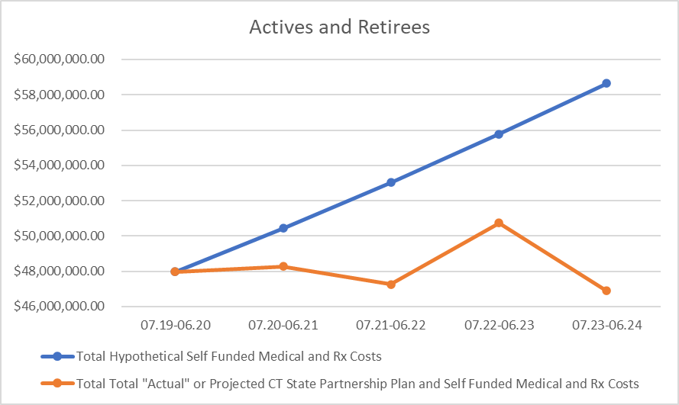
Hypothetical Active and Retiree Self Funded Medical and Rx Costs V Savings from Moving to the State Partnership Plan
Over 5 years the estimated Self Funded Medical and Rx Costs were projected to be $265.8 million.
The strategy to move to the CT SPP resulted in a projected total savings of about $24.7 million.
Active Savings are projected at about $7.4 million
Retiree Savings are projected at about $17.2 million
Notes
Blue Line: Projected Medical and Rx Cost (No Changes)
Orange Line: Projected Cost Based on Move to the CT SPP

Slide 8
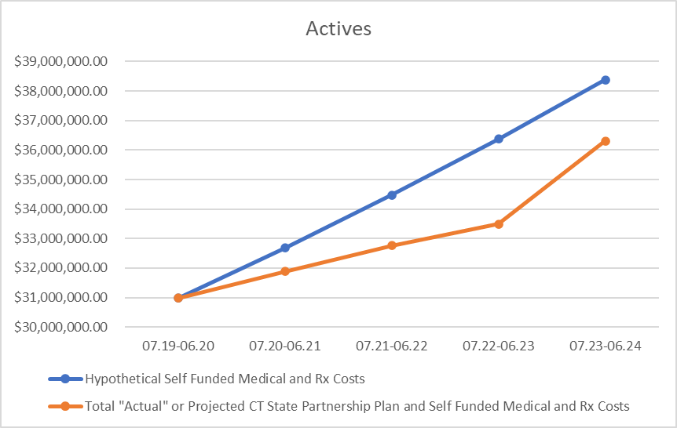
Hypothetical Active Self Funded Medical and Rx Costs V Savings from Moving to the State Partnership Plan
7/19
  no movement to SPP:
  Projected Savings: $0
1/21
  473 actives moved:
  Projected Savings : $795K
7/21
  additional 384 actives moved:
  Projected Savings: $1.7 million
7/22
  no changes:
  Projected Savings: $2.9 million
7/23
  potential move of all remaining active employees to SPP:
  Projected Savings: $2 million
Total Projected Active Savings over 5 Years:
  $ 7.4 million

Slide 9
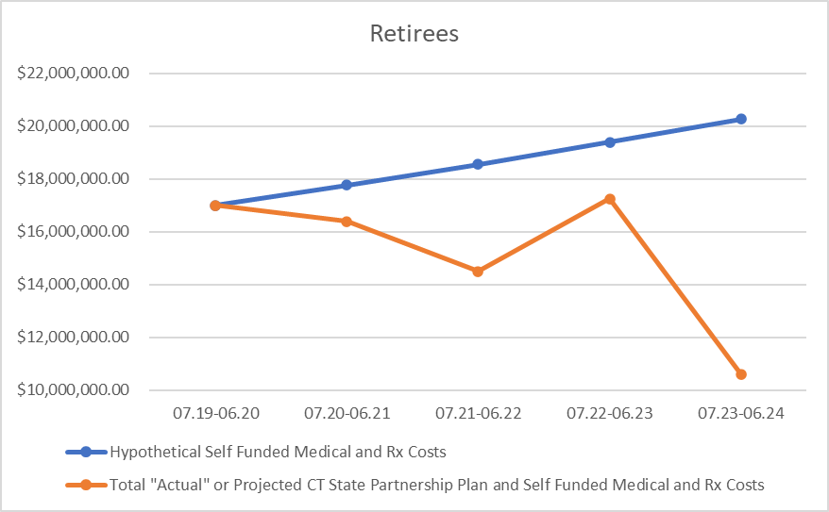
Hypothetical Retiree Self Funded Medical and Rx Costs V Savings from Moving to the State Partnership Plan
7/19
  no movement to SPP:
  Projected savings: $ 0
1/21
  25 retirees moved:
  Projected savings : $1.4 million
7/21
  additional 319 retirees moved:
  Projected savings: $4 million
7/22
  no changes:
  Projected savings: $2.1 million
7/23
  potential move of all remaining retirees' employees to SPP:
  Projected Savings: $9.7 million
Total Projected Retiree Savings over 5 Years:
  $17.2 million

Slide 10
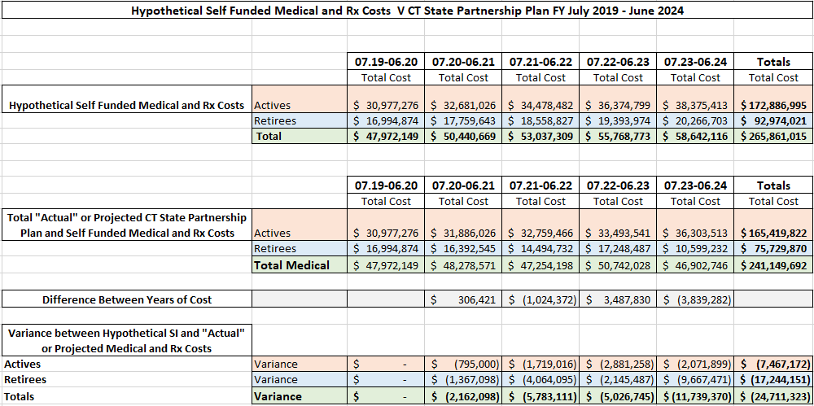
Hypothetical Self Funded Medical and Rx Costs V Savings from Moving to the State Partnership Plan

Slide 11
Caveats
1. Active Hypothetical Self Funded Medical and Rx Costs Trended is estimated at 5.5%.
2. Retiree Hypothetical Self Funded Medical and Rx Costs Trended is estimated at 4.5%.
3. CT State Partnership Plan Rate Increase are estimated as follows:
a. Actives and non-Medicare Retirees: +8%
b. Medicare Retirees: +2%
4. Enrollment for all years is based on census data given to Lockton by the City of Stamford
5. 07.19 - 06.21 Actual Self Funded Medical and Rx Active and Rx Costs are based on actual claim costs from claim reports from the carriers where applicable
6. Self Funded Medical and Rx Costs Include the Following
a. Cigna Medical and Rx Claims Cost, Admin Fees for both Actives and Retirees
b. Maxor Drug Claims and Admin Costs as well as EGWP and Medicare Admin Costs where applicable
c. IPI Retiree Claims and Admin Costs
d. Additional Self Funded Taxes and Fees as line itemed on the City's budget summary
e. Changes in H.S.A contributions, rx rebates and run off costs
7. Please note that the Aetna Medicare Advantage Program is not included as it's a Fully Insured Program
8. Retirees included Pre 65, Post 65 Non-Medicare and Post 65 Medicare Retirees
9. Actives include Active Employees

Slide 12
Appendix

Slide 13
Union Migration Dates to the CT State Partnership

Slide 14
Current Enrollments by Union and Medical Carrier

