Slide 1
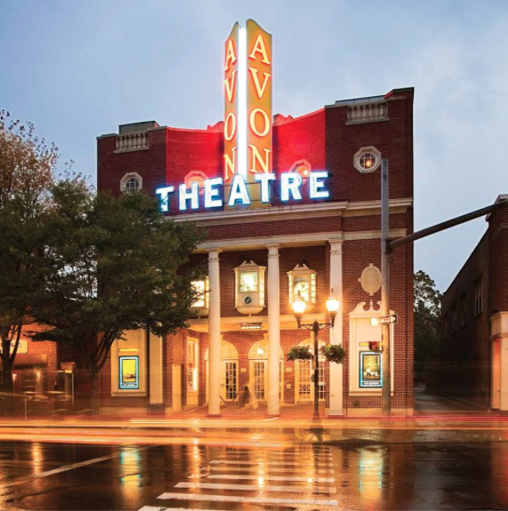
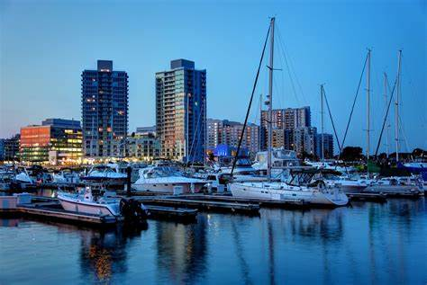
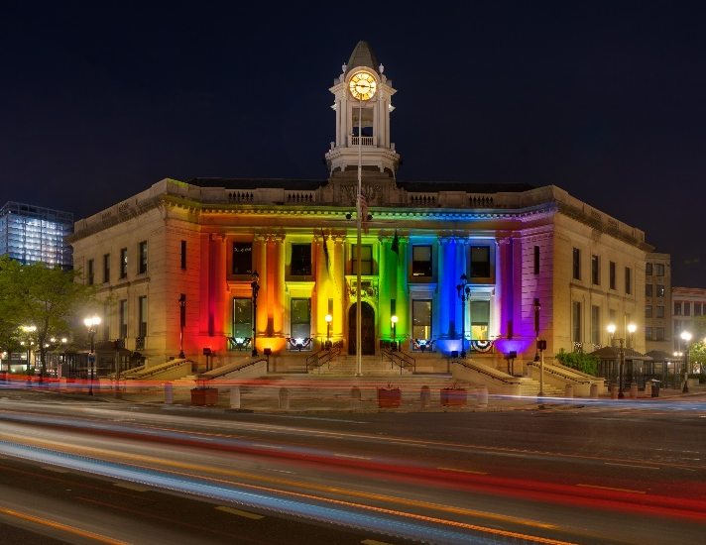
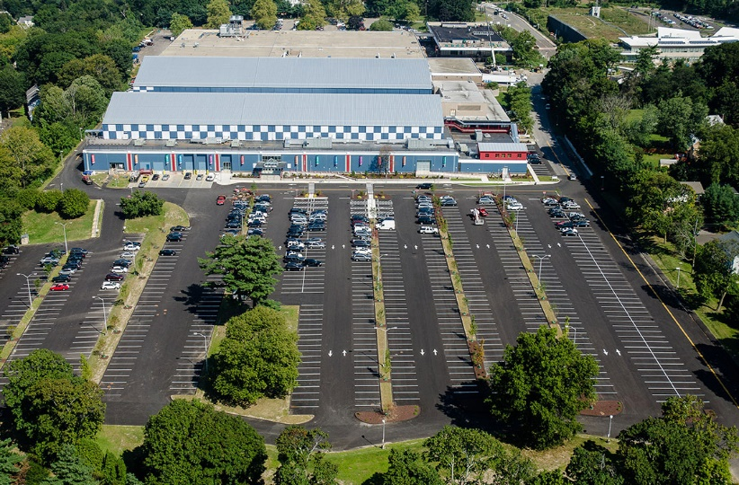
City of Stamford
March 22nd
^{Office of Legal Affairs}
^{Board of Finance Presentation}

Slide 2
Office of legal affairs
Mayor
Corporation Counsel &
Director of Legal Affairs
Law Department
Human Resources
Diversity Equity & Inclusion Officer

Slide 3
Office of Legal Affairs Mission statement
The Office of Legal Affairs provides legal services to all City officials, departments, boards, commissions and agencies. The Office of Legal Affairs also provides the professional human resources administration for the City of Stamford.

Slide 4
Office of Legal Affairs Function
The Office of the Corporation Counsel represents the City in all actions and proceedings brought by or against the City. The Corporation Counsel’s office prepares or reviews and approves, as to form, all contracts, leases and agreements. It represents the City in all actions and proceedings brought by or against the City. The office also renders formal and informal legal opinions.

Slide 5
Law Department
Corporation Counsel &
Director of Legal Affairs
Executive Assistant
Deputy
Corporation Counsel
Senior Paralegal
Paralegal (2)
Part-time Paralegal (1)
Assistant
Corporation
Counsel (7)
Part-time Assistant
Corporation
Counsel (1)

Slide 6
Representative DUTIES OF LEGAL STAFF
Assistant Corporation Counsels
Negotiate real estate transactions (sale, purchase, lease, easements, etc)
Represent City, employees, and boards and commissions and their members in litigation
Negotiate and draft contracts, purchase orders, agreements
Advise on procurement, competitive bidding and potential partnerships
Advise all City boards on procedure, FOIA, charter compliance, open meetings
Draft ordinances and other legal and legislative language
Represent City before CT FOI Commission and CHRO
Defend City in tax appeals
Paralegals
Process claims against the City
Manage collection of damages on behalf of City
Manage delinquent real property tax collection
Manage document review and discovery in litigation and enforcement matters
Legal administrative support to attorneys in litigation and other matters

Slide 7
Law Department Highlights 2021/2022
Internal
$118k collected for damage to City property – additional $55K pending receipt
Negotiations with major telecom companies for installation of 5G small cell equipment on City utility poles
Summary Judgment awards and multiple favorable rulings at CHRO and FOI Commission
Updating and modernization of civil service procedures
Settlements in blight and land use enforcement cases favorable to neighborhood residents’ quality of life
Outside Counsel
Negotiation with Disney Studios for use of Westhill High School – cost to City $6K – ROI $172K
Litigation involving mold in school buildings – seeking to recoup 10s of millions in $ damages
Victory in federal court lawsuit claiming discrimination in police promotions – summary judgment granted
Mediation regarding police promotions – resolved promotion issue - HR to provide more detail
Mediation regarding firefighter promotions – settlement would mean significant savings vs. litigation
Negotiating with firefighters’ union to resolve pending arbitrations over disciplinary cases

Slide 8
LAW DEPARTMENT FY 2022-23 Requested Budget (Full Time Salary)
 | FY 21/22 | FY 22/23 (DEPT) | FY 22/23 (MAYOR)
Job Title | Pos Count Adopted Budget | Pos Count Department Request | Funded Mayor’s Pos $Var %Var Pos Count Proposed Var Adpt. Adpt.
Assistant Corp Counsel | 7 $1,103,051 | 9 $1,436,653 | 8 $1,295,635 1 $192,584 17.5%
Chargeback to BOE | 0 $-313,637 | 0 $-324,727 | 0 $-324,727 0 $ -11,090 -3.5%
Deputy Corp. Counsel | 1 $168,078 | 1 $176,768 | 1 $176,768 0 $ 8,690 5.2%
Director of Legal Affairs | 1 $176,950 | 1 $180,843 | 1 $180,843 0 $ 3,893 2.2%
Diversity, Equity & Inclusion Officer | 1 $150,217 | 1 $152,370 | 1 $152,370 0 $ 2,153 1.4%
Executive Assistant to Corp. Counsel | 1 $101,393 | 1 $108,530 | 1 $108,530 0 $ 7,137 7.0%
Paralegal | 2 $133,192 | 2 $158,711 | 2 $158,711 0 $ 25,519 19.2%
Senior Paralegal | 1 $ 92,541 | 1 $ 96,783 | 1 $ 96,783 0 $ 4,242 4.6%
Total | 14 $1,611,785 | 16 $1,985,931 | 15 $1,844,913 1 $233,128 14.5%

Slide 9
Changes for the next Fiscal Year
Request for one new full-time attorney
Majority of salary increases are driven by contractual obligations
$200K increase for Professional Consultants (i.e. outside counsel) from $900K to $1.1m. Actual expense has exceeded approved budget 4 of the last 5 years
$2K increase in sick time – payout of attorney sick time per contract
$2K increase in facility rental is for offsite storage of legal files

Slide 10
Proposed additional Staff
Assistant Corporation Counsel (1)
Represent City in land-use matters, zoning enforcement, and related litigation, with cross-support to legal team on other matters
Put the City on a more equal footing with large developers
Increase enforcement, litigation, and negotiation capacity, potentially reduce outside counsel expenses
Currently 1 part-time attorney dedicated to land use
Stamford is CT’s second largest city – 10% increase vs. 1% statewide (WTBY 3.6%, BPT 3%, NH 3%, HTFD -3%)
Higher attorney-to-population ratio than other cities
Higher attorney-to-land-area ratio than other cities
Failure to add this position will result in greater outside counsel expenses, longer lead time in providing opinions, and less internal capability to creatively and aggressively enforce zoning and other building, land-use, and housing regulations

Slide 11
Benchmark against other towns
 | Stamford | New Haven | Hartford | Bridgeport | Waterbury
Population | 135,470 | 134,023 | 121,054 | 148,654 | 114,403
Land Area | 37.6 | 18.7 | 17.3 | 16 | 28.5
Total Attorneys | 9.5* | 11 | 9 | 11 | 10
Residents per Attorney | 14,260 | 12,183 | 13,450 | 13,514 | 11,440
Attorneys Per Square Mile of Land Area | 1/4 | 3/5 | 1/2 | 2/3 | 1/3
Total Staff | 14 | 18 | 9 | 19 | 17
Budget for outside Professional Legal Services | $900,000 (FY 21/22) | $840,000 (FY 21/22) | $1.46M (FY 21/22) | $750,000 (FY 21/22) | $500,00 (FY 21/22)
* includes approved position for Special Education Attorney for Board of Ed – starting 4/19/22 – will reduce BOE outside counsel expense

Slide 12
REPRESENTATIVE USES OF OUTSIDE COUNSEL
Representation to seek compensation or damages for the City
Defense of outside claims against the City
Employee claims against the City
HR investigations and other special investigations
Conflict of interest (e.g. contractual duty to represent police officers, etc.)
Out-of-state legal matters
Freedom of Information cases
Land use enforcement, including defense of enforcement actions
Labor negotiations and other labor matters

Slide 13
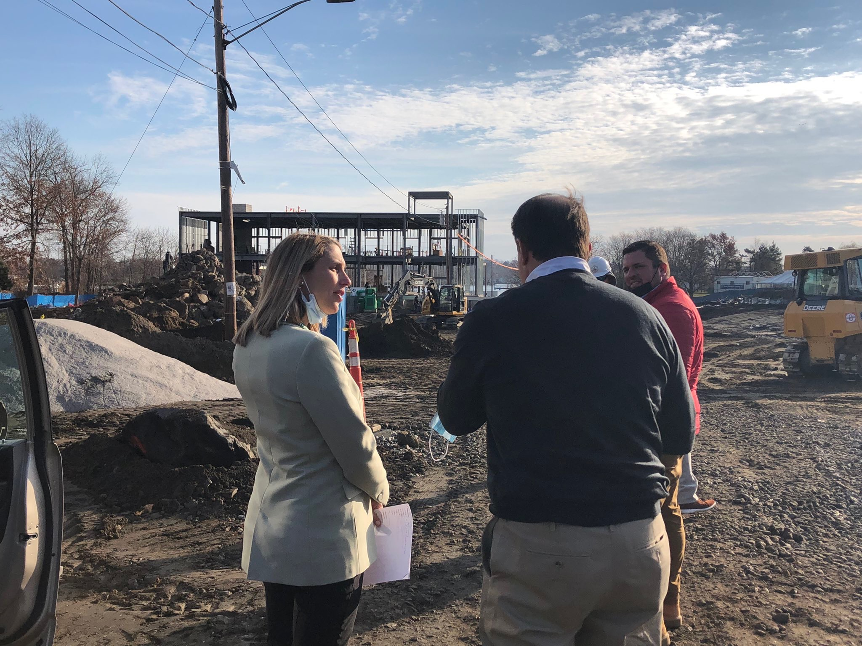
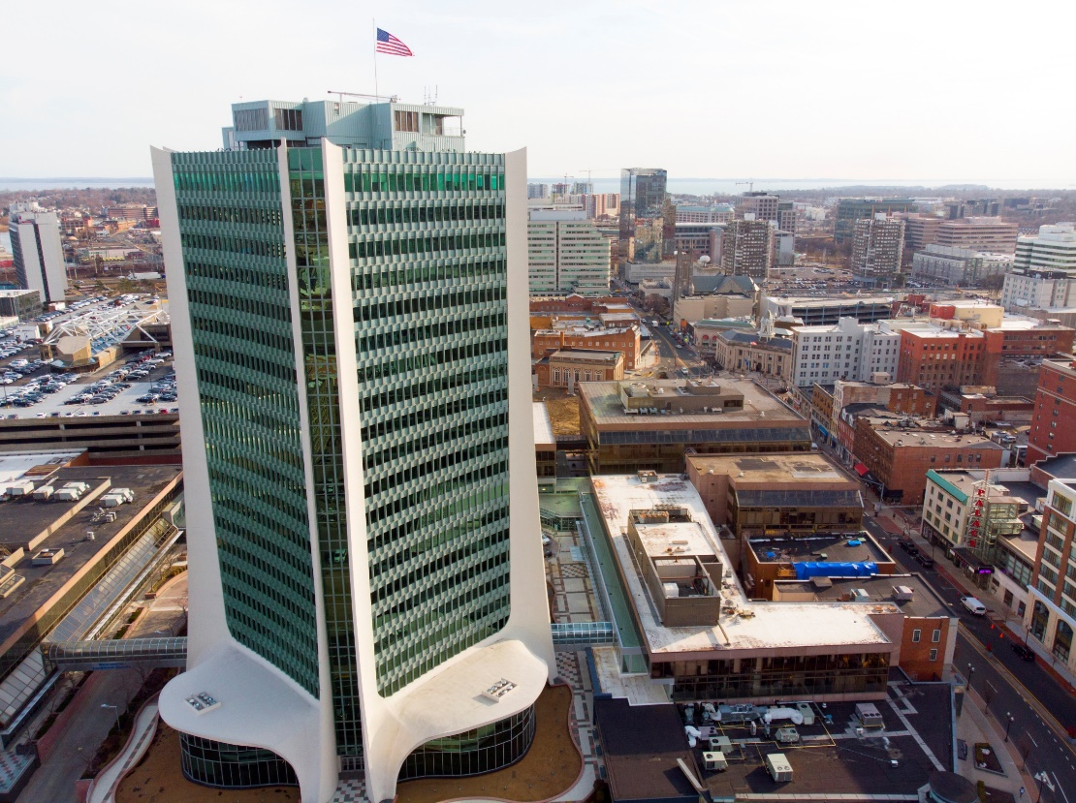
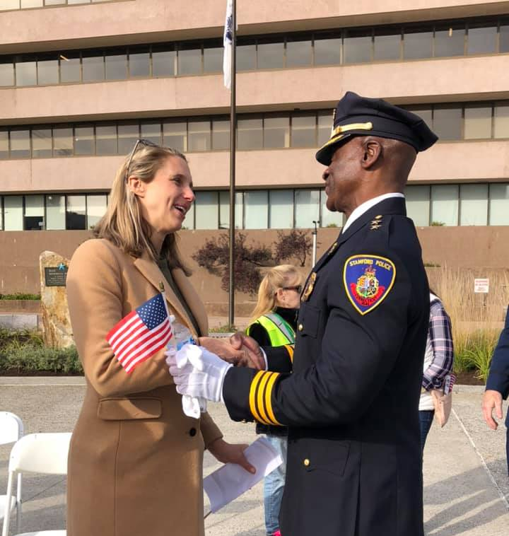
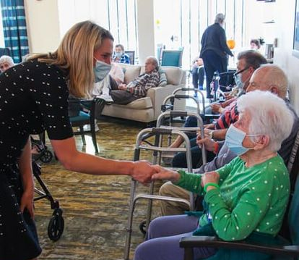
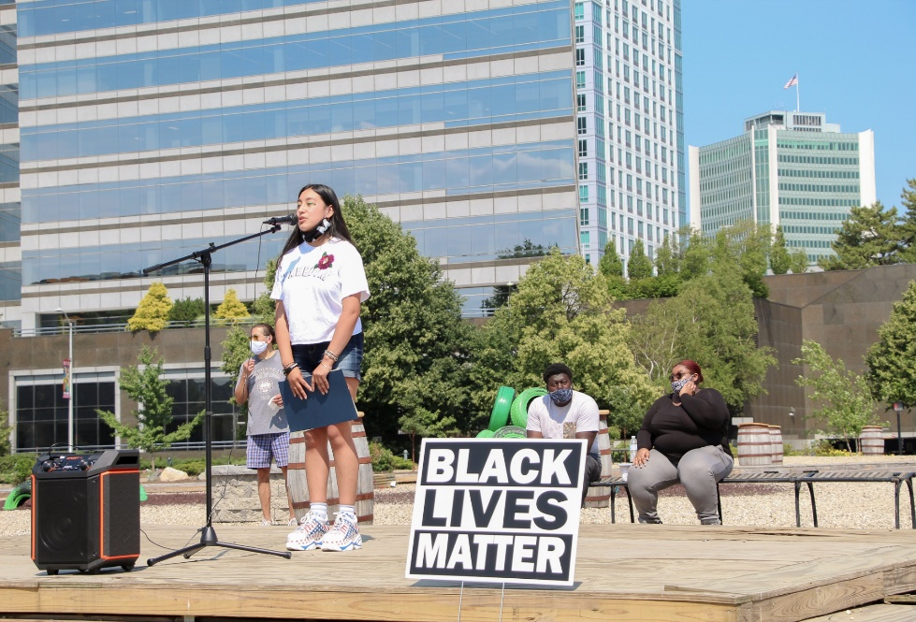
STAMFORD, CT

