Slide 1
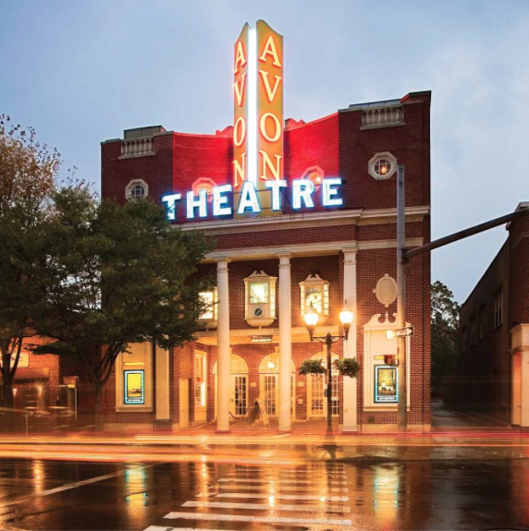
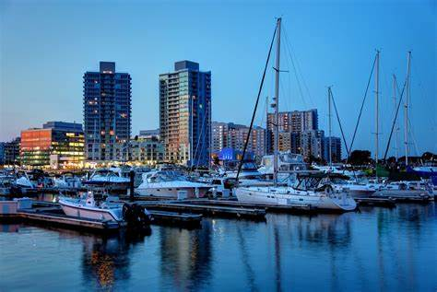
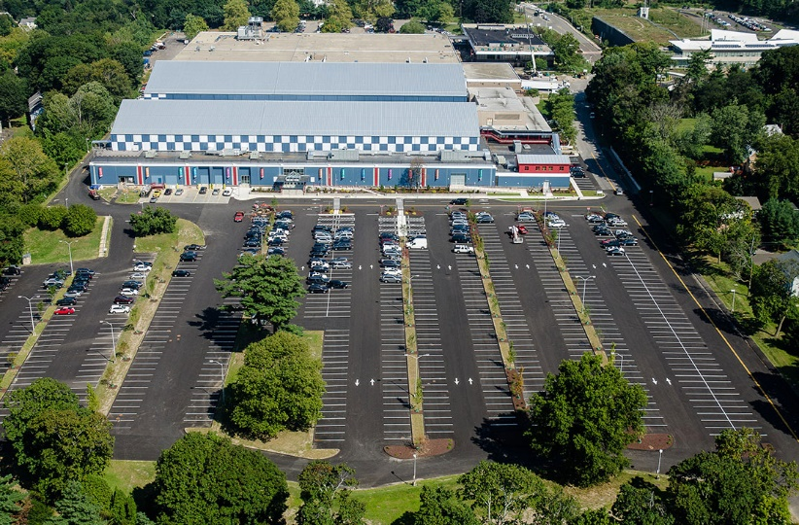
Office of administration - risk
March 22nd Board of Finance
David Villalva

Slide 2
Department Functions

Slide 3
Department Functions
Insurance & Claims
Workers’ Compensation Administration
Safety & Loss Control
Structure the City’s self-insured loss program and excess insurance coverages through an Enterprise Risk Management Approach
Design, review and approve contractual insurance requirements
Building/Park-Use permit reviews and signoffs
Submit and coordinate claims with insurance adjusters
Coordination of Third Party Administrator over the daily management of claims
Review of injury reports and workers’ compensation claims
Review and reconcile claim payments and expenses
Apply actuarial valuations and analytics in understanding cost drivers
Develop and provide safety training events
Development and maintenance of safety policies and procedures
Accident investigation and root-cause analysis
OSHA compliance and reporting

Slide 4
Current staff

Slide 5
Current Staff

Slide 6
Fiscal year 2022-23

Slide 7
Changes for the next Fiscal Year
The increase in insurance premiums is driven by a tightening insurance marketplace and the City’s recent loss history, primarily from property insurance claims. Over the 4-year period from FY18/19 to FY21/22, the City submitted property insurance claims of $13.9M on premiums of $4.3M, for a loss ratio of 325%. (industry norm is 30%-40%)

Slide 8
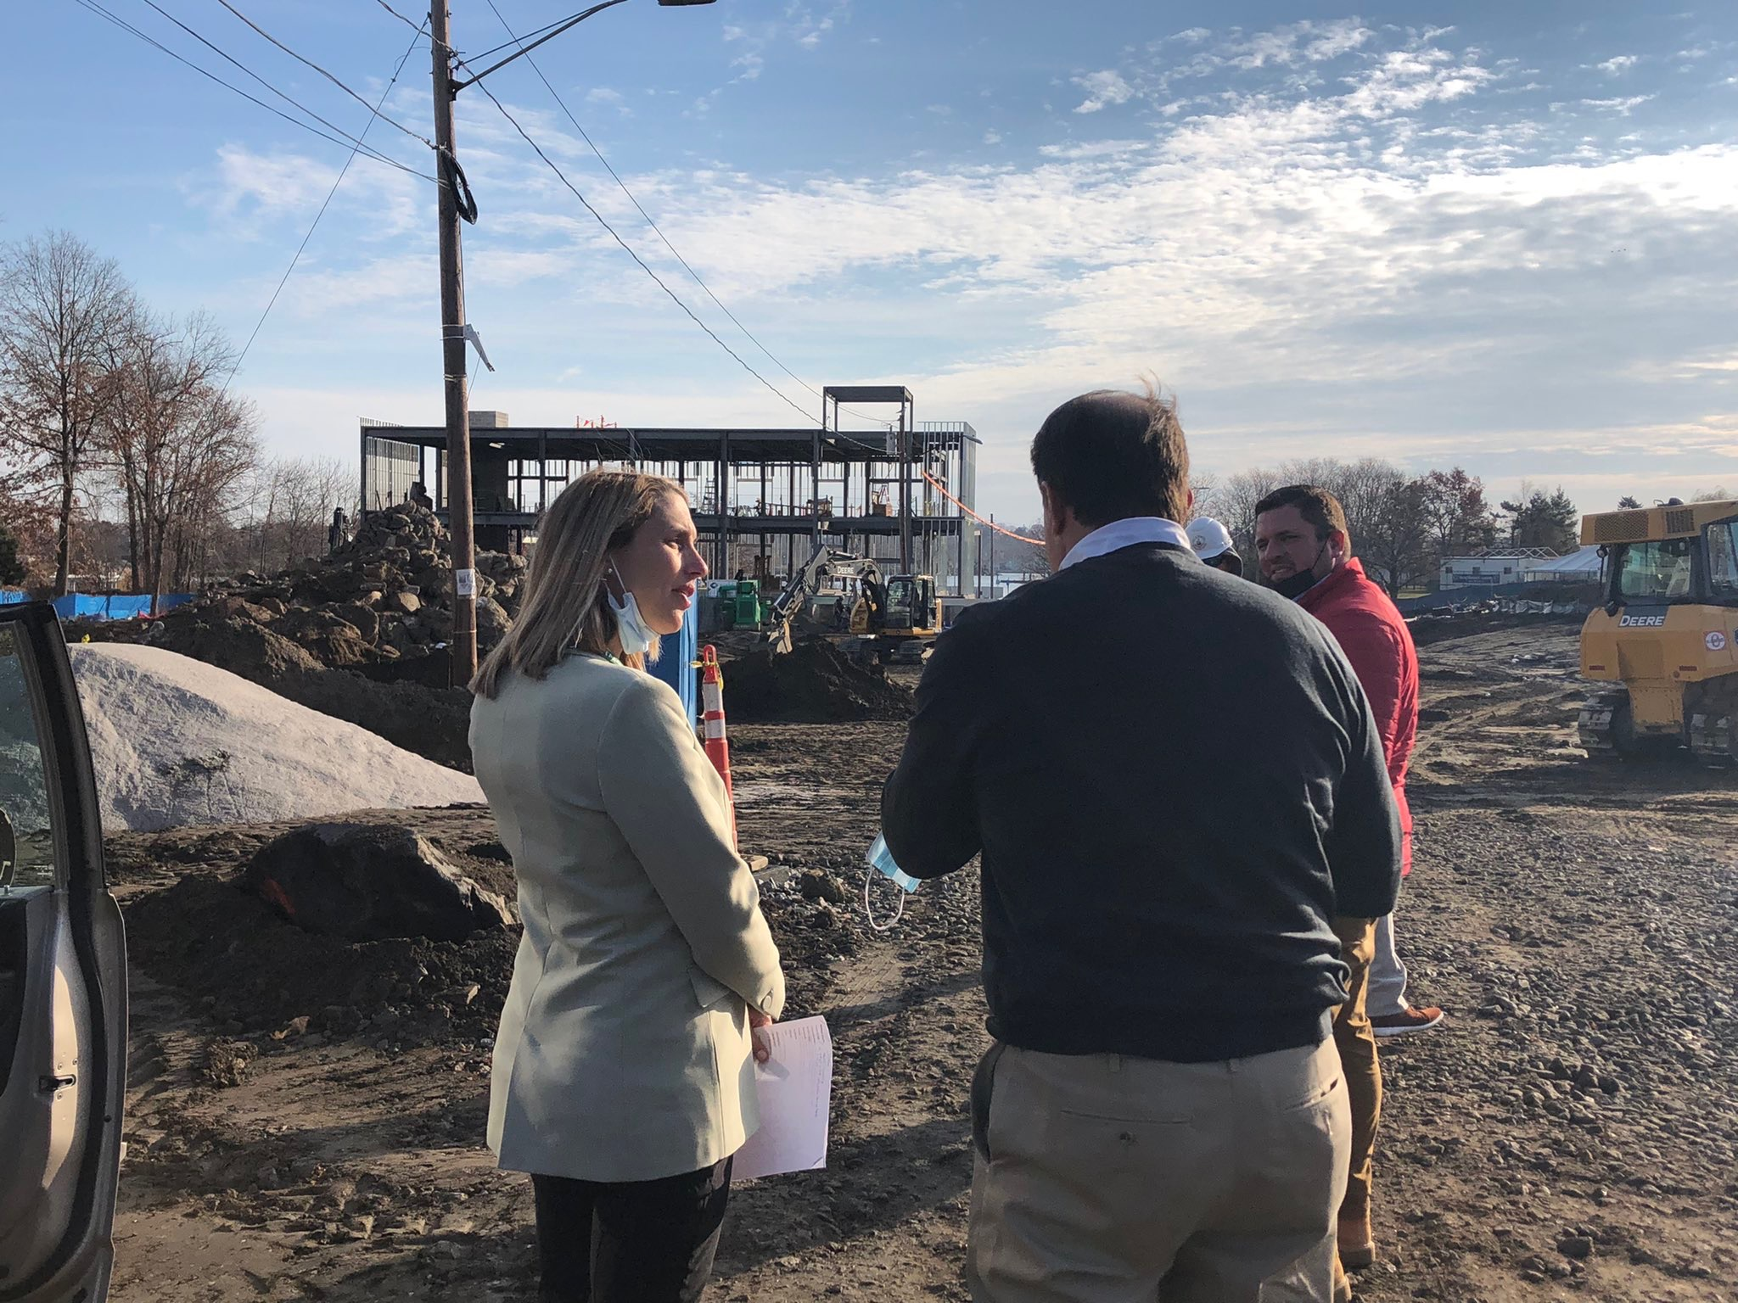
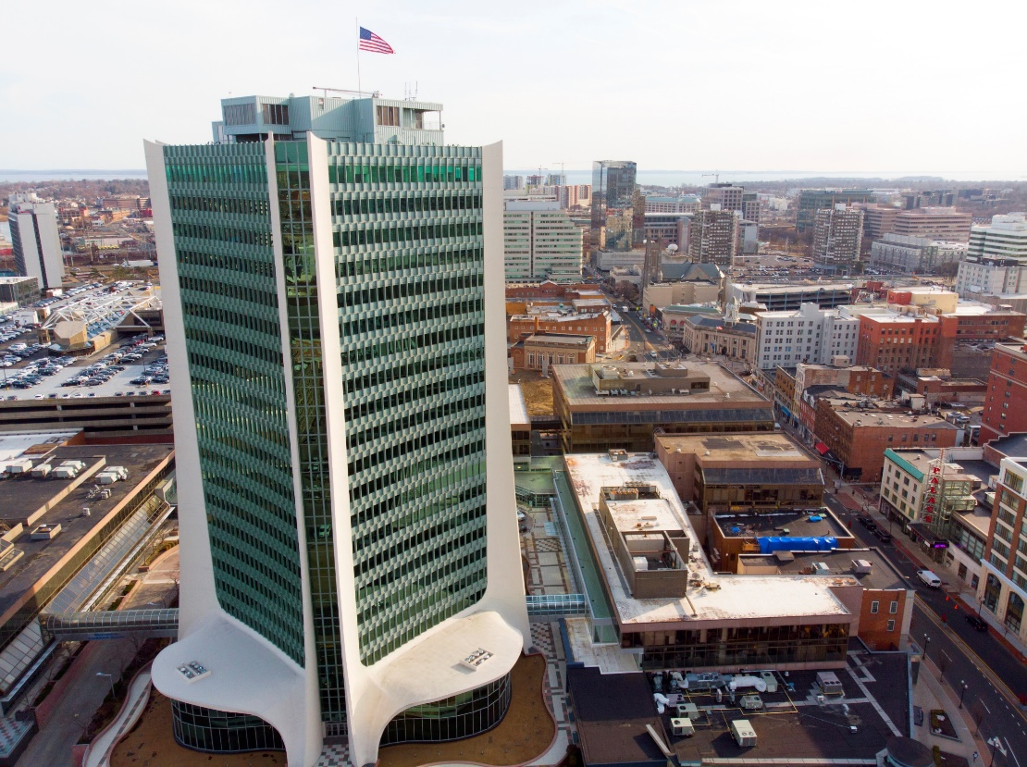
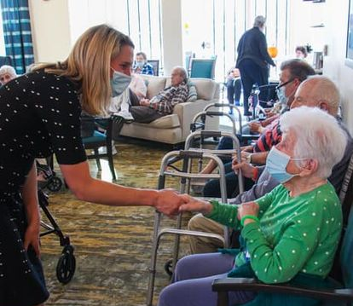
STAMFORD, CT

