Slide 1
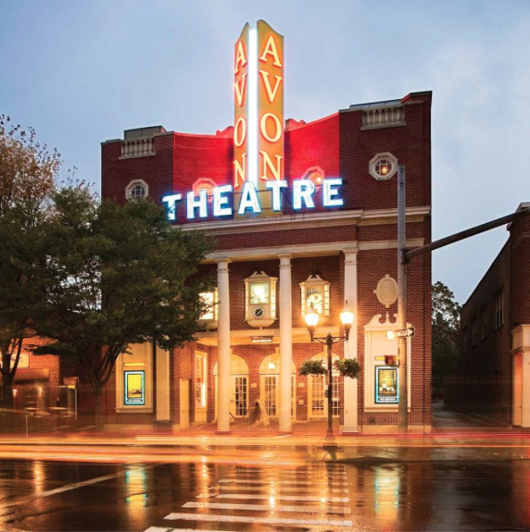
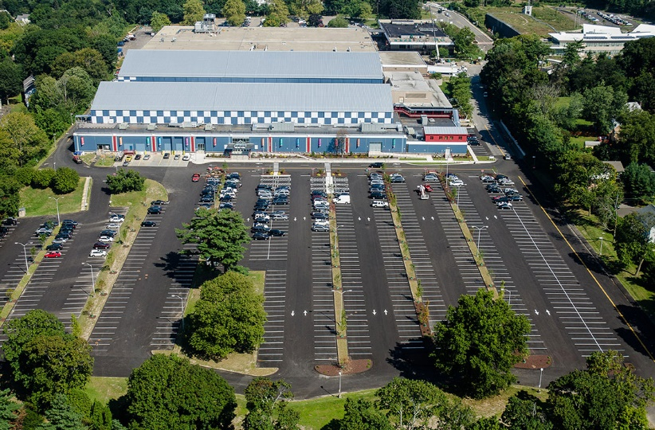
Office of administration - Administration, Assessor, Tax & Collection, Controller’s Office
March 29th Board of Finance
Sandra L. Dennies

Slide 2
Department Overview

Slide 3
Office of administration
Director of Administration
Office of Policy and Management
Tax and Collection
Purchasing
Risk Management Fund
Grants Administration
Assessment
Controller’s Office
Anti-Blight Fund

Slide 4
Current staff

Slide 5
Office of administration - Administration
Director of Administration
Executive Secretary

Slide 6
Fiscal year 2022-23

Slide 7
Office of Administration (Admin) FY 2022-23 Requested Budget (Full Time Salary)
 | FY 21/22 | FY 22/23 | FY 22/23
Job Title | Pos Count Adopted Budget | Pos Count Department Request | Funded Mayor’s Pos $Var %Var Pos Count Proposed Var Adpt. Adpt.
Dir of Administration | 1 $176,949 | 1 $180,843 | 1 $180,843 0 $3,894 2.2%
Executive Secretary | 1 $76,146 | 1 $79,997 | 1 $79,997 0 $3,851 5.1%
Total | 2 $253,091 | 2 $260,840 | 2 $260,840 0 $7,745 3.1%

Slide 8
Capital Budget Item Request

Slide 9
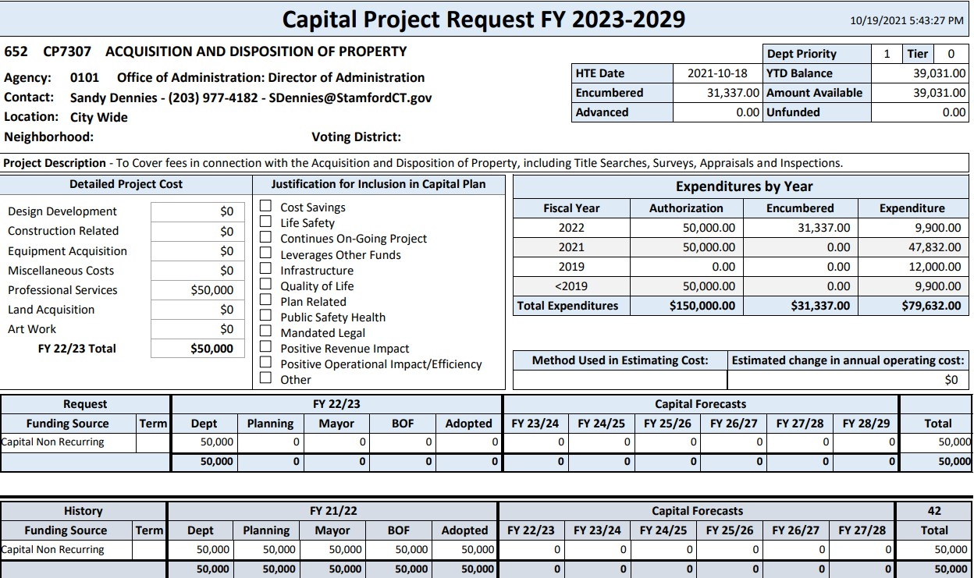
Capital budget items

Slide 10
Office of administration- assessor
March 29th Board of Finance
Greg Stackpole

Slide 11
Department Functions

Slide 12
Department Functions
1020
ASSESSOR
1021
BOARD OF ASSESSMENT APPEALS
1026
PROPERTY REVALUATION
Annually discover, measure and list all taxable and exempt property perfected and according to law – 38,000 RE accounts, 4,800 PP accounts, and 115,000 MV accounts. YOY increase of 2.40%, or 532MM.
Process all State and Local exemption programs.
Audit Personal Property accounts (TMA), discover and list out of State MV’s (MTS).
Provide data and historical research services to public and other City departments accurately and in a timely manner.
The Board of Assessment Appeals – A State-mandated autonomous body that hear and deliberate upon assessment related appeals from taxpayers who feel erred by the actions of the Assessor.
Board members are appointed by the Mayor.
Analyze Real Estate market trends for commercial and residential properties.
Annually collect and analyze income and expense data from commercial and industrial property owners.
Review all transferred Real Property at time of sale.

Slide 13
Current staff

Slide 14
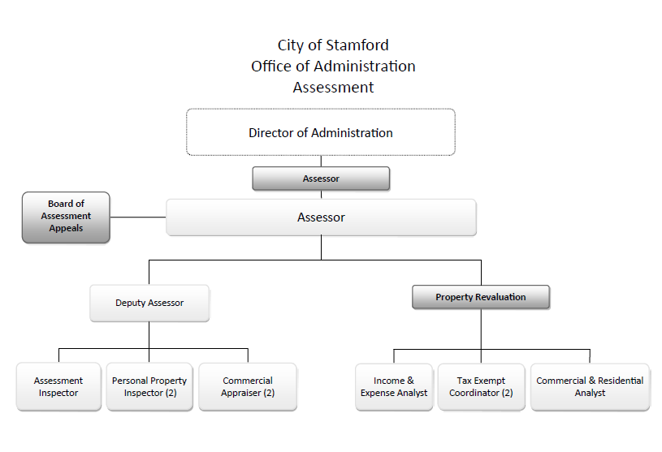
Current Staff

Slide 15
Fiscal year 2022-23

Slide 16
Changes for the next Fiscal Year
ASSESSOR – 1020 – – Increase in Software Maintenance ($5.8k due to increased costs of NADA price guides required for Motor Vehicle Pricing) – All other budget line items remained flat with the exception of salaries.
BOARD OF ASSESSMENT APPEALS – 1021 – No change Year Over Year
PROPERTY REVALUATION – 1026 – Decrease of $1,045,000 – State mandated City Wide revaluation project was fully funded in FY 2021-2022. – All other budget line items remained flat with the exception of salaries.

Slide 17
Department management

Slide 18
Changes for the next Fiscal Year
New or Expanded Services or Programs
Not Applicable
Abandoned or Curtailed Services or Programs
Office Closed to Public due to COVID-19 – Appointment Only
Assessment Inspectors have returned to fully inspecting the interior of properties (if permitted by the owner)
Key Department Challenges
City-wide Property Revaluation – Effective for the 10/1/2022 Grand List Year
Highlights, Efficiencies and Service Improvements
Expedite Public Requests
Provide online access for the Public to request historical field card and abutters lists via seamlessdocs on the City website.
Continued effort to convert and catalog 50 years of historical, microfiche field cards into digital images.

Slide 19
Office of administration- tax & collection
March 29th Board of Finance
Bill Napoletano

Slide 20
Department Functions

Slide 21
Department Functions
#1
#2
#3
Tax office Re-Org
Combine Tax and C&P Cashiers
3 Positions removed from Tax – 221K salary decrease
8 Positions reclassified with upgrades – 94K salary increase
1 Existing position upgraded – 9k salary increase
Overall savings 118K
Cashiers have been merged and 3 cashiers have been cross trained to process Tax or C&P payments
Bill and collect all Real Estate, Personal Property and Motor Vehicle tax bills.
Assist residents in the addition, deletion and adjustment of account
Bill and collect all Sewer Assessment/Connection Loans
Perform all lien applications and removals
Issue beach permits
Issue residential parking passes
Issue parking garage and RR parking passes
Issue parks use passes
Issue boating permits
Collection of parking citations

Slide 22
Current staff

Slide 23
Current Staff

Slide 24
Fiscal year 2022-23

Slide 25
Changes for the next Fiscal Year
Salary increase 30k – A) settlement of Union contracts during re-organization and necessity for all upgrades to received minimum 10% increase. B) transfer of cashiers salary from C&P to tax
Conferences & Training 5K – new tax collection laws requiring 50 hours of continuing education for State Certified Tax Collectors – currently have 3 on staff
Contracted Services 5k – to allow for additional delinquent billings throughout the year to increase revenues
Postage 5K – to cover the additional billings noted above
Equipment Rental 10k – replacement of several old copy/printing/scanning machines and renewed annual contract

Slide 26
Office of administration- Controller’s office
March 29th Board of Finance
David Yanik, Controller
Joanne Noone, Assistant Controller

Slide 27
Department Functions

Slide 28
Department Functions
Mission: The Controller’s Office mission is to maintain the books and records of the City of Stamford and its various agencies, functions and departments by supporting the General Accounting, Accounts Payable, Treasury, and Payroll functions and ensuring that prudent accounting policies, procedures and practices have been established which are supported by well-designed and operationally effective internal controls.
#1
#2
1032 Transaction Processing & Financial Reporting
1034 Internal Audit

Slide 29
Current staff

Slide 30
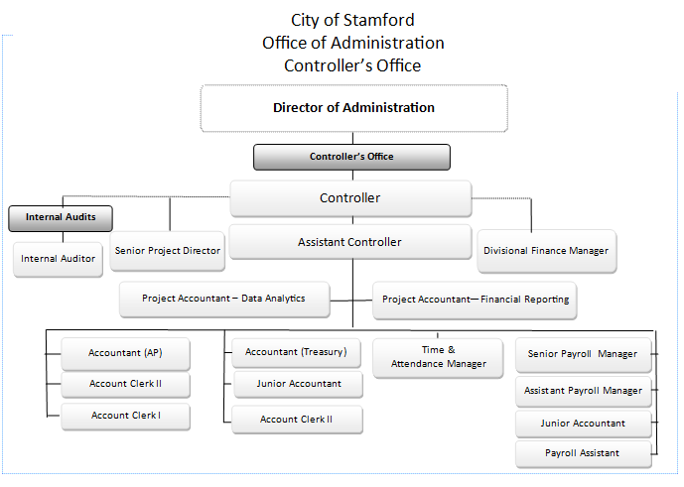
Current Staff
Insert Flow Chart/Org Structure

Slide 31
Fiscal year 2022-23

Slide 32
Changes for the neW Fiscal Year
HTE#01410321100 Controller/Salaries
FY2022 Projected Expenditures of $1,597,648 vs FY2023 Mayor’s Budget of $1,884,792
$287,144 increase (6.7%) over prior year Projected Expenditures due to salary COLAs and addition of two positions: Project Accountant – Data Analytics and Senior Project Director
HTE#01410323604 Controller/Outside Payroll Service
FY2022 Projected Expenditures of $625,000 vs FY2023 Mayor’s Budget of $645,524
$20,524 increase (3.3%) over prior year Projected Expenditures due to continuing costs related to Payroll and Timekeeping System application conversion projects and other costs for the implementation of the Employee Self-Service module
HTE#01410325405 Controller/Postage
FY2022 Projected Expenditures of $50,000 vs FY2023 Mayor’s Budget of $12,500
$37,500 decrease (75.0%) over prior year Projected Expenditures due to the expected implementation of the Employee Self-Service module

Slide 33
Challenges in the Coming Fiscal Year
FY 2023 Challenges
The two most significant challenges in FY2023 for the Controller’s Office are going to be:
1) Supporting the staff’s participation in the ERP Software implementation while completing their ongoing work responsibilities; and,
2) Skills enhancement, retention and recruiting for the Controller’s Office staff in light of changes in the post-pandemic workplace and job market

Slide 34
previous Fiscal Year Service Improvements
FY 2022 Service Improvements:
The Controller’s Office implemented a new cloud-based payroll software system effective July 1, 2022 and stayed within the original budget established by the Planning Board when the project was originally approved. City and BOE employees did so despite the onset of the pandemic, remote work / office closure mandates, and other challenges.

Slide 35
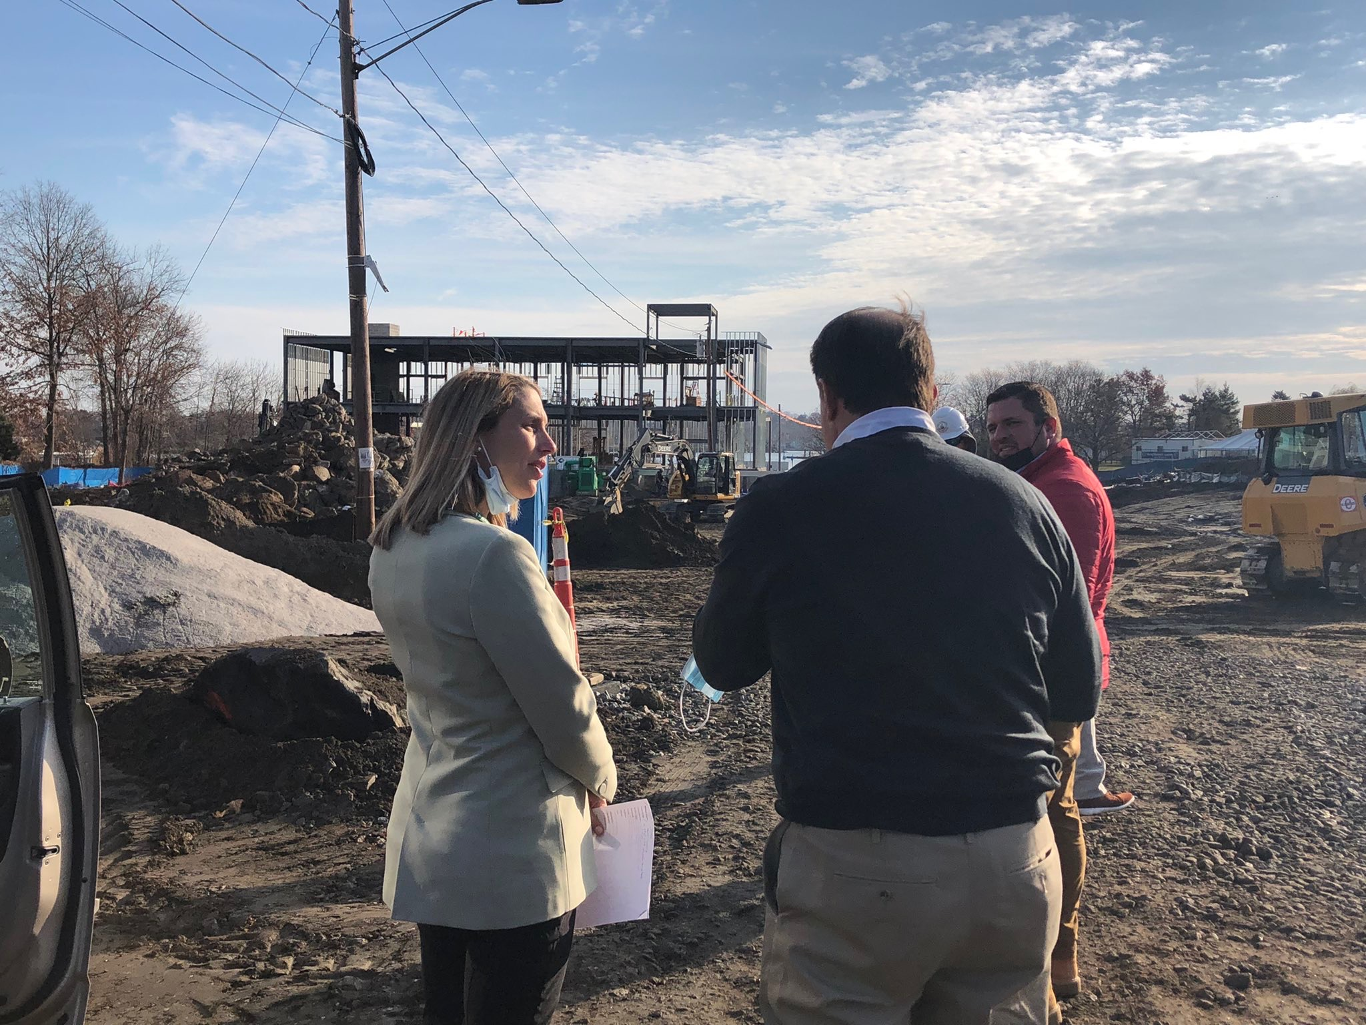
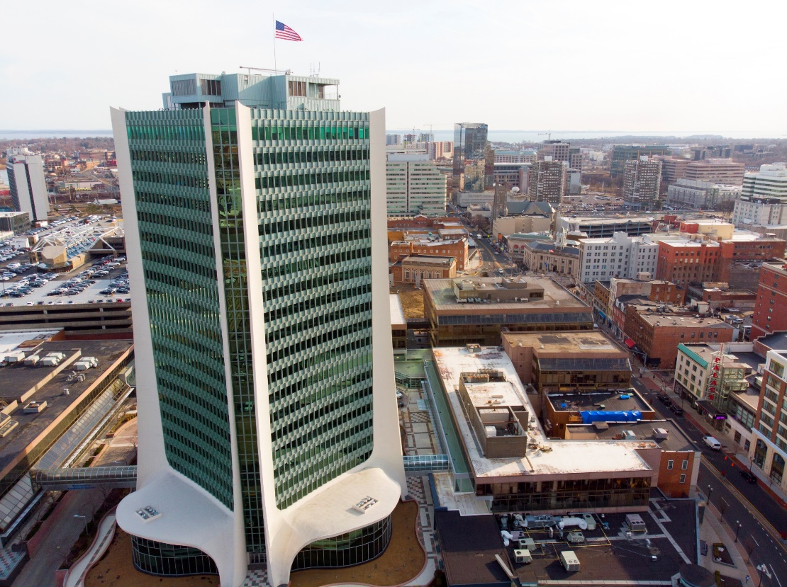
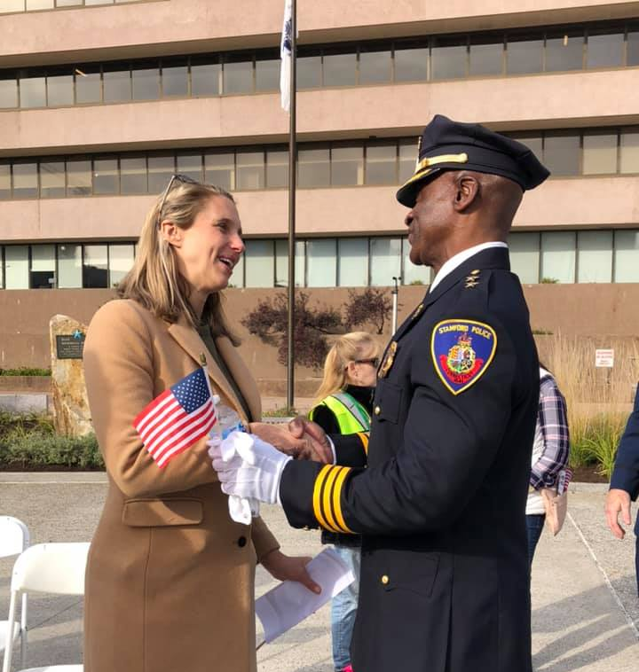
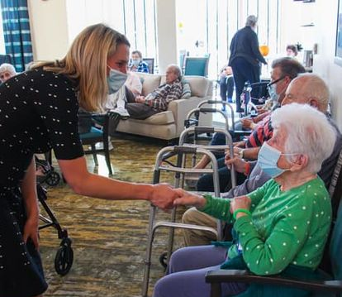
STAMFORD, CT

