Slide 1
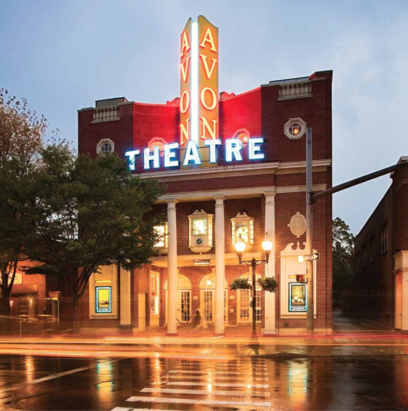
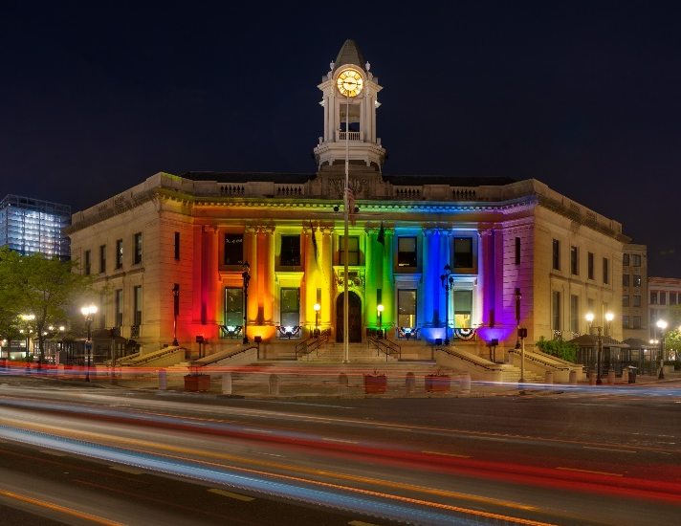
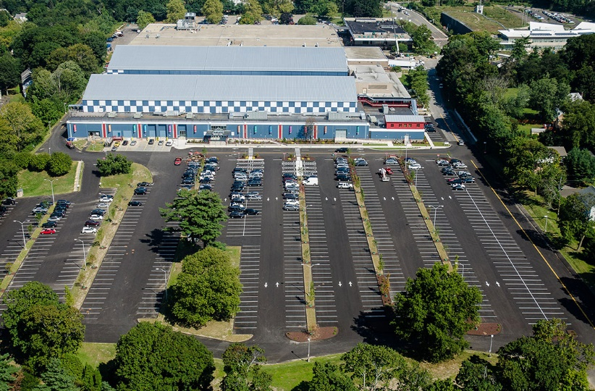
City of Stamford
March 29th Controller’s Office
David Yanik, Controller
Joanne Noone, Assistant Controller

Slide 2
Department Functions

Slide 3
Department Functions
Mission: The Controller’s Office mission is to maintain the books and records of the City of Stamford and its various agencies, functions and departments by supporting the General Accounting, Accounts Payable, Treasury, and Payroll functions and ensuring that prudent accounting policies, procedures and practices have been established which are supported by well-designed and operationally effective internal controls.
#1
#2
1032 Transaction Processing & Financial Reporting
1034 Internal Audit

Slide 4
Current staff

Slide 5
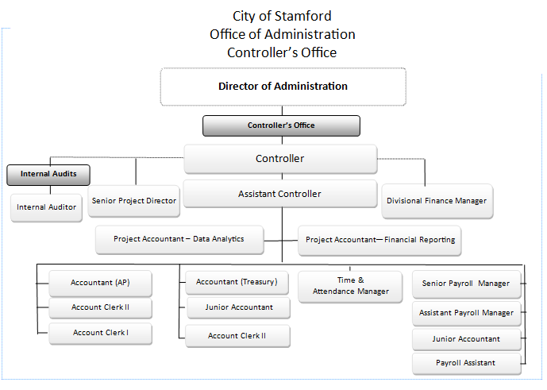
Current Staff
Insert Flow Chart/Org Structure

Slide 6
Fiscal year 2022-23

Slide 7
Changes for the neW Fiscal Year
HTE#01410321100 Controller/Salaries
FY2022 Projected Expenditures of $1,597,648 vs FY2023 Mayor’s Budget of $1,884,792
$287,144 increase (6.7%) over prior year Projected Expenditures due to salary COLAs and addition of two positions: Project Accountant – Data Analytics and Senior Project Director
HTE#01410323604 Controller/Outside Payroll Service
FY2022 Projected Expenditures of $625,000 vs FY2023 Mayor’s Budget of $645,524
$20,524 increase (3.3%) over prior year Projected Expenditures due to continuing costs related to Payroll and Timekeeping System application conversion projects and other costs for the implementation of the Employee Self-Service module
HTE#01410325405 Controller/Postage
FY2022 Projected Expenditures of $50,000 vs FY2023 Mayor’s Budget of $12,500
$37,500 decrease (75.0%) over prior year Projected Expenditures due to the expected implementation of the Employee Self-Service module

Slide 8
Challenges in the Coming Fiscal Year
FY 2023 Challenges
The two most significant challenges in FY2023 for the Controller’s Office are going to be:
1) Supporting the staff’s participation in the ERP Software implementation while completing their ongoing work responsibilities; and,
2) Skills enhancement, retention and recruiting for the Controller’s Office staff in light of changes in the post-pandemic workplace and job market

Slide 9
previous Fiscal Year Service Improvements
FY 2022 Service Improvements:
The Controller’s Office implemented a new cloud-based payroll software system effective July 1, 2022 and stayed within the original budget established by the Planning Board when the project was originally approved. City and BOE employees did so despite the onset of the pandemic, remote work / office closure mandates, and other challenges.

Slide 10
Capital Budget Request Items

Slide 11
Capital budget items
ERP Accounting Software Project budget is included under the Office of Administration
INSERT LINE ITEM
Capital Budget
INSERT LINE ITEM
INSERT LINE ITEM

Slide 12
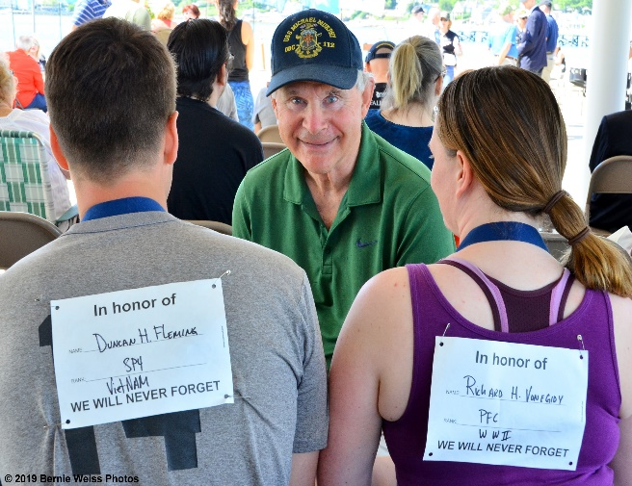
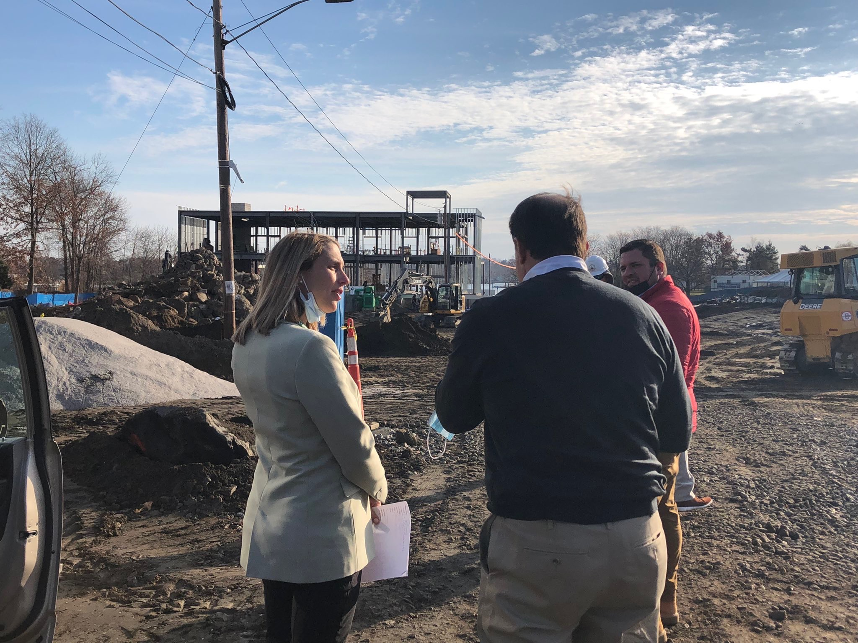
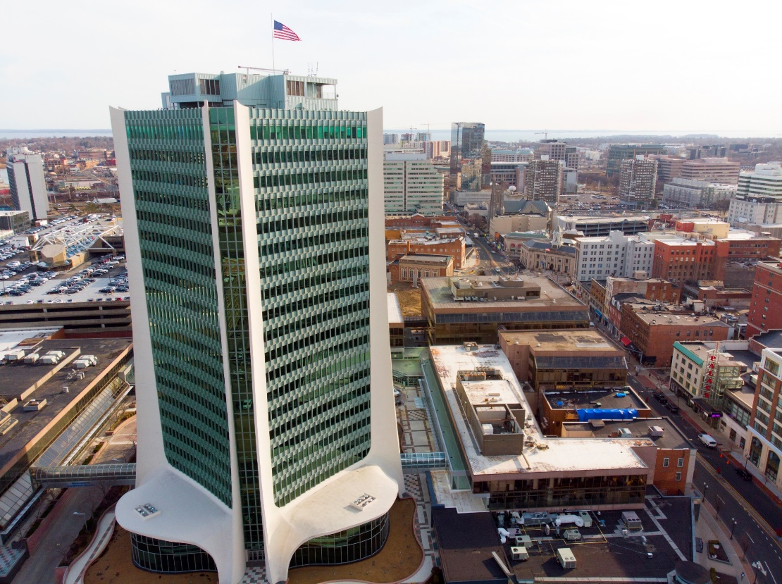
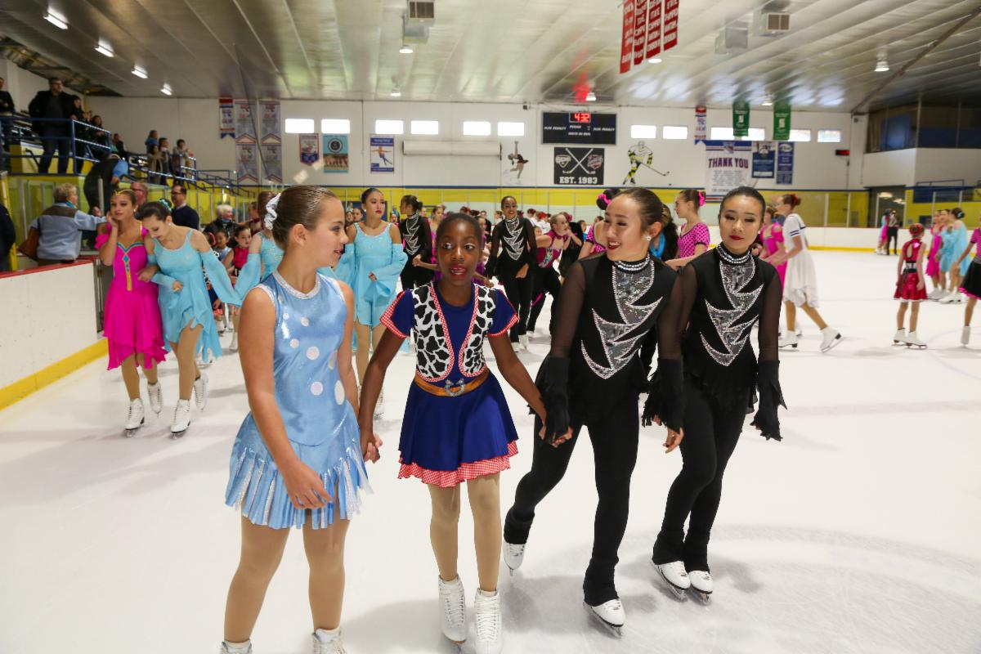
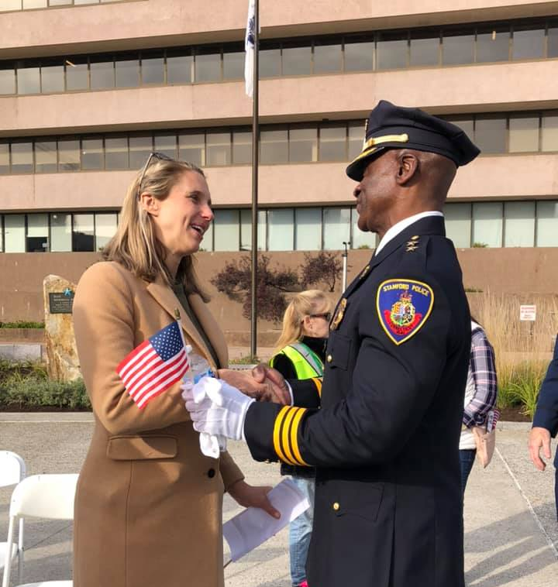
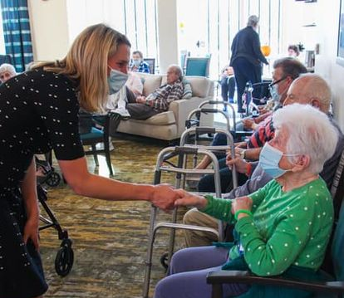
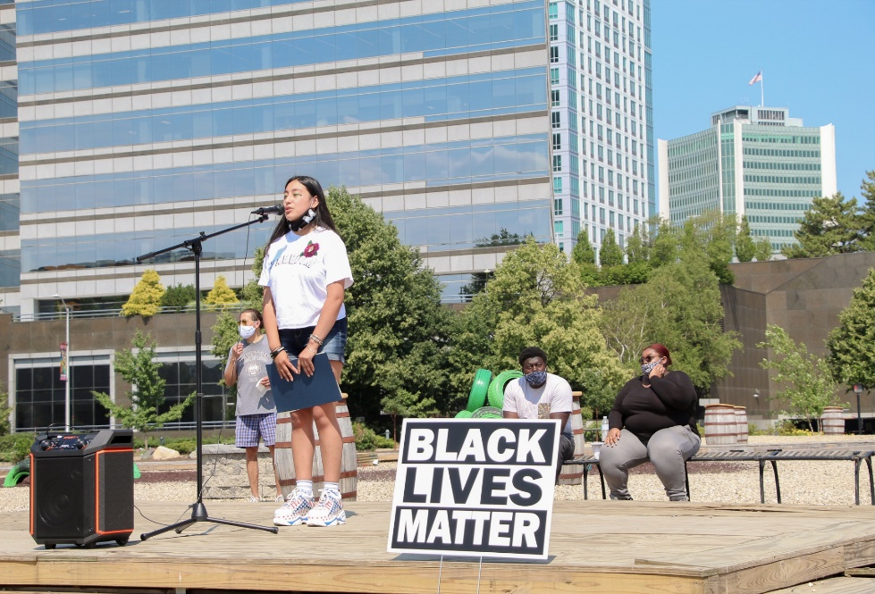
STAMFORD, CT

