Slide 1
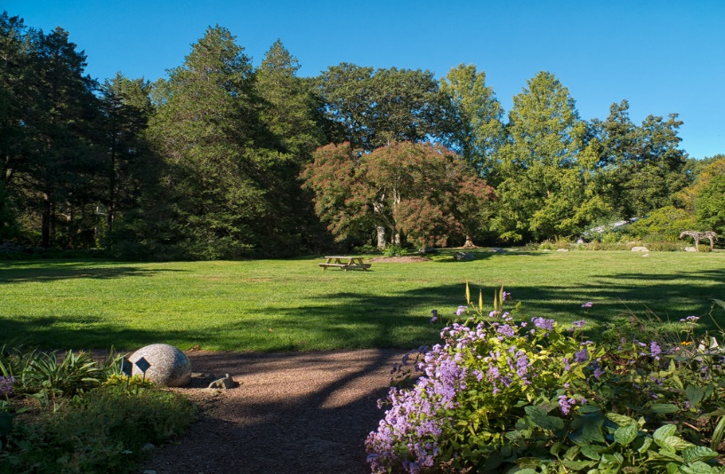
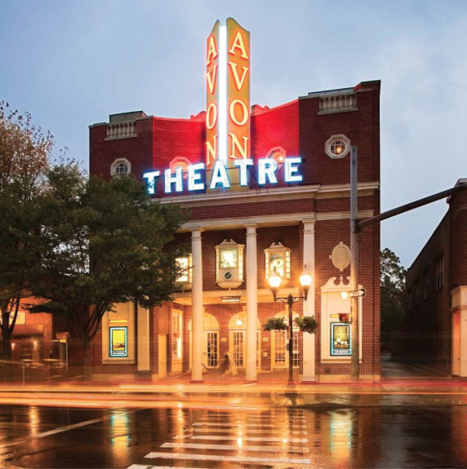
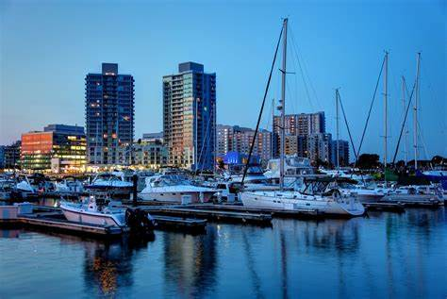
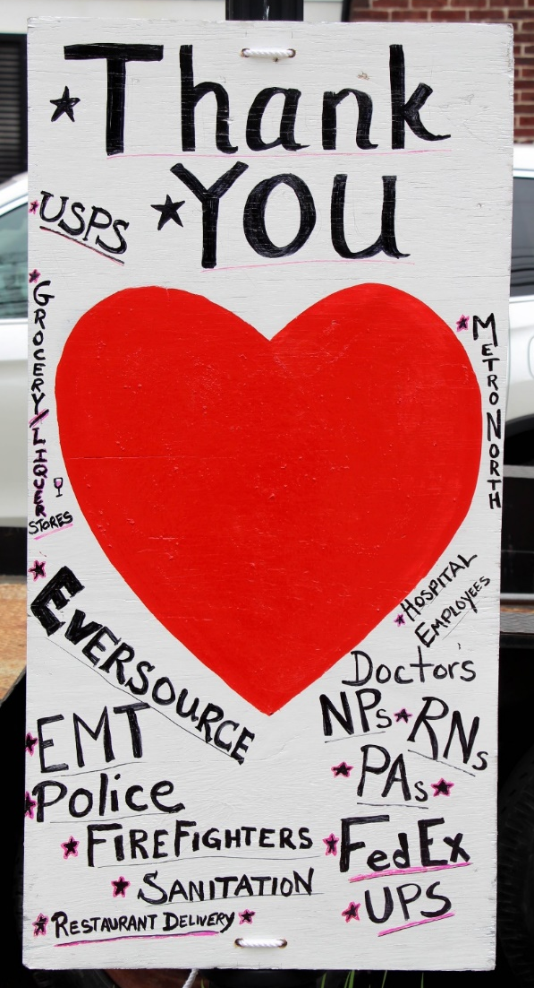
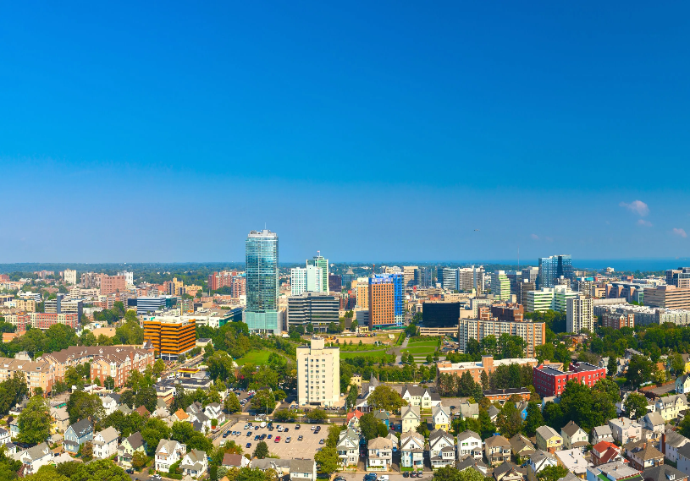
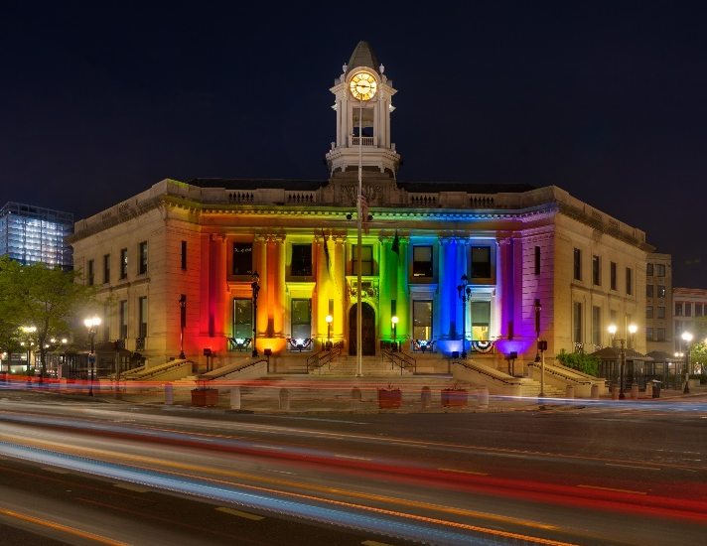
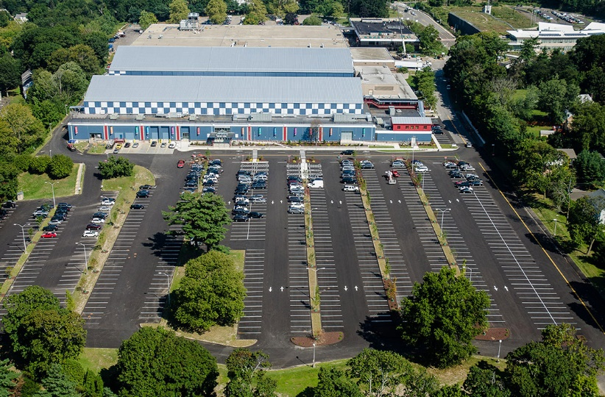
City of Stamford
March 9th
^{Dan Colleluori}
Solid Waste/Recycling & Sanitation

Slide 2
Department Functions

Slide 3
Department Functions
The mission of the Recycling and Sanitation Department is to provide for the efficient and expedient collection of garbage and recyclables from designated areas within the City of Stamford. The Department manages the Transfer Station, Scale House, Katrina Mygatt Recycling Center, Take it or Leave it and Book Swap, Food Waste compost Program and the Scofield Public Works facility during leaf hauling and collection events.
Enhance recycling services by providing updated recycling information to the Public as well research new programs for recycling. Provide collection events for hazardous waste and special collection events in North Stamford.

Slide 4
Current staff

Slide 6
Fiscal year 2022-23

Slide 7
Changes for the next Fiscal Year
In continuing efforts to improve City services: 2021/22 updated Collections Foreman job description to new JD under title “Operations Foreman Vehicles and Equipment” which resulted in improved truck maintenance coordination with Vehicle Maintenance. Collaborated for the transfer of the Solid Waste Master Mechanic position to Vehicle Maintenance in our effort to reduce overall City expense for all repairs and welding.
2022/23 15% Contract price increase for MSW hauling requires budget increase in Haulaway garbage requested budget from $4.5M to $5.8. Increase is also a result of estimated increase from 62k to 66K Tons. Additional result of hauling price increase is an estimated increase in revenues from $2.4M to $3.3M
New /expanded Services 22/23
Expansion of Food Waste Composting program at Bartlett Arboretum.
Re-implement Neighborhood dumpster program starting Spring 2022

Slide 8
Capital Budget Request Items

Slide 9
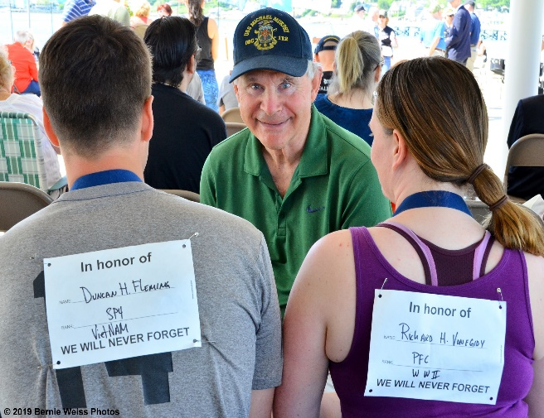
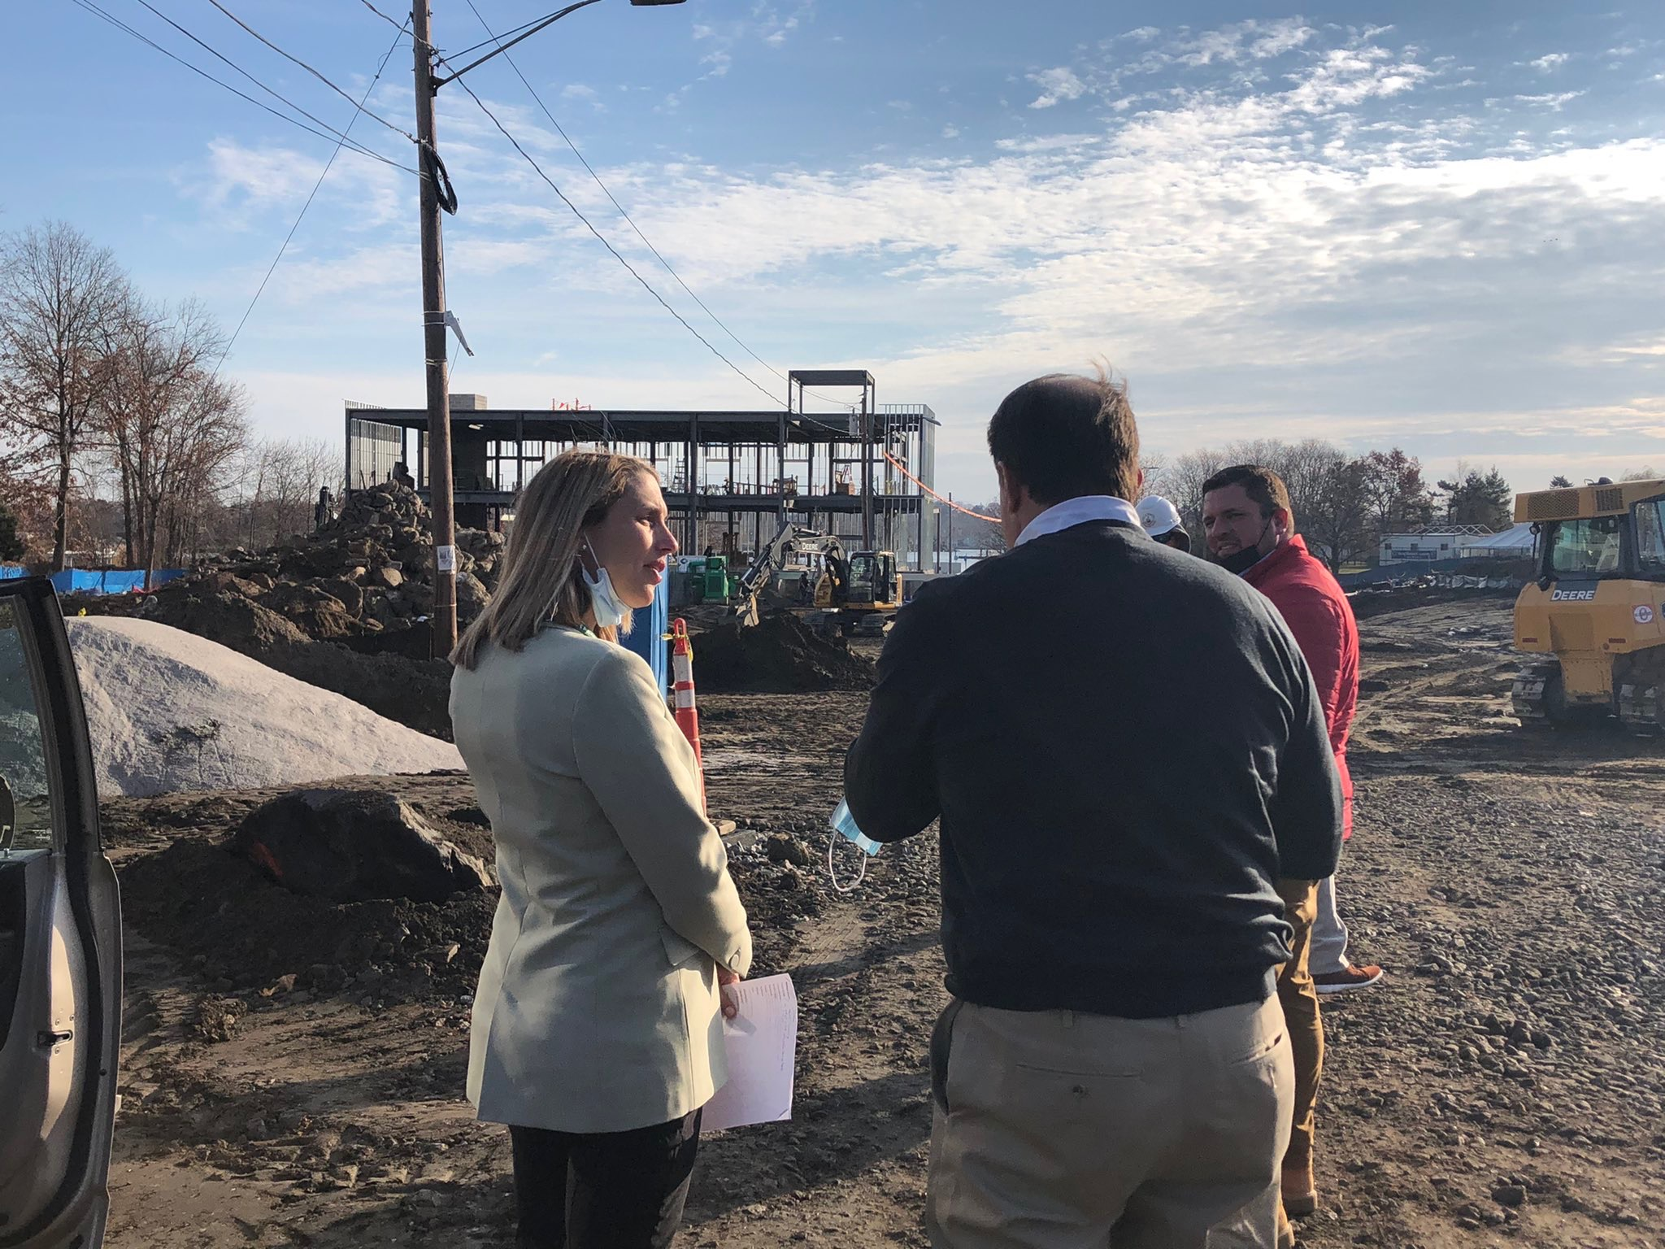
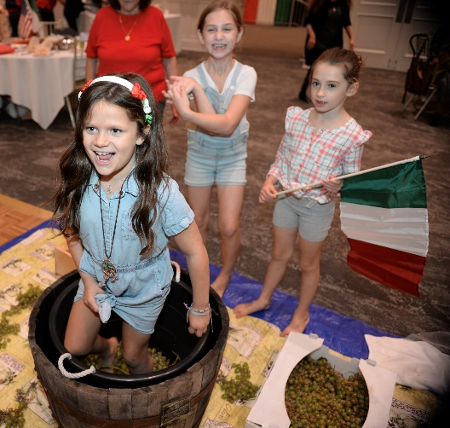
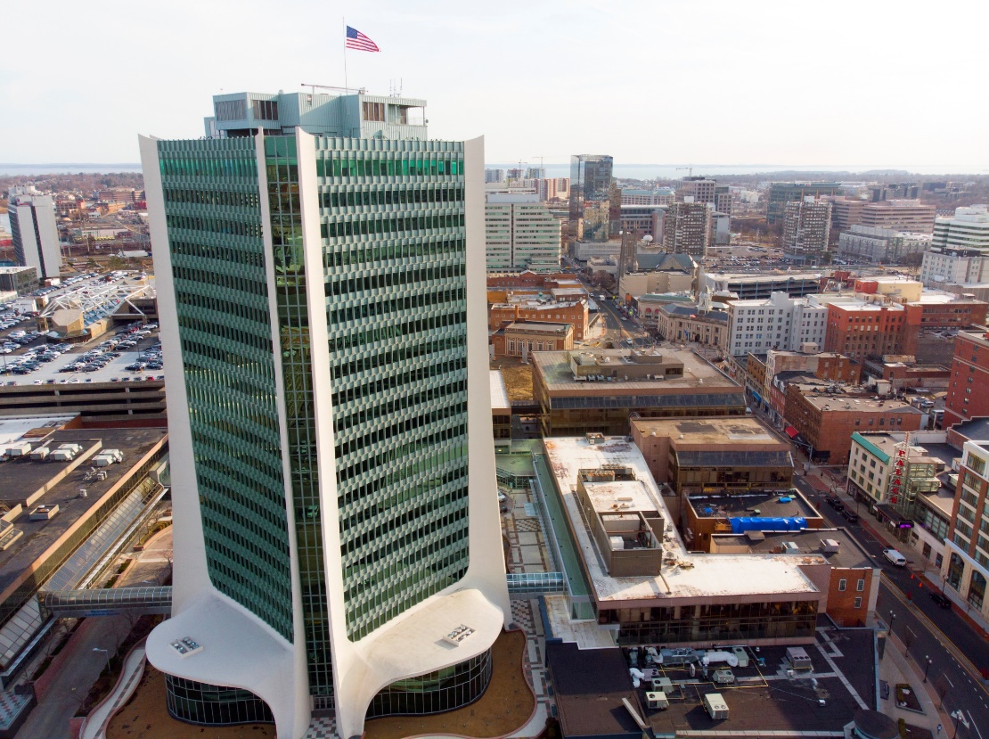
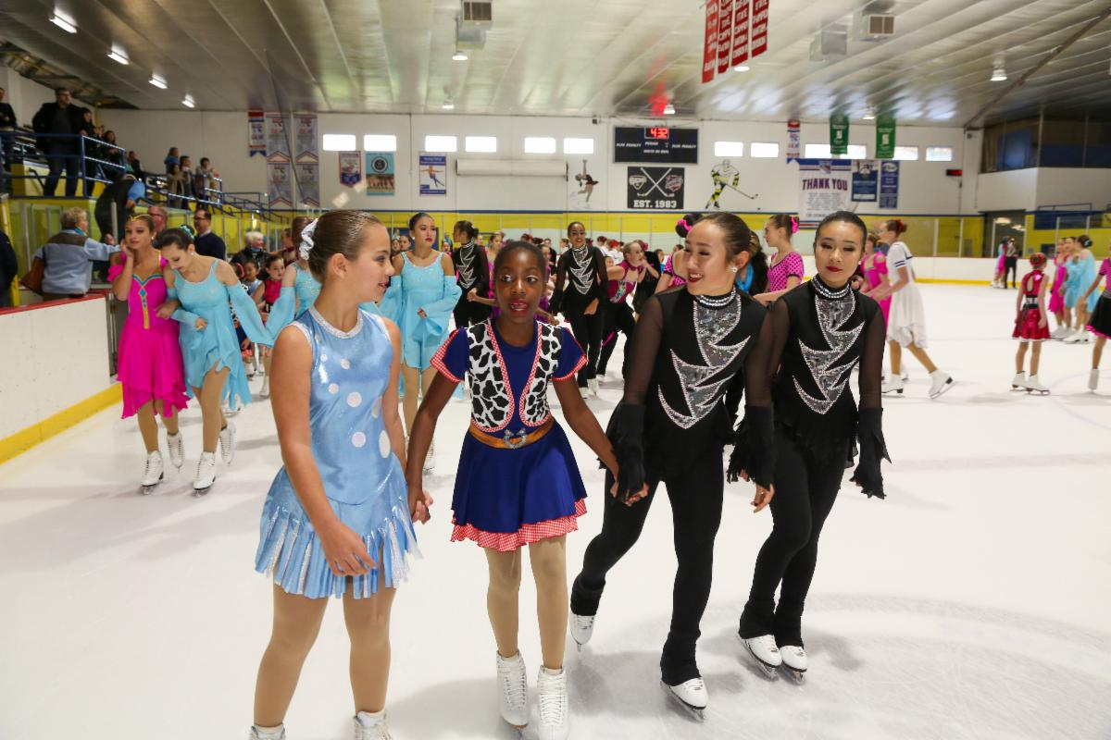
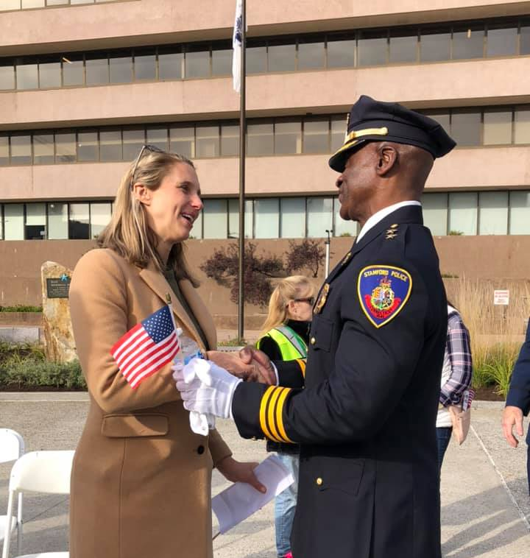
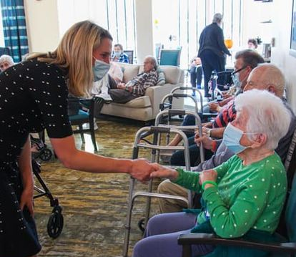
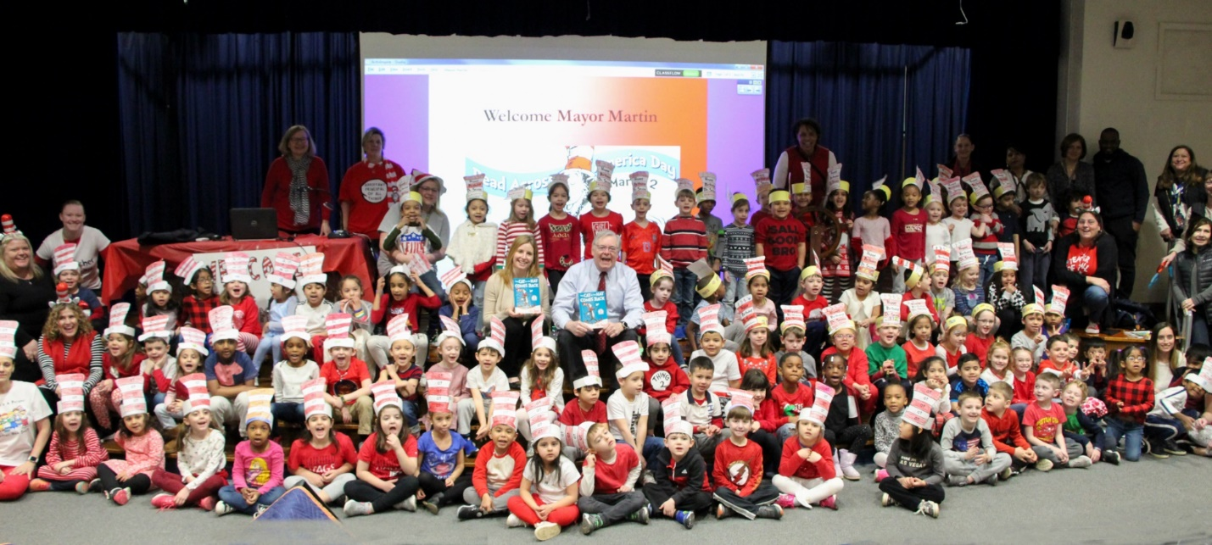
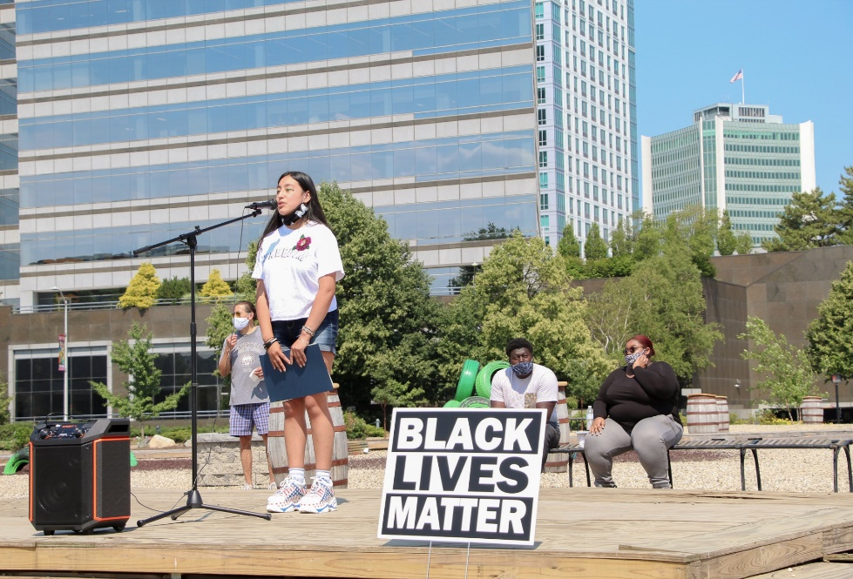
STAMFORD, CT

