Slide 1
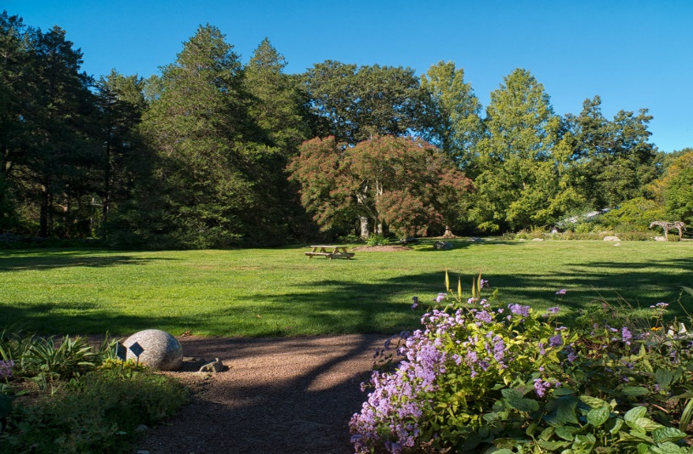
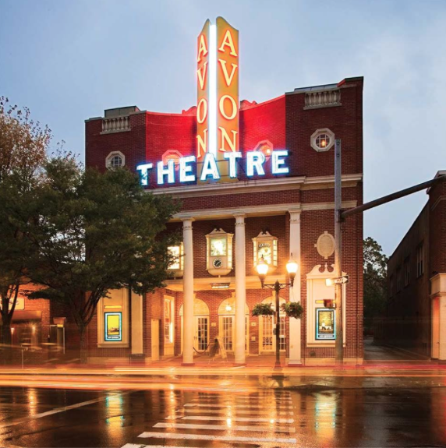
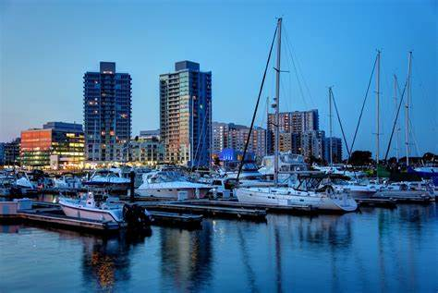
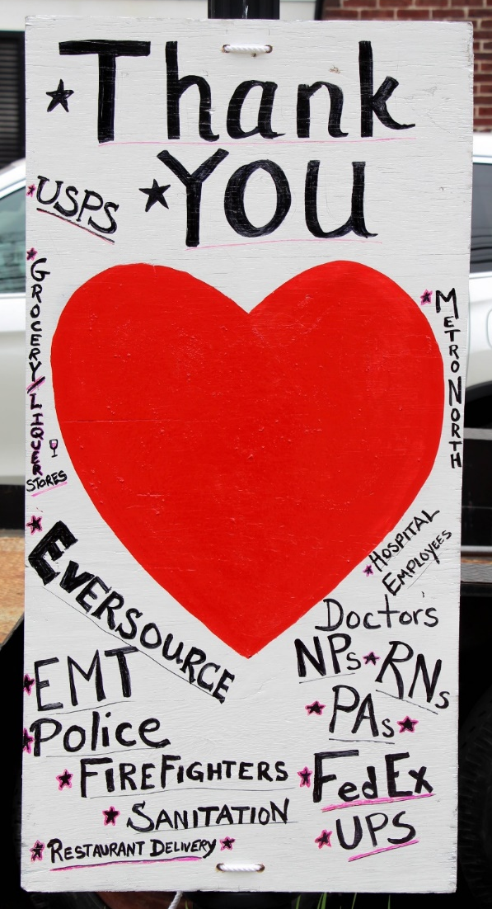
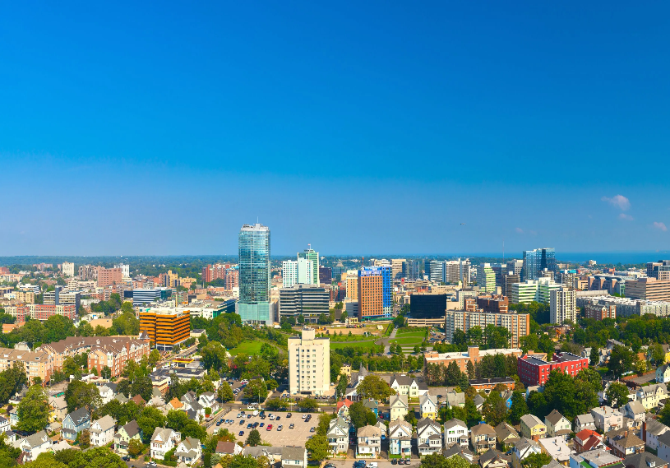
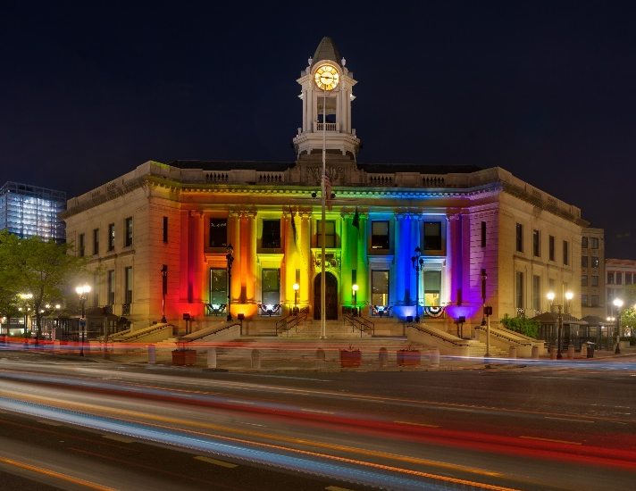
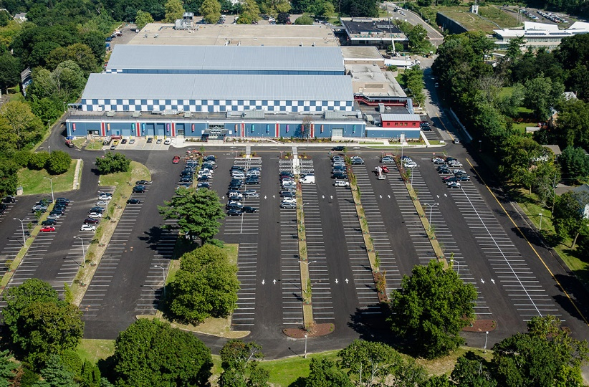

City of Stamford
Vehicle Maintenance FY 22/23 Budget Presentation

Slide 2

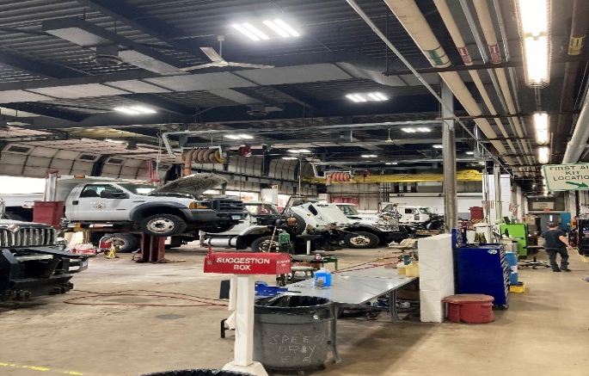
Department Introduction & Brief History
Fleet Maintenance Department Overview:
The Fleet Maintenance Department strives to establish efficient and effective delivery of city fleet services by providing city departments with well maintained, safe and reliable transportation and related support services that are responsive to the needs of each department and that conserve vehicle value and equipment investment at a cost savings to city residents.
This includes the maintenance & repair of approximately 750 vehicles and equipment utilized by the Operations Department and Police Department throughout the City Of Stamford. This includes, Collection, Recycling, Transfer Station, Composting Sites, Highway and Road Maintenance, Traffic Maintenance Department, Parks Maintenance, Traffic Signal Department, Recreation, Parks Police, Engineering Department, Health Department, Police Department and the departments bases in the Government Center.
Operations:
The Fleet Maintenance division is comprised of three departments:
1) Vehicle and Heavy Duty Equipment repair and maintenance.
2) Small Equipment repair and maintenance.
3) Police Dept. vehicle repair and maintenance.
The Fleet Maintenance division is also responsible fuel purchases for the City’ fuel Magee Ave. and Haig Ave. facilities. Responsible for all inter-department billing for fuel consumption. Overseeing all functions, repairs and maintenance of all City owned fuel stations at Haig Ave. and Magee Ave. as well as maintaining the databases of vehicles and employees authorized to get fuel.
Some additional functions of the Fleet Maintenance Division is purchasing vehicles and equipment in the most cost effective manner, including writing specifications for new vehicles to ensure departments have the most effective vehicle for their operational needs. In addition all city surplus is sold at auction through Vehicle Maintenance.

Slide 4
Fiscal year 2022-23
Changes, Challenges and Goals.

Slide 5
Changes for the next Fiscal Year
Personnel
  Transferred Master Mechanic/Welder Position from Solid Waste to Vehicle Maintenance.
    Allows for better service to departments of the City as well as reduce costs by reducing outsourcing welding work and more technical work.
  Promoted three (3) Equipment Mechanics to Master Mechanics.
    Allows for better service to departments of the City, reduces vehicle and equipment downtime, as well as reduce costs, by decreasing the amount of more technical work outsourced.
  Partnered with Wright Tech to bring interns to Vehicle Maintenance from the Automotive program.
    Creates a pipeline of future mechanics

Slide 6
Challenges for the next Fiscal Year
Staffing:
  The fleet maintenance division is significantly under staffed. The current mechanic to vehicle ratio is approximately 90:1. The average for a municipality of the size of Stamford is 55:1 to 60:1.
Vehicles:
  The average of our Operations Department fleet is 12.5 years old. The national average is 7-10 years old.
    Lack of Annual Vehicle Replacement Plan.
    New Vehicle Lead Times are now close to a year
    Vehicle prices have risen dramatically and experts say they will not return to normal until 2024.
Parts:
  Parts pricing and availability are both a huge problem.

Slide 7
Goals for the next Fiscal Year
Green Fleet Plan
A plan to reduce the City of Stamford’s vehicle fleet carbon footprint through idle reduction,
bio-diesel, transitioning to Electric vehicles and/ or plug in hybrid vehicles as well overall fleet
reduction.
Centralization of all City fleet operations.
A plan to break down the silos within the various city fleets and create a centralized Fleet Operations Division. All aspects of the City’s fleet will be managed using the new centralized approach. The result of this centralization will be real savings on purchasing goods and services and additional savings for the city through process improvements such as :
  Fleet Right-sizing
A plan to analyze vehicle and equipment usage across all departments and create a plan to eliminate low use and redundant vehicles. Explore supporting vehicle needs on a seasonal basis with rentals.
  Updating and creating all new fleet related policies
Preventive Maintenance (PM) Compliance - This measurement is a standard in the industry. Our goal is 95 percent of PM’s completed on time.
Education / Training
It is imperative that the Fleet technicians stay abreast of the latest technology in the industry. With training funds at a premium, Fleet Management staff and the City has to find ways to aide in mechanics keeping up with the latest information.

Slide 8
Capital Budget Request Items

Slide 9
Capital budget items
Install infrastructure for an EV Fleet in City yards
President Biden signed an executive order recently that sets a target for half of all new vehicles sold by 2030 to be zero-emissions capable (including battery electric or BEV, plug-in hybrid electric or PHEV, and fuel cell electric vehicles or FCEV). That EO in conjunction along with his announcement in January about electrifying the government fleet, the City of Stamford needs to begin the development of our own EV infrastructure. There will be grants available as a result of this EO, as well as the infrastructure bill that is due to be passed soon. More than likely there is a good chance every other government and/or private entities will be vying for the funds available. In addition, both the public sector and private sector will be building their infrastructure and starting the process of converting their fleet to zero emissions vehicles leading to long lead times and possibly short supply of vehicles and charging stations. Starting the process as a City project, we can still move towards making our City fleet greener.
Capital Budget
Storage Building at City Yard
Build a 60’X100’ metal building behind the vehicle maintenance facility for the storage of vehicles and equipment used for seasonal work such as plow trucks, plows, detachable sanders, leaf vac equipment, blacktop equipment as well as other misc. equipment currently stored out in the elements. Storing vehicles and equipment in an enclosed and heated structure out of the elements would lengthen the life of the equipment as well as reduce maintenance costs and increase uptime. An additional benefit to a garage is snow trucks could be prepped and loaded for an impeding storm allowing for the trucks to be out on the road clearing snow and ice quicker.

Slide 10

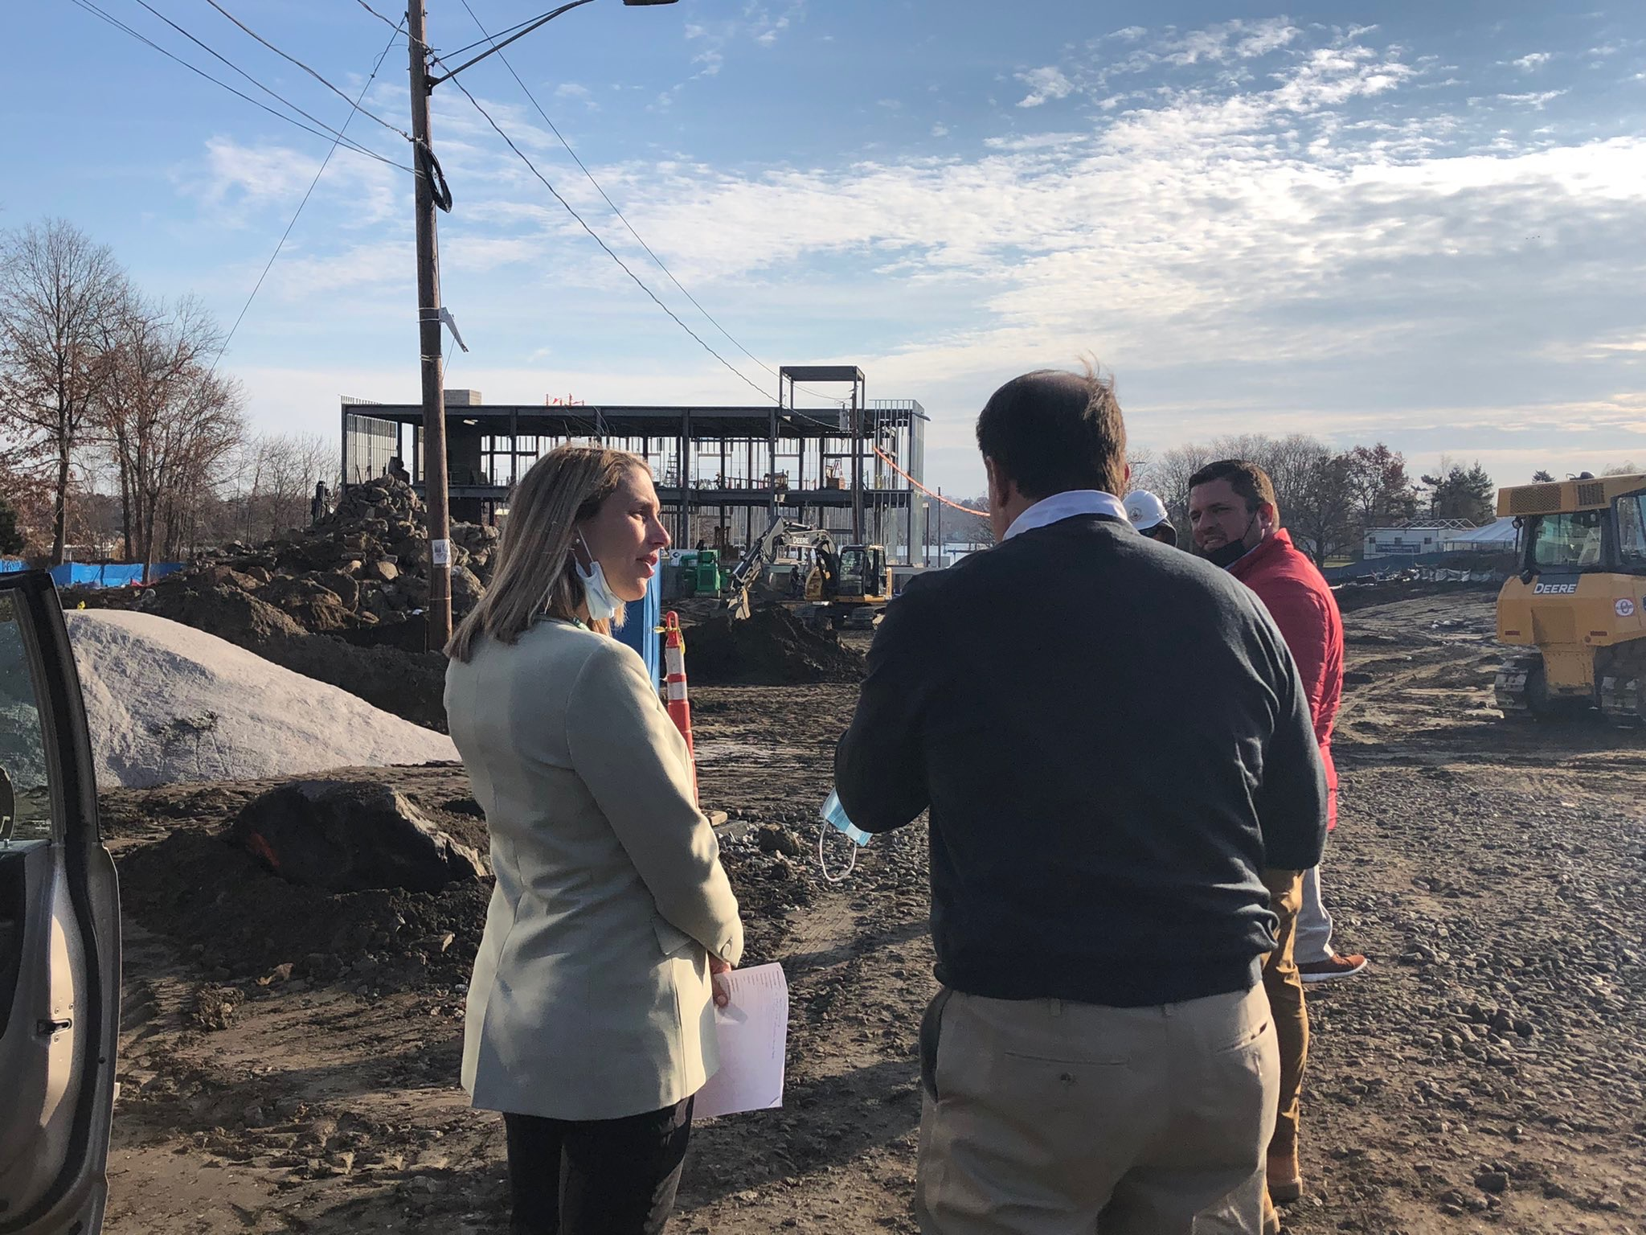

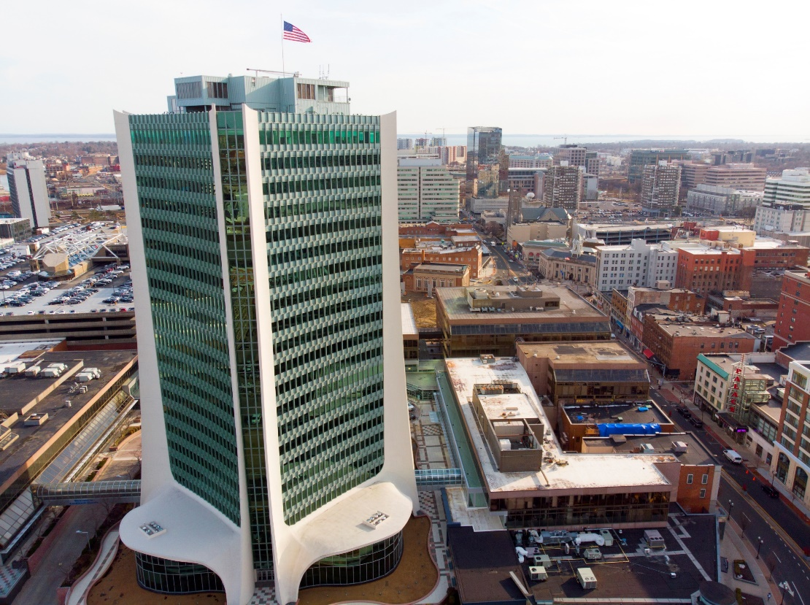

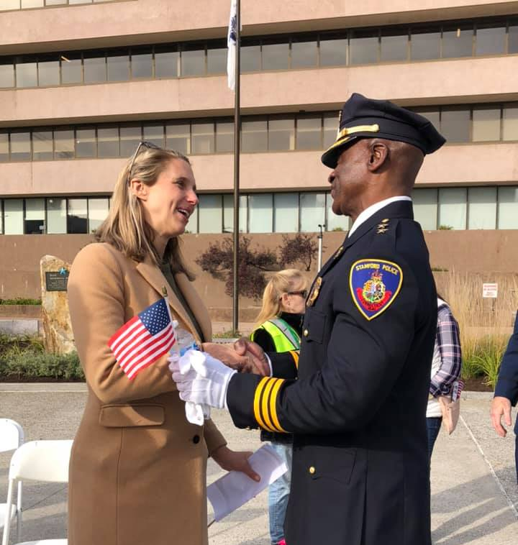



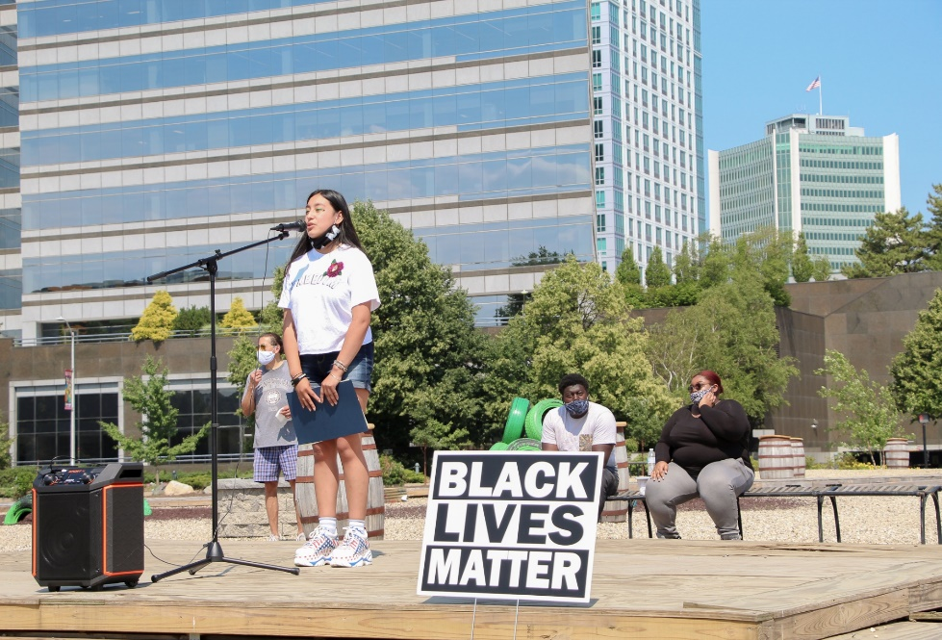
STAMFORD, CT

