Slide 1
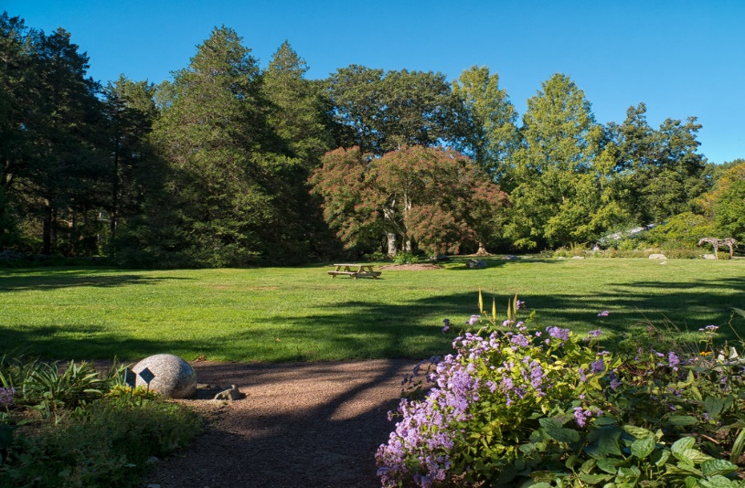
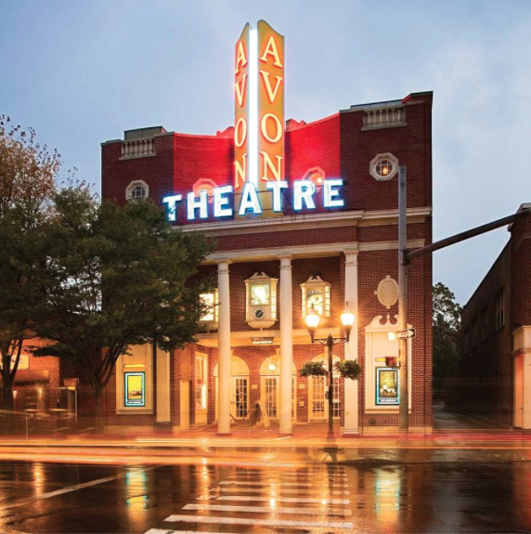
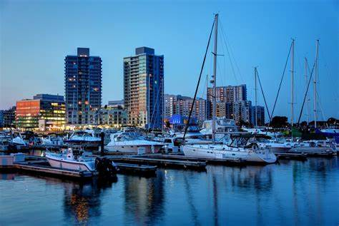
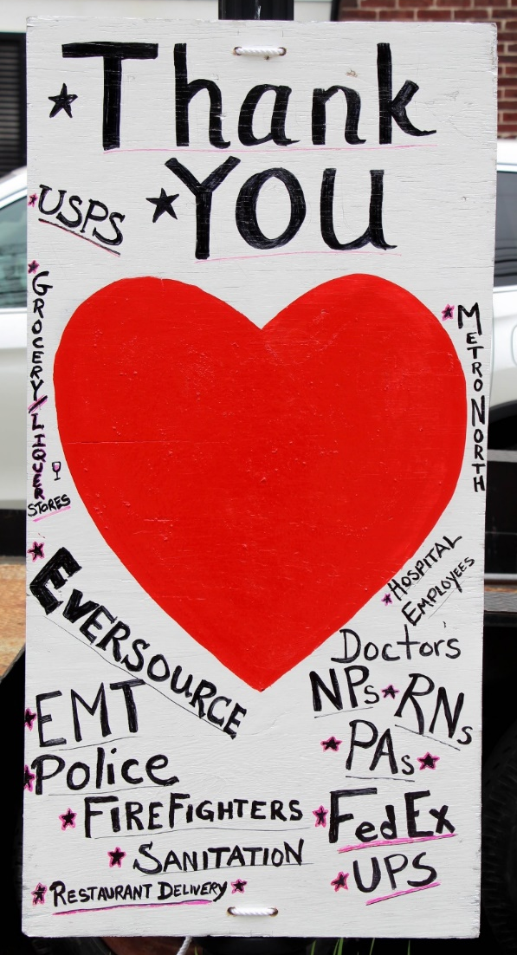
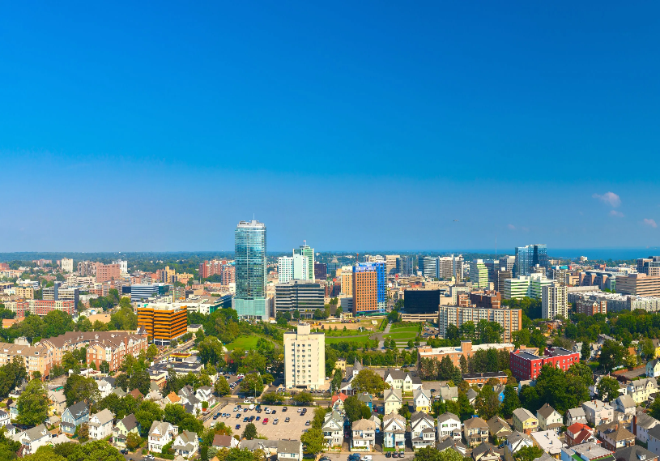
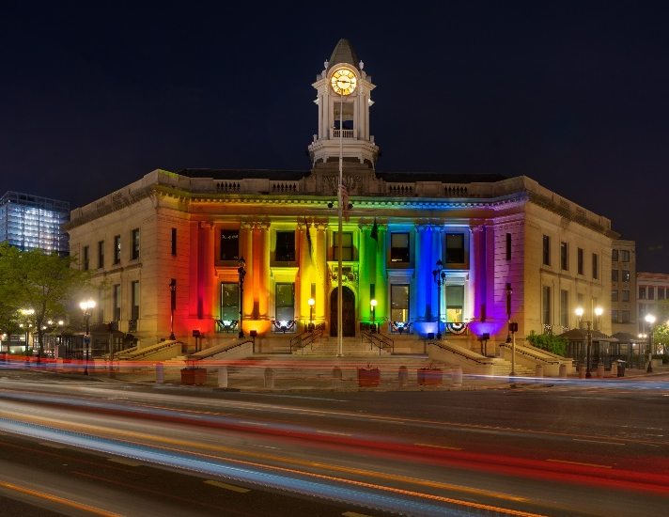
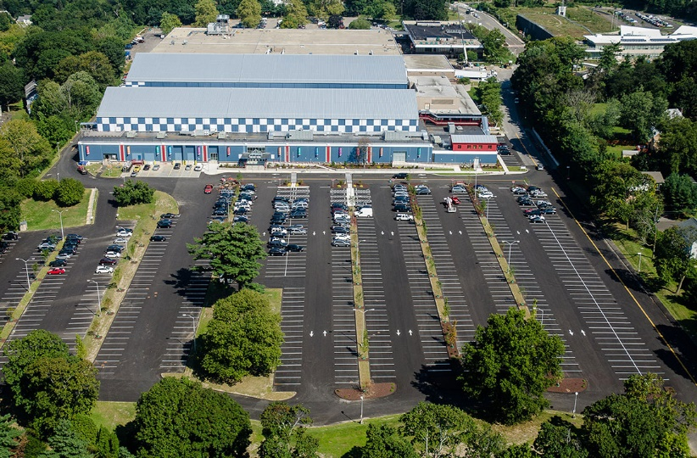
City of Stamford
March 9th

Slide 2
Department Functions

Slide 3
Department Functions
Department Function
The mission of the E.G. Brennan Golf Course is to provide the residents of Stamford and areas neighboring a preeminent public golf course. E.G. Brennan Golf Course is an 18 Hold Golf Course with a practice chipping/putting green, a full service restaurant and a clubhouse containing a golf simulator, lockers, and golf shop. Amidst a competitive market for public golf, the aim is for continually improving course conditions while being both fiscally responsible and environmentally mindful.

Slide 4
Program overview and Highlights

Slide 5
Program overview and Highlights
Rounds and revenue are up
Tee leveling project complete with favorable comments from golfing public
Re-routing of holes enhanced flow of course and increased pace of play
Alternate revenue streams i.e. parking lot rental
Establish a tree maintenance program, including pruning and removal of dead and dangerous trees
Paving of cart path to #3 tee
Growing of our fund balance
Zody’s 19th Hole Restaurant expansion and lease renewal

Slide 6
Challenges

Slide 7
challenges
Aging infrastructure including Irrigation System, building and mechanicals, equipment
Supply chain issues and escalating costs of goods
Staying relevant in a competitive market where our rate structure is limited with two public golf courses in the same city
Dependency on weather in prime golf months of summer
Finding and retaining quality labor
Retaining golfers that visited EGB during Pandemic

Slide 8
Current staff

Slide 9
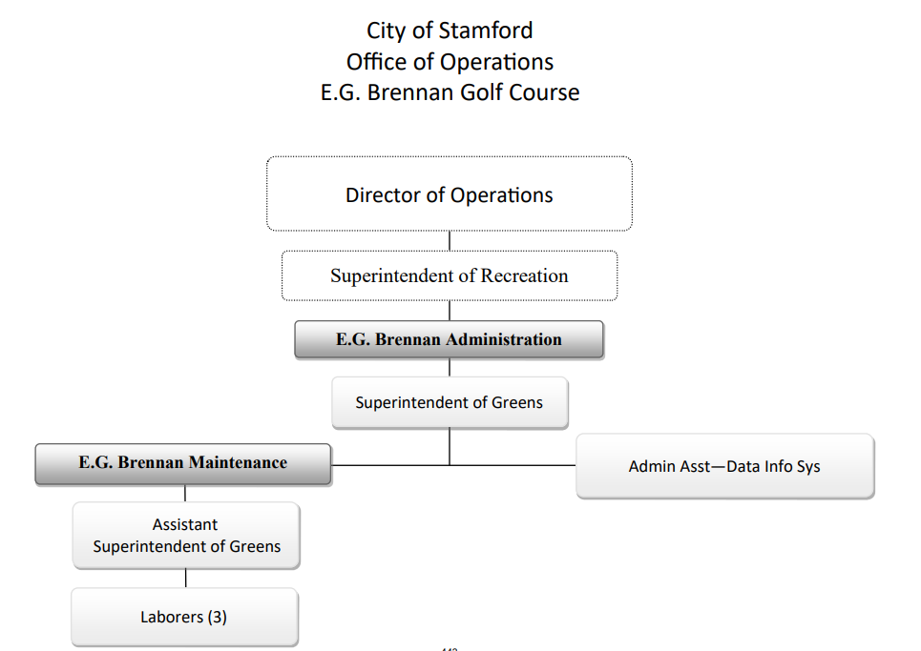
Current Staff
Superintendent of Greens
Responsible for all facets of golf course maintenance including
planning, budgeting, and implementing maintenance programs
Assistant Superintendent of Greens
Responsible for in the field supervision, monitoring of turf conditions
and equipment, supervision of full time and seasonal staff
Administrative Assistant/Data Analyst
Tracks and maintains monthly/yearly rounds of play and cart rentals
Processes Requisitions and payments for vendors, on boards
Seasonal employees and assists with payroll
3 Full Time Laborers
Performs tasks as directed for all outdoor work
4 Seasonal Laborers
Performs tasks as directed for all outdoor work
6 Seasonal Rangers
On course enforcement for play rules

Slide 10
Fiscal year 2022-23

Slide 11
Changes for the next Fiscal Year
Proposed FY 22-23 Budget $1,897,124 = +$176,839
True Cost to City $0, EG Brennan Golf Course is self funded
Capital Expenses – $1.6M* Irrigation Project
*actual boned amount to be determined

Slide 12
Capital Budget Request Items

Slide 13
Capital budget items
$1.6M Irrigation Project; actual amount tbd
Capital Budget

Slide 14
Metrics

Slide 15
metrics
FY Comparison FY 2021-22 to FY 2020-21
 | Totals through end of Feb.
 | FY 2021-22 | FY 2020-21 | Full FY 2020-21
Rounds Played | 22,443 | 26,247 | 43,347
Player Revenue | $686,520 | $753,677 | $1,264,676
Carts Rented | 17,670 | 19,305 | 31,616
Carts Revenue | $274,462 | $285,768 | $478,184
Resident Permits Sold | 205 | 248 | 1,284
Permit Revenue | $13,490 | $13,740 | $83,110
PAR Pass Sold | 29 | 22 | 95
PAR Pass Revenue | $5,475 | $4,075 | $18,300
Sr Pass Sold | 35 | 30 | 160
Sr Pass Revenue | $2,800 | $2,340 | $12,740

Slide 16
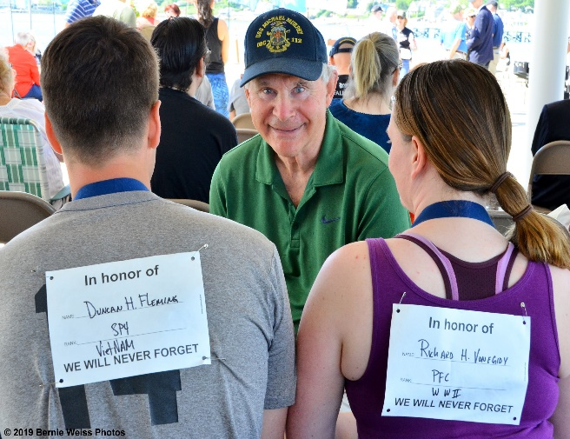
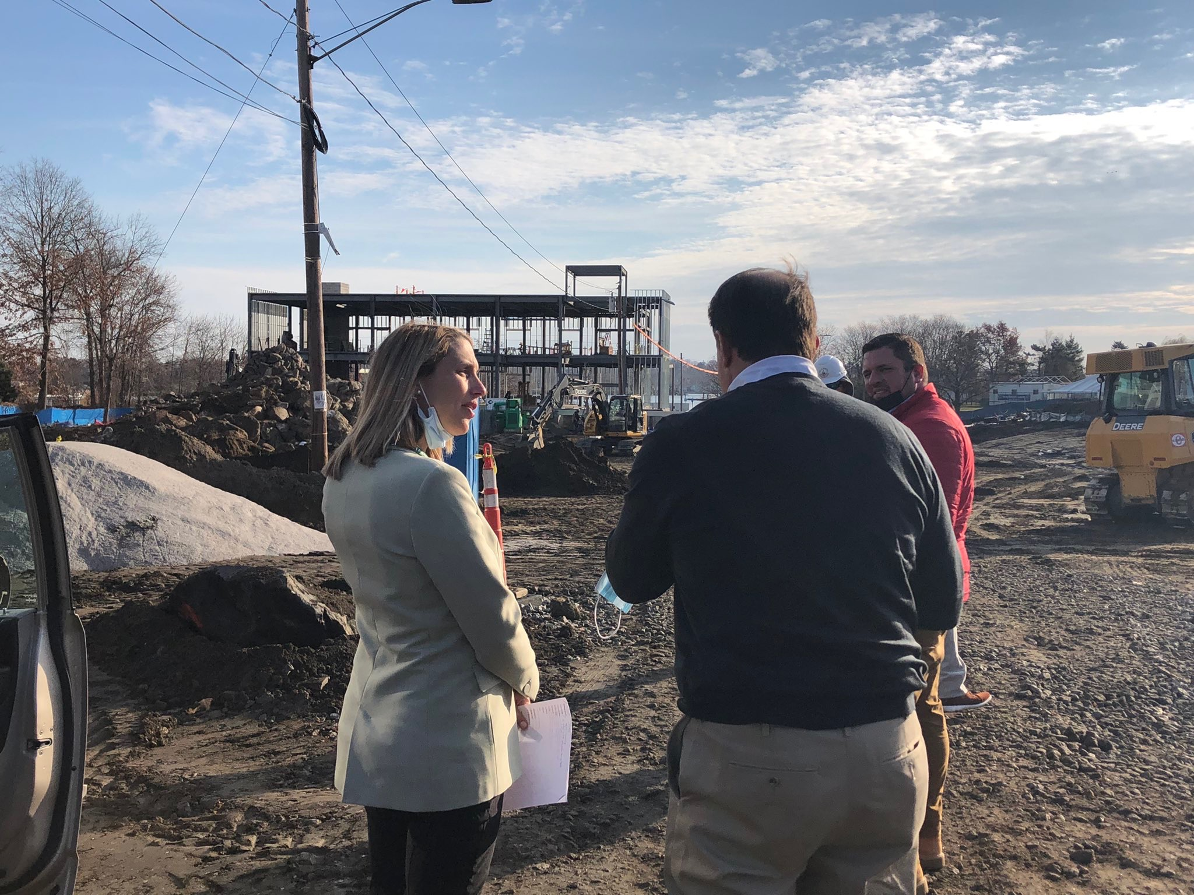
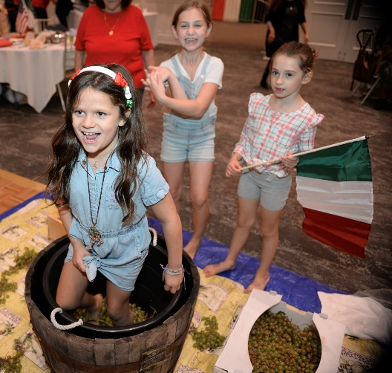
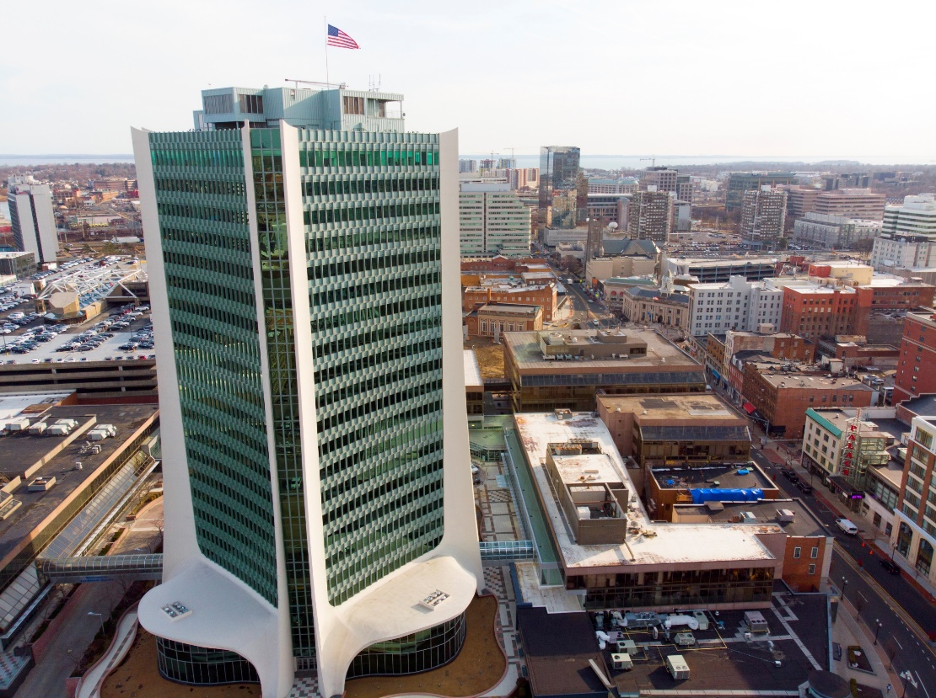
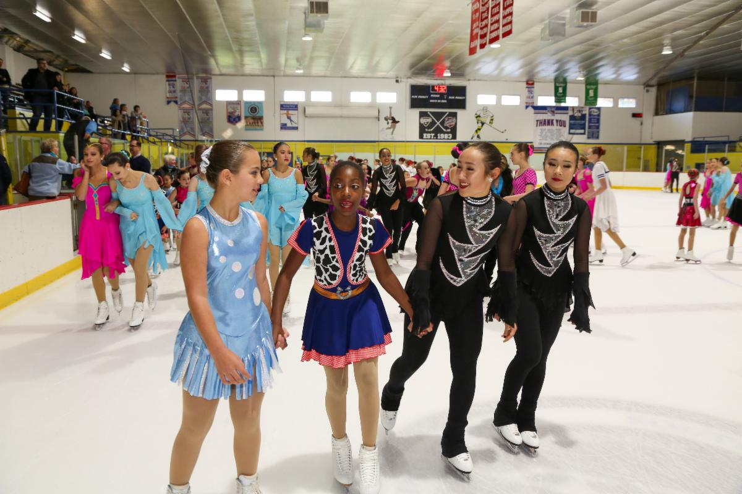
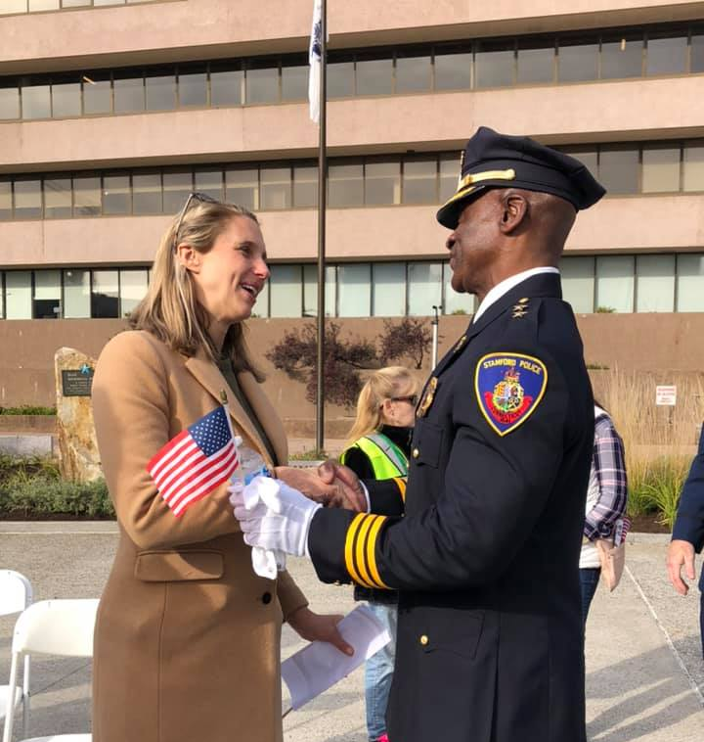
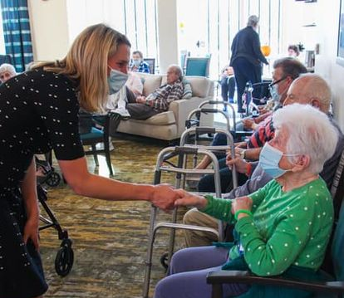
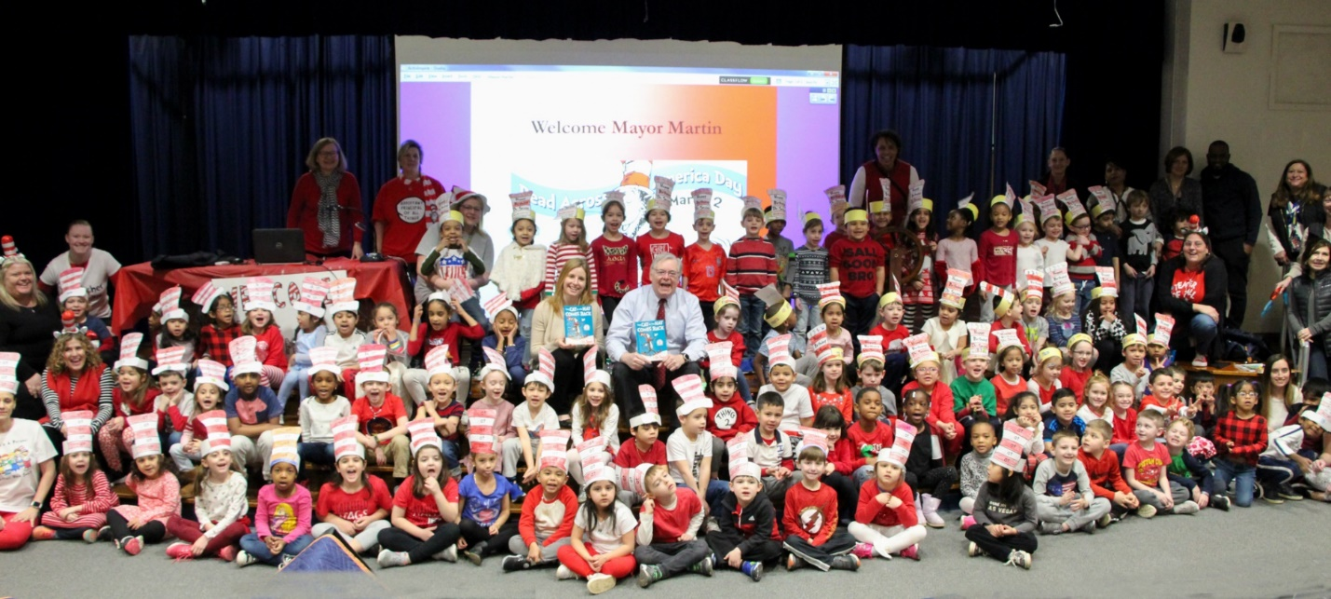
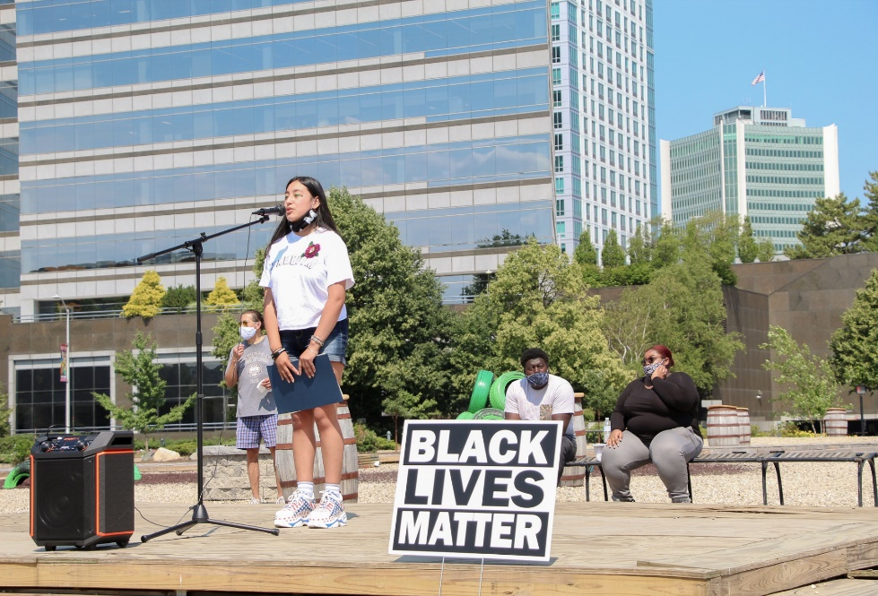
STAMFORD, CT

