Slide 1
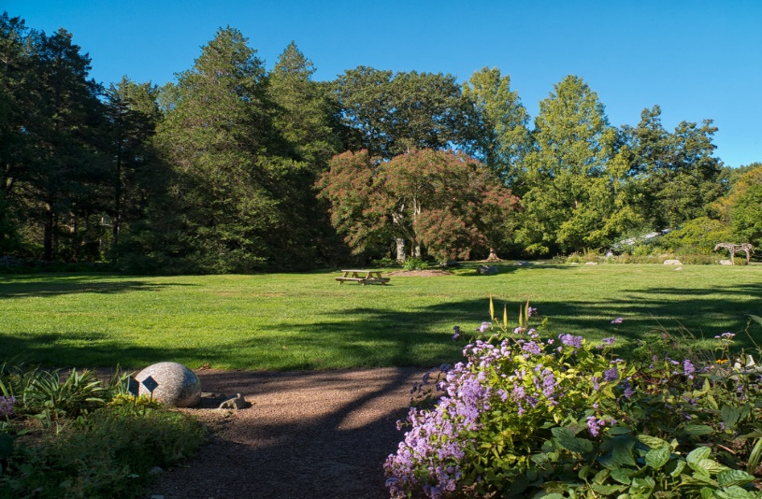
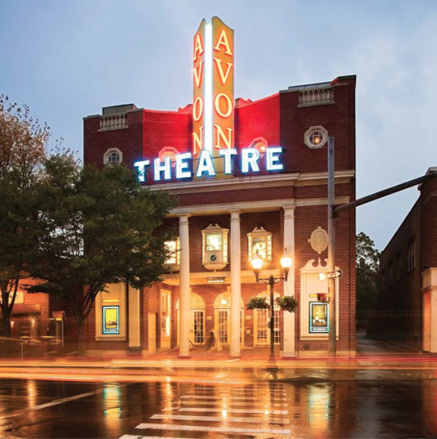
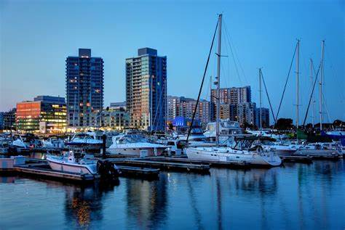
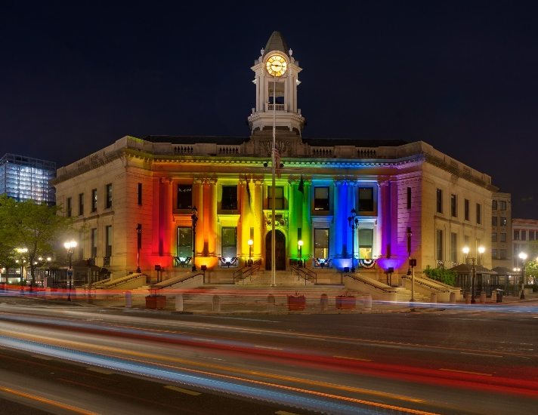
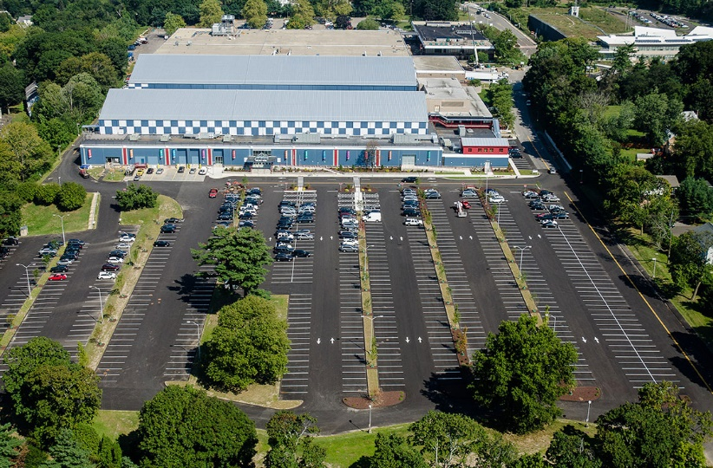
City of Stamford
March 9th

Slide 2
Recreation services Budget Overview/Summary FY’s 21-22 & 22-23 To Date

Slide 3
Services Overview/summary

Slide 4
Services overview/summary
Proposed FY 22-23 Budget $3,388,791 = (-$65,491) or (-2%)
* Offsetting Program Revenue $1,754,200 = (+16%)
* True Cost to City $1,634,591 or 0.07 cents on every Operations $50+ Budget dollar.
* No Capital Expenses
* FY 22-23 Staff
Recreation Services Supt.
2 Assistant Supt.’s of Recreation
1 Recreation Supervisor
1 Recreation Leader
1 Account Clerk II
1 Customer Service Specialist

Slide 5
Recreation services mission

Slide 6
Recreation services mission
It is the mission of the Stamford Recreation/Leisure Services Department to create inclusive, comprehensive and diverse recreational opportunities that build community and enhance residents’ quality of life by developing active and passive programs, classes, trips, special events, leagues, and tournaments.

Slide 7
Program functions

Slide 8
Recreation services program functions
The Leisure Services Administrative unit provides general administrative support to the Leisure program units including clerical services and supplies, facilities scheduling, allocation and direction of staff, long and short range planning, and coordination of services with other units of government.
The Star Center formerly the Our Lady Star of the Sea elementary school is now a building for Stamford Recreation Services youth and some evening adult programming. The facility perfectly offers plenty of parking, outside play areas, classrooms and a gym/café/stage. In addition it is conveniently located within a short walking distance to West Beach. Classes after school and early evening are held along with a popular 8 week summer camp. Programs are very well attended and the summer camp sells out every year.
Special Needs Recreation provides diverse, quality recreation programs and activities for developmentally disabled members of the Stamford community, no matter what their ability. This includes adaptive services for special needs children to participate in summer camps, school vacation programs, as well as all after school programs with certified trained staff. In addition, this account provides for the same adaptive services necessary for disabled adults to participate in recreation programs. It is our mission to maintain an inclusive environment for our residents and to comply with the federally mandated Americans with Disabilities Act.

Slide 9
Recreation services/functions con’t
The Aquatics staff provides lifeguards at Stamford's four public beaches and two pools, and coordinates use of public facilities for swimming classes and recreational swimming. As a waterfront community we believe it's imperative to offer swim lessons throughout the year to ensure that our local children can swim, and to train new Lifeguard candidates. Aquatics hires, trains and supervises a year-round lifeguard staff, youth and adult swim lessons, and a public open swim program.
Subsidized programs and events provide positive quality of life local experiences for children, families and seniors to enjoy. Examples include the Tram Drivers at Cove Island, the Halloween event, Hay Ride with Santa, and the Easter event and parades and events where our costume characters entertain.
Fee Supported Programs offer safe and quality summer day camps and playgrounds, vacations camps, pre-school, after school and enrichment programs to Stamford youth. This program provides for the organization, supervision and coordination of partially fee-supported youth programs. Revenue is collected, but does not cover the indirect costs to operate some of these programs. This includes all non-Star Center elementary and adult programs, all summer playground and day camps, winter and spring vacation camps, open gyms, ski trips, crafts, pre-school classes, computer, fitness, youth sports, arts, music, and, dance programs, etc.
The Self-Sustaining programs budget provides for the organization and supervision of adult sports leagues, programs and trips, in which revenues completely cover the direct cost of all expenses. All programs in this account are 100% self-supported via team registration fees. This program organizes and supervises the adult sports leagues of flag football, kickball, basketball, indoor soccer, beach volleyball, indoor volleyball, and softball; which provide residents and local corporations and businesses with good fun, comradery and organized athletic competition and recreation. Each adult sport in this budget is covered 100% by user fees.

Slide 10
Recreation services/org chart

Slide 11
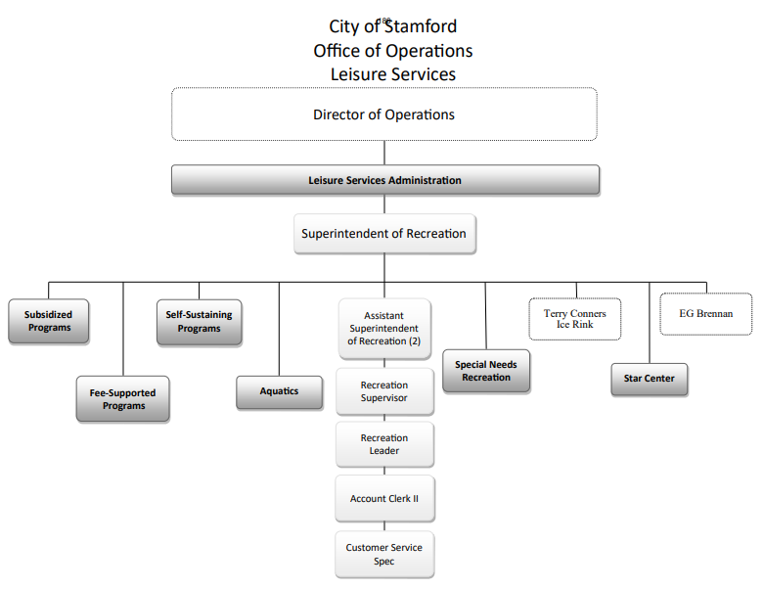
Recreation services/org chart

Slide 12
Staff/Recreation Superintendent
Recreation Superintendent
The Recreation Superintendent is the administrative manager over the Recreation Services Division, the Terry Conner's Ice Rink, and E. Gaynor Brennan Golf Course. The position manages 17 full time positions, approximately 500 seasonal staff, and revenues of approximately $8 million dollars per fiscal year. The Superintendent leads, manages and oversees the day to day business, short and long term strategic planning of recreational programs, collaborations and services in a variety of youth and adult recreation, sports leagues, camps, swimming skating, hockey, and golf. Facility oversight of the rink and golf course including maintenance needs. The Star Center building and the schedule of the Lathon Wider gym. Works closely with the Parks Manager on field and park needs for recreation. Approves all school use beach permits. Also includes all third party permitted field use organizations. Work includes budgeting (operating and capital), accounts receivable, payable, personnel issues, policy development and enforcement, processes, software, purchasing bids/RFP’s, communications, marketing, contracts, legal issues/waivers, liability, State laws, etc. There is a high degree of internal and external staff and public contact including elected officials, appointed officials, department customers and the general public. Operations run year round 7 days per week. Position also advises on all Parks Capital planning, design and development, and leads the City annual Fireworks team, RFP and vendor relationship. The position also is the staff liaison to the EGB Golf Commission and the Parks & Recreation Commission. Serves on the Internal Events Committee.

Slide 13
Recreation staff
Assistant Supt. of Recreation/Youth - provides all administrative program development and management for summer day camps, and all recreation programs, trips and special events for children from ages 2 thru 12 predominately. Programs include sports, arts, crafts, cooking, STEM, music, fitness etc. Oversight of the Star Recreation Center, software program registration data input, prepares the seasonal brochure of programs, works with BOE on after school grant programs. Runs some adult fitness and bus trips.
Assistant Supt. of Recreation/Adults – provides all administrative adult league management, vendor revenue sharing contract with youth sports camps , aquatics (swim lessons and Lifeguards school year and summer at beaches), and park field permitting. Also includes hiring drivers and scheduling the Cove Island Tram and scheduling and programming the Lathon Wider gym. Keeps close contact with the Parks Dept. on field scheduling/maintenance needs.

Slide 14
Recreation staff con’t
Recreation Supervisor – assistant to Asst. Supt. of Recreation/Youth
Recreation Leader – assistant to Asst. Supt. of Recreation/Adult
Account Clerk II – handles all revenue reports and data reporting. Processes refunds and daily POS reconciliation. Fields front desk phone calls, emails, walk in registrations and various clerical tasks.
Customer Service Rep – handles all accounts payable/recievable, processes daily POS reconciliation. Fields front desk phone calls, emails, walk in registrations, and various clerical tasks. Assists professional staff with program tasks and maintains the online field and event calendar.

Slide 15
Recreation services/program highlights

Slide 16
Program highlights
* Youth Programs
* Star Center – Proposed expansion of facility use and lease extension at no increase
* Wait lists for AM Stay & Play and After School Club.
* 90% of programs run here with registrations from all over the City.
* See Star Center Annual Report.
* Summer Camps – 7 sites with a max capacity of 1200 children. Sports, Arts, Crafts, Games, Swimming & Field Trips.
* Registrations and camps are in high demand/wait lists as we move more past COVID.
* Fees for full pay and low income families.
* Offer on line registration for full pay and walk in appointments (NEW) for those who need additional care and paperwork assistance. Also preempts long waiting lines.
* After School Programs/Special Events – SRS hosts a variety of sports, music, arts, dance, etc. programs during the school year.
* Most programs are held at the Star Center.
* Special events include 3 holiday time themed events for kids and families.
* Kids to Parks Day and Movie Nights

Slide 17
Program highlights con’t
Adult Leagues – Managed by Recreation.
Basketball
Beach Volleyball
Kickball
Indoor Volleyball
Softball
Flag Football
Adult Independent Permitted Leagues
Soccer - 4 Stamford teams/Regional play
Rugby – 1 Stamford practice team
Over 30 Baseball – 2 Stamford teams/Regional play
Cricket – 3 Stamford teams/Regional play
Bocce – 8 to 10 teams in a Stamford league

Slide 18
Program highlights con’t
Field Permitting – Permits for all sanctioned youth and adult sports leagues on park fields.
15 organizations = 12,750 permits issued annually
Compliance paperwork consists of insurance cert, roster, policy sign off, invoicing as necessary, sports parking pass allocation and scheduling.
Aquatics – Heroy and Westhill HS Pool
Swim lessons
Lifeguards – hiring, training, scheduling and supervising 50 guards in the summer, and 10 in the fall, winter and spring.

Slide 19
Recreation services/participation metrics

Slide 20
Recreation services/participation metrics
FY 19-20 FY 20-21
Star Center 2316 1,914
Summer Camps 1051 927
Aquatics 55 0
Sports Camps/Vendor Programs 847 832
Adult Leagues Teams 168 260
Tournaments 25 27
Field Permits Issued 12,225 12,750

Slide 21
Recreation services/challenges

Slide 22
Recreation services/challenges
Meet program demand/lack of space
Current number of staff is at maximum capability to grow.
Recruiting and retaining seasonal staff (Lifeguard, Counselors, and Para Educators)
School space use and cost limitations both in school year and summer
Minimal City pool availability both indoor and outdoor
Rising cost of minimum wage
Lack of active athletic field space including lighted fields

Slide 23
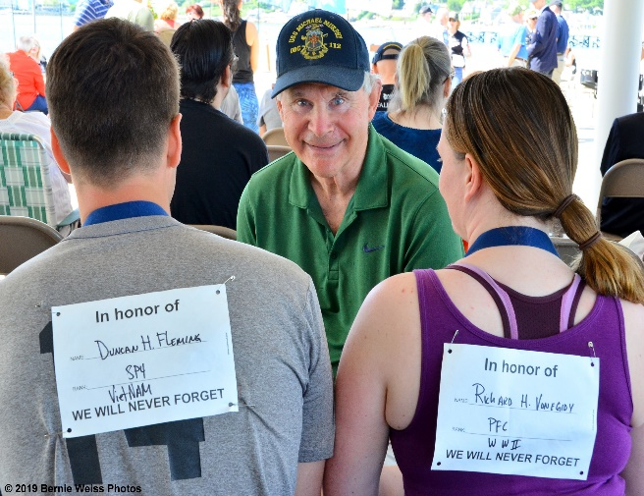
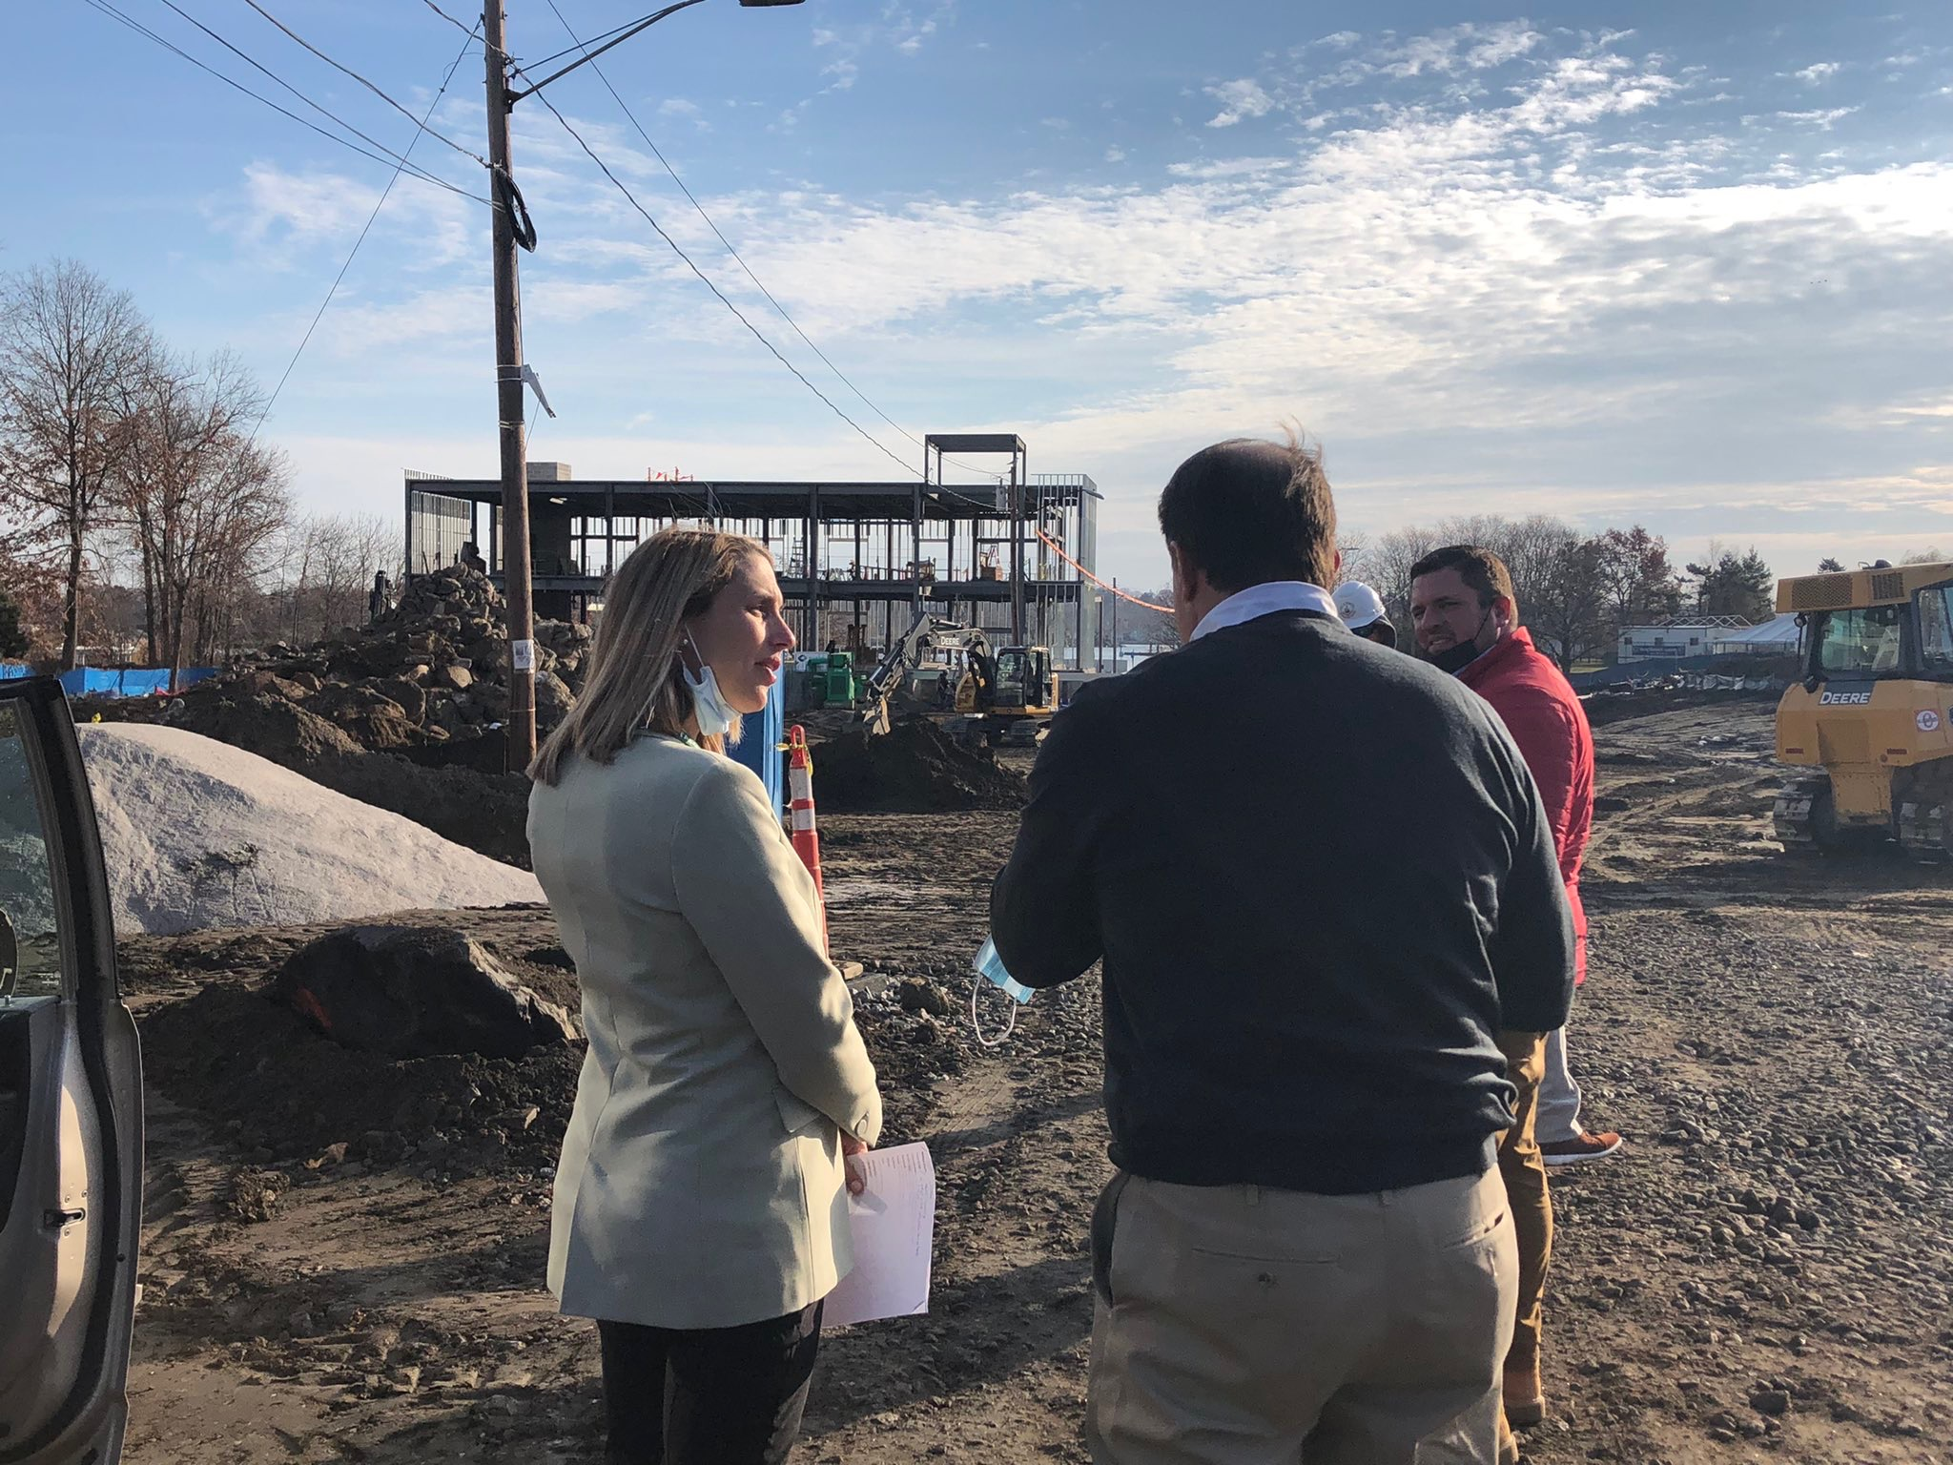
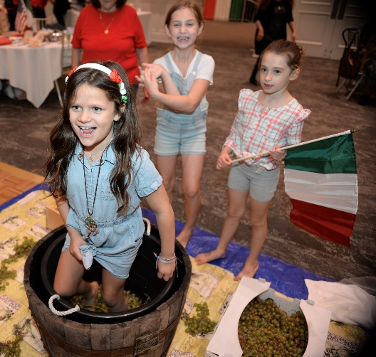
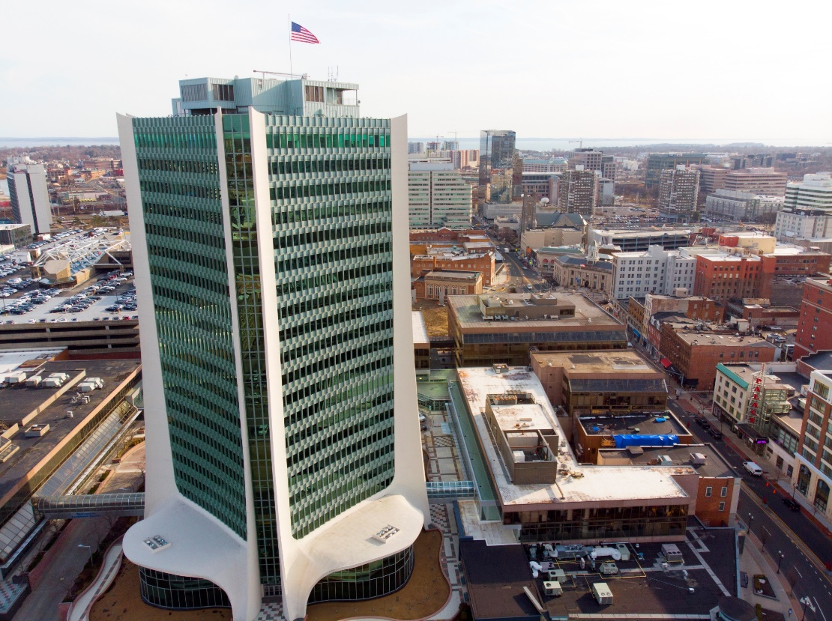
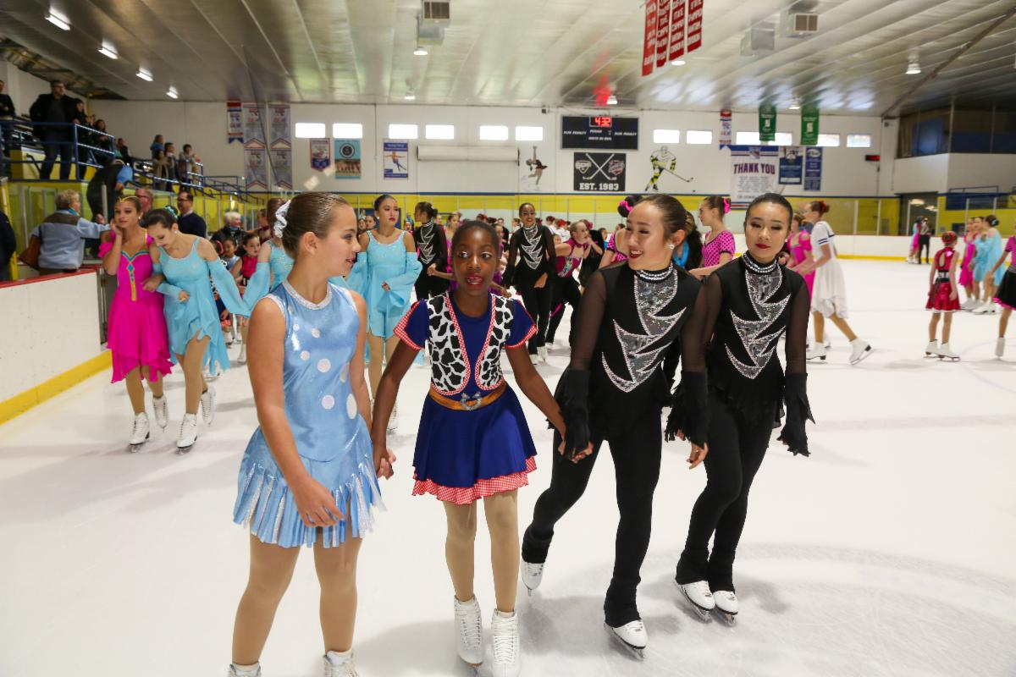
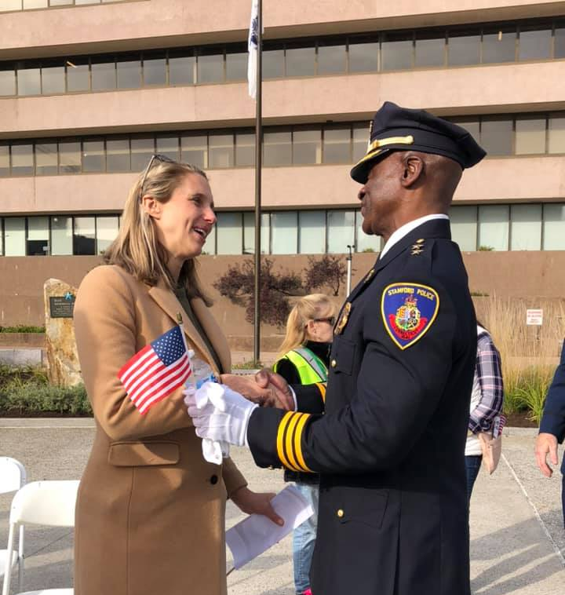
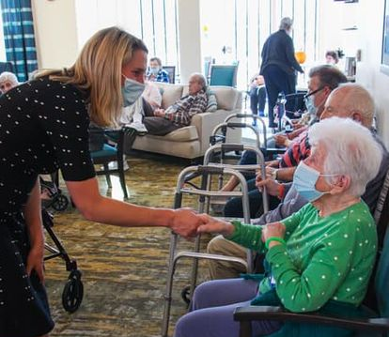
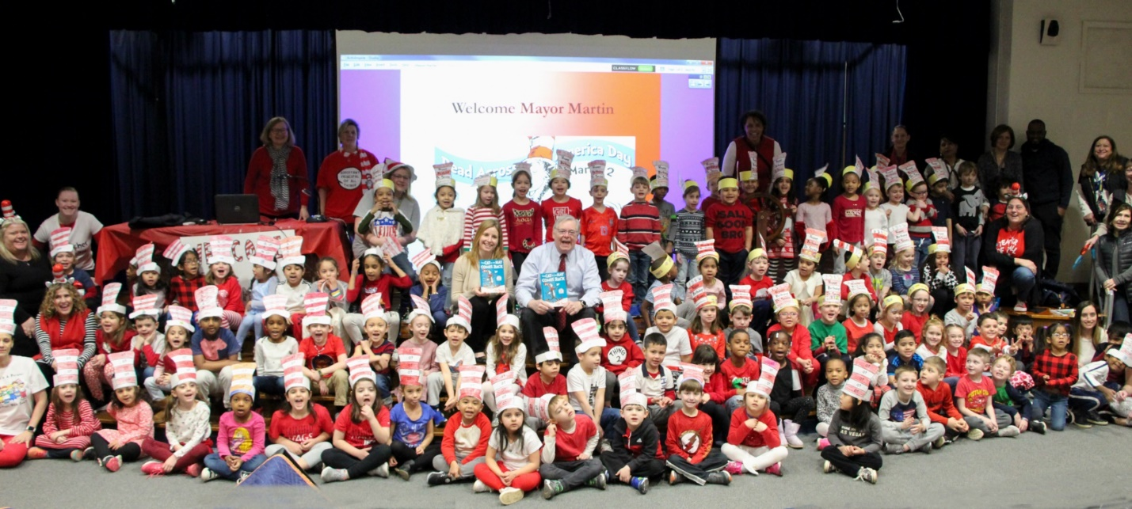
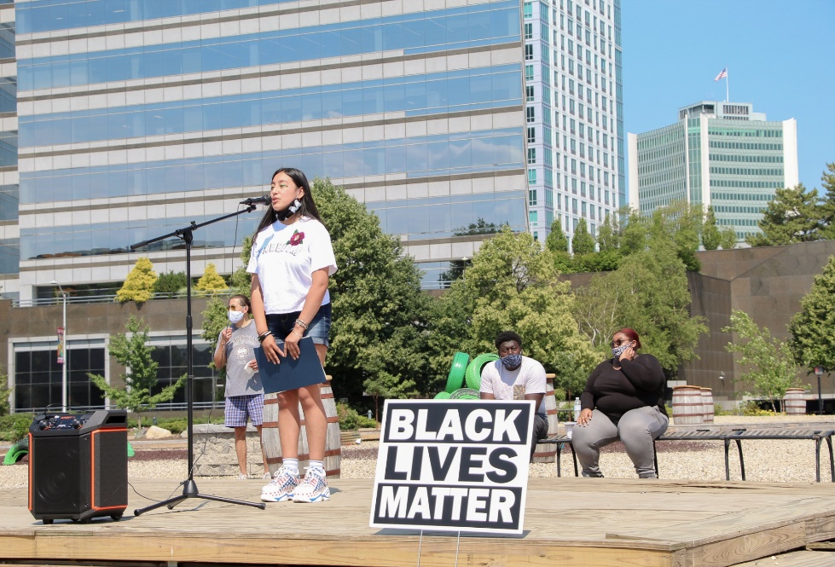
STAMFORD, CT

