Slide 1
FY 2022/23
Terry Conners Rink

Slide 2
Department Function
It is the mission of the Terry Conners Rink to provide a superior and affordable community public skating facility for residents and area non residents alike. TCR offers varied skating activities including ; Hockey , Figure Skating , Group Skating Lessons , Synchronized Team Skating , Public Skating Sessions and a Summer Skating Camp. In addition we strive to maintain a clean , safe skating environment and facility at all times.

Slide 3
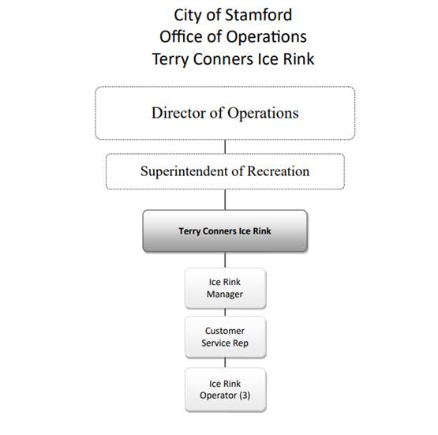
Current Staff structure

Slide 4
Current Staffing details
Ice Rink Manager – Ken’s general summary of duties include; Under the general direction of the Superintendent of Parks & Recreation , manages and supervises a full service ice rink; plans , organizes and supervises maintenance , programming , scheduling , budgeting and fiscal matters pertaining to the rink; provides training to staff as needed , orders or otherwise procures all equipment and supplies needed to maintain the ice rink; contacts and schedules vendors for any needed repairs around the facility ; assists staff when needed for repairs including driving of resurfacer or shift coverage.
Customer Service Specialist – Lisa’s general summary of duties include; customer service, point of sale, lesson and camp registrations, scheduling and maintaining camp and lesson enrollments. All revenue reporting, purchasing and inventory of office supplies. Website input and maintenance; party and group scheduling. Seasonal employee supervision and training; All brochure production and mailings; H.TE. cash receipts and requisitioning for purchase orders; Backup ice rental scheduling and Kronos editing. Sends all customer invoices and processes payments of same.
Ice Rink Operator ( 3 ) – Rich / Mark / Eugene respectively , the ice rink operators duties are as follows ; under the direction of the ice rink manager monitors the rinks ice refrigeration , dehumidification and heating systems ; maintains all area’s throughout the facility , performs ice maintenance and operation of ice resurfacer ; performs general maintenance throughout the facility , opens and closes the rink as needed and provides assistance as needed to customers ; keeps inventory as requested and other related duties
Seasonal Personnel – Consists of a Group Skating / Summer Skating Camp Director , Skating Instructors for group lessons and summer skating camp , Custodial/Maintenance help , ice rink operators , skate monitors , skate rental workers and cashiers.

Slide 5
Changes for Fiscal Year 2022/23
More emphasis on seeking revenue outside of ice related activities in the form of finding local businesses to advertise at the rink along it’s dasher boards surrounding the ice surface.
Assuming we will be operating in a post covid environment we can get back to hosting events as in years past and having our year to year user groups maintain a consistent schedule.

Slide 6
Capital Budget Projects
We have no capital projects lined up for fiscal year 2022/23
In 2021/22 Two capital projects were completed , the latter being a rinkwide comprehensive fire/smoke/ammonia detection/alarm system. The former being the replacement of the rinks 2 compressors , installation of a ventilation system and installation of a computerized monitoring system.
These infrastructure upgrades increase the rinks overall safety and assist in maximizing operating efficiency.

Slide 7
Our Challenges/Changes for 22/23
Increasing our Group Skating Lessons enrollment
Using Social Media Platforms to better broadcast rink programming and events
Strategically ordering supplies for projects to improve the rink in the face of inflated freight costs

Slide 8
21/22 Highlights and Lowlights
Throughout the last 2 years up until a month ago we have had Covid protocols to follow , both local and state , as a recreational facility the protocols were stricter and lasted longer. We were under on ice and building capacity restrictions which limited our ability to generate revenue.
Covid cancelled tournaments and competitions normally held at TCR including the Synchro Open the last two Decembers which draws synchronized skating teams from up and down the east coast and brings much commerce to Stamford.
TCR closed multiple times due to weather , twice due to the Omicron covid variant as a test site was opened in Cove Island parking lot and created massive lines all the way to Post Rd. and St. Mary’s church respectively so rink patrons could not make it in and once due to a deceased person being found near the Cove marina.
In March we did have a Basic Skills and Ice Dancing Competition take place with skaters all the way from Florida participating.
Also in March we were host to a CIAC Division 1 high school semi final game that drew close to 1,200 spectators.
2 Capital Projects were completed
Our Summer Skating Camp has increased every year ( besides covid years ) since it’s beginning in 2010

Slide 9
Additional Facts and Figures
 | 2019/20 | 2020/21 | 2021/22 | 2022/23
Revenue | $711,835 | $862,348 | $832,011 ytd projected$1.25m | $1.3m est
Expenses |  |  | $1.2m est | $1.198m est
Group Lessons | 812 skaters | 341 skaters | 660 skaters ytd projected 850
Summer Skating Camp | 456 campers $108,011 | 278 campers $77,570 | 403 campers $116,949

