Slide 1
677 & 707 Washington Boulevard
Signage Rights Transfer Application
Stamford Washington Office, LLC & World Wrestling Entertainment, Inc.
Stamford Zoning Board
Monday, February 28, 2022

Slide 2
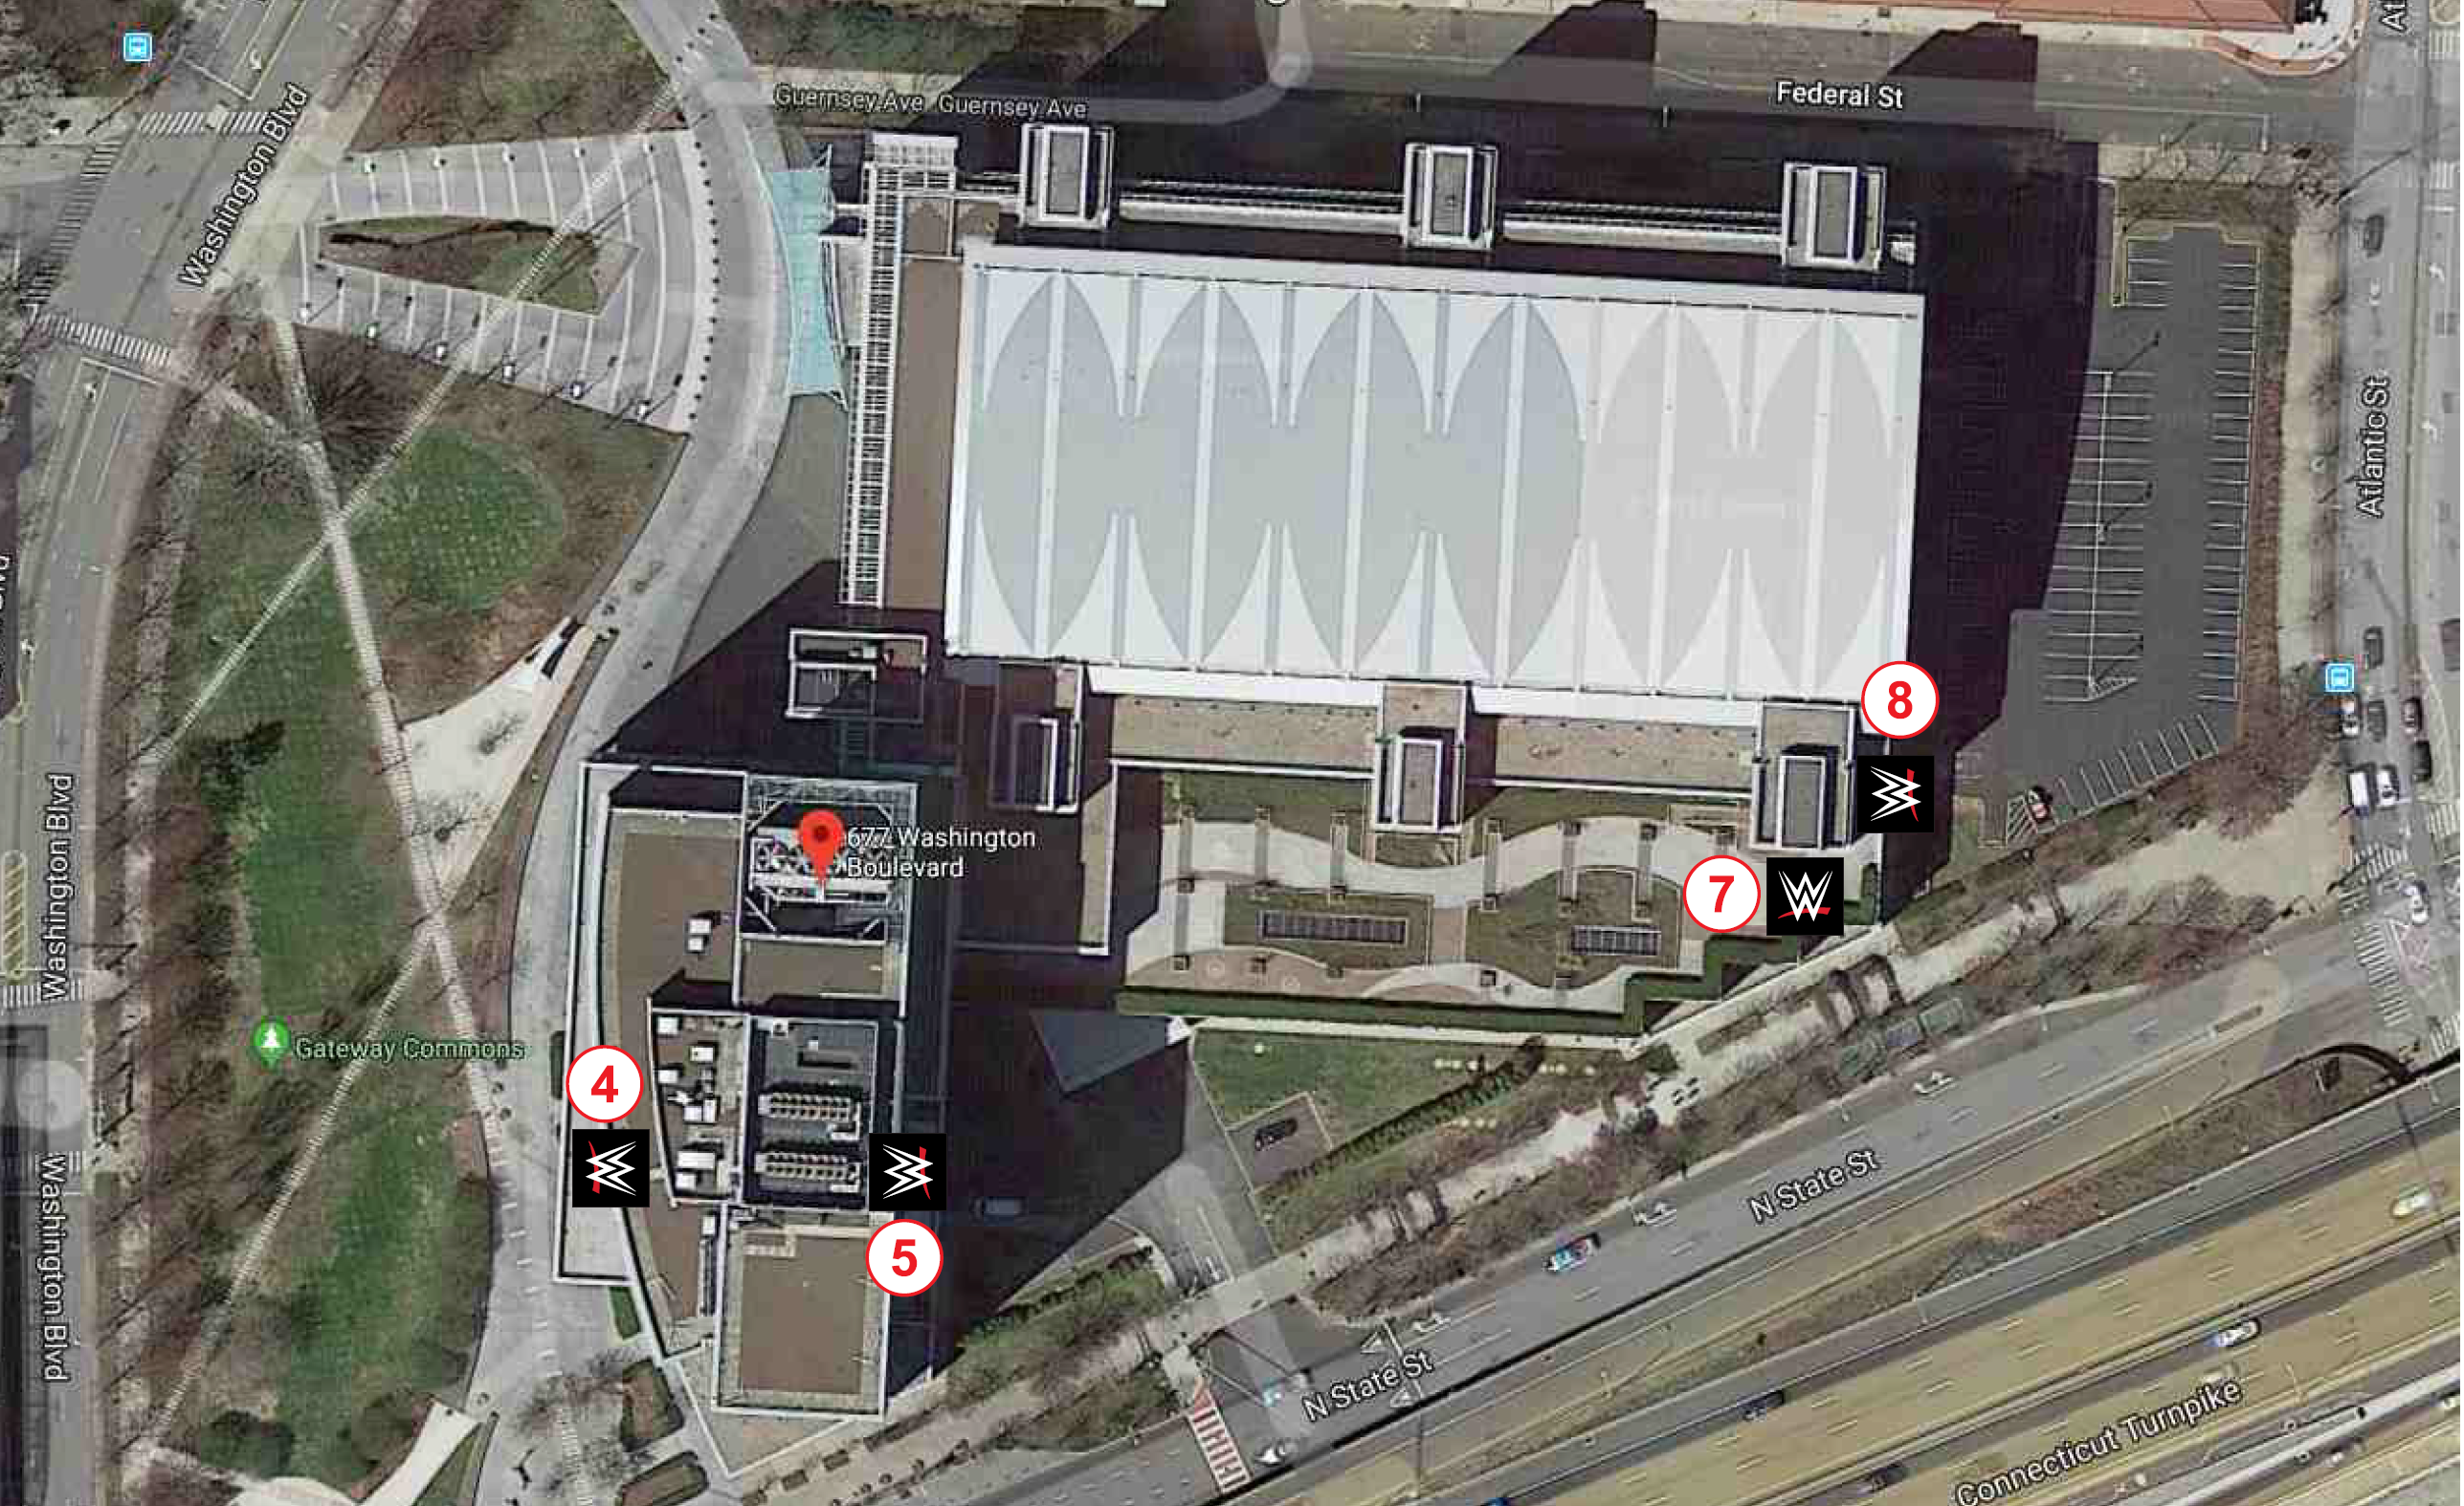

Slide 4
Signage Rights of Applicants
Building Frontage | Permitted in CC Zone | Approved | Proposed | Remaining
Federal Street (North) | 330± SF | 196± SF | None | 330± SF
Washington Boulevard (West) | 822± SF | 641± SF | 541± SF | 281± SF
State Street (I-95) (South) | 688± SF | 554± SF | 358± SF | 330± SF
Atlantic Street (East) | 643± SF | 627± SF | 737± SF | (94 SF)*
This Application proposes transferring 94 square feet of signage rights from the Federal Street (North) frontage to the Atlantic Street (East) frontage

Slide 5
Signage Rights of All Tenants Following Proposed Transfer of Signage Rights
Federal Street (North) | Washington Boulevard (West) | State Street (I-95) (South) | Atlantic Street (East)
NONE | WWE - 196± SF KPMG - 115± SF Future - 115± SF Future - 115± SF TOTAL: 541± SF | WWE - 196± SF Address - 162± SF TOTAL: 358± SF | WWE - 196± SF KPMG - 115± SF Future - 115± SF Future - 115± SF SUBTOTAL: 541± SF WWE - 196± SF TOTAL: 737± SF

