Slide 1
Stamford ERP Project
Board of Finance
Project Update
July 14, 2022
Innovating Since 1641

Slide 2
Agenda
Progress-to-date
Project Schedule
Current Activities
Budget Status
Breadth of the Project
Review Open Issues and Risks
Change Order Approval Request

Slide 3
Progress-to-date

Slide 4
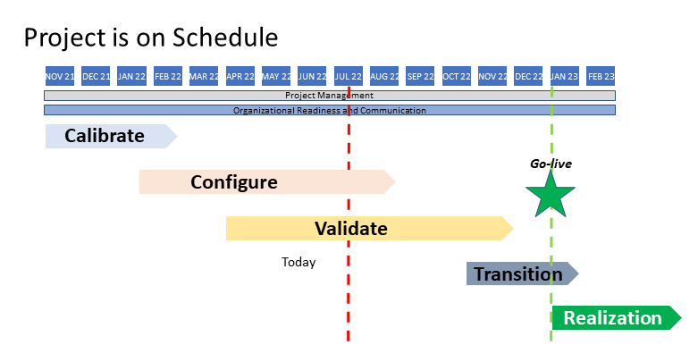
Project Schedule

Slide 5
Current Activities
Conference Room Pilot 2 (CRP2)
Stamford team hands-on configuration testing
Scripted tests – over 200 scripts
No converted data
No interfaces
Multiple 3-hour sessions for each module
Purpose is to confirm the configuration is as expected based on
Configuration Workbooks
Configuration Documents
CRP1 – conducted by Sierra-Cedar
Initial hands-on experience for the Stamford team
Scheduled from June 15 – July 13
The next major activity is System Integration testing starting in mid-August

Slide 6
Project Budget Status
Estimated Capital Cost by Fiscal Year
Cost Category | FY 21/22 | FY 22/23 | FY 23/24 | FY 24/25 | Total Budget | Adjustments | Actuals-to-Date | Unexpended | Encumbered | Available Balance
ERP Implementation | $1,997,500 | $1,402,500 |  |  | $3,400,000 |  | ($1,772,500) | $1,627,500 | $1,627,500 | $0
L&P Implementation |  | $470,000 | $509,000 |  | $979,000 |  |  | $979,000 | $979,000 | $0
Cashiering Implementation | $88,500 | $53,260 |  |  | $141,760 |  | ($41,020) | $100,740 | $100,740 | $0
ERP Implementation Contingency |  | $100,000 |  |  | $100,000 |  |  | $100,000 |  | $100,000
Total Implementation | $2,086,000 | $2,025,760 | $509,000 | $0 | $4,620,760 | $0 | ($1,813,520) | $2,807,240 | $2,707,240 | $100,000
ERP Software Subscriptions | $198,100 | $330,013 |  |  | $528,113 |  | ($275,390) | $252,723 | $252,723 | $0
L&P Subscriptions |  | $123,525 | $164,700 | $137,250 | $425,475 |  |  | $425,475 | $425,475 | $0
CanAm Subscriptions | $16,635 | $49,905 |  |  | $66,540 |  | ($66,540) | $0 | $0 | $0
Total Subscriptions | $214,735 | $503,443 | $164,700 | $137,250 | $1,020,128 | $0 | ($341,930) | $678,198 | $678,198 | $0
ERP Travel Expense (estimated) | $50,000 | $35,000 |  |  | $85,000 |  |  | $85,000 |  | $85,000
L&P Travel Expense (estimated) |  | $35,000 | $50,000 | $25,000 | $110,000 |  |  | $110,000 |  | $110,000
Cashiering Travel Expense (estimated) | $10,000 | $15,000 |  |  | $25,000 |  | ($1,802) | $23,198 | $23,198 | $0
Total Travel | $60,000 | $85,000 | $50,000 | $25,000 | $220,000 | $0 | ($1,802) | $218,198 | $23,198 | $195,000
ISG Project Management | $399,000 | $399,000 | $399,000 | $280,000 | $1,477,000 |  | ($631,750) | $845,250 | $845,250 | $0
ISG Consulting Conversion & Interface Resources | $208,000 | $92,000 |  |  | $300,000 | $146,400 | ($96,700) | $349,700 | $349,700 | $0
City Overtime | $200,000 | $450,000 | $200,000 | $150,000 | $1,000,000 |  |  | $1,000,000 |  | $1,000,000
Equipment Acquisition | $118,000 | $66,000 | $0 | $0 | $184,000 |  |  | $184,000 |  | $184,000
Fleet Maintenance and Fuel Dispensing Software | $592,000 | $0 | $0 | $0 | $592,000 |  |  | $592,000 |  | $592,000
Ceridian Dayforce Integration |  |  |  |  |  | $80,000 |  | $80,000 |  | $80,000
Contingent 3rd Party Consulting - Innovations |  | $750,000 | $750,000 | $500,000 | $2,000,000 | ($226,400) |  | $1,773,600 |  | $1,773,600
Total Other | $1,517,000 | $1,757,000 | $1,349,000 | $930,000 | $5,553,000 | $0 | ($728,450) | $4,824,550 | $1,194,950 | $3,629,600
Contingency |  |  |  |  | $500,000 |  |  | $500,000 |  | $500,000
Total ERP by FY | $3,877,735 | $4,371,203 | $2,072,700 | $1,092,250 | $11,913,888 | $0 | ($2,885,702) | $9,028,186 | $4,603,586 | $4,424,600

Slide 7
Breadth of the Project

Slide 8
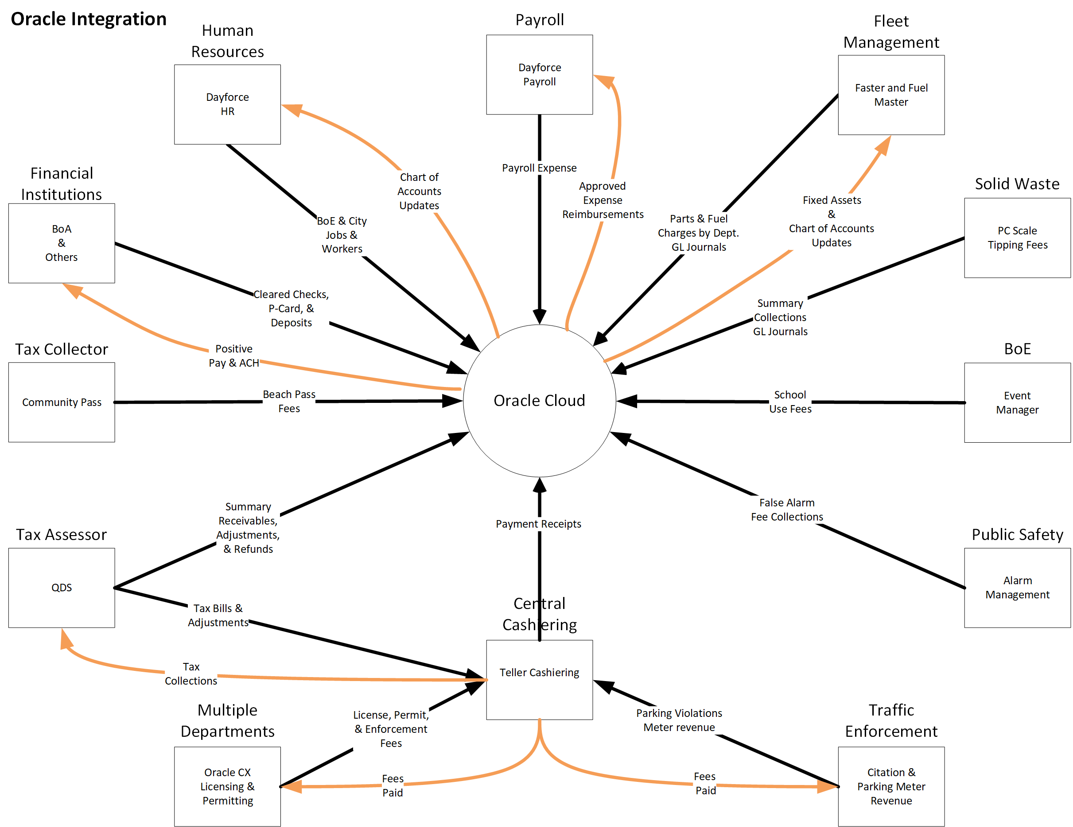
The Enterprise Nature of the Project
Each Integration Requires
Analysis
Design
Functional Specification
Technical Specification
Development
Testing
Inbound from City systems to Oracle
Outbound from Oracle to City systems

Slide 9
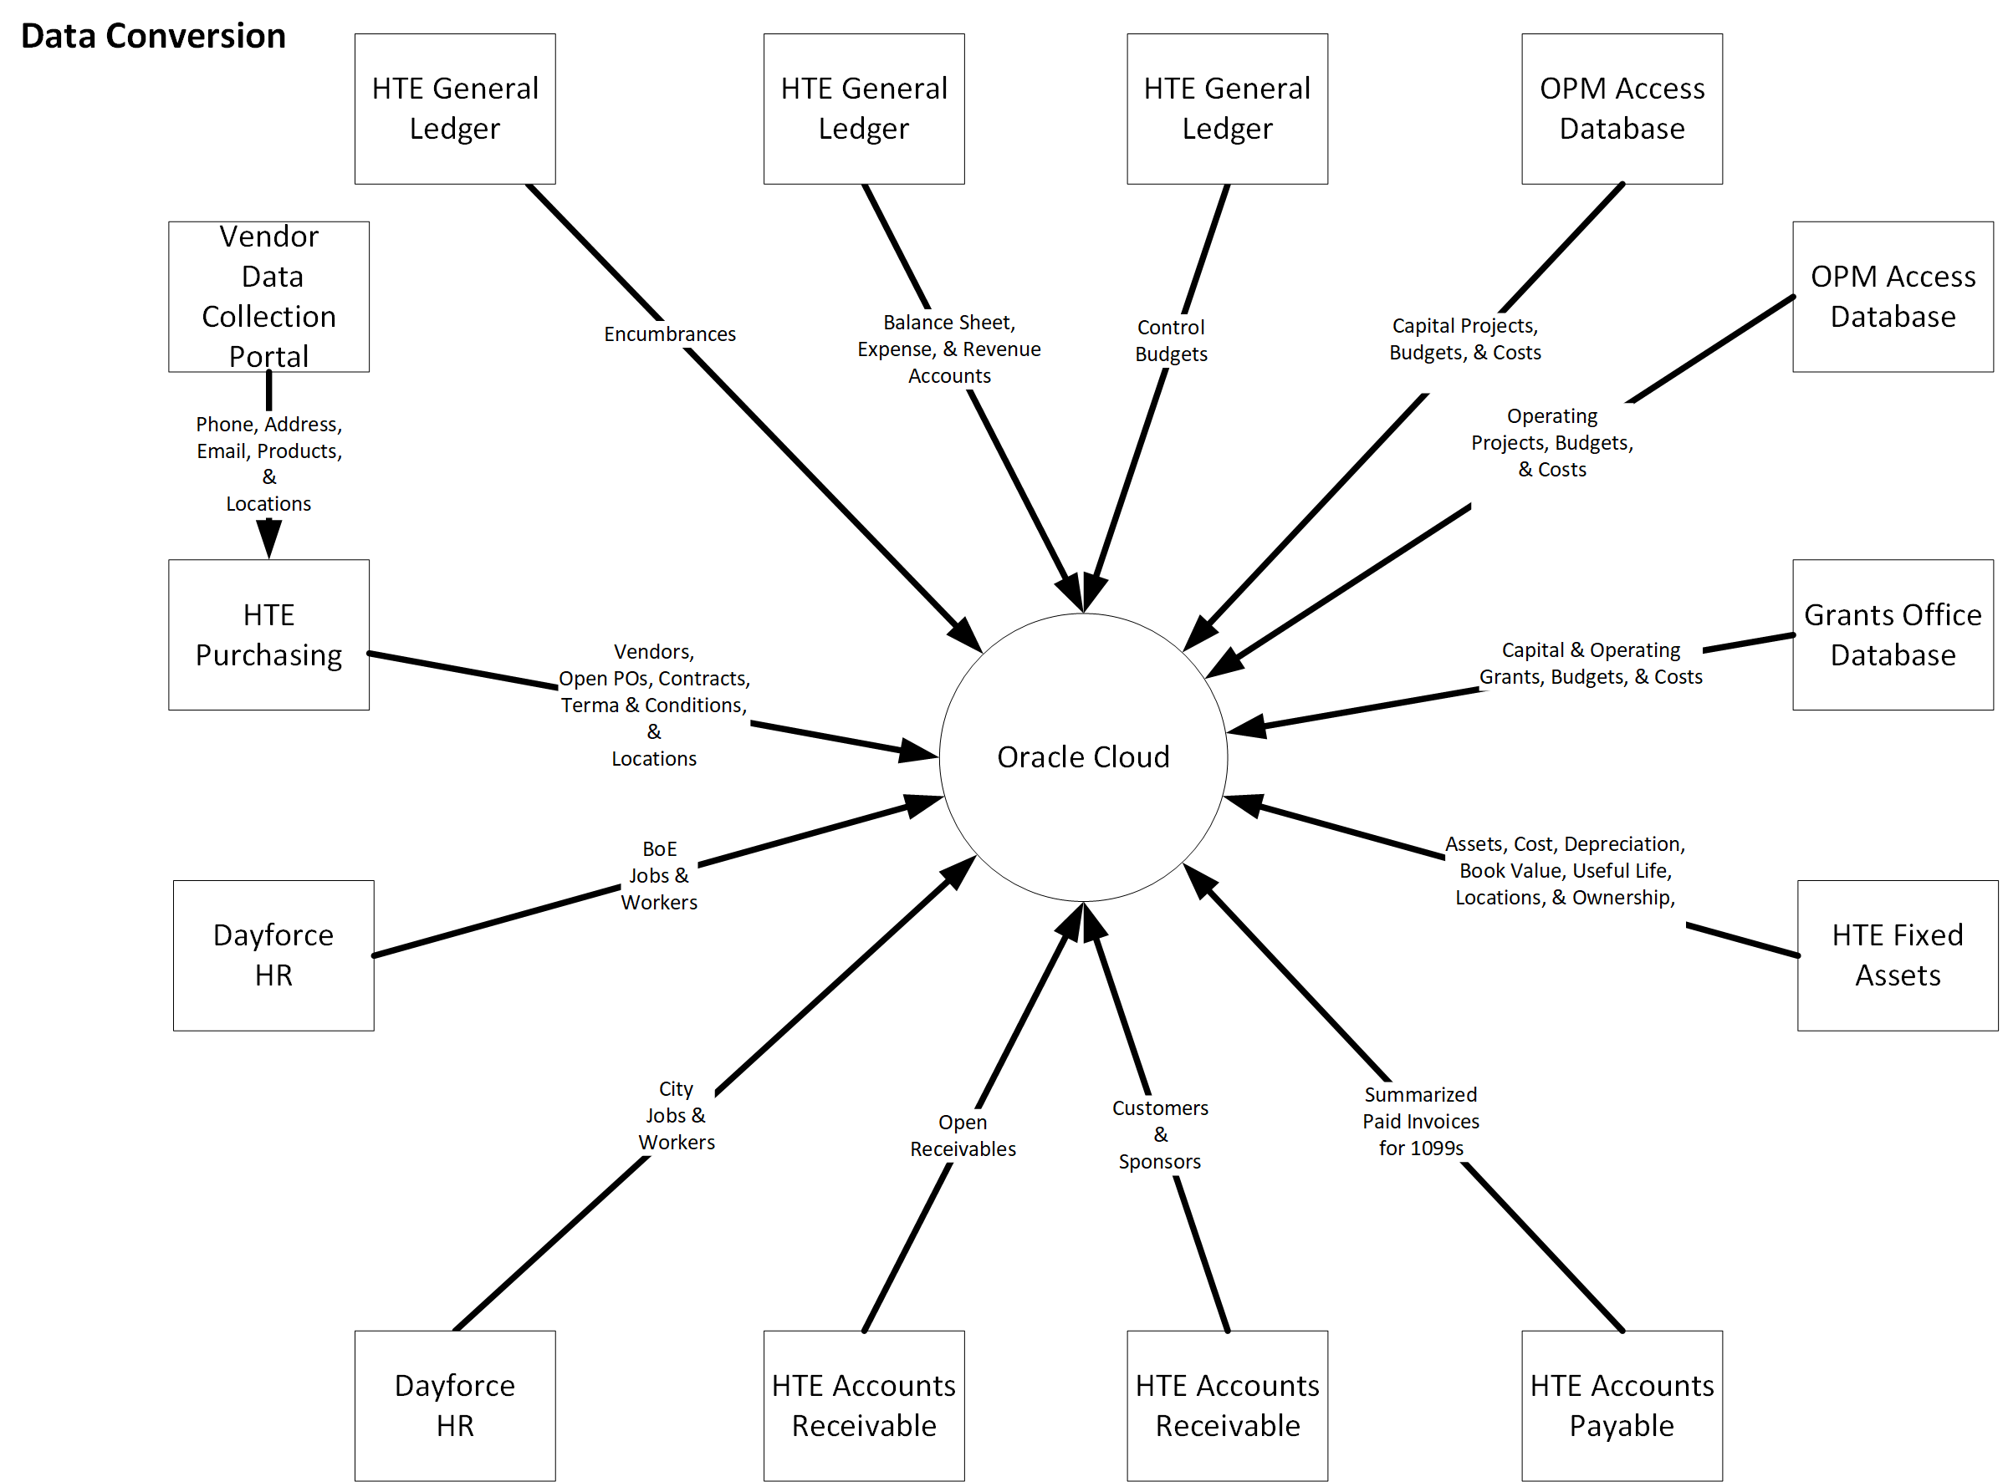
Continuity of Data
Each Integration Requires
Analysis
Design
Functional Specification
Technical Specification
Development
Testing

Slide 10
Risks and Issues

Slide 11
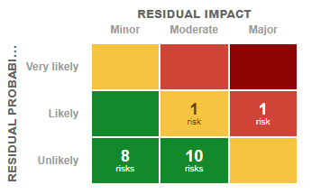
Key Risk – Ceridian Dayforce Integration
Risk Factors
The Dayforce system was implemented as one system with separate high-level configurations for BOE and the City resulting in one system used in two different ways
Some implemented workarounds make it more difficult to make the required changes for example, embedding the sub-department in the job title
In addition, Dayforce is inflexible and has difficulty handling routine chart of accounts changes
The level of effort involved in the changes necessary to integrate DayForce with Oracle Cloud may result in the integration not being ready for System Integration Testing
Every integration activity is twice the effort – once for BOE and once for the City
Currently working on the Ceridian change order for this work
Mitigating Activities
Stamford is using an existing SOW with Ceridian
Ceridian has assigned a project manager
BOE and the City HR and Payroll managers have been involved in the planning
A project plan will be developed to manage the process.
Contingency plan is to develop a traditional crosswalk for the interface

Slide 12
Key Risk – Ceridian Dayforce Integration
Ceridian Change Order
For completion of the work to more fully integrate Ceridian with Oracle
SRS #1 changes to the Ceridian chart of accounts
SRS #2 changes to the payroll interface extract files
An additional test environment to isolate this work from other ongoing testing by HR and Payroll
This work will be funded from the ERP project.
Change order amount
Modification of the HR / Payroll system*: $69,480
*Includes $14,400 contingency

Slide 13
Questions?

