Slide 1
CITY OF STAMFORD OFFICE OF ADMINISTRATION Sandra L. Dennies Director of Administration March 8, 2023

Slide 2
Office of Administration
Director of Administration
Office of Policy and Management
Tax and Collection
Purchasing
Risk Management Fund
Grants Administration
Assessment
Controller

Slide 3
Department Introduction & Brief History
The mission of the Office of Administration is to ensure that Stamford's taxpayers benefit from sound and prudent financial and administrative management.
The Office consists of the following departments: the Office of Policy and Management (OPM), Purchasing, Grants, the Assessor’s Office, the Tax and Revenue Collector’s Office, the Controller’s Office, and Risk Management.

Slide 4
Department Introduction & Brief History
State Your Department’s Strategic Initiatives
for FY2023-2024
First Year Implementation of Enterprise Resource Planning (ERP) Financials and Teller Cashiering Module as well as integration of external systems
Budget, Project Portfolio Management, and Licensing and Permitting Modules of the ERP
Implementation of Enterprise Performance Management (EPM) for budget development

Slide 5
Major Changes
First year of ERP Financials and Project Portfolio Management implementation and training on EPM for budget
Tax and Revenue Services will initiate the use of Teller for current revenue collections on the first floor and will begin to migrate collections from other areas of the Government Center to the first floor
The Oracle Module for Licensing and Permitting will provide status in Building, Engineering, Zoning and Land Use as well as the Health Department to better serve the administering departments and City residents though timely information as well as on-line cash management

Slide 6
Major Changes
ERP-Specific Changes
A new State-compliant chart of accounts has been implemented
Realignment of the coding structure to reflect the City’s organizational structure
Funds
Cost Centers (activity/program)
Accounts (line items)
Configured trees to enforce hierarchical controls and reporting rollups
Organization Tree
Tree Level 3 Office
Tree Level 2 Department
Tree Level 1 Cost Center
Line-Item Tree
Tree Level 3 Major Object
Tree Level 2 Minor Object (line-item)
Tree Level 1 Detail Object

Slide 7
Major Changes
ERP-Specific Changes
Over the past 20 years, the City has become more complex, and the budget has grown from $220 million to $660 million
Controlling the budget at the detail level has become transfer intensive as budget must be moved between very similar accounts
Budgetary control by Minor Object (line-item) has been selected
Grouping of detail accounts into spending categories (minor object) to enable more departmental flexibility and fewer transfers while controlling spending at a responsible level
Accommodates price fluctuations without enabling inappropriate cross-category spending
Grouped by types of line items such as wages, supplies, professional services

Slide 8
Major Changes
ERP-Specific Changes
The budget will continue to be developed and presented by detail account
Spending will continue to be by detail account
Identification of the Minor Object as the Budget Control will allow the system to process payments within the category of the Minor Object regardless of funding availability in the detail account
If a detail account has need for additional funding, another detail account in the same category in that department can provide it
The transfer trigger has changed from detail account to minor category, but transfers will continue to be processed at the detail line level

Slide 9
Major Changes
Major Object | Minor Object |  | Major Object | Minor Object
Wages | Wages |  | Employee Benefits | Employee Benefits
 | Full Time Salary |  |  | Unfunded Retirement Benefits
 | Overtime |  |  | FICA
 | Stipends |  |  | Retirement Benefits
 | Paid Time Off |  |  | Retirement Benefits
 | Accumulated Leave |  |  | Tuition
 | Retro Pay |  |  | Unemployment Comp
 | Other Salary |  |  | Payments to Insurance Fund
Purchased Professional Services | Purchased Professional Services |  | Other Objects | Other Objects
Purchased Property Services | Purchased Property Services |  |  | City Support to BOE
Purchased Other Services | Purchased Other Services |  |  | Professional Development
 | Self Insurance Payments |  |  | Transfer to Other Funds
 | Insurance Premiums |  |  | Reserve for Contingency
Capital Assets | Capital Assets |  |  | Internal Transfers
Miscellaneous | Miscellaneous |  | Supplies | Supplies
 | Community & Cultural |  |  | Utilities & Commodities
 | Volunteer Fire Dept
 | Debt Service
 | Election Expenses
 | Dues and Fees
Supplies | Office Supplies & Expenses
 | Materials & Supplies
 | Program Supplies
 | Street Painting Supplies
 | Processing Chemicals
 | Instructional Supplies
 | Animal Supplies
 | Maintenance Supplies
 | Small Tools & Replacement

Slide 10
Major Changes
ERP-Specific Changes
Purchase Order Carryforward
Purchase orders for goods or services not received as of June 30 of a given FY can be carried forward from one year to the next
As encumbrances in the new year budget
Not in a separate bucket
Unlike current practice, the PO related budget will be carried forward as well
Expenditures on carried forward POs will be more visible than past years
This practice is recommended by the City’s external auditor

Slide 11
Major Changes
ERP-Specific Changes
Accounts Payable
Invoices will be scanned into Oracle by the departments
Departments will confirm the invoices online
Invoices will be electronically routed through workflow
For departmental approvals
Accounts Payable where they will be audited, posted and paid

Slide 12
Major Changes
ERP-Specific Changes
Other Noteworthy Changes
As travel authorizations and expense reimbursement requests are entered into the system, the system will redirect users to the appropriate GSA per diem rates for the travel destination
Project Portfolio Management is an integrated project and grants management module for capital projects, City and BOE grants, and CDBG grants
Funding source-specific controls – bonds, grants, local funding with priorities and percentage splits
No longer a separate database that requires manual intervention to update from the GL
Solid Waste, Recreation, and Cashiering &Tax Collection systems integrated to recognize revenue daily

Slide 13
What are the most significant accomplishments made & challenges faced by the department in the last FY 2021-2022?
Improving service delivery through implementation of the ERP
Improving customer satisfaction (citizens and/or internal customers)
Consolidation of Cashiering Planning
13

Slide 14
FY 2023-2024 Goals
Department goals for FY2023-2024 include those stated as Major Changes as well as those related to implementation of appropriate mill rate to address 2022 Revaluation
Office of Administration Budget Totals $296,115
The only variance is the inclusion of funds to attend GFOA and Oracle meetings.
The Office of Administration will determine one employee to attend each conference.
Funding is the only obstacle to addressing this variance.
Identification of the appropriate individuals to attend that have systems obligations.
Total $5,000 requested for 2 Conferences. Any remaining funds will support CTGFOA Conference Attendance.
14

Slide 15
Department Introduction & Brief History
One of the functions of the Office of Administration is Debt Administration which is the payment of interest and principal on non-self-supporting General Obligation bonds issued by the City.
The funds necessary to fulfill this obligation are transferred to the Debt Service fund for payment. The division also includes the annual transfer of the City match of grant funds.

Slide 16
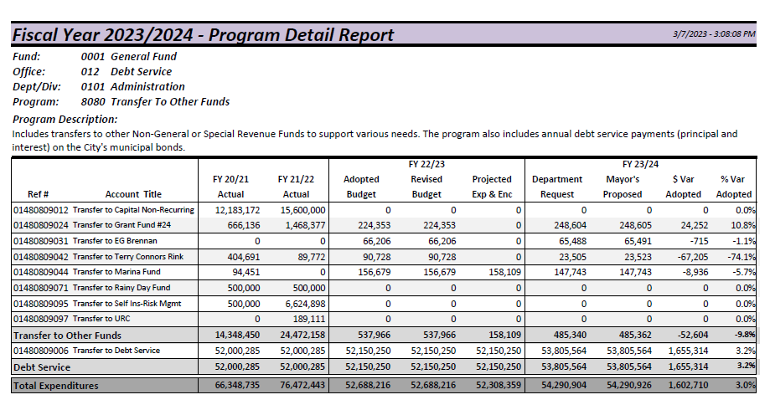
Department Introduction & Brief History

Slide 17
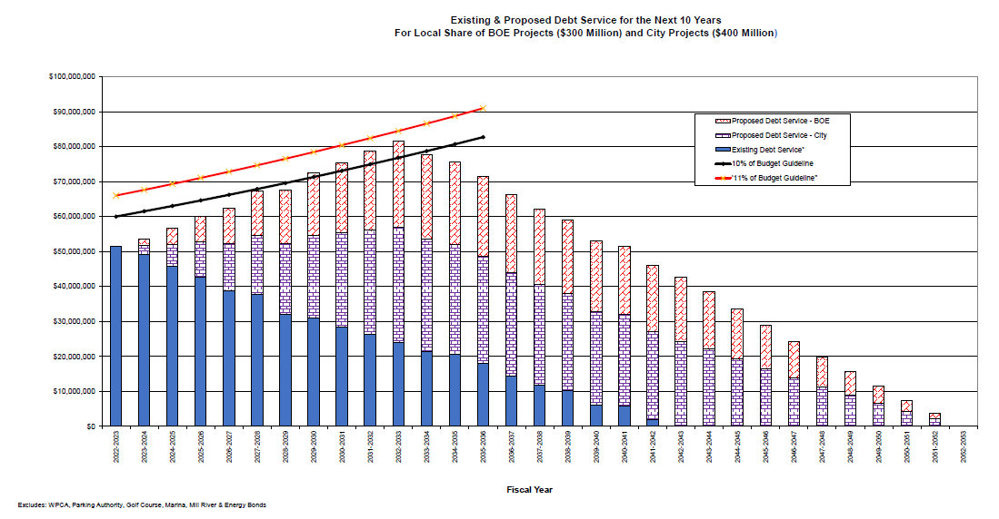
Department Introduction & Brief History

Slide 18
Department Introduction & Brief History

