Slide 1
RISK MANAGEMENT FUND David Villalva Risk Manager March 21, 2023

Slide 2
Department Introduction & Brief History
The Risk Fund is an internal insurance service fund that develops and initiates insurance and self-insurance programs, safety and loss control activities, and claims administration to minimize the financial impact of accidental loss.
Other funds are charged back an annual budgeted expense by the Risk Fund through an allocation based on exposure and actual loss experience.

Slide 3
Department Initiatives – Insurance & Claims
Structure the City’s self-insured loss program and excess insurance coverages through an Enterprise Risk Management Approach
Design, review and approve contractual insurance requirements
Building/Park-Use permit reviews and signoffs
Submit and coordinate claims with insurance adjusters

Slide 4
Department Initiatives – Workers’ Compensation Administration
Coordination of Third Party Administrator over the daily management of claims
Review of injury reports and workers’ compensation claims
Review and reconcile claim payments and expenses
Apply actuarial valuations and analytics in understanding cost drivers

Slide 5
Department Initiatives – Safety and Loss Control
Develop and provide safety training events
Development and maintenance of safety policies and procedures
Accident investigation and root-cause analysis
OSHA compliance and reporting

Slide 6
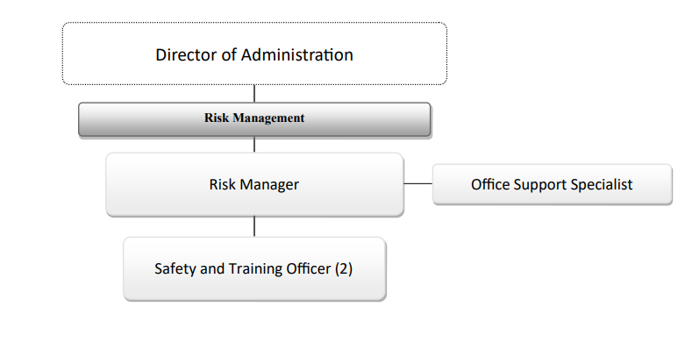
Organizational Chart

Slide 7
Changes and Challenges – Fiscal Year 2023-2024
Self-Insured Loss Payments for Liability Claims and Police/Fire Heart & Hypertension have trended higher. The increase in Liability expense is based on review with the Legal Dept of outstanding claims.
Insurance premium increases reflect a continuing tightening of insurance marketplace and the City’s recent loss history. Property insurance premium projected at a 22% increase and 10% across various other lines of Liability coverage.

Slide 8
Changes and Challenges – Property Premiums Fiscal Year 2023-2024
The increase in insurance premium is driven by a tightening insurance marketplace and the City’s recent loss history. Over the 4-year period from FY19/20 to FY22/23, the City submitted property insurance claims of $8.8M on premiums of $6.2M, for a loss ratio of 142%. (industry norm is 30%-40%)

Slide 9
Accomplishments Made & Challenges Faced
In FY 2022-2023:
Migration to on-line systems for building-use permit reviews/signoffs implemented by City Operations and BOE Facilities departments.
Additional in-house training events by Safety Officers to reduce costs.
Revamping of internal City Risk Management intranet with updated user-friendly instructions, policies and procedures.
Workers’ Compensation claims continue to be a challenge due to aging employee population and medical cost inflation.

Slide 10
Safety Officers
Accomplishments and Goals
Safety Officers’ focus to reduce costs:
Provide in-house safety training events including:
Red Cross – CPR/AED/First Aid
Slips, Trips, and Falls
Blood Borne Pathogens
Fleet Safety, Ladder Safety, Seasonal Laborer Safety
Overexertion
PMT (Physical & Psychological Management Techniques) – restraining aggressive students
OSHA Compliance:
Hazardous Communications
OSHA 300A Log
Safety Awareness, Policies and Procedures:
Updating Government Center Safety Policies and Procedures – Evacuation/Safety/Active Shooter
Updates to Risk Dept Intranet for Employees’ Injury Reporting and the Workers’ Compensation process
Quarterly Safety Newsletter – resources and tips to reenforce a culture of safety

