Slide 1
Stamford WPCA Operating and Capital Budget for FY 23-24
Presentation to
Board of Finance and Board of Representatives Fiscal Committee
March 21, 2023
William Brink, Executive Director
Rhudean Bull, Administration Manager

Slide 2
Stamford Water Pollution Control Authority
Enterprise fund within City
Nine (9) member Board of Directors
Provides wastewater collection and treatment services for sanitary sewered areas of the City
Receives septage from non-sewered areas of City
Provides wastewater treatment for the Town of Darien
Operates and maintains the City’s Hurricane Barrier and three (3) storm water pump stations
Total staff of 47

Slide 3
SWPCA’s Mission
To provide wastewater collection and treatment for the City that meets regulatory requirements and protects the water quality of Stamford Harbor and Long Island Sound, to provide these services in the most cost-effective manner to control costs and the impact on sewer user charges, all while being a good neighbor to those in proximity to our wastewater collection and treatment facilities.

Slide 4
Highlights of Proposed Operating Budget for FY 23-24
No change in services, programs or number of SWPCA staff
Includes reorganization of SWPCA mechanics, with new positions of Mechanic I, Mechanic II and Lead Mechanic assigned to appropriate cost center
Includes energy efficiencies and reduction in methanol use from plant upgrade completed in 2022
Total Expenditures of $28,327,712, an increase of $693,596 or 2.5%
Total Revenue of $29,022,712 an increase of $757,891 or 2.7%

Slide 5
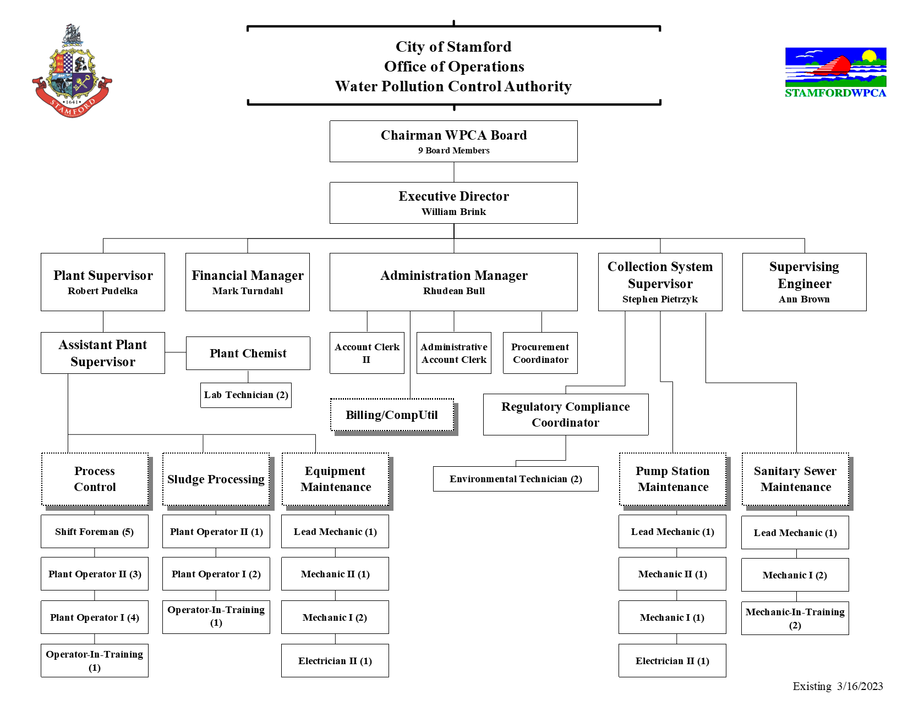

Slide 6
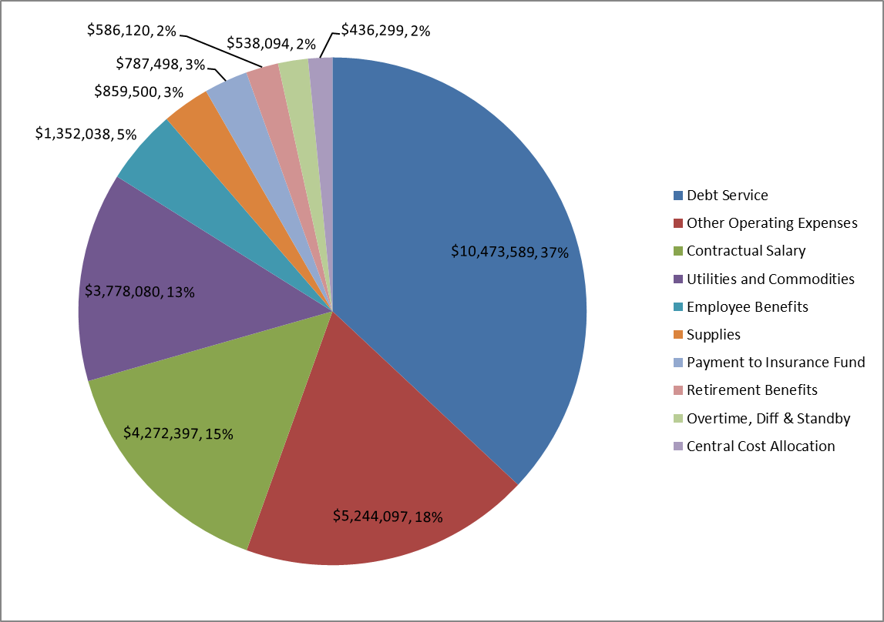
FY23-24 Operating Budget
Debt Service | $10,473,589
Other Operating Expenses | $5,244,097
Contractual Salary | $4,272,397
Utilities and Commodities | $3,778,080
Employee Benefits | $1,352,038
Supplies | $859,500
Payment to Insurance Fund | $787,498
Retirement Benefits | $586,120
Overtime, Diff & Standby | $538,094
Central Cost Allocation | $436,299
Total FY23-24 Budget | $28,327,712
Other Operating Expense: Legal, All Contracted Services, Purchased Property

Slide 7
Major Variances of Expenditures from Prior Year
Contractual increase in wages for operators and mechanics in renewal of IUOE agreement (from 7/1/21) of $213,406
Increase in Active Medical and Payments to Insurance Fund of $217,514 offset by reduction in Pension Fund, OPEB Service Costs and UAL Amortization of ($221,150)
Increase in Sludge Dryer Operating Contract of $151,000 (+7.1%) pegged to increase in CPI and increase in sludge hauling and disposal costs.
Increase in natural gas for sludge dryer of $343,573 (+71%)
Note: Electrical costs stabilized by fixed supply cost contracts through November 2025 (+1.6%)

Slide 8
Major Variances of Revenue from Prior Year
Increase in interest income from cash reserve of $450,000 (+900%)
Increase in connection charges (principal) of $200,000 (15.4%) from new construction
Increase in Darien treatment charge of $219,000 (+11%) based on metered flow
Decrease in Darien capital reimbursement of ($495,000) (-29.5%)
Increase in Sewer Use Fees of $564,420 (2.7%)
Decrease in Aquarion User Charges ($203,920) or (-69.9%)
Aquarion will cease discharge of WTP sludge

Slide 9
Capital Project Requests
001313 Collection System Staff Building $450,000
Existing 1940’s metal building is beyond repair
CP6904 WPCA Major Replacement $820,000
Upgrade final clarifier No. 3 and misc. equipment replacements at WPCF
CP4242 Sanitary Sewer Rehabilitation $865,000
Misc. sewer and manhole repairs, lining sewers and manholes to remove extraneous water identified by infiltration and inflow removal program
CP9270 Sanitary Pumping Station Upgrade $1,050,000
Saddle Rock PS upgrade construction, Alvord Lane PS upgrade design, and misc. pump equipment replacement
C71282 Vehicle Replacement and Repair $50,000
Replace aged vehicles

