Slide 1
City of Stamford
FY 22/23 and FY 23/24 Budget Highlights
March 21, 2023

Slide 2
Total (Active and Retiree)
Expenditures and Revenue
The initial FY 22/23 in force net budget was projected to be $45.4 million
We reprojected the FY 22/23 budget based on the following factors
  An additional 159 total active and retiree employees elected to move to the SPP effective Oct 2022 and Jan 2023.
  We migrated everyone (24) from the Aetna Medicare Advantage Plan to the CT State Partnership Aetna Medicare Plan effective Jan 2023.
  This reprojection resulted in a net 1.9% increase to the FY 22/23 in force budget which is a projected increase of $886K
The FY 23/24 budget:
  We are expecting a net 6.6% increase over the FY 22/23 reprojection, approximately $3.1 million
    This assumes that effective July 23 there will be an average 7.1% increase to the CT State Partnership Plan Premiums for the actives; an average 4.1% increase for the Under 65 and a 4.2% increase for the over 65 non-Medicare Premiums and a 5% increase to the Medicare Premiums effective Jan 24

Slide 3
Active
Expenditures and Revenue
The initial FY 22/23 in force net budget was projected to be $30.7 million
We reprojected the FY 22/23 budget based on the following factor:
  An additional 1 unions (118 employees) elected to move to the SPP effective Oct 2022.
  This reprojection resulted in a net 8.1% increase to the FY 22/23 in force budget, approximately $2.4M
The FY 23/24 budget:
  We are expecting a net 2.4% increase over the FY 22/23 reprojection, approximately $785K.
    This assumes that effective July 23 there will be an 7.1% increase to the CT State Partnership Plan Active Premiums
    Note:
      Migration to the SPP in 2022 did not result in an immediate reduction in active claim cost due to high large claims which carries over into the 23/24 budget.

Slide 4
Retiree
Expenditures and Revenue
The initial FY 22/23 in force net budget was projected to be $14.6 million
We reprojected the FY 22/23 budget based on the following factors:
  The Aetna Medicare Advantage Enrollees (24) were moved to the CT State Partnership Plan effective Jan 2023.
  An additional 1 retiree unions (41 employees) elected to move to the SPP effective Jan 23.
  Claims also for the retirees are also running better than the budget predicted
  This reprojection resulted in a -10.9% decrease to the FY 22/23 in force budget which is a projected savings of $1.6M
The FY 23/24 budget:
  We are expecting a 17.6% increase over the FY 22/23 reprojection, approximately $2.3 million
    This assumes that effective July 2023 there will be an 4.1% increase to the CT State Partnership Plan under 65 premiums and a 4.2% increase to the Over 65 Non-Medicare Premiums. A 5% increase was applied to the Medicare Premiums effective Jan 2024.

Slide 5
Caveats
Active
FY 22/23 Reprojections assume Fire, and Cobra (with exception of NEW Cobra) will be remaining in the city self funded plans after October 2022 until June 2023
FY 23/24 Budget assumes that only the Fire, and Cobra (with exception of NEW Cobra) will be remaining with Cigna and Maxor (as applicable) for July 1, 2023 .
3. For Vision, actual year to date claims through Nov 2022 were used and then a reprojection was created for Dec
2022 through June 2023
4. For Dental and Cigna actual year to date claims through Dec 2022 were used and then a reprojection was created
for January 2023 through June 2023
5. Assumed an 7.1% increase to the SPP rates for July 2023, this is an estimate by the SPP team. SPP will have a final rate increase confirmed in April.
Retiree
FY 22/23 Reprojections assume the Police (with exception from NEW Police), and Fire will be remaining after January 2023 until June 2023 for the under 65, over 65 non-Medicare and Self Funded Medicare populations.
FY 23/24 Budget assumes that only the Police (with exception from NEW Police) and Fire will be remaining with Cigna, IPI and Maxor/EGWP for July 1, 2023.
IPI and Cigna actual year to date claims through Dec 2022 were used and then a reprojection was
created for January 2023 through June 2023
4. Assumed a 7.1% increase to the SPP rates for July 2023, this is an estimate by the SPP team. This is an estimate by the SPP team. SPP will have a final rate increase confirmed in April.
5. Used a 5% increase to the Medicare rates for Jan 2024; this has not been confirmed by the State

Slide 6
Hypothetical Self Funded and CT SPP Savings over 6 Years

Slide 7
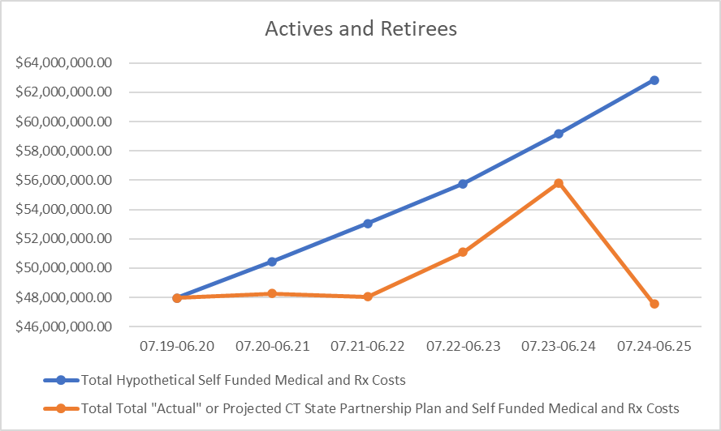
Hypothetical Active and Retiree Self Funded Medical and Rx Costs V Savings from Moving to the State Partnership Plan
Over 6 years the estimated Self Funded Medical and Rx Costs were projected to be $329.2 million.
The strategy to move to the CT SPP resulted in a projected total savings of about $30.6 million.
Active Savings are projected at about $5.9 million
Retiree Savings are projected at about $24.6 million
Notes
Blue Line: Projected Medical and Rx Cost (No Changes)
Orange Line: Projected Cost Based on Move to the CT SPP

Slide 8
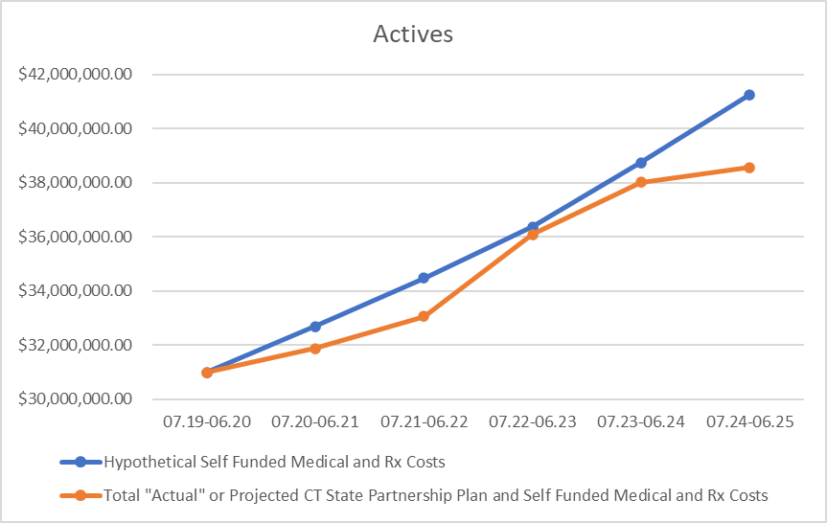
Hypothetical Active Self Funded Medical and Rx Costs V Savings from Moving to the State Partnership Plan
7/19
  no movement to SPP:
  Projected Savings: $0
1/21
  473 actives moved:
  Projected Savings : $803K
7/21
  additional 384 actives moved:
  Projected Savings: $1.4 million
10/22
  Additional 121 actives moved
  Projected Savings: $287K
7/23
  No additional actives move
  Projected Savings: $718K million
7/24
  All additional 223 actives move
  Projected Savings: $2.7 million
Total Projected Active Savings over 6 Years:
  $ 5.9 million

Slide 9
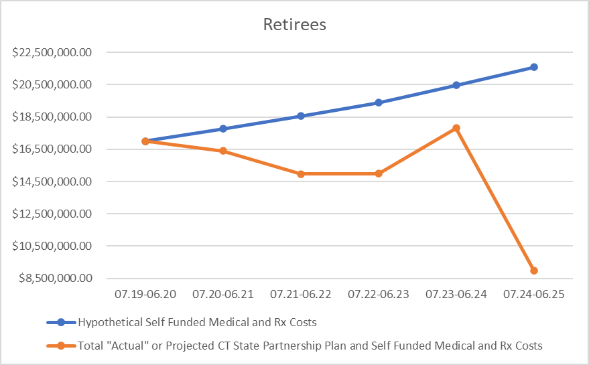
Hypothetical Retiree Self Funded Medical and Rx Costs V Savings from Moving to the State Partnership Plan
7/19
  no movement to SPP:
  Projected savings: $ 0
1/21
  25 retirees moved:
  Projected savings : $1.4 million
7/21
  additional 319 retirees moved:
  Projected savings: $3.6 million
10/22
  Additional 26 retirees moved
  Projected savings: $4.3 million
7/23
  No changes
  Projected Savings: $2.6 million
7/24
  All additional retirees move
  Projected Savings: $12.6 million
Total Projected Retiree Savings over 6 Years:
  $24.6 million

Slide 10
Hypothetical Self Funded Medical and Rx Costs V Savings from Moving to the State Partnership Plan

Slide 11
Caveats
1. Active Hypothetical Self Funded Medical and Rx Costs Trended is estimated at 6.5%.
2. Retiree Hypothetical Self Funded Medical and Rx Costs Trended is estimated at 5.5%.
3. CT State Partnership Plan Rate Increase are estimated as follows:
a. Actives and non-Medicare Retirees: +7.1%
b. Medicare Retirees: +4.2%
4. Enrollment for all years is based on census data given to Lockton by the City of Stamford
5. 07.20 - 06.21 Actual Self Funded Medical and Rx Active and Rx Costs are based on actual claim costs from claim reports from the carriers where applicable
6. Self Funded Medical and Rx Costs Include the Following
a. Cigna Medical and Rx Claims Cost, Admin Fees for both Actives and Retirees
b. Maxor Drug Claims and Admin Costs as well as EGWP and Medicare Admin Costs where applicable
c. IPI Retiree Claims and Admin Costs
d. Additional Self Funded Taxes and Fees as line itemed on the City's budget summary
e. Changes in H.S.A contributions, rx rebates and run off costs
7. Please note that the Aetna Medicare Advantage Program is included in the SPP enrollment as members were moved as of 10.22 to the Aetna Medicare SPP Program
8. Retirees included Pre 65, Post 65 Non-Medicare and Post 65 Medicare Retirees
9. Actives include Active Employees and Cobra

Slide 12
Union Migration Dates and Enrollments

Slide 13
Union Migration Dates to the CT State Partnership

Slide 14
2023 Enrollments by Union and Medical Carrier

Slide 15
2022 Enrollments by Union and Medical Carrier

