Slide 1
CITY OF STAMFORD Controller’s Office David Yanik, Controller Joanne Noone, Assistant Controller March 28, 2023

Slide 2
Department Introduction – Mission
Mission: The Controller’s Office mission is to maintain the books and records of the City of Stamford and its various agencies, functions and departments by supporting the General Accounting, Accounts Payable, Treasury, and Payroll functions and ensuring that prudent accounting policies, procedures and practices have been established which are supported by well-designed and operationally effective internal controls.
Program #1032 Transaction Processing & Financial Reporting
Program #1034 Internal Audit

Slide 3
Department Accomplishments
Key participant in Oracle ERP Software configuration, data conversion, feature testing, and implementation leading to a successful go-live in of March, 2023, (including training and workflow design).
Created interfaces between key banking service providers and Oracle ERP Software to upload transaction activity, including Purchasing Cards transactions, and automate processes.
Partnered with Human Resources to plan rollout of Employee Self-Service portal in conjunction with earlier implementation of Ceridian DayForce Payroll / HCM software (currently piloting with one union).

Slide 4
Department Initiatives for FY 2023-2024
Post-Implementation rollout of Oracle ERP software features including financial reporting module implementation, dashboard reporting and account reconciliation, and workflow automation.
Support City OPM team with implementation of Oracle ERP Software – EPM (Budgeting) Module including configuration, account mapping to financial statement line items, data conversion, feature testing, workflow design and training for use in conjunction with FY 2024-2025 Operating Budget.
Complete transition to Ceridian Workforce Management Time & Attendance software for all City departments and discontinue use of Kronos Time & Attendance software to save license fees, improve timekeeping processes, and improve integration.

Slide 5
Department Goals FY 2023-2024
Continue post-implementation report, and dashboard, design work in the Oracle ERP Software. Support implementation of Financial Reporting Module, including configuration, account mapping to financial statement line items, data conversion, feature testing, workflow design and training for use in conjunction with FY 2023-2024 financial reporting.
Partner with BOE, Grants Dept and Engineering Dept in create workflow around accumulating support documents for periodic submission to State of CT Grants Office and obtaining timely reimbursement of amounts expended for new School Construction projects in conjunction with the Project Accountant – BOE School Construction.
Complete rollout of Employee Self-Service Payroll portal to reduce payroll related postage expenditures and save staff resources used to respond to employee inquiries.

Slide 6
Proposed Budget for F2023-2024
Proposed Budget $3.4 Million / Increase of $540K:
Payroll Services – Impacted by Ceridian Workforce Management Time & Attendance software rollout (+$100K software licensing fees with future expected savings in TMS - City & BOE - when Kronos sunsets of approx. $30-40K); Ceridian DayForce License Fee increases (+$40K); Special programming work (+$75K)
Salaries – Addition of Project Accountant – BOE School Construction (+$125K) and full year impact for previous new hires
Other:
Contracted Services – Use of outside contract employees to assist with workload increases during year-end closing and annual audit, staff turnover, etc. (+$60K)
Postage – Delays in rollout of Employee Self-Service portal due to security concerns, and information access (+$50K)

Slide 7
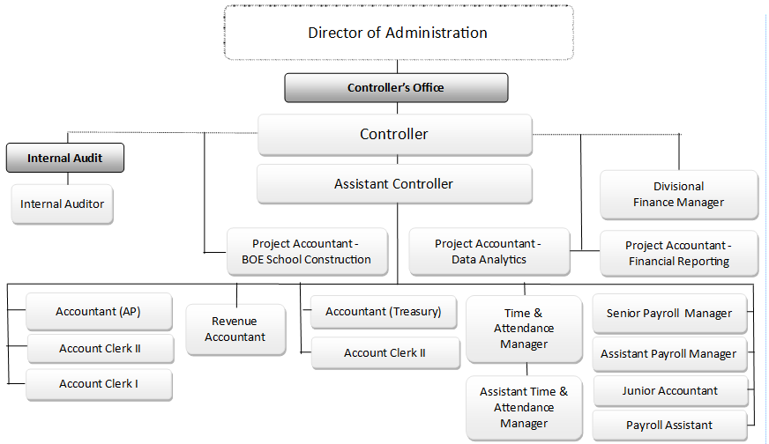
Department Organization Chart
Controller’s Office
Department Organizational Chart

Slide 8
Excerpts from Mayor’s Proposed Budget for FY 2023-2024

Slide 9
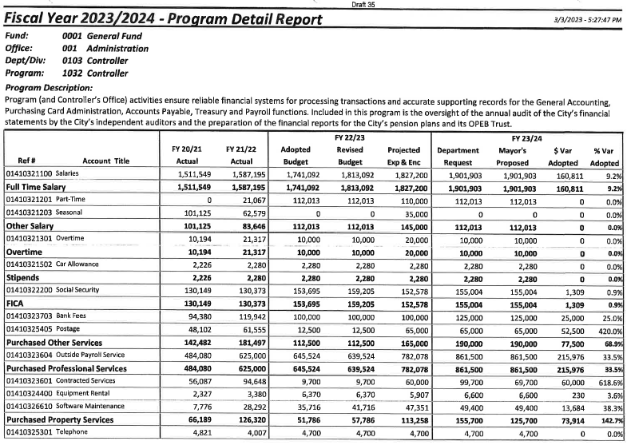

Slide 10
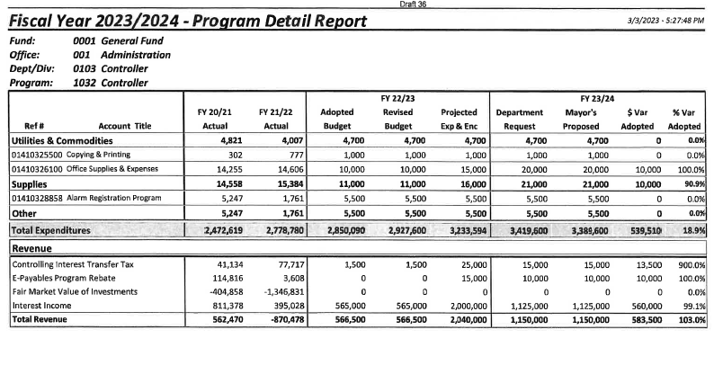

Slide 11
