Slide 1
CITY OF STAMFORD OFFICE OF THE ASSESSOR Greg Stackpole, CCMA II Assessor (203) 977-4018 GStackpole@StamfordCT.gov March 28, 2023

Slide 2
Department Introduction & Brief History
Department’s Mission: To maintain and defend an equitable tax base and appraisal of all real and personal property business assets and motor vehicles within the City of Stamford, for the inclusion onto the annual Grand List; including all State and local tax exemptions and elderly tax benefits for eligible recipients. The Grand List represents the total assessed value for all taxable and exempt property located within the City on October 1, in accordance with Section 12-62a of the Connecticut General Statutes.

Slide 3
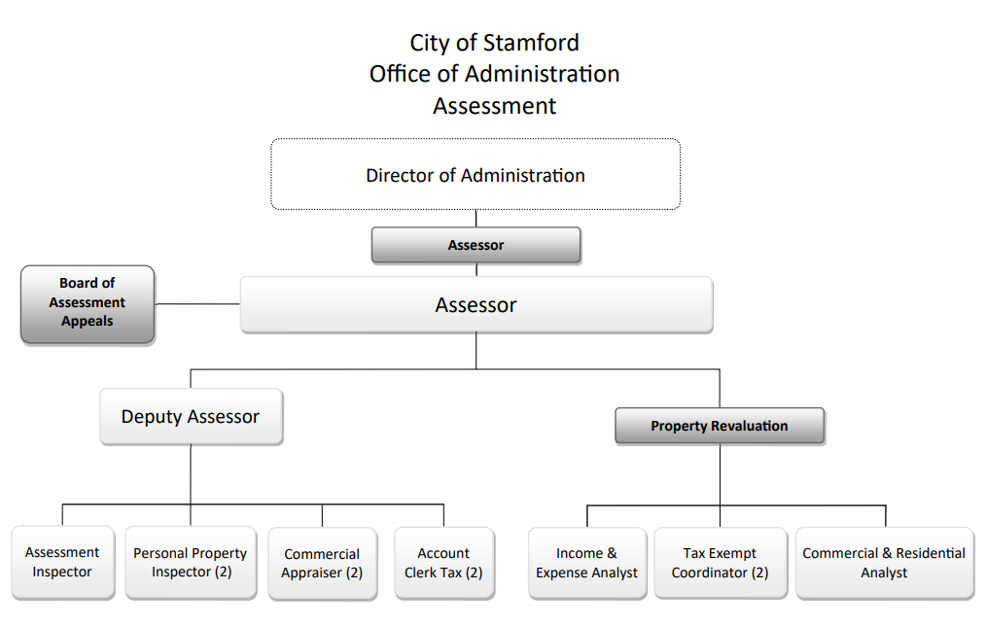
Department Org. Chart

Slide 4
Major changes
Online processing of abutters Lists and historical field cards
Online access to PRC Field Cards – eliminates requirement for public to visit the Office of the Assessor
Online Interactive GIS map of property sales

Slide 5
What are the most significant accomplishments made & challenges faced by the department in the last FY 2021-2022.
Accomplishments:
Completion of 2022 City wide revaluation
Initiated tracking of Income and Expense statements via bar-code technology – to allow for greater reporting capabilities; such as, follow up for required nonreturned forms.
Personal Property Business Audit Program collected $808K with 301% ROI.
Potential collection to exceed $2.4MM.
Motor Vehicle Compliance Program:
Added 1,288 vehicles to tax rolls.
(Contract year: 1/22 -1/23)

Slide 6
FY 2023-2024 Goals
What are your department goals and plans for 2023-2024
What is the Department’s/Program’s budget? (highlight changes)
Departmental costs are minimal other than salary – have remained LEAN and flat with the exception of the state mandated revaluation – no changes were made for FY 23-24, with the exception of contractual obligations.

Slide 7
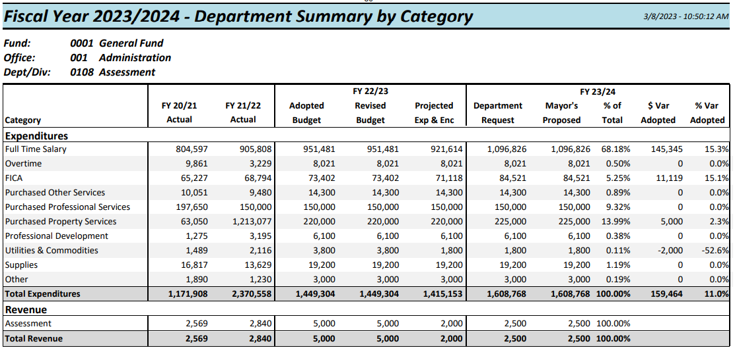

Slide 8
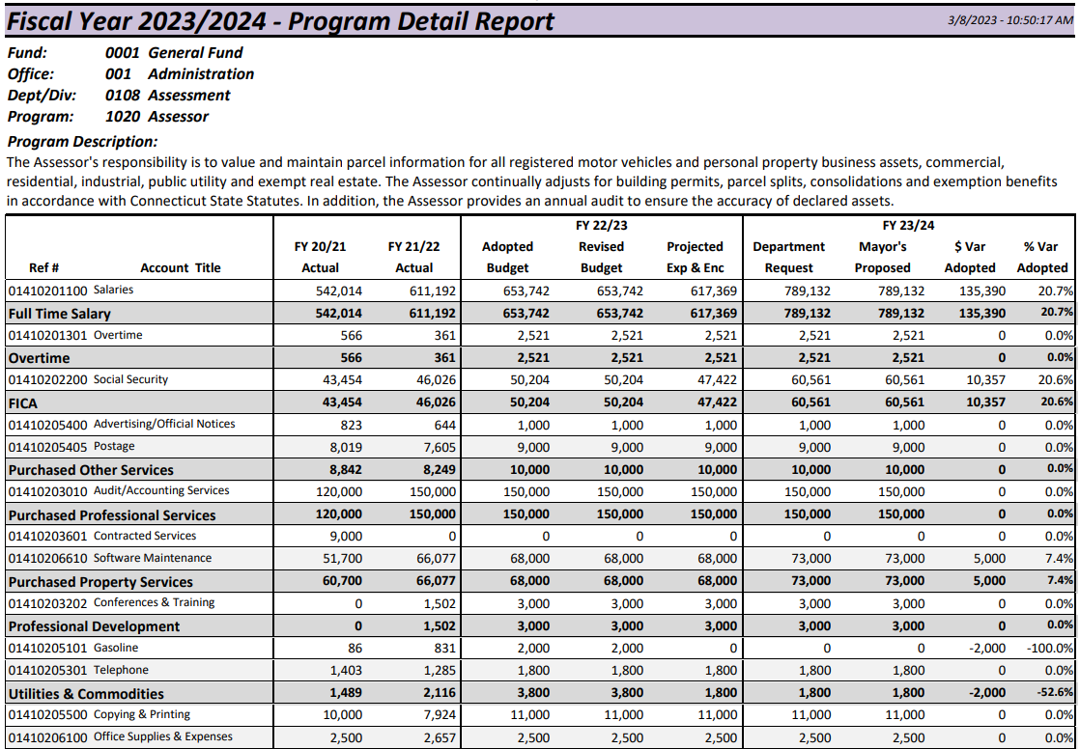

Slide 9
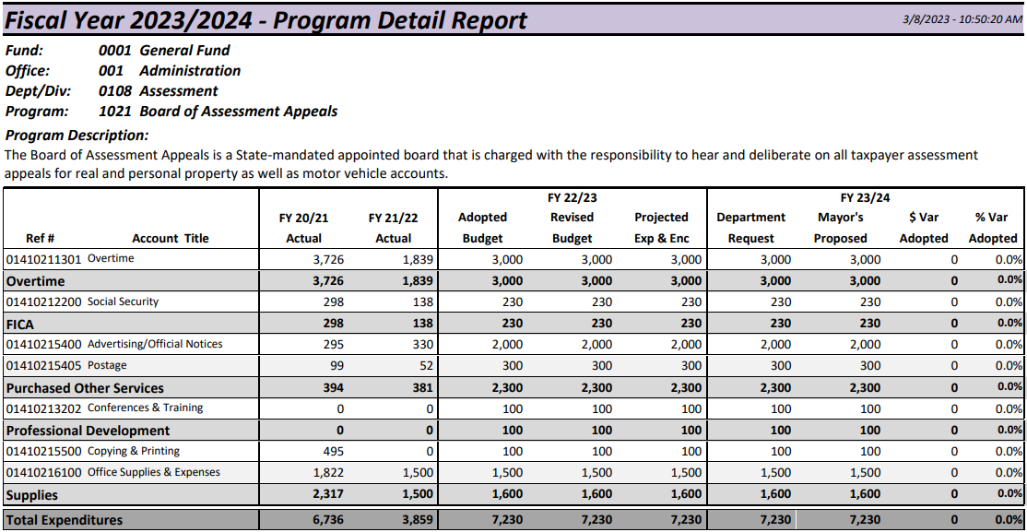

Slide 10
