Slide 1
City of Stamford, Connecticut
Board Of Finance
ERP Project Update
May 11, 2023
Innovating Since 1641

Slide 2
State of the ERP Project
ERP projects have multiple phases:
Implementation – complete
Stabilization – working out initial issues and user acclimation to the system - in progress
Optimization – Increasing utilization of technology and business processes - next
Financials Go-live: March 6th
Smooth cutover and go-live for Oracle and Teller
1 system issue to-date: Budget query response time was lagging; fixed within 3 days
User Access – Single Sign On
Data segment access – accounts users can access
Role assignments – what a user can do in the system
Notes:
Todd
Acknowledging the fact that the BOF got this project started and Board member participation
The board participants are the watch dogs that will report back to the boards on our progress and issues

Slide 3
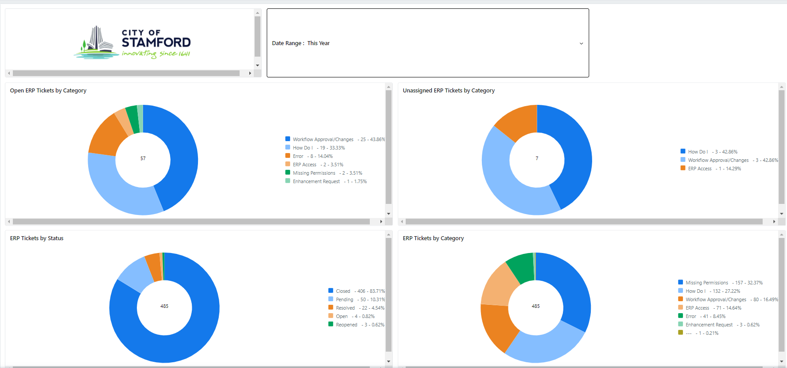
State of the ERP Project

Slide 4
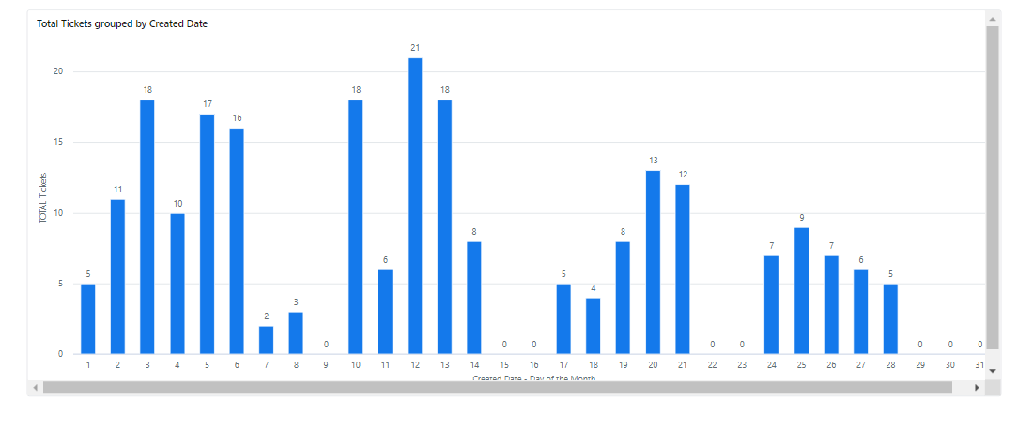
State of the ERP Project
Issue Volume

Slide 5
ERP Financials Business Process Changes
Budgetary control by Minor Object (line-item) has been selected
Grouping of detail accounts into spending categories (minor object) to enable more departmental flexibility and fewer transfers while controlling spending at a responsible level
Accommodates price fluctuations without enabling inappropriate cross-category spending
Grouped by types of line items such as wages, supplies, professional services
The budget will continue to be developed and presented by detail account
Spending will continue to be by detail account
Identification of the Minor Object as the Budget Control will allow the system to process payments within the category of the Minor Object regardless of funding availability in the detail account
If a detail account has need for additional funding, another detail account in the same category in that department can provide it
The transfer trigger has changed from detail account to minor category, but transfers will continue to be processed at the detail line level
Notes:
Todd
Acknowledging the fact that the BOF got this project started and Board member participation
The board participants are the watch dogs that will report back to the boards on our progress and issues

Slide 6
ERP Financials Business Process Changes
Major Object | Minor Object |  | Major Object | Minor Object
Wages | Wages |  | Employee Benefits | Employee Benefits
 | Full Time Salary |  |  | Unfunded Retirement Benefits
 | Overtime |  |  | FICA
 | Stipends |  |  | Retirement Benefits
 | Paid Time Off |  |  | Retirement Benefits
 | Accumulated Leave |  |  | Tuition
 | Retro Pay |  |  | Unemployment Comp
 | Other Salary |  |  | Payments to Insurance Fund
Purchased Professional Services | Purchased Professional Services |  | Other Objects | Other Objects
Purchased Property Services | Purchased Property Services |  |  | City Support to BOE
Purchased Other Services | Purchased Other Services |  |  | Professional Development
 | Self Insurance Payments |  |  | Transfer to Other Funds
 | Insurance Premiums |  |  | Reserve for Contingency
Capital Assets | Capital Assets |  |  | Internal Transfers
Miscellaneous | Miscellaneous |  | Supplies | Supplies
 | Community & Cultural |  |  | Utilities & Commodities
 | Volunteer Fire Dept
 | Debt Service
 | Election Expenses
 | Dues and Fees
Minor Object | Detail Object
Supplies | Office Supplies & Expenses
 | Materials & Supplies
 | Program Supplies
 | Street Painting Supplies
 | Processing Chemicals
 | Instructional Supplies
 | Animal Supplies
 | Maintenance Supplies
 | Small Tools & Replacement
Notes:
Todd
Acknowledging the fact that the BOF got this project started and Board member participation
The board participants are the watch dogs that will report back to the boards on our progress and issues

Slide 7
ERP Financials Business Process Changes
Purchase Order Carryforward
Purchase orders for goods or services not received as of June 30 of a given FY can be carried forward from one year to the next
As encumbrances in the new year budget
Not in a separate bucket
Unlike current practice, the PO related budget will be carried forward as well
Expenditures on carried forward POs will be more visible than past years
This practice is recommended by the City’s external auditor
Revised year-end procedure will be forth coming
Notes:
Todd
Acknowledging the fact that the BOF got this project started and Board member participation
The board participants are the watch dogs that will report back to the boards on our progress and issues

Slide 8
ERP Financials Business Process Changes
Accounts Payable
Invoices will be scanned into Oracle by the departments
Departments will confirm the invoices online
Invoices will be electronically routed through workflow
For departmental approvals
Accounts Payable where they will be audited, posted and paid
Notes:
Todd
Acknowledging the fact that the BOF got this project started and Board member participation
The board participants are the watch dogs that will report back to the boards on our progress and issues

Slide 9
ERP Financials Business Process Changes
A new State-compliant chart of accounts has been implemented
Realignment of the coding structure to reflect the City’s organizational structure
Funds
Cost Centers (activity/program)
Accounts (line items)
Configured trees to enforce hierarchical controls and reporting rollups
Organization Tree
Tree Level 3 Office
Tree Level 2 Department
Tree Level 1 Cost Center
Line-Item Tree
Tree Level 3 Major Object
Tree Level 2 Minor Object (line-item)
Tree Level 1 Detail Object
Notes:
Todd
Acknowledging the fact that the BOF got this project started and Board member participation
The board participants are the watch dogs that will report back to the boards on our progress and issues

Slide 10
ERP Financials Business Process Changes
Other Noteworthy Changes
As travel authorizations and expense reimbursement requests are entered into the system, the system will redirect users to the appropriate GSA per diem rates for the travel destination
Project Portfolio Management is an integrated project and grants management module for capital projects, City and BOE grants, and CDBG grants
Funding source-specific controls – bonds, grants, local funding with priorities and percentage splits
No longer a separate database that requires manual intervention to update from the GL
Revenue Collection, Solid Waste, Recreation, and Tax Collection systems integrated to recognize revenue daily
Notes:
Todd
Acknowledging the fact that the BOF got this project started and Board member participation
The board participants are the watch dogs that will report back to the boards on our progress and issues

Slide 11
State of the ERP Project
Oracle Permitting and Licensing (OPAL)
Implementation phase is ongoing
Approximately 12 months to go live
Implemented to fit the City’s business processes
Improved customer service via robust web payment capabilities
Integration with Oracle financials and Can/Am Teller
License, Permits, and other forms developed for:
Buildings - complete
Land Use – in progress
Health Department – in progress
Town Clerk
Contractor Registration
Engineering
Fire Department
Zoning
Code Enforcement
Notes:
Todd
Acknowledging the fact that the BOF got this project started and Board member participation
The board participants are the watch dogs that will report back to the boards on our progress and issues

Slide 12
State of the ERP Project
Can/Am Teller Cashiering
Training went very well and after 2 days the Revenue Service/Collection department was ready for the live environment
Implemented March 7, 2023
Go Live day there were minimal issues with the conversion mostly related to set up – in the test environment all possible scenarios are not tested, therefore these items were found after we went live, and they are typical issues with software conversions:
Security authorizations required tweaking
A few missing Items in set up
Credit Card processer connection
All issues were resolved within 48 hours

Slide 13
State of the ERP Project
Can/Am Teller Cashiering
Teller has been processing beach, parking permits and citations for two months
There are currently no outstanding issues with Teller
The implementation of the Teller payment software will help make the resident/consumer experience in the City of Stamford quicker and more rewarding
The ultimate goal is one stop shopping – eventually residents will be able to pay multiple invoices at one location
Our department has been trained to add additional items and set up the Oracle link without the need for a Teller programmer, thereby saving the City programming charges
Since the implementation the department has added Recreation programs to the teller software with the connecting links to Oracle.
We are anticipating accepting payments for Recreation programs through Teller within the next week, pending approval of the set up from the Parks Department.

Slide 14
Questions?

