Slide 1
Stamford WPCA Operating and Capital Budget for FY 24-25
Presentation to
Board of Finance
March 26, 2024
William Brink, Executive Director
Rhudean Bull, Administration Manager

Slide 2
Highlights of Proposed Operating Budget for FY 24-25
No change in services, programs or number of SWPCA staff
Includes energy efficiencies and reduction in methanol use resulting from treatment plant upgrades completed in 2022 and participation in Eversource’s Strategic Energy Management team program.
Electrical energy supply cost per kWh fixed from Nov. 2023 through Nov. 2025
Includes the final debt service payment for the $74 million CWF loan for the major wastewater treatment plant upgrade completed in 2004
Total Expenditures of $28,923,297 an increase of $595,585 or 2.1%
Total Revenue of $29,552,956 an increase of $533,080 or 1.9%

Slide 3
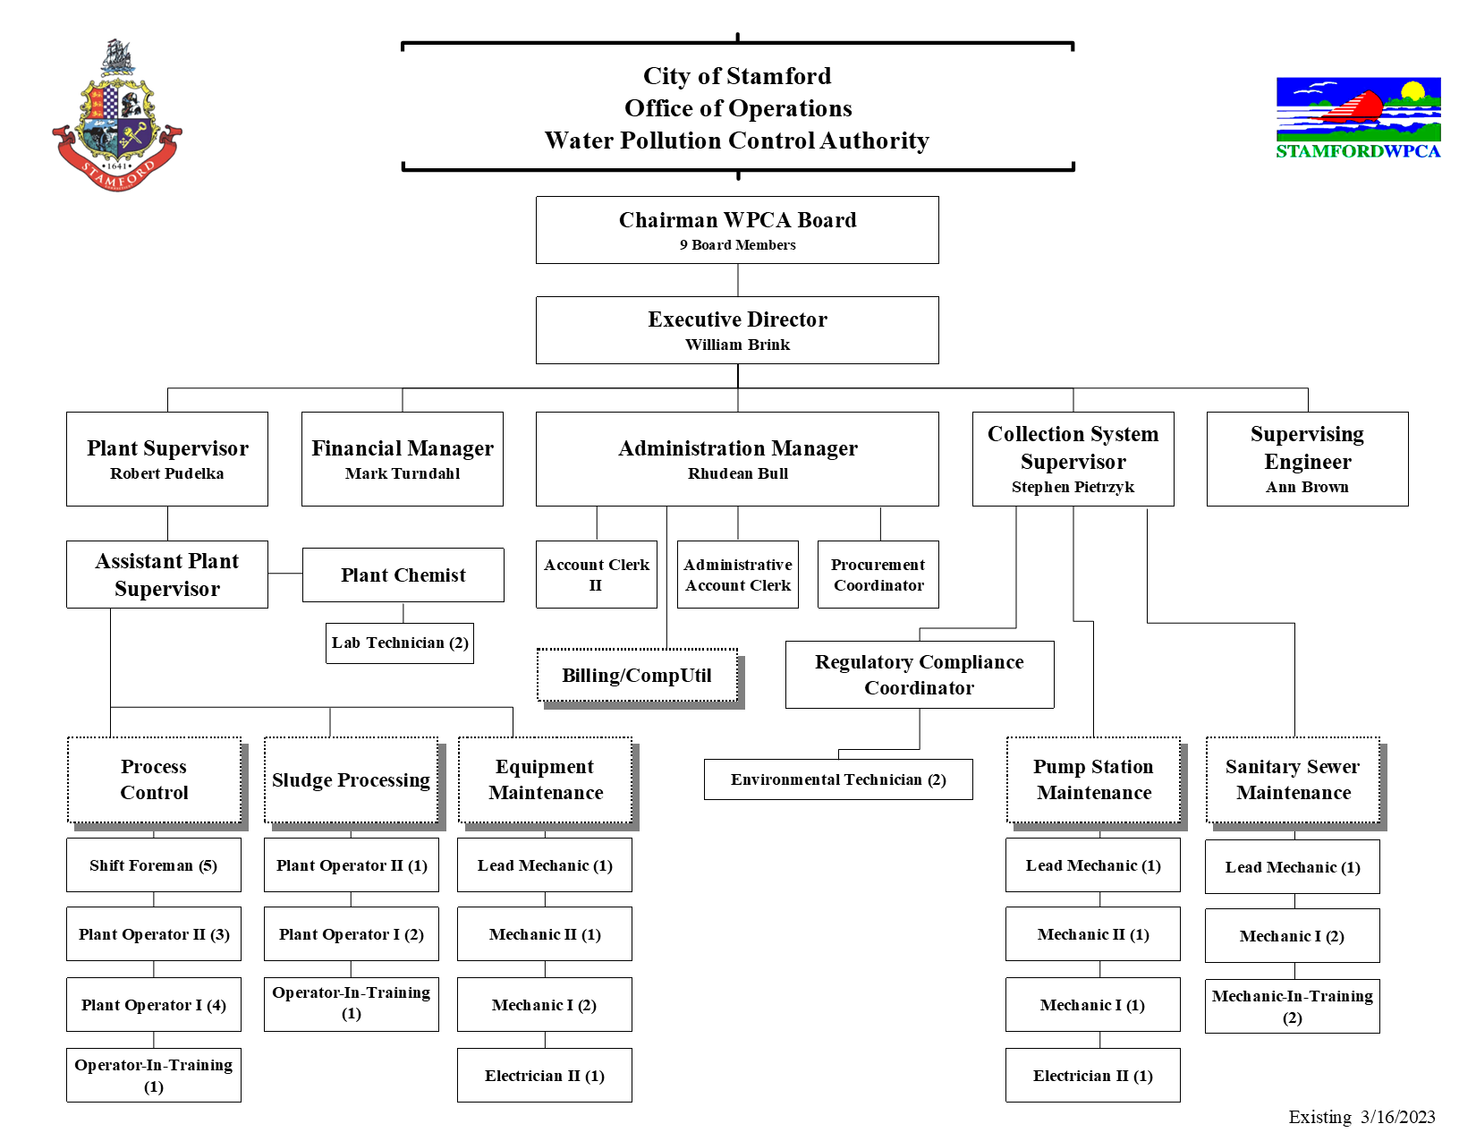

Slide 4
Major Variances of Expenditures from Prior Year
Contractual increase in wages due to MAA, IUOE and UAW contracts total $363k.
Increase in CERF Pension UAL Amortization and Classified Pension Fund of $125k offset by reduction in CERF OPEB AUL Amortization ($128k)
Increase in Contracted Services of $180k for Engineer’s Report for 2025 Revenue Bond issue and Electrical Preventive Maintenance
Increase in Sludge Dryer Operating Contract of $69,000 pegged to increase in CPI and increase in screenings and grit hauling and disposal costs of $50,000.

Slide 5
Major Variances of Revenue from Prior Year
Increase in interest income from cash reserves of $200k
Increase in connection charges (principal) of $200k from new construction
Decrease in Darien treatment charge of ($196k) based on metered flow
Increase in Sewer Use Fees of $192k
Decrease in Aquarion User Charges ($77k) since Aquarion ceased discharge of Water Treatment Plant sludge to sanitary sewer
Increase in reimbursement from the City for operation and maintenance of the hurricane barrier and repair of sewer laterals in City ROW of $317k
Decrease in reimbursement from CTDEEP from the sale of nitrogen credits due to the drop in the price of nitrogen credits of ($128k)

Slide 6
Capital Project Requests
C71196 CMOM- Sewer Capacity Management, Operation and Maintenance $600,000
Next phase of the infiltration and inflow removal program to remove surface and groundwater from the sanitary sewer system.
CP9270 Sanitary Pumping Station Upgrade $2,100,000
Saddle Rock PS design and upgrade construction
Alvord Lane PS and Commerce Drive PS upgrade design
Various pump station equipment replacement
C71282 Vehicle Replacement and Repair $700,000
Replace aged jet/vac truck that is 40 years old that is used to clean sanitary sewers and manholes

