Slide 1
CITY OF STAMFORD OFFICE OF LEGAL AFFAIRS THOMAS M. CASSONE tcassone@stamfordct.gov 203-977-4082 Board of Finance March 19, 2023 7:00 p.m. Board of Representatives Fiscal Committee April 11, 2023 6:30 p.m.

Slide 2
Office of Legal Affairs
Mayor
Corporation Counsel &
Director of Legal Affairs
Law Department
Human Resources
Diversity Equity & Inclusion Officer

Slide 3
Law Department
Corporation Counsel &
Director of Legal Affairs
Executive Assistant
Deputy
Corporation Counsel
Senior Paralegal
Paralegal (2)
Part-time Paralegal (1)
Assistant
Corporation
Counsel (8)
Part-time Assistant
Corporation
Counsel (1)

Slide 4
Staffing Updates
Request for permanent part-time Assistant ADA Coordinator
Grade increase for Executive Assistant from MAA A06 to A07. Only grade increase in 20 years. Previous Executive Assistant had been at Grade A07

Slide 5
Explanation of budget increases in individual line accounts
Salary increases are all due to new contracts
Sick time increase is due to attorney’s contract allowance for payout of sick time and addition of two new attorneys

Slide 6
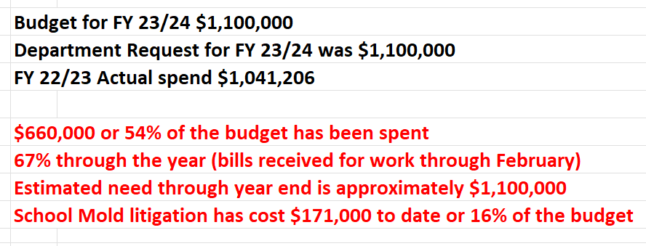
Law Department Professional Consultant

