Slide 1
CITY OF STAMFORD HUMAN RESOURCES Dr. Paula A. Russell-Nisbett Director of Human Resources 203-977-4329 March 19, 2024

Slide 2
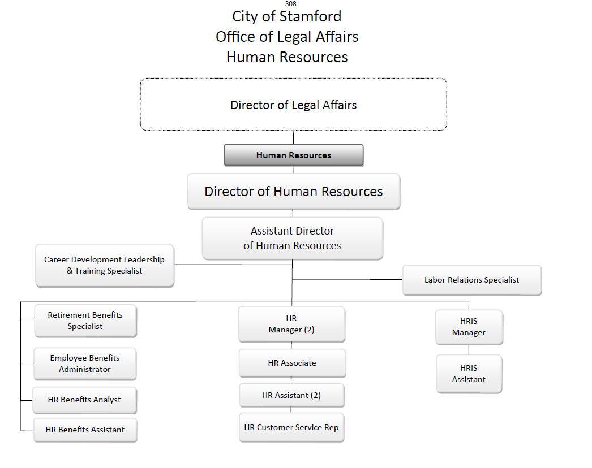
Human Resources Department Organizational Chart
Current

Slide 3
City of Stamford Office of Legal Affairs Human Resources
Human Resources Department Organizational Chart
Eliminated
Assistant Director of HR
HR Customer Service Rep.
Updated Title
Career Development (1)
Proposed FY 24-25
Director of Legal Affairs
Director of Human Resources
Career Development, Leadership and Training Manager
Labor Relations Specialist
Retirement Benefit Specialist
Employee Benefits Administrator
HR Benefits Assistant
Human Resources Manager (2)
HRIS Manager
HR & Benefits Analyst
Human Resources Assistant (2)
HRIS Assistant
HR Associate

Slide 4
Human Resources Department Staffing Updates
The Career Development Leadership and Training Specialist position was renamed and updated to Career Development Leadership and Training Manager. The main responsibilities include:
Overall administration of the City of Stamford Leadership and Training Institute.
Identify career advancement, employee training, and educational needs
Develop, administer, and train supervisors in annual employee performance evaluations.

Slide 5
Human Resources Department Budget Increases
Individual Line Account | Explanation
Full-Time Salary | Salary increases due to new contracts
Other Salary -Overtime | Need to hold multiple police and fire exams during the upcoming year. Exams are normally held on weekends. Staff who work these hours would be eligible for overtime.
Purchased Other Services – Recruitment & Hiring | Increased fees related to; Background checks Recruitment on professional sites and reaching a diverse pool of candidates Various fees for driving records, national criminal databases, and sex offense registries Possible implementation and processing of seasonal employees who require the same rigorous background check
Utilities & Commodities – Copying & Printing | Printing of: New and finalized City contracts (MAA, Nurses, Police, and Fire) New Hire Orientation materials Civil service Exams Various HR projects that require additional written communication with retirees, active members, and applicants.
Utilities & Commodities – Office Supplies & Expenses | Increase of prices for items no longer covered by the CARES Act

Slide 6
What adjustments could be made if the department budget were to be reduced?
Reduce civil service exam testing which would in turn reduce the need for recruitment and staff for testing (but might affect overtime costs in the department(s) affected due to staffing levels).
Consider compensatory time instead of overtime depending on the applicable employee’s contractual agreement

