Slide 1
CITY OF STAMFORD E. Gaynor Brennan Golf Course Hidalgo Nagashima, CGCS Superintendent of Greens 3/12/2024
1

Slide 2
Department Introduction & Brief History
The Mission of E. Gaynor Brennan Municipal Golf Course is to provide the residents of Stamford and neighboring areas a preeminent public golf course. E. Gaynor Brennan is an 18 Hole Golf Course with a practice chipping/putting green, a full-service restaurant and clubhouse containing a golf simulator, lockers and golf shop. Amidst a competitive market for public golf the aim is for continually improving course conditions while being both fiscally responsible and environmentally mindful.

Slide 3
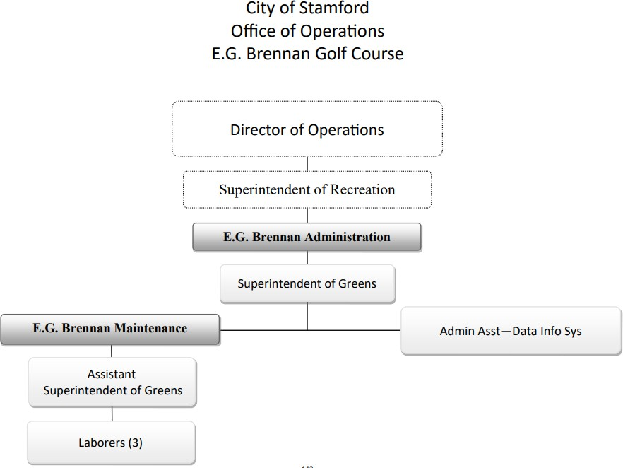
Department Org Chart
Director of Parks and Recreation

Slide 4
Current Staff
Superintendent of Greens
Responsible for all facets of golf course maintenance including
planning, budgeting, and implementing maintenance programs
Assistant Superintendent of Greens
Responsible for in the field supervision, monitoring of turf conditions
and equipment, supervision of full time and seasonal staff
Administrative Assistant/Data Analyst
Tracks and maintains monthly/yearly rounds of play and cart rentals
Processes Requisitions and payments for vendors, on boards
Seasonal employees and assists with payroll
3 Full Time Laborers
Performs tasks as directed for all outdoor work
4 Seasonal Laborers
Performs tasks as directed for all outdoor work
6 Seasonal Rangers
On course enforcement for play rules

Slide 5
Major Changes
E. Gaynor Brennan Municipal Golf Course will be upgrading our Irrigation System in the upcoming years. This will improve the course aesthetic appeal, maximize water delivery system, reduce waste, minimize repairs of our current system while saving labor.
E. Gaynor Brennan Municipal Golf Course keeps a lean number staff employees to reduce the cost of labor. We purchase products on an as needed basis to keep minimum on hand. We utilize competitive bids and state contract pricing to get the best price for products and services.
New Golf Cars for 2024 Season
Purchased 4 new Electric Utility Vehicles replacing aging gas units, Aligning with The City’s Vision for a Greener Stamford.

Slide 6
Accomplishments & Challenges
What are the most significant accomplishments made & challenges faced by the department in the last FY 2022-2023
As more recreation options are available, we have maintained our customer base established during the peak of COVID.
The golf course has increased the tee time interval to 10 minutes resulting in faster pace of play and increased player satisfaction.
Coordinating maintenance crew start times with first tee times to maximize efficiency out on the course.

Slide 7
FY 2024-2025 Goals
What are your department goals and plans for 2024-2025
What is the Department’s/Program’s budget? (highlight changes)
List goals and priorities for your department
Describe in detail the plan to achieve them
What are the obstacles to attaining your goals?
How will you measure your success?
Budget highlights

Slide 8
Achievement Plan of Goals & Priorities
Meet targeted rounds(Raised to 39,000 from 38,000)
Provide excellent customer service
Provide consistent golf course conditions
Stay within budget
No Increase in User Fees for FY24/25
By creating an appropriate fee structure that meets revenue goals and to give the golf community the best value for the cost.
By being fiscally responsible:
Sound purchasing practices
Labor efficiency
Attracting and hiring the best candidates

Slide 9
Obstacle Resolution to Obtain Department Goals
Weather
Competition
Supply chain cost
Utility cost
Labor shortage(Increase in Minimum Wage)

Slide 10
Measurement of Success
Golf Rounds
Customer comments
Social media
Retainage of customers

Slide 11
Budget Highlights
Fiscal Year Comparisons
 | Through the end of February |  |  |  |  |  |  | Full Year
 |  |  | FY 2022-23 |  | FY 2023-2024 |  |  | FY 2021-22 |  | FY 2022-23
Rounds Played |  |  | 23,922 |  | 22,333 |  |  | 38,262 |  | 41,285
Player Revenue |  |  | $736,533 |  | $702,078 |  |  | $1,160,948 |  | $1,262,134
Carts Rented |  |  | 19,232 |  | 17,696 |  |  | 29,884 |  | 32,552
Cart Revenue |  |  | $298,660 |  | $291,047 |  |  | $462,713.00 |  | $503,714
Resident Permits Sold |  |  | 308 |  | 269 |  |  | 1,458 |  | 1505
Permit Revenue |  |  | $24,660 |  | $19,995 |  |  | $110,555 |  | $114,145
PAR Pass Sold |  |  | 34 |  | 15 |  |  | 93 |  | 95
Par Pass Revenue |  |  | $6,300 |  | 2725 |  |  | $17,875 |  | $18,275
Sr Pass Sold |  |  | 45 |  | 40 |  |  | 147 |  | 138
Sr Pass Revenue |  |  | $3,600 |  | $3,200 |  |  | $11,760 |  | $11,040

