Slide 1
RISK MANAGEMENT FUND David Villalva Risk Manager Board of Finance March 26, 2024

Slide 2
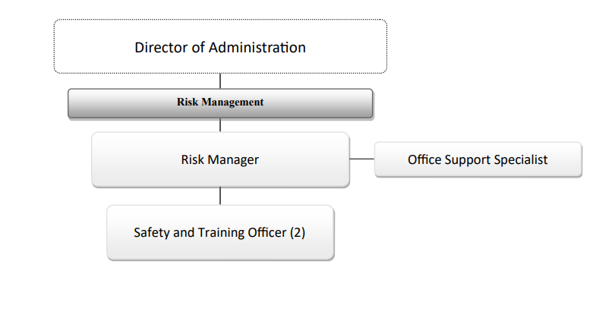
Organizational Chart

Slide 3
Staffing Updates
There are no changes to current existing staffing levels for Fiscal year 2024-2025. Increases in Salaries due to contractual wage increases and one step increase.

Slide 4
Changes and Challenges – Fiscal Year 2024-2025
Self-Insured Loss Payments for Workers’ Compensation claims are trending lower. Estimated loss payments for Legal Settlements is based on review with the Legal Dept of outstanding claims.
Insurance premium increases due to the national insurance marketplace. Property insurance premium increase of $1.2M is 38% higher driven by national macro-economic factors. (Global warming causing larger weather-related catastrophic events, and inflation driving higher construction costs)

Slide 5
Changes and Challenges – Property Premiums
The increase in insurance premium is mostly due to macroeconomic factors of national large-loss weather events, and the City’s loss history. Over the 5-year period from FY19/20 to FY23/24, the City received property insurance reimbursements of $6.9M on premiums of $9.8M, for a loss ratio of 70%. (industry norm is 30%-40%)

Slide 6
Appendix - Department Function
The Risk Fund is an internal insurance service fund that develops and initiates insurance and self-insurance programs, safety and loss control activities, and claims administration to minimize the financial impact of accidental loss to the taxpayers.
Other funds are charged back an annual budgeted expense by the Risk Fund through an allocation based on exposure and actual loss experience.

Slide 7
Appendix -Summary of Significant Changes
There are no significant changes to the Risk Fund – no headcount or capital expense requests and no changes to program services and deliverables.
The Risk Department’s continued focus is on utilizing the Safety Officers for safety training of employees, OSHA compliance, and accident investigations & reviews to drive down Workers’ Compensation claims.

Slide 8
Appendix – Fiscal 2023/2024 Highlights
Efficiencies and Service Improvements
In FY 2023-2024:
Full-year migration to on-line systems for building-use permit reviews/signoffs implemented by City Operations and BOE Facilities departments.
Additional in-house training events by Safety Officers to reduce costs –we are now seeing improvements in actuarially-determined Workers’ Compensation cost to the City.
OSHA programmed inspections of City departments provided an opportunity to address and mitigate safety-related findings.

