Slide 1

CITY OF STAMFORD
ENGINEERING
DEPARTMENT
FY24/25 Budget
Appendix
Board of Finance
March 26, 2024
(Recommend reviewing)

Slide 2

NEW: Government Center EV Infrastructure
Plug-In Electric Vehicle (PEV)
Charging Station Installation in Government Center Garage
Description: This request is for the design, procurement, and installation of multiple level 2 and level 3 PEV chargers throughout the City of Stamford’s Government Center Garage (888 Washington Blvd.) The chargers will be for use by the public and the City Fleet.
Total Project Cost: $860,565.20
  Design Development: $40,000.00
  Construction Related: $820,565.20
Funding Sources:
  $301,197.82 – City Bond (35%)
  $559,367.38 – CT DEEP¹ Grant (65%)
  Important Grant Guidelines:
  Completion by June 2025
  24/7 Public Access for five years once in service
  Cannot generate a profit for three years once in service
    City is permitted to charge a fee to cover the costs of electric consumption
    After three years, City can set rate as desired
¹ Connecticut Department of Energy and Environmental Protection (CT DEEP)

Slide 3

2024 Bridge Grant Intentions
CP2220: Major Bridge Repairs and Design
Currently, I am preparing 4 local bridge applications to submit in the 2024 cycle that include:
Old Long Ridge Road Bridge #135007
Mill Road Bridge #135008
Cascade Road Bridge #135001
Dannell Drive Culvert #135002
Application deadline is May 31, 2024.
These bridges are in poor condition.

Slide 4
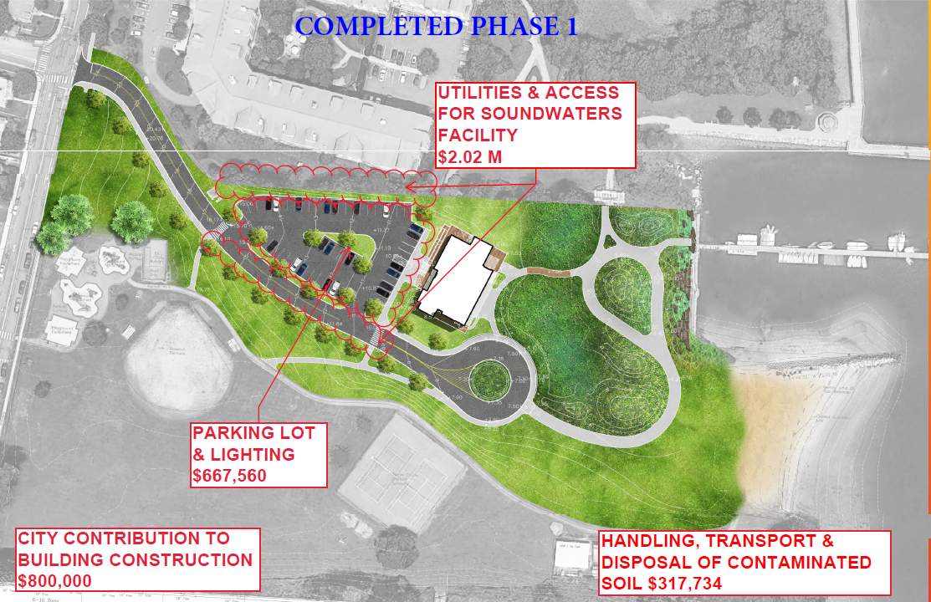
CP8701: John J. Boccuzzi Park

Slide 5
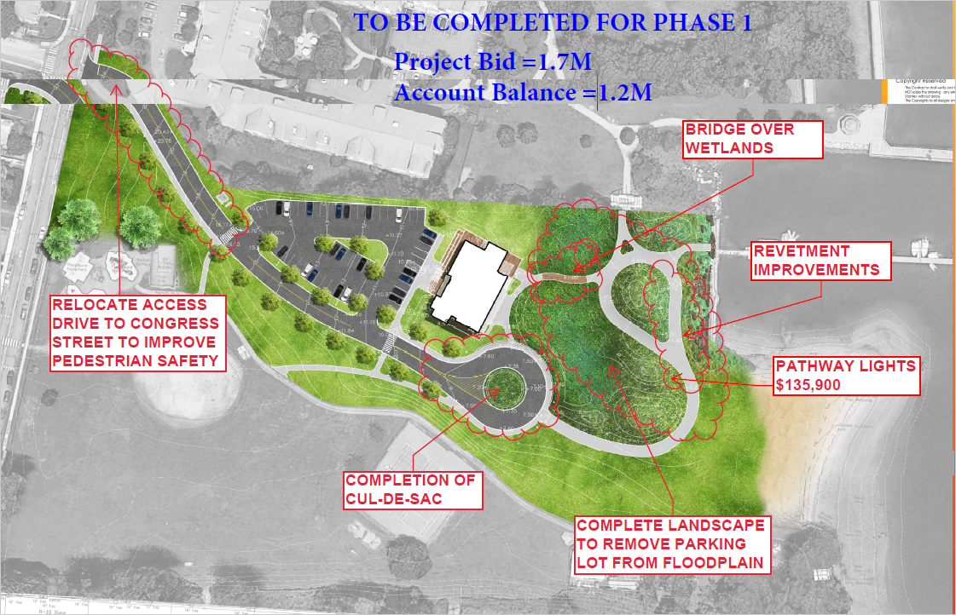
John J. Boccuzzi Park

Slide 6
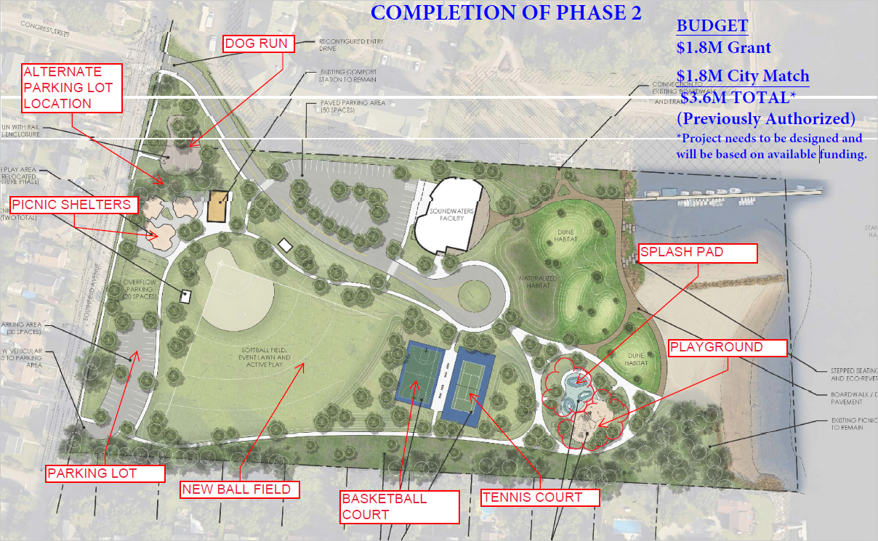
John J. Boccuzzi Park

Slide 7
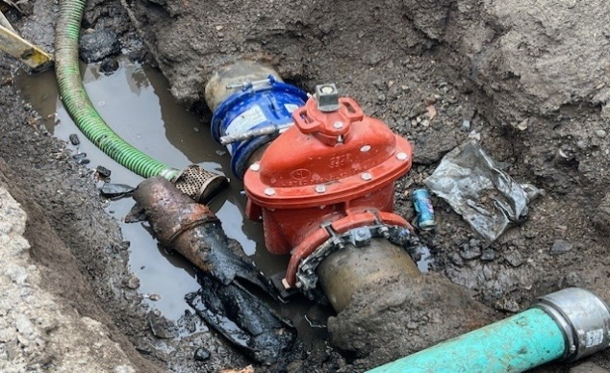
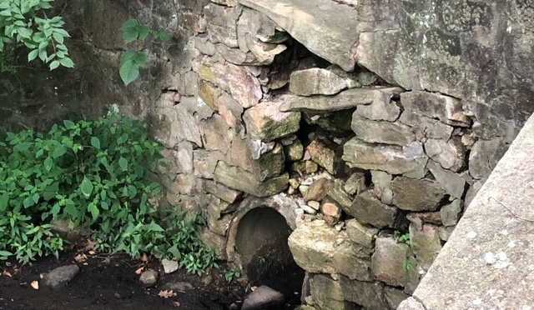
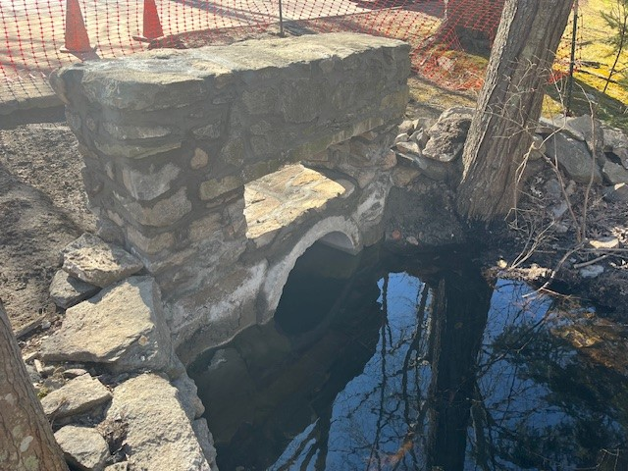
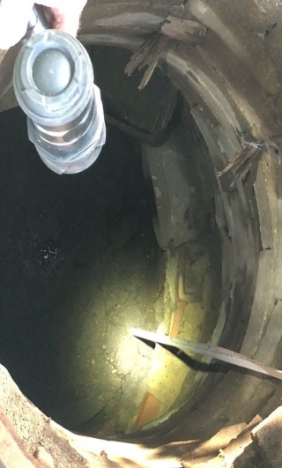
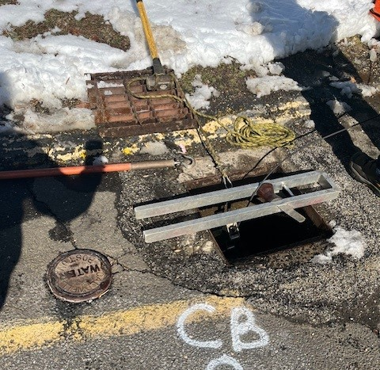
C16012: Drainage Improvements Projects
94 Bentwood Drive
23 Rock Rimmon Lane
Transfer Station
Headwall from culvert crossing Bentwood Drive
Culvert under Rock Rimmon Lane and headwall repair.
Valve installed along water service main line
20 River Hill Drive
Northeast School
775 Den Road
Culvert crossing under Den Rd. was blocked
Drainage piping investigation
Front parking lot drainage investigation
Culvert crossing under Den Road was blocked.

Slide 8
Major changes
Now that the City’s finance system has been replaced with Oracle, investigate a more automated way to process utility bill payments. Currently, the system is manual as Eversource Electric, Gas and Aquarion bills are mailed out based on 145 City utility accounts that Engineering Department manages (this does not include Police, Fire and WPCA accounts). This requires more collaboration between Utility Co. and Oracle. If utilities billing can be integrated in the Oracle system, this could free up staff time to work on other assignments. This was not possible under the old HTE system.
Working with Oracle to replace the City’s VPC permitting system. Challenged by Oracles inability to integrate with GIS.
Use Bluebeam software and training to allow for more collaborative plan reviews on city side and on private development plan review side. Software allows for real-time comments by all stakeholders like Goggle docs.
Work with new Director of School Construction to improve the administration of capital school construction projects.
    Applied for generation based incentives at 6 sites through Eversource (solar projects) to reduce dependency on fossil fuel emissions.
    Added a junior position of Associate Engineer to support project managers workload.
    Received significant increases in Federal and State grant funds i.e. ConnDOT increased from 80% to 100% for federal reimbursement on 4 Federal/Local bridge projects.
    Working to secure $2M D.O.E. grant for $4M LED street lighting (50% federal/50% City).

Slide 9

FY 2024-2025 Goals
Staffing:
The primary departmental goal for FY 24/25 continues to be aligning project needs with the necessary staffing levels to maintain department operations & workload. Requested 3 new positions to fulfill this goal.
Workload is measured by the number and complexity of projects.
Project:
Advance design of Westhill and Roxbury Schools.
Advance Citywide drainage assessment.
Improve the process for utility bill payment in Oracle.
Migrate permitting process from VEOCI to OPAL.
Carryout new utility restoration protocol.

Slide 10

Current Capital Projects
Bridges
Parks
City Facilities
Schools
Energy Efficiency Projects

Slide 11
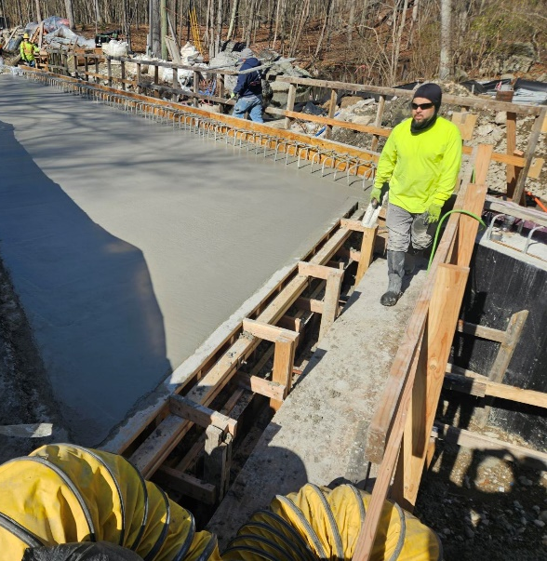
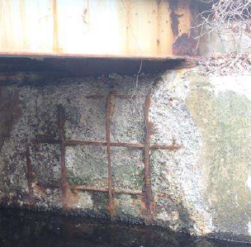
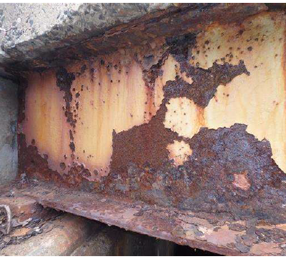
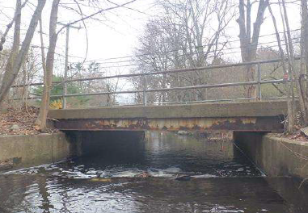
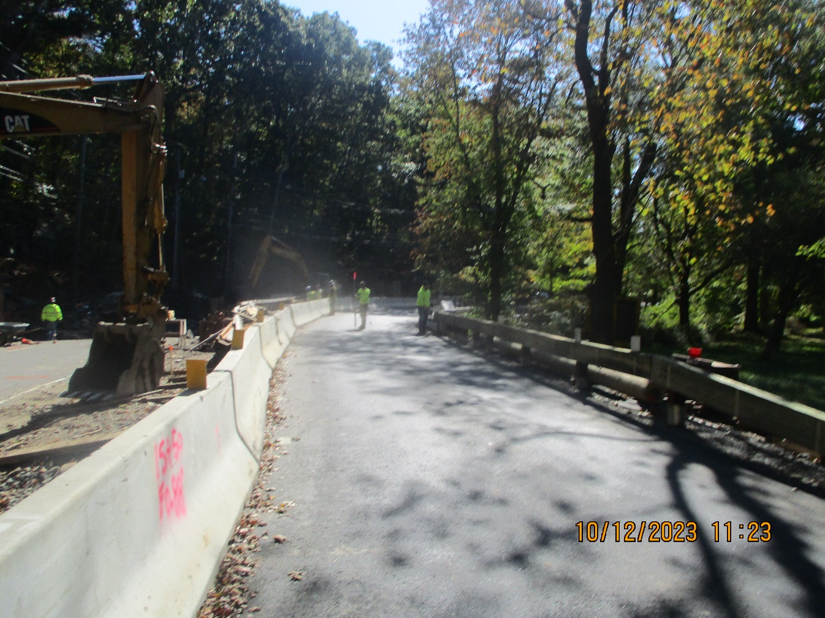
Riverbank Road Bridge Replacement #04071
On-going Federal Local Bridge Program
Funding Source: 80% Federal, 20% City
Est. Completion Date: Spring 2024
Project Bid: $3,770,500

Slide 12
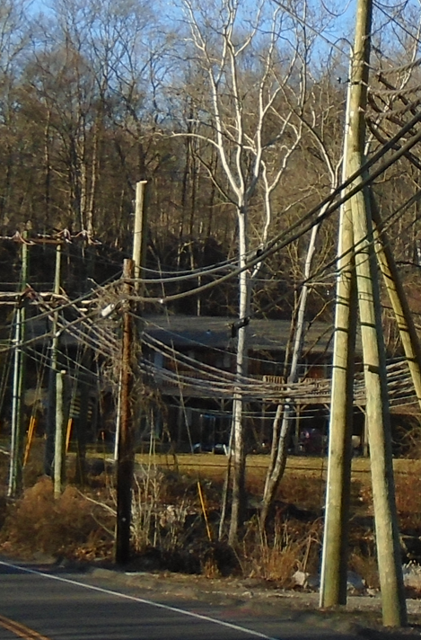
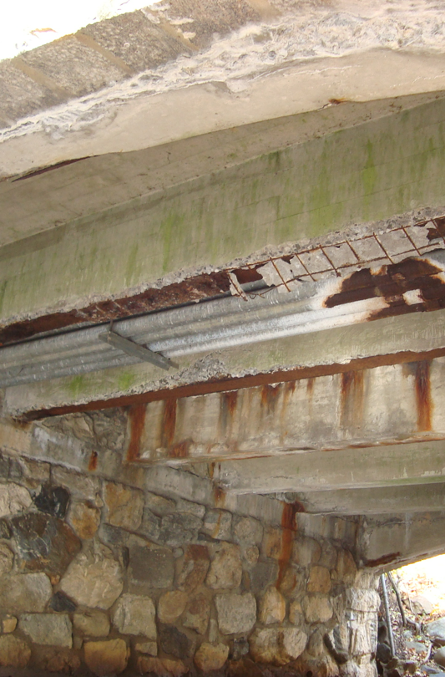
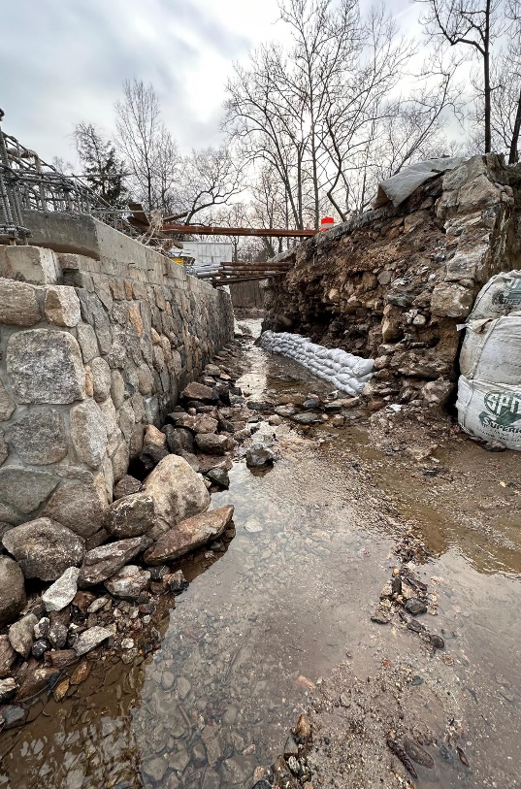
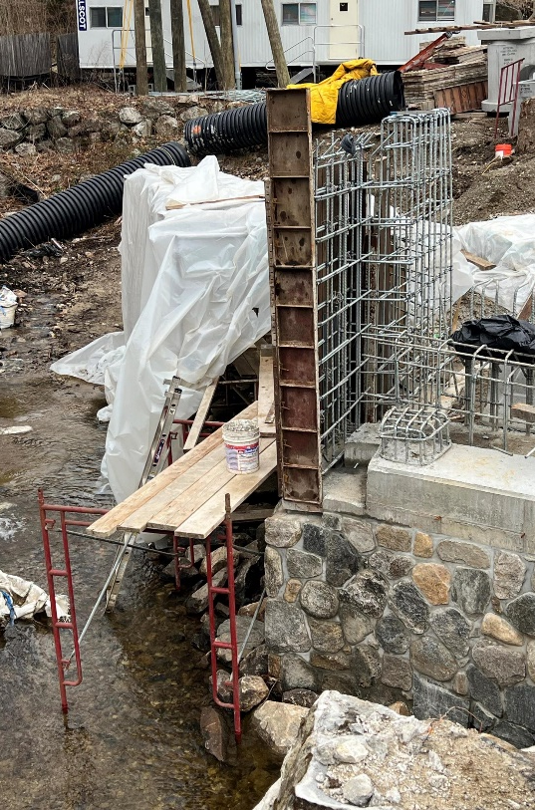
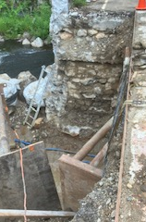
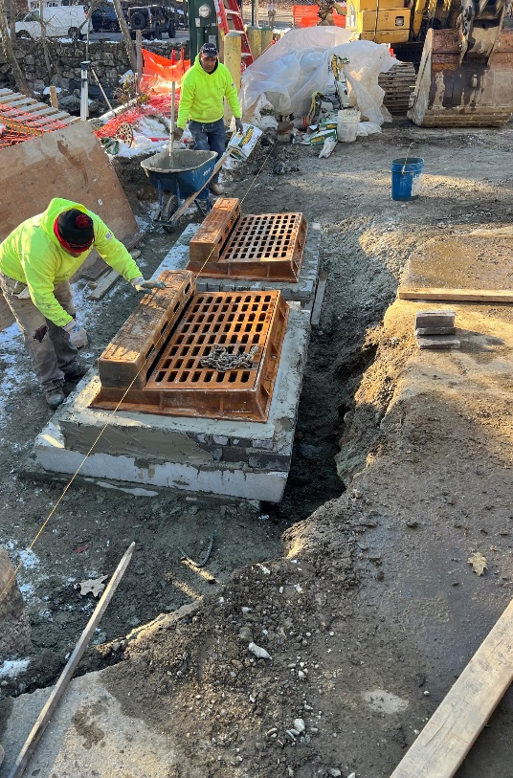
Cedar Height Bridge Replacement #04067
On-going Federal Local Bridge Program. Funding Source: 80% Federal, 20% City
Project Bid: $3.37M
Recovery schedule provided which shows roadway will be open to traffic on 6/30/24

Slide 13
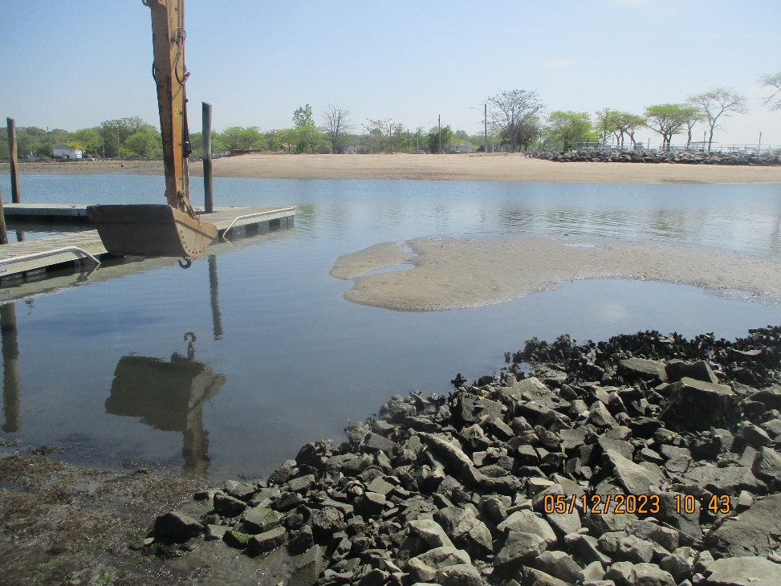
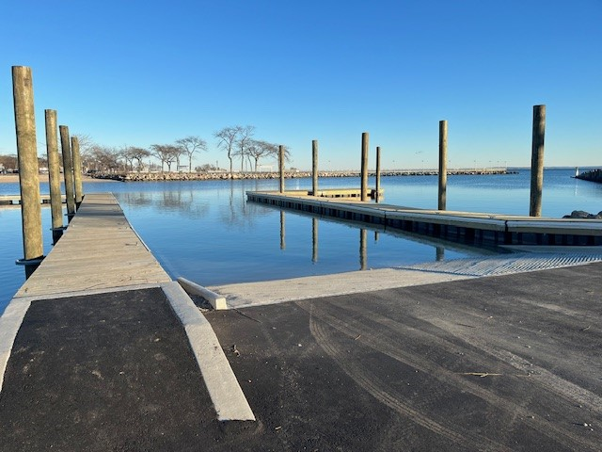
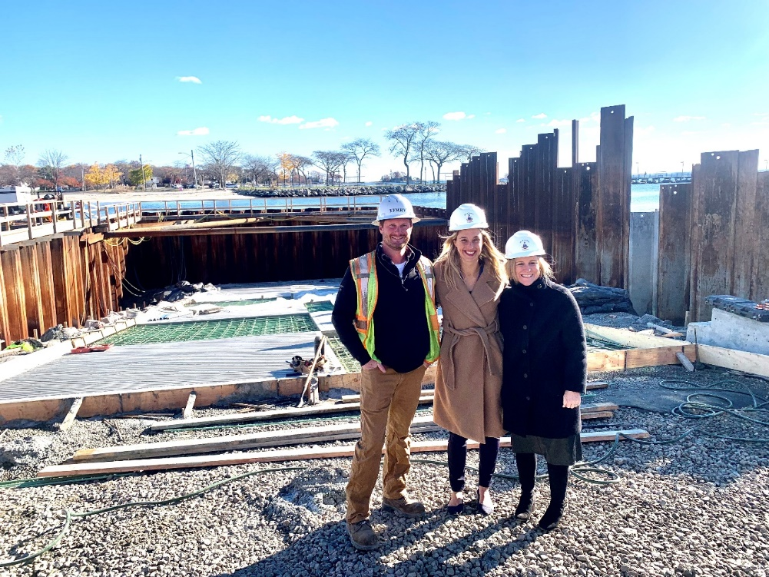
Completed West Beach Boat Ramp
Project Cost: $3M ($1.2M from SHIPP grant) Pre and Post Construction Photos

Slide 14
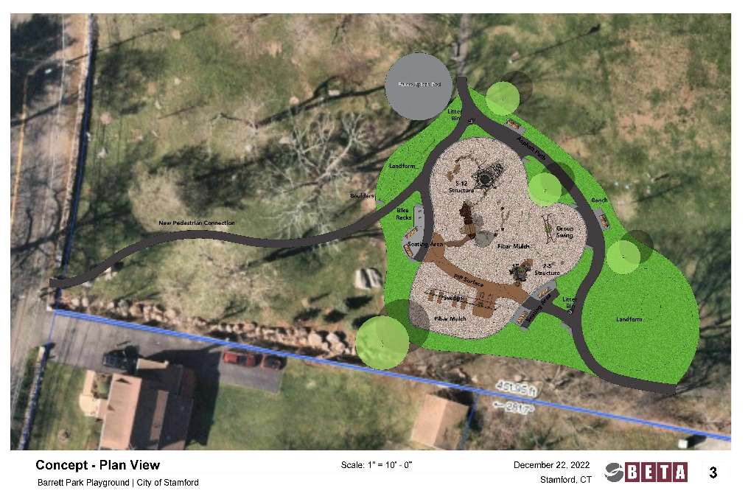
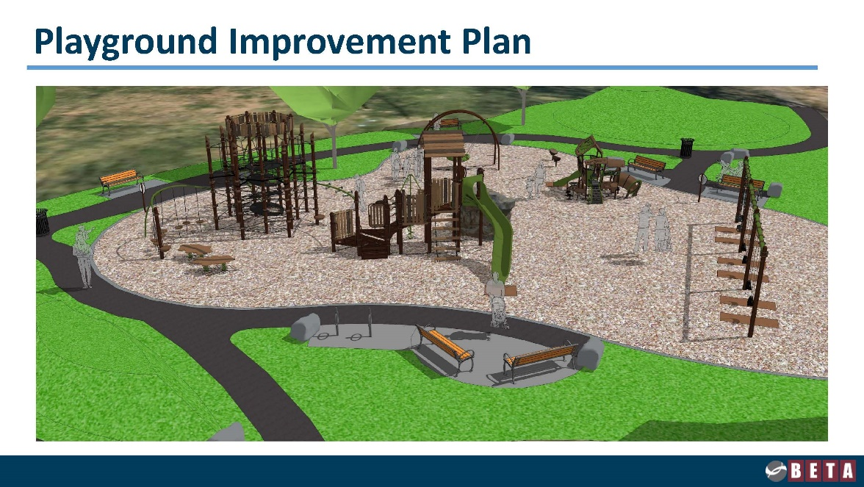
Barrett Park Playground and Drainage Improvements
Est. Completion date: End of May 2024
Project Cost: $757,000

Slide 15
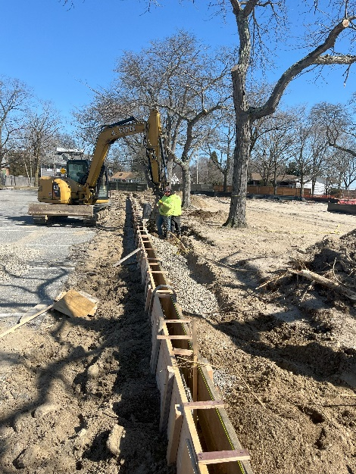
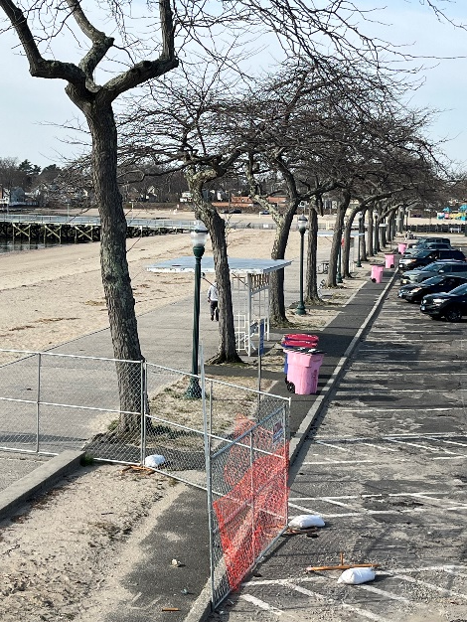
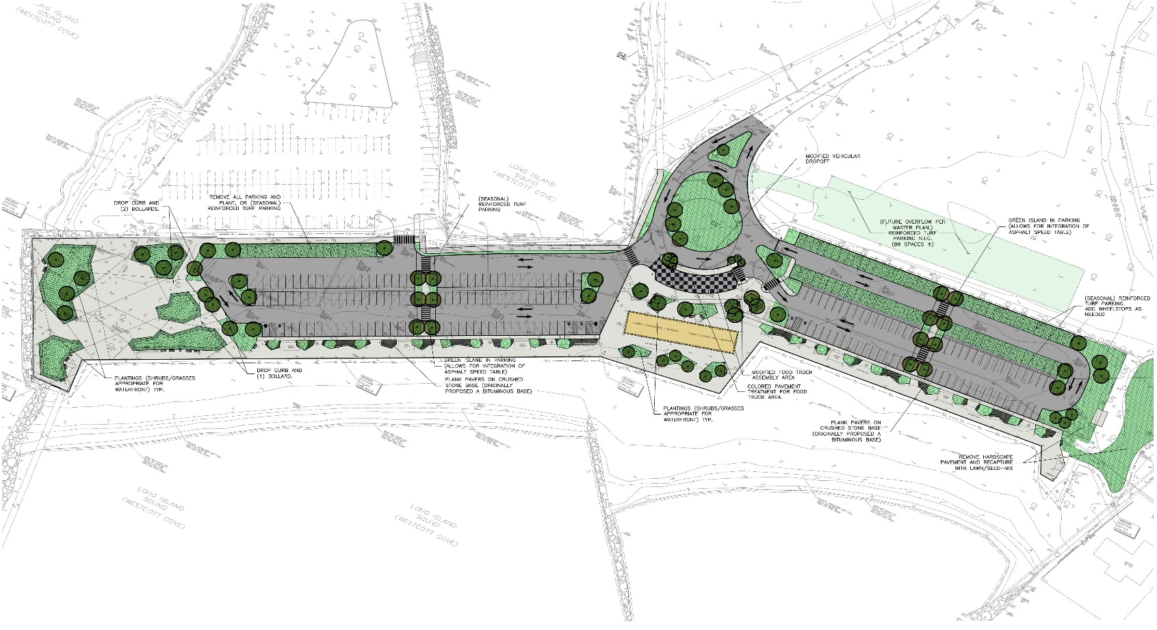
Cummings Park East & West Beach Promenades
Project Cost: $ 1.57M
Est. Completion July 2024

Slide 16
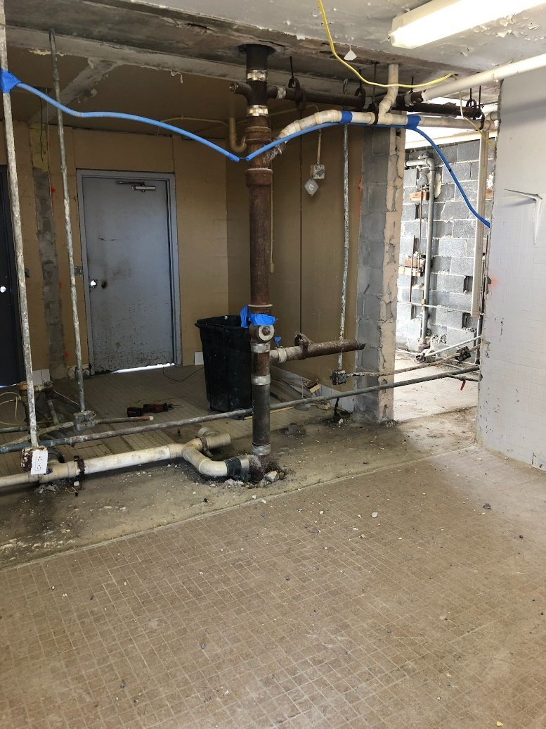
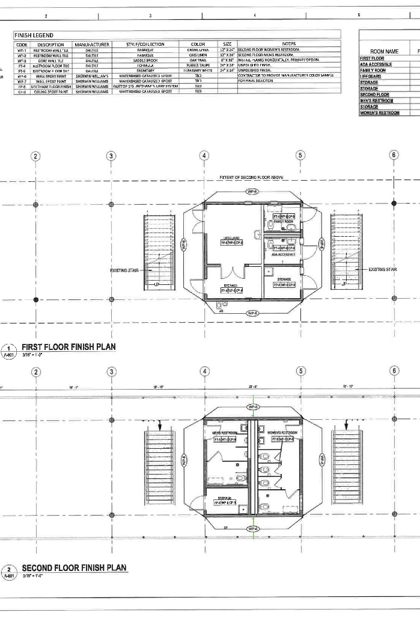
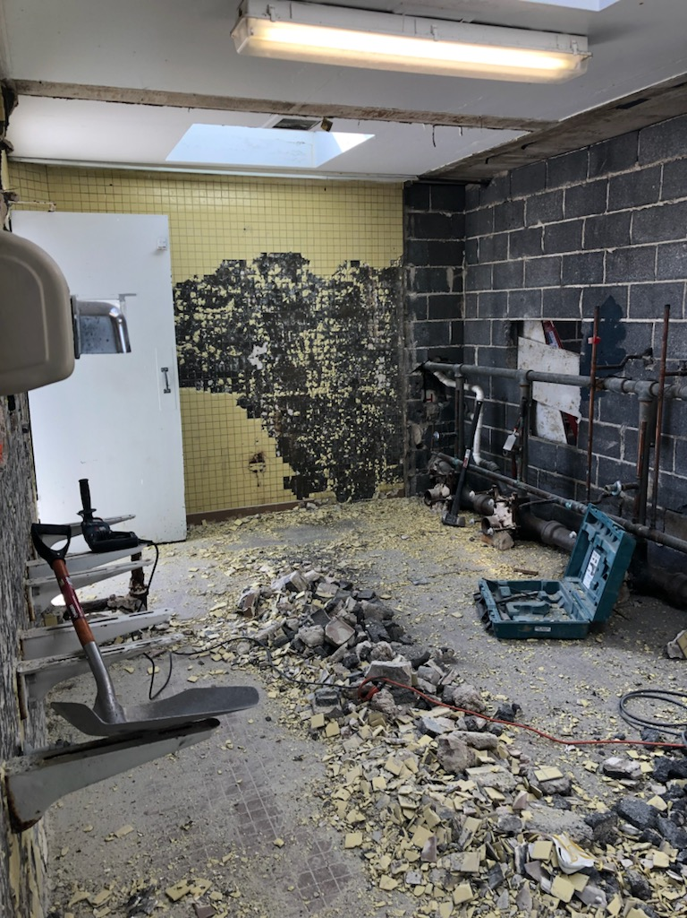
Anticipated completion date: June 2024
Project Cost: $353,000
1st Floor
2nd Floor
Renovations to Cummings Park Pavilion is underway

Slide 17
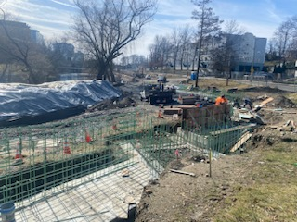
Mill River Middle Corridor Tresser Blvd. to Richmond Hill
Project Cost = $ 4M (State of CT DEEP Grant = $4M)
Est. Completion September 2024

Slide 18
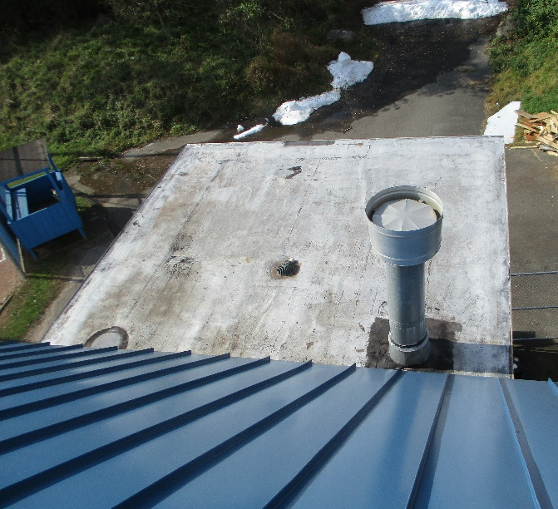
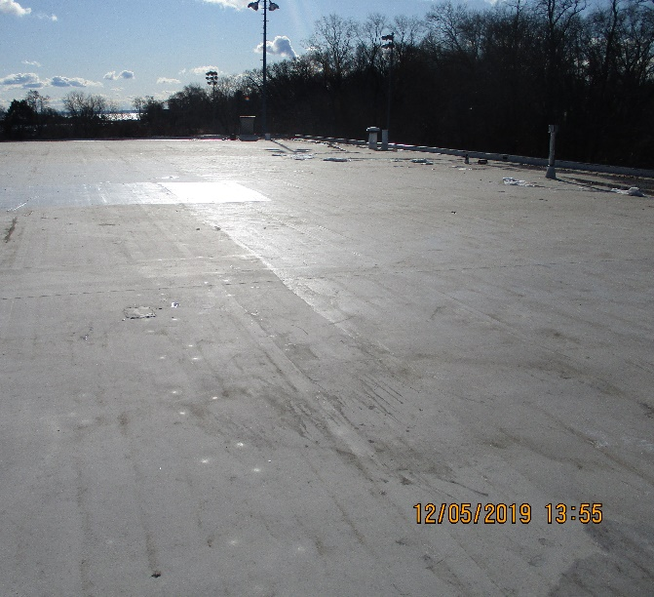
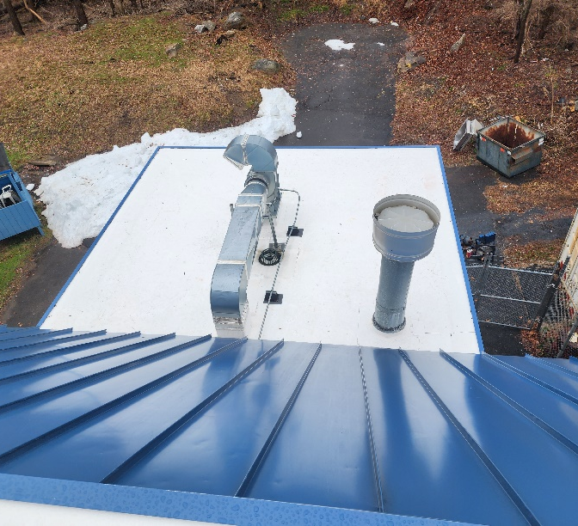
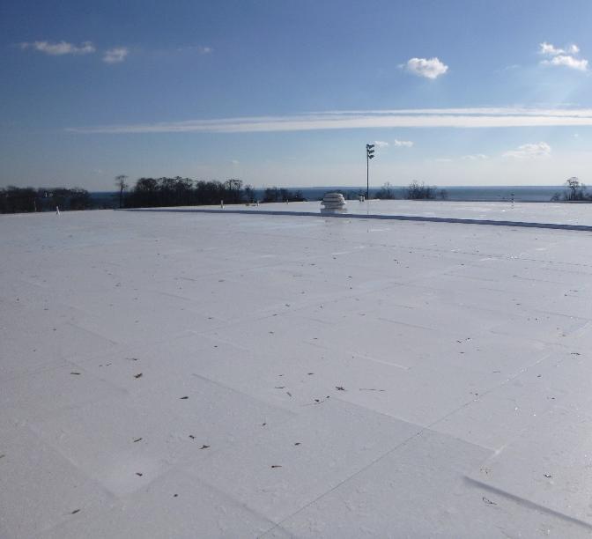
Completed Terry Conners Ice Rink Roof Replacement
Before
Project Cost: $735,000
After

Slide 19
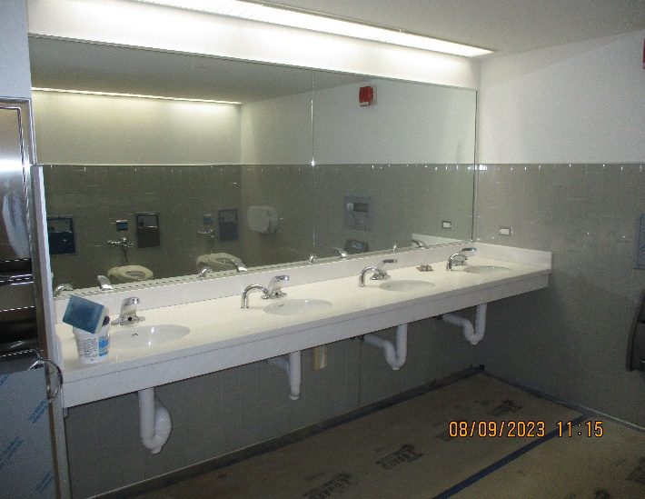
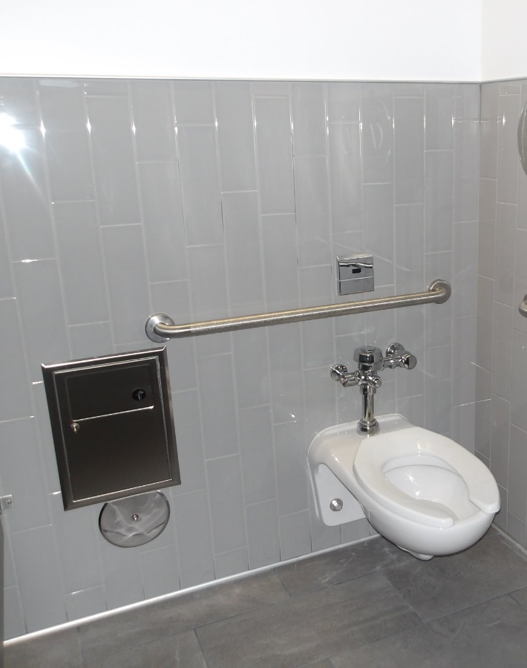
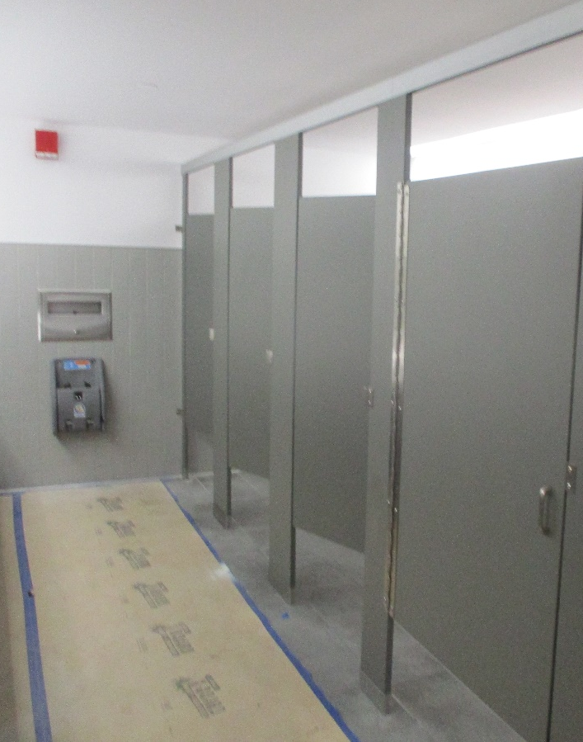
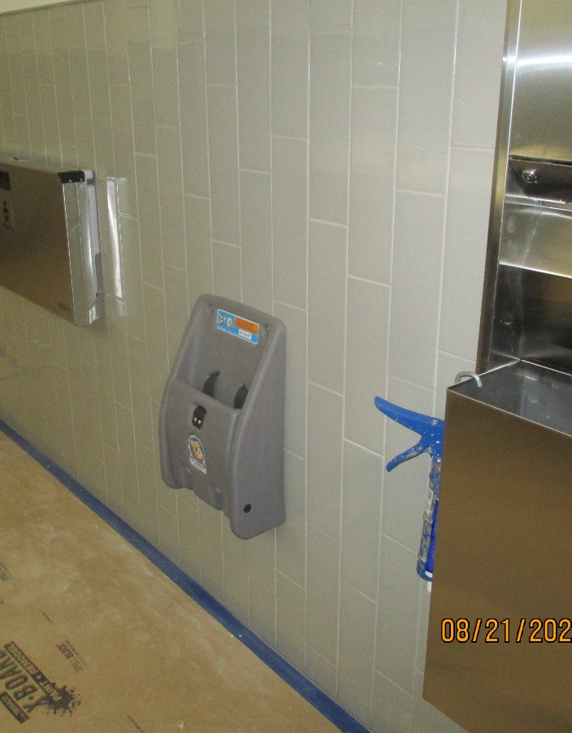
Completed Government Center Restrooms Renovations on 3rd and 5th floors
2nd floor to be completed by 6/30/24
Project Cost: $451,460

Slide 20
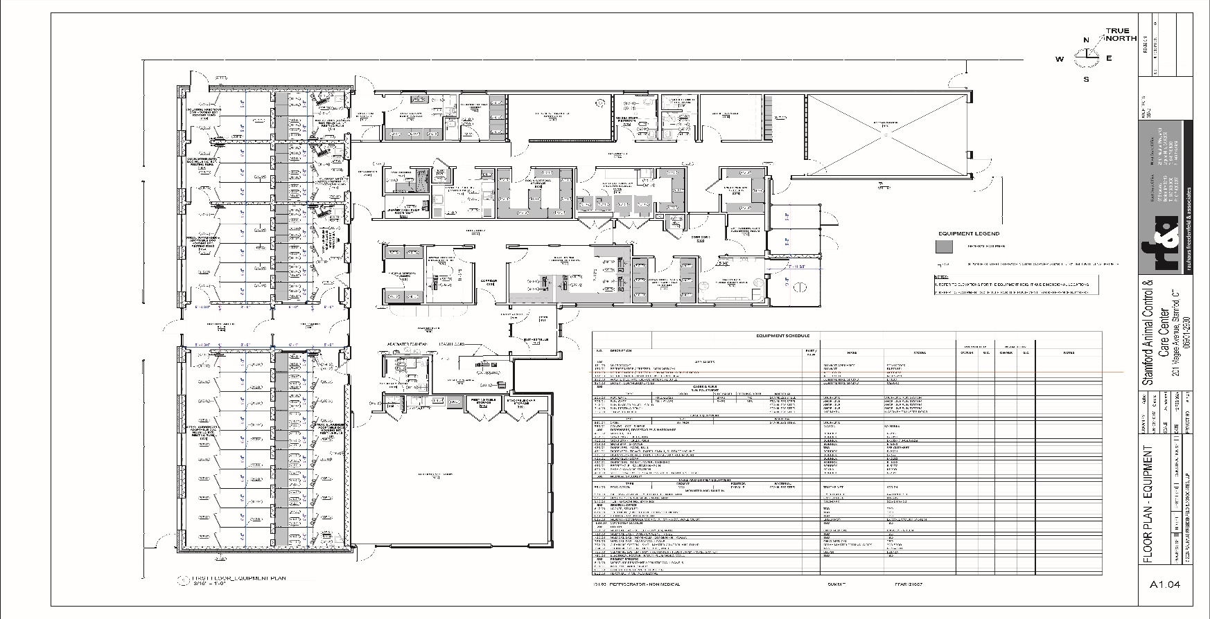
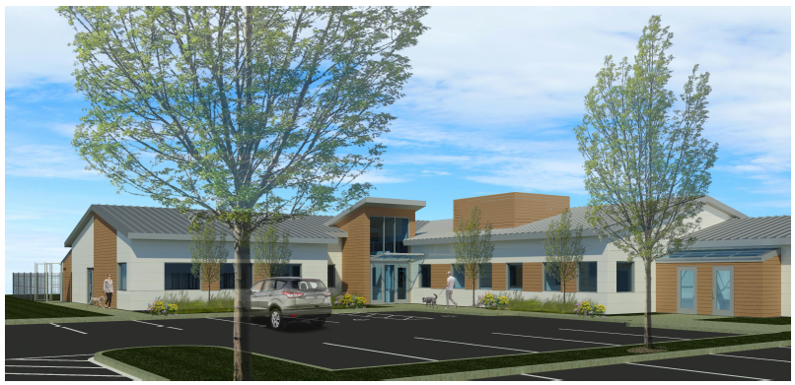
Animal Shelter
In-design

Slide 21
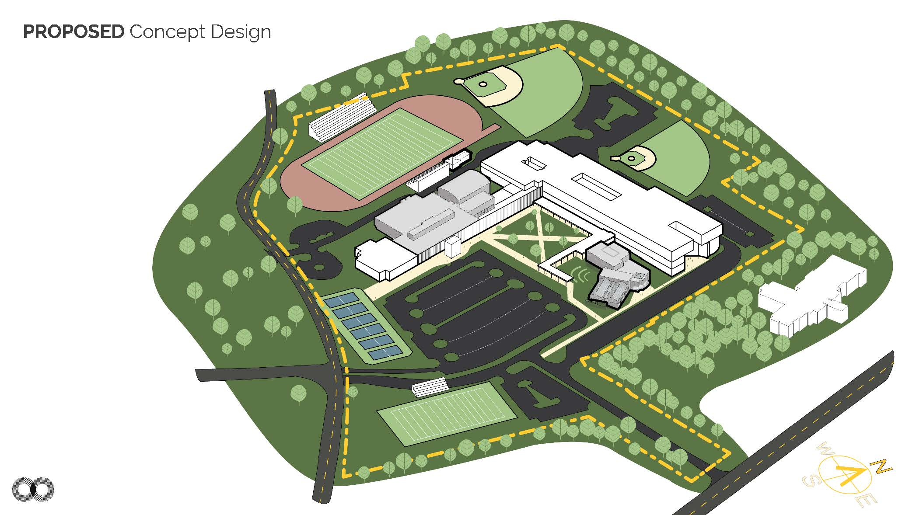
Westhill High School

Slide 22
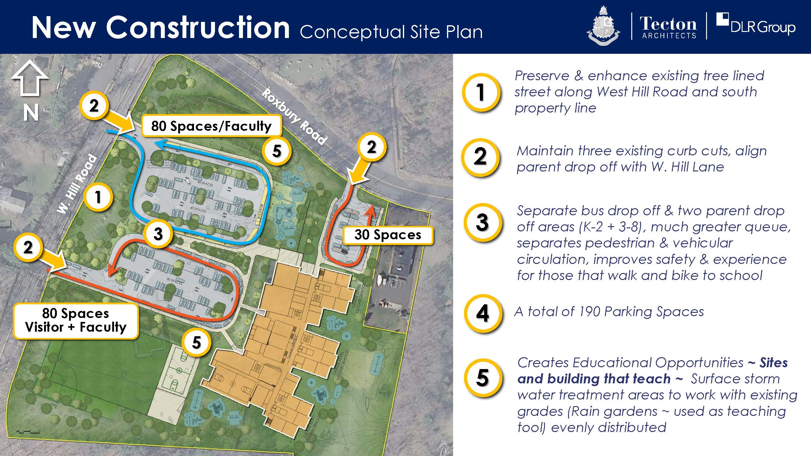
Roxbury School

Slide 23
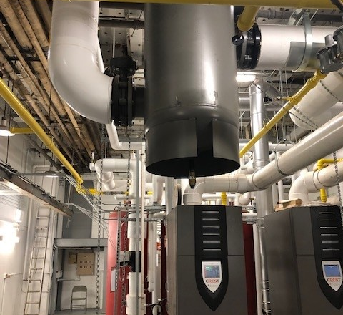
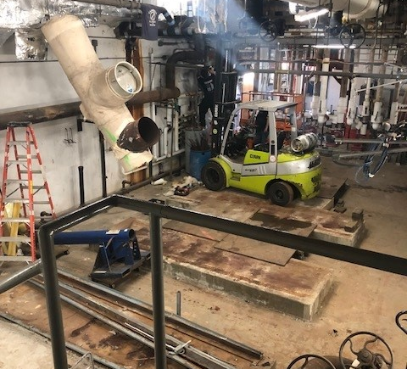
Completed Boiler Replacement at
Turn of River Middle School
Completed February 2024
Project Cost: $1.3M

Slide 24
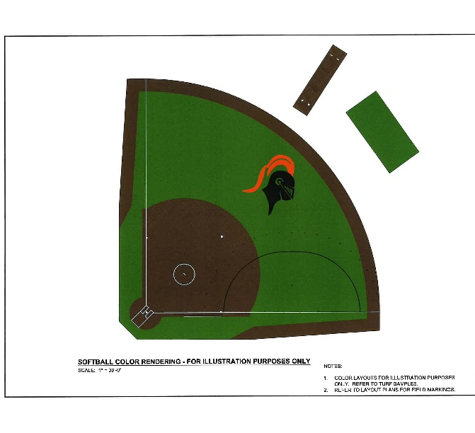
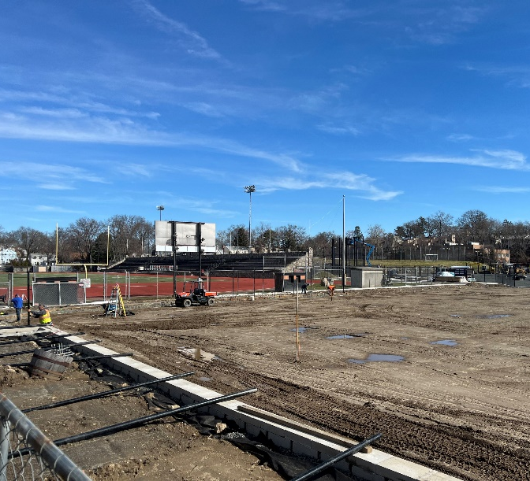
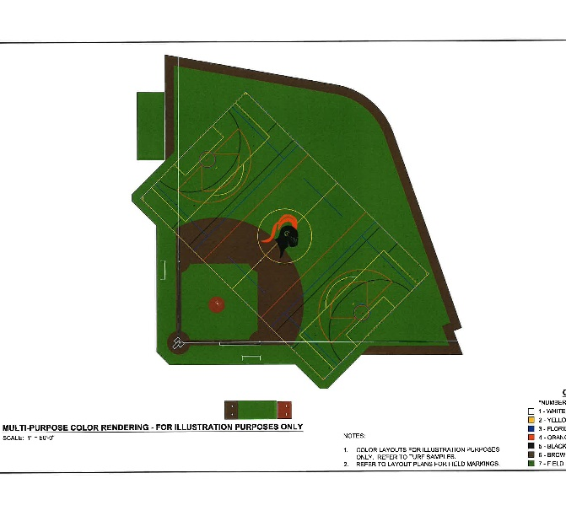
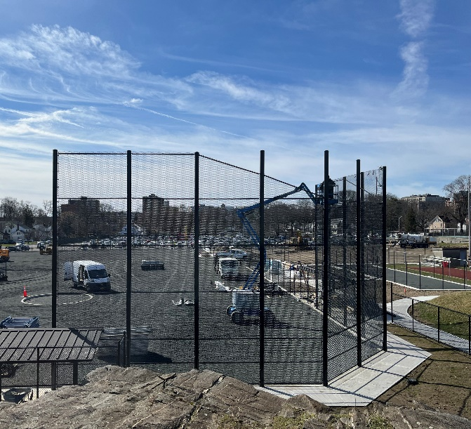
Stamford High School Synthetic Turf
Replacement
Softball field
Project Cost: $ 3,277,000
(State of CT DEEP Grant = $3M)
Project Completion June 2024
Baseball field

Slide 25

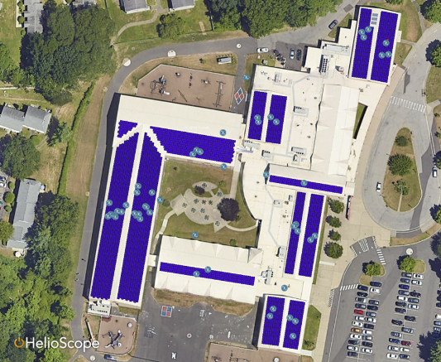



Solar Projects - BOE
All four Stamford schools were submitted and awarded generation-based incentives through Eversource’s competitive NRES program:
  Medium Projects (>200 kW AC)
    Incentive: $145/MWh over 20 years
    63 projects submitted, 19 awarded statewide
  Small Projects (≤ 200 kW AC)
    Incentive $201/MWh over 20 years
    119 projects submitted, 60 awarded statewide
CT DAS Grant may cover up to 60% project cost
30-40% Investment Tax Credit (ITC) via the Inflation Reduction Act (IRA) is available
Note:
  CBR = Capital Budget Request/Project Cost
  NB = Net Benefit
  PB = Payback
Westover Magnet School | 464 kW (AC)
Stamford HS | 544 kW (AC)
CBR: $1,596,920
CBR: $2,095,709
20 yr NB: $968,624
4.68 yr PB
20 Yr NB: $1,084,110
5.3 yr PB
Rogers International | 200 kW (AC)
Strawberry Hill School | 100 kW (AC)
CBR: $901,824
CBR: $461,014
20 Yr NB: $640,656
4.19 yr PB
20 Yr NB: $319,300
4.28 yr PB

Slide 26


Solar Projects - City
Yerwood Center | 121kW (AC)
CBR: $454,230
Two projects from Stamford were submitted and awarded generation-based incentives through Eversource’s competitive NRES program:
  Small Projects (≤ 200 kW AC)
    Incentive: $201/MWh over 20 years
    119 projects submitted, 60 awarded statewide
30-40% Investment Tax Credit (ITC) via the Inflation Reduction Act (IRA) is available
Note:
  CBR = Capital Budget Request/ Project Cost
  NB = Net Benefit
  PB = Payback
20 yr NB: $197,171
12.19 yr PB
Vehicle Maintenance | 200 kW (AC)
CBR: $552,240
20 Yr NB: $458,905
8.82 yr PB

