Slide 1
CITY OF STAMFORD Information Technology Isidore Sobkowski isobkowski@StamfordCT.gov 203-977-7963 Board of Finance March 26, 2024

Slide 2
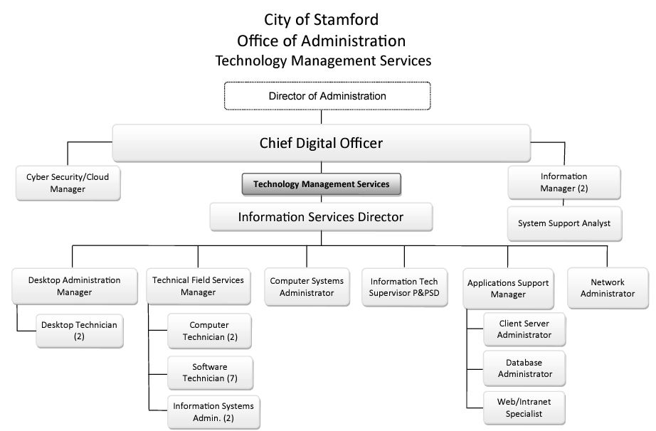
1. Org Chart is up-to-date: No changes since budget book was printed

Slide 3
2. Staffing Updates
Additions: None
Deletions: None
Salary Changes: None
Union negotiated: Per CoS Contract
Note: No Head Count Ask

Slide 4
3. Explanation for any budget increases in individual line accounts
A. Combine 1050 and 1060 into 1060 (TMS)
All current 1050 expenses are migrated to the matching 1060 accounts
All items are now showing as a combined total.
B. Software
Total Variance $424,940 (Base budget $1.598M, Dept Request for FY $2.023M)
Cloud: Move from Capital to Operations
Office 365 Variance $100K Due to added users, Entire CoS is now active
Office 365 Back-up Variance $130,000 (new) Teams, one-drive, etc.
ERP Variance $156,829 Move from capital to operations
Legacy:
Software maintenance Variance $38,111 Annual increase

Slide 5
4. What adjustments could be made if the department budget were to be reduced?
Professional Consulting
Professional Services
Consistent with 2023-2024 ($600K for Office 365 and Cyber-security)
IT request was $600K for 2024-2025
$120K (20%) has already been cut, leaving $480K for projects
Project | Amount | Description
Cyber security | 200K | Protecting sensitive date, encryption, end-point security
System migration from on-premises to cloud | 300K | Ongoing as on-premises reach systems end of life
Innovation consulting services | 100K | UCaaS – Teams telephone migration
Total… | $600K $480K

