Slide 1
BOYS & GIRLS CLUB OF STAMFORD
Craig Baker
Chief Executive Officer
Notes:
-Dibbles scores present us as an org that can measure results and achieve outcomes for kids
-identifying the problem - should be put together up front earlier and specifically stated
'our impact is a placeholder' - do we even need it
full color logo on plain background
Add Gary Wendt Teen center to be consistent with website - check website for order
why are we capable - why us - 22 busses

Slide 2
1
Who We Are
2
The Need
TABLE OF CONTENTS
3
Why BGCS Best Suited to Address the Need
4
What We Offer
5
Program Vision
6
Request for Support

Slide 3
public school buses drop off at BGCS
Teen center expansion and YMCA closure increasing demand to 550+ daily
22
TWO LOCATIONS
Mary C. Rich Clubhouse
Yerwood Center
Provide underserved youth access to after school and summer camp programs
Notes:
Karyn: When I think about what makes our Club unique, I think about access and scale. Our two locations are physically located in the heart of the community we serve, the westside of Stamford, where, unfortunately, socioeconomic challenges pervade. Families are never turned away from our programs and essential services, regardless of their finances or ability to pay.
This is the place where youth feel safe, the place parents can count on, and the place that acts in lockstep with the City of Stamford and public school system.

Slide 4
CLUB DEMOGRAPHICS
3,000+
95%
99%
65%
51%
youth served between the
ages of 5-18
youth of color
families below CT income survival budget of $75,000
of members come from households below federal poverty line of $30,000
of youth we serve come from single parent households
Notes:
Karyn: I believe most people share a desire to help the youth of their community, that's why I first got involved. But the truth is if you are a family that has means there are incredible resources out there. For families near or below the poverty line, for single-parent households, for youth facing stereotypes and discrimination, it is a whole different ballgame. That's why I feel so strongly about moving the needle for the youth who truly need our support the most. When you hear about the opportunity gap or the talent gap, it is our youth they are talking about. When you hear about people of color underrepresented in STEM, we hear the need to catalyze the exposure and education of our youth if we want to realize long-term results for girls like Jayda (next slide).

Slide 5
ALARMING COMMUNITY ISSUES
In Stamford, young people face big challenges, including:
POVERTY
1 in 11 live in poverty
FOOD INSECURITY
1 in 7 lack consistent access to food
ACADEMIC FAILINGS
53% cannot read at grade level by grade 3
VIOLENCE, GANG ACTIVITY, DRUG USE
1 IN 5 YOUTH ARE UNSUPERVISED AFTER SCHOOL
ONE MISTAKE CAN RESULT IN LIFELONG CONSEQUENCES

Slide 6
THE NEED
Not all youth graduate
from High School
Many youth who graduate from High School don’t
go to college
Youth are Unemployed / Underemployed –
possibly for life
Rise in Crime & Drug Use

Slide 7
BGCS BEST SUITED TO
ADDRESS THE NEED
We serve over 3,000 youth annually | Over 550 youth attend the Club daily after school | We have continuity and a pipeline of youth from grades K – 12 | We have delivered over the years – and we are poised to scale our offering
WE NEED YOUR HELP TO SCALE

Slide 8
PROGRAM OVERVIEW
CHARACTER & LEADERSHIP DEVELOPMENT
EDUCATION & ENRICHMENT
WORKFORCE DEVELOPMENT
ATHLETICS & WELLBEING

Slide 9
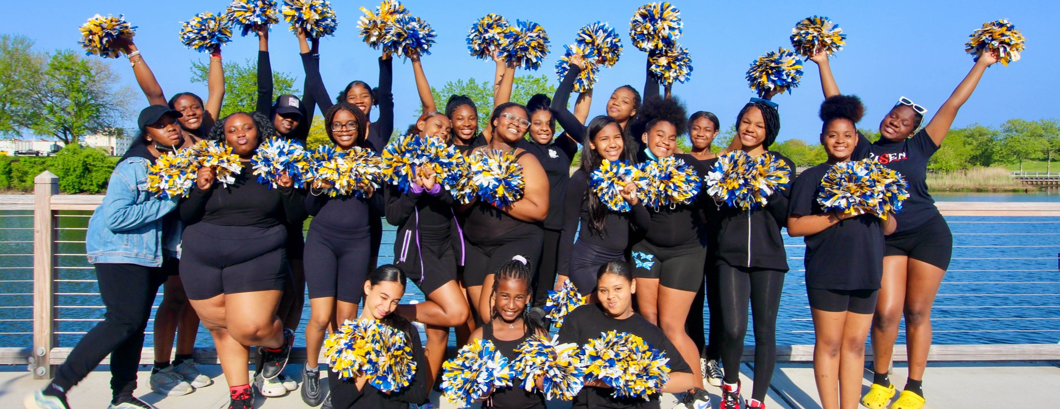
WHAT WE NEED

Slide 10
PIPELINES TO COLLEGE AND CAREER SUCCESS
PROGRAM VISION
EDUCATION AND ENRICHMENT
K-12
2024-2028
Literacy and Homework Help
STEM
Graduation with a Plan
WORKFORCE DEVELOPMENT
Culinary Arts
STEM
Counselors in Training - Summer Camp/Lifeguard
Internships/Apprenticeships
Invest in program staff and curriculum development to increase teen enrollment 2x within 5 years
Amplify impact through robust programs and intentional pipelines to college and career success
HOW WE WILL INCREASE ENROLLMENT
ATHLETICS AND WELLBEING
Basketball
Swimming
Soccer
VISUAL AND PERFORMING ARTS
Recording Studio
Instruments - Keyboard, Drums, Brass
Dance, Drill Team, Fine Arts

Slide 11
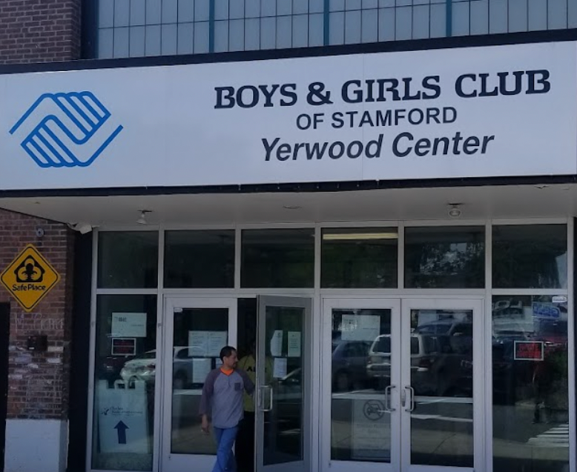
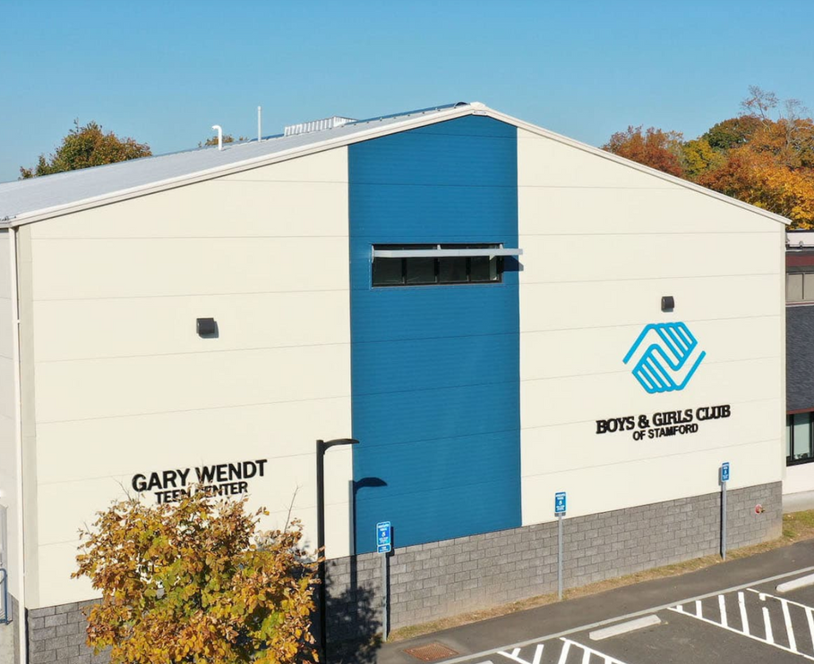
REQUEST FOR SUPPORT
2024-2025 - CORE PROGRAMS
MARY C. RICH CLUBHOUSE AND GARY WENDT TEEN CENTER
$148,784
YERWOOD CENTER*
$231,802
*City of Stamford requested BGCS operate Yerwood Center in 2015. While it has increased our capacity, it continues to be an overweighted operating burden.

Slide 12
REQUEST FOR SUPPORT
2024-2025 - CITY OF STAMFORD PARTNERSHIPS
COMMUNITY NIGHT PROGRAM*
$123,435
COMMUNITY SWIM PROGRAM*
$60,000
SUMMER CARE POVERTY ALLEVIATION
$60,980
*City of Stamford requested BGCS form Community Night Program in 2015 and Community Swim Program in 2021

Slide 13
SUMMER CARE -ACCESS
NEED
Increase capacity to meet demand, ensure 50-150 more youth have a safe, positive, and productive place this summer.
OUTCOME
Combat learning loss, avoid juvenile crime, improve mental health and food security.

Slide 14
MAILING ADDRESS
347 Stillwater Avenue
Stamford, CT 06902
REACH OUT
EMAIL ADDRESS
cbaker@bgcastamford.org
PHONE NUMBER
(203) 324-0594

