Slide 1
SCOFIELD MANOR
Stamford’s residential care home
REQUEST FOR FY24/25
OPERATING AND CAPITAL FUNDING
Stamford Board of Finance
April 4, 2024
Natalie Coard, Executive Director
Vincent Tufo, Chief Executive Officer

Slide 2
PROGRAM BACKGROUND
Residential Care Homes offer a continuum of residential support and care for occupants with limited financial means who are living with mental and/or physical disabilities.
RCH’s provide an array of supportive services, personalized assistance, and health care and pharmacological support to meet residents’ diverse needs.
This unique combination of specialized services fills the gap between independent living and far more costly skilled nursing home level of care.
Scofield Manor is the only Residential Care Home in Stamford and the only RCH is operated and managed by Charter Oak Communities.

Slide 3
REQUEST FOR FY24/25 OPERATING SUPORT
Charter Oak Communities (COC) requests $447,619 to continue operating the 50-bed, City-owned Residential Care Home (RCH), Scofield Manor.
COC and the City are committed to preserving this link in the continuum of care for Stamford’s most vulnerable residents and are pursuing alternatives to place Scofield on a sustainable financial and operational footing.
In the short term, however, Scofield Manor continues to run a structural operating deficit and requires the requested funding for its continued operation.

Slide 4
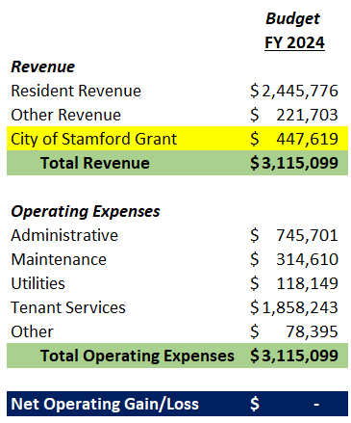
FINANCIAL SUMMARY

Slide 5
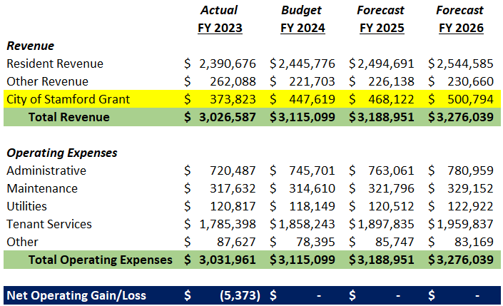
TRENDING PROJECTION

Slide 6
REVENUE DRIVERS
Occupancy rates: Occupancy is currently hovering at about 90%.
While indicating that Scofield Manor is a needed facility, this suboptimal occupancy rate impacts our Medicaid revenue.
A full complement of staffing is State-mandated, but we are only reimbursed based upon the resident census.
State reimbursement: Scofield Manor was ‘flat funded’ by the State up to the 2021 fiscal year, although costs have increased at the rate of inflation.
The main funding source, State Medicaid payments have increased in the past year by $4.22 per patient day, an increase of only 3%.

Slide 7
EXPENSE DRIVERS
Medical coordination: With high acuity level of residents, nurses are responsible for managing 600+ daily medications, hospital transfers, physician visits, COVID protocols, and visiting therapeutic services.
Qualified staffing: The shortage of available staff having required certifications forces temporary outsourcing for licensed nursing and attendants.
Utilities and Food: Electricity and heating oil costs have increased 10% to 20%; Food is 6-8% above previous years’ cost.
Extraordinary maintenance: Although the City is responsible for capital replacement (e.g., boiler, roofing), COC provides ongoing repairs to this 90+ year old facility (e.g., piping, pumps, tanks, etc.).

Slide 8
REQUEST FOR FY24/25 CAPITAL SUPPORT
Charter Oak Communities (COC) requests $575,000 to fund needed capital repairs and replacement at the 50-bed, City-owned Residential Care Home (RCH), Scofield Manor.
COC and the City are committed to preserving this link in the continuum of care for Stamford’s vulnerable residents by addressing its ongoing capital needs and to ensure that the facility is operated responsibly and efficiently.
Working together for over 30 years, the City of Stamford and Charter Oak Communities have maintained the 90+ year old facility so that it may safely and comfortably continue to serve the needs of our community.

Slide 9
CAPITAL REQUEST #1 - $350,000.00 Replace Existing Chiller & Vertical Stack Air Conditioning
COC proposes to replace 45 individual vertical stack fan coil units located in the resident rooms and offices throughout the building. They are in poor condition and the same age as the chiller (35 years+).
Parts for both the chiller and the fan coil units are increasingly hard to locate.
Cleaned 2X a year and filters replaced, they are increasingly problematic and prohibitive to maintain.
Obtaining parts for the chiller has resulted in periodic shutdowns while parts are ordered, delivered, and installed.
There is a potential liability during periods of extremely hot weather if the system were to fail for a prolonged period of time and parts are not immediately available. This will negatively impact Scofield’s vulnerable population resulting in unnecessary disruption and potential health hazards.
Approval to replace the system would reduce the liability and eliminate ongoing costly repairs, saving money in the long run.

Slide 10
CAPITAL REQUEST #2 - $225,000.00 Replace Windows, Site Paving & Site Lighting
Window Replacement – The windows throughout the entire facility are worn out, leak energy and need replacement.
New windows will increase energy efficiency, improve security, and add curb appeal resulting in increased property value and improved occupancy levels.
Site Paving- The parking areas and driveways at Scofield Manor are in poor condition. A majority of the driveway presents hairline cracking and settling and generates numerous potholes requiring constant repair.
The driveways should be resurfaced to prevent tripping hazards. The curbing throughout the development is in poor condition and must be replaced.
The portion of the driveway in front of the building will be taken to grade and new asphalt and curbing installed.
Lighting- The light poles are 20+ years, and the fixtures need replacing. Site lighting is proposed to be added to the front lawn sitting area for the benefit of residents.
New site lighting enhances the safety and security vulnerabilities.

Slide 11
SUMMARY
The City’s support for Scofield Manor is vital to provide this essential service to our most vulnerable residents, most of whom would no longer be able to live on their own.
Until a long-term alternative has been identified and implemented, the city grant will ensure the continuation of essential functions not covered under State reimbursement.
While COC has made strides in stabilizing Scofield Manor’s financial position, COC is unable to absorb current and projected financial losses without additional financial support from the City.
Therefore, under present operating conditions, Scofield Manor is not sustainable without the City Grant and requires $447,619 to cover operating costs for the 2024 fiscal year and $575,000 to address accrued capital needs.

Slide 12
SCOFIELD MANOR
Stamford’s residential care home
QUESTIONS and COMMENTS
Stamford Board of Finance
April 4, 2024

