Slide 1
BUDR

Slide 2
Introduction
Joseph Capalbo, Esq.
Derrick Gibbs, Owner
Carl Tirella, Owner
Jim Bubaris, Traffic Consultant
Ken Frattaroli, Surveyor

Slide 3
389 WEST MAIN STREET
North side of West Main on the corner of West Main Street and Liberty Street
Lot Area: 15,236 sq. ft.
One story brick building constructed in 1978
Building Size: 2,449 sq. ft.
20 existing parking spaces, 2 handicap
Zones C-L, Limited Business District
Allows the Proposed Use by Special Permit

Slide 8
BUDR
Derrick Gibbs, Owner
Company Information

Slide 10
BUDR Community Outreach
1. Attended two community meetings at Bethel ME Church.
2. With the assistance of Cynthia Bowser, organized a community meeting where BUDR presented to community leaders and residents of the West Side at the Stamford Police Department Community Room.
Met with Reverend Ford of Faith Tabernacle Church and Reverend Bradley of Union Baptist Church.
Met twice with Representative Corey Paris.
Met with State Black and Puerto Rican Caucus – several City of Stamford officials sit on the caucus.
Provided tours of the BUDR Danbury facility to 3 West Side Community Leaders: Cynthia Bowser, Community Activist, Maya Donald, President of CORNERS and Mike Meyer, Director Family and Community Development.
Met with Representative Denis Patterson (6th) and and briefly with Representative Bonnie Kim Campbell (5th)
Spoke with Janeen Freeman- Special Assistant to the Mayor and Director of Partnership and Community Engagement.
Met with Matt Quinones, Director of Operations to discuss West Side operational concerns.
Also reached out to Craig Baker at the Stamford BGC; Jeffrey Stella and Kindrea Walston, District 9 Reps; Representative Davis Michel and Senator Patricia Billie Miller.

Slide 11
Site Information
Carl Tirella
Retail Layout
Purchase Process
Building Details
Security

Slide 12
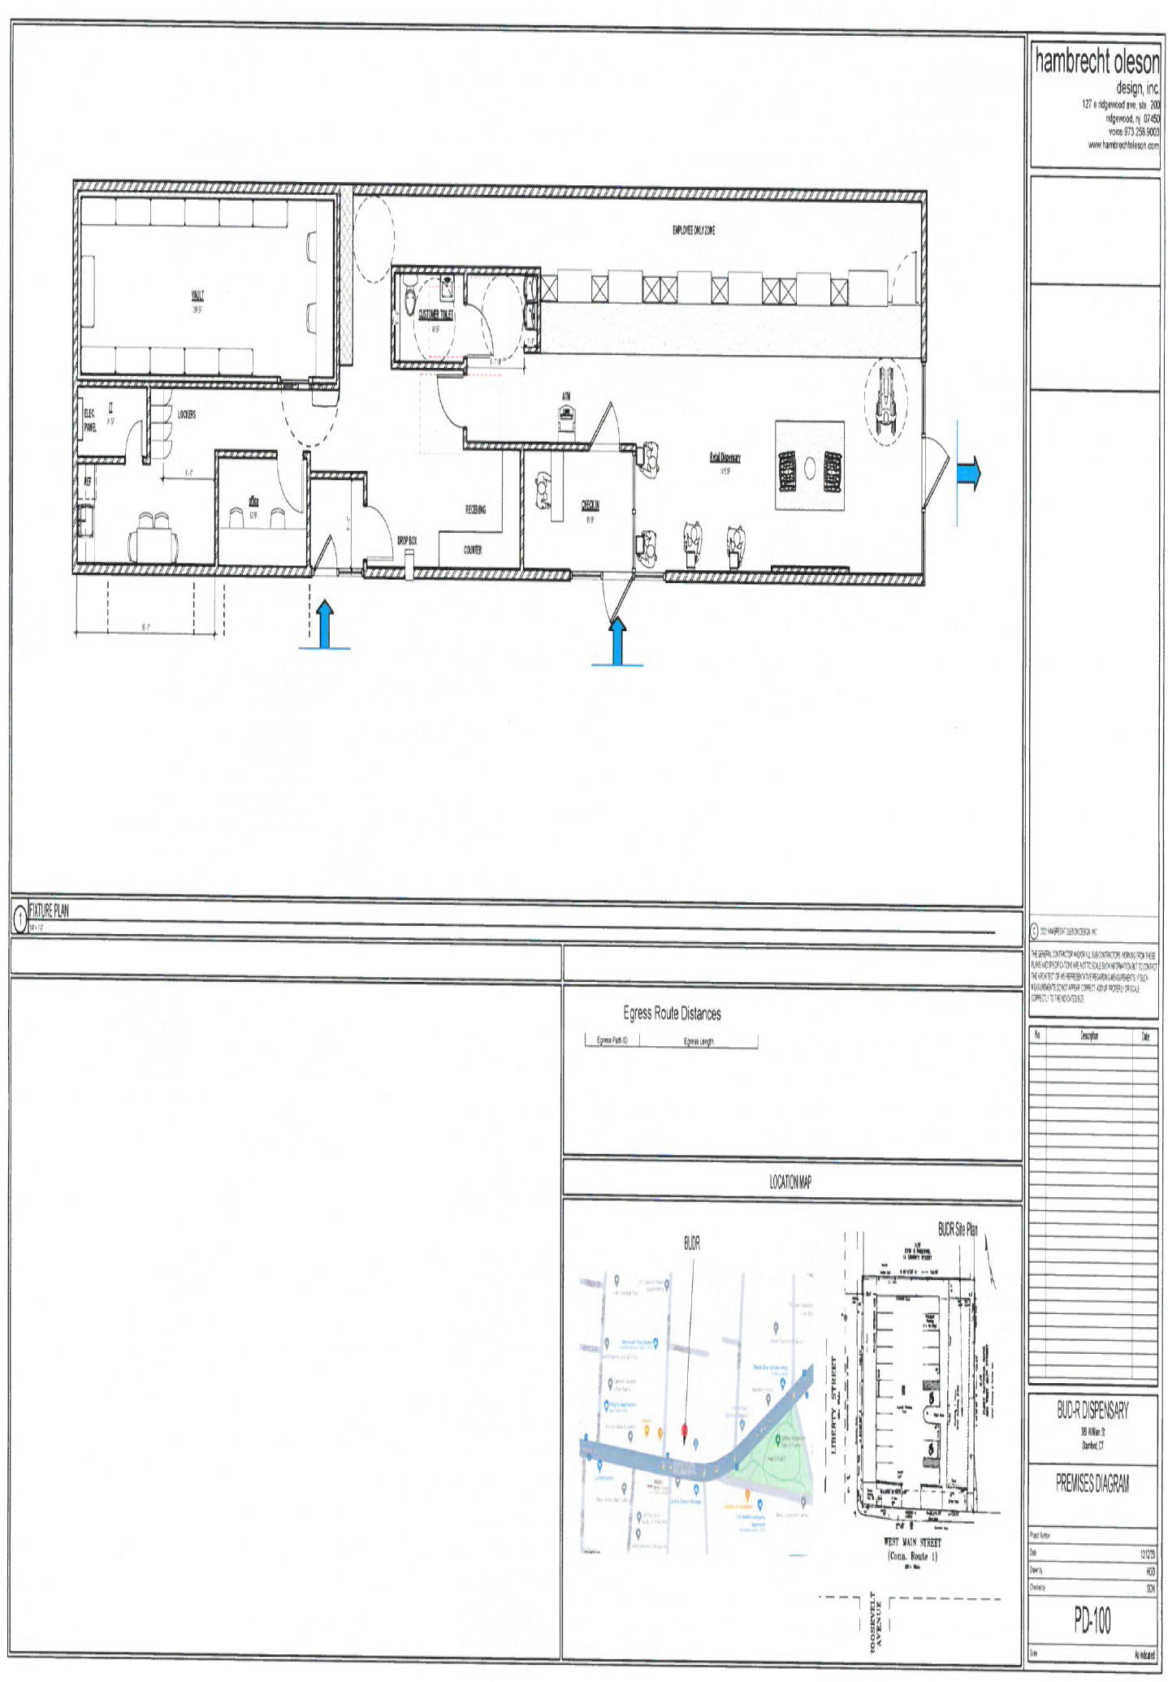

Slide 14
Traffic
Bubaris Traffic Associates – Report/Study

Slide 15
Conclusions
It is the professional opinion of Bubaris Traffic Associates that the proposed cannabis facility, to be located at the northeast quadrant of the signalized intersection of West Main Street at Liberty Street and Roosevelt Avenue, with access to/egress from the surrounding roadway network via the one existing drive serving the site intersecting the north side of West Main Street east of Liberty Street, should not adversely impact traffic operations on the surrounding roadway network in the year 2025-2026 when occupancy of the subject space and full operation is expected.
The proposed development will generate about 22 vehicular trips per hour during the weekday am peak, about 46 trips per hour during the weekday pm peak, and about 70 trips per hour during the Saturday midday peak, where each patron visiting the site will generate one inbound and one outbound vehicular trip. Therefore, the projected patron numbers would be HALF of these estimated trip generation estimates.
Traffic operational analyses indicate that the proposed development should not have an adverse impact on traffic operations with good to excellent levels of service.
The traffic crash experience for the subject study area is satisfactory, with no recurring problems that need to be corrected, or that may be exacerbated by the proposed development.
Available sight line distances at the proposed site drive location were found to be satisfactory.

Slide 16
STAMFORD ZONING REGULATIONS: ADULT-USE CANNABIS RETAILER
SECTION 5.E
Adult-Use Cannabis Retailer means a place of business licensed by the State of Connecticut where Adult-Use Cannabis may be sold at retail directly to qualifying customers. The regulations for Adult-Use Cannabis Retailer shall also apply to Hybrid Retail facilities where both Medical Marijuana and Adult-Use Cannabis products are sold at a retail directly to qualifying customers and/or patients.

Slide 17
STAMFORD ZONING REGULATIONS: ADULT-USE CANNABIS RETAILER
STANDARDS:
In Stamford there shall be no more than one Adult-Use Cannabis Retailer for every 25,000 residents.
There are currently 3 Retailers with Permits. Stamford would permit up to 5 based upon a population of about 136,000.
2 Permits currently available

Slide 18
STAMFORD ZONING REGULATIONS: ADULT-USE CANNABIS RETAILER
STANDARDS:
Adult-Use Cannabis Retailers must possess a current license from the State of Connecticut Department of Consumer Protection. Evidence of proper licenses must be provided in connection with a Building Permit application. Failure to maintain proper licenses shall be deemed an immediate violation of the City of Stamford Zoning Regulations.
Applicant maintains a current Connecticut license and has other locations already established and operating in Connecticut. The license shall be presented prior to the Building Permit Application process.

Slide 19
STAMFORD ZONING REGULATIONS: ADULT-USE CANNABIS RETAILER
STANDARDS:
No Adult-Use Cannabis Retailers shall be located within a 3,000 foot radius of any other Dispensary, or within 1,000 feet of public or non-public schools.
The proposed location does not fall within a radius of 3,000 feet of any other approved Dispensary, nor is it proposed to be within 1,000 feet of a public or non-public school as schools are defined in the Stamford Zoning Regulations.

Slide 20
STAMFORD ZONING REGULATIONS: ADULT-USE CANNABIS RETAILER
STANDARDS:
Signage for Adult-Use Cannabis Retailers shall be the more restrictive either (1) the requirements of the State of Connecticut relating to signage for Adult-Use Cannabis Retailers or (2) the sign regulations for the retrospective zoning district as prescribed in Section 13 of those regulations. In addition, the following limitations shall apply:
There shall be no illumination of a Sign advertising adult-use cannabis products at any time;
There shall be no signage that advertises adult use cannabis brand names or utilizes graphics related to marijuana or paraphernalia on the exterior of the Dispensary or the Building in which the Dispensary is located.
There shall be no display of adult use cannabis or paraphernalia within the facility which is clearly visible from the exterior of the facility; and
There shall be no signage on the exterior of the facility which advertises the price of its adult-use cannabis.
All signage will conform to the requirements of the Zoning Regulations.

Slide 21
STAMFORD ZONING REGULATIONS: ADULT-USE CANNABIS RETAILER
STANDARDS:
Parking shall be provided according to Section 12 of the Zoning Regulations, following the parking standard for the Retail Store.
Applicant is proposed to be located in a free standing commercial structure with 20 exclusive on site parking spaces
9.8 parking spaces are required at a ratio of 4/1000
20 spaces provided

Slide 22
STAMFORD ZONING REGULATIONS: ADULT-USE CANNABIS RETAILER
USE | RA-3 | RA-2 | RA-1 | R-20 | R-10 | R-7 ½ | R-6 | RM-1 | R-5 | R-MF | R-H | C-N | C-B | C-L | C-G | C-C | C-I | M-L | M-G
ADULT USE CANNABIS RETAILER | - | - | - | - | - | - | - | - | - | - | - | B | B | B | - | - | B | B | B
APPENDIX A – TABLE I LAND USE SCHEDULE
- : Indicates that a Use is not permitted in the respective Zoning District
B : Indicates a Use that is subject to approval by the Zoning Board, pursuant to the regulations for the respective Zoning District and Section 19.C. of these Regulations and Section 19 of these Regulations.

Slide 23
SECTION 19.C. SPECIAL PERMITS
19.C.2 – STANDARDS AND CONDITIONS
The location and nature of the proposed site including its size and configuration, the proposed size, scale and arrangement of the Structures, drives and Parking Areas and the proximity of existing Dwellings and other Structures.
The applicant will occupy the existing structure. No external improvements are proposed.
The size, scale, and arrangement of the existing site will not be altered or effected.

Slide 24
SECTION 19.C. SPECIAL PERMITS
STANDARDS AND CONDITIONS
The nature and intensity of the proposed use in relation to its site and the surrounding area. Operations in connection with Special Permit uses shall not be injurious to the neighborhood, shall be in harmony with the general purpose and intent of these Regulations, and shall not be more objectionable to nearby properties by reason of noise, fumes, vibration, artificial lighting or other potential disturbances to the health, safety or peaceful enjoyment of property than the public necessity demands.
The existing zone is one of the few which permits the applicants intended use.
The intensity of the proposed use is consistent with the other existing and permitted uses in the area.
The proposed use does not generate noise, fumes, vibrations or artificial lighting or other potential disturbances.
The fact that this location is one of the few that permits the proposed use and is consistent with the surrounding uses, makes it “per-se” in harmony with the general purpose and intent of the regulations.

Slide 25
SECTION 19.C. SPECIAL PERMITS
STANDARDS AND CONDITIONS
The resulting traffic patterns, the adequacy of existing Streets to accommodate the traffic associated with the proposed use, the adequacy of proposed off-street parking and loading, and the extent to which proposed driveways may cause a safety hazard, or traffic nuisance.
Applicant’s traffic study provides that the proposed use will not have an adverse impact to the existing traffic
Study is comprehensive and takes into consideration all the standards enumerated in this section
Traffic operational analysis concludes no adverse impacts on traffic operations with good to excellent levels of service

Slide 26
SECTION 19.C. SPECIAL PERMITS
STANDARDS AND CONDITIONS
The nature of the surrounding area and the extent to which the proposed use or feature might impair its present and future Development.
The applicant is and will be located in an existing building. There are no external improvements proposed or intended. What possibilities for future development exist at this site, if any, are not affected by the applicant’s proposed use.

Slide 27
SECTION 19.C. SPECIAL PERMITS
STANDARDS AND CONDITIONS
The Master Plan of the City of Stamford and all statements of the purpose and intent of these regulations.
The Planning Board has reviewed this application and has UNANIMOUSLY determined that it is consistent with the City of Stamford’s Master Plan.

Slide 28
SECTION 5 – USE REGULATIONS
DEFINITIONS – SCHOOLS:
School, Public
Any Building, Structure and/or land principally and regularly used by teachers and students for instructional or educational purposes, which is under the direct supervision and control of the Stamford Board of Education.
School, Vocational or Secretarial or Language
Any Building, Structure and/or principally and regularly used by teachers and students for instructional or educational purposes, at the post-secondary level (excluding colleges and universities), which is licensed by the State of Connecticut or administered by an accredited educational institution or an accredited language school.

Slide 29
SECTION 5 – USE REGULATIONS
School, Non-Public
Any Building, Structure and/or land principally and regularly used by teachers and students for instructional and educational purposes, at the nursery, primary, and secondary levels only, which is not under the direct supervision and control of the Stamford Board of Education and which is licensed by the State of Connecticut, or which is administered by an accredited educational institution or a bona fide religious institution. “Schools, Non-Public” shall include land used for recreational purposes as an adjunct to the principal instructional or educational use and any dormitories connected with such schools, but excluding fraternities and sororities. “School, Non-Public” shall not include vocational or secretarial schools.

Slide 30
APPENDIX A – TABLE 1 LAND USE SCHEDULE
USE | RA-3 | RA-2 | RA-1 | R-20 | R-10 | R-7 ½ | R-6 | RM-1 | R-5 | R-MF | R-H | C-N | C-B | C-L | C-G | C-C | C-I | M-L | M-G
School, Private | A | A | A | A | A | A | A | B | B | B | B | A | A | A | B | B | A | A | A
School, Public | √ | √ | √ | √ | √ | √ | √ | √ | √ | √ | √ | √ | √ | √ | √ | √ | √ | √ | √
Schools, Vocational, Secretarial & Languages | - | - | - | - | - | - | - | - | - | - | - | - | - | √ | √ | √ | √ | √ | √
- : Indicates that a Use is not permitted in the respective Zoning District
√ : Indicates a Use that is permitted as-of-right in the respective district, but Site plan or Large-Scale Development Plan approval pursuant to Sections 19.D. or 19.E., respectively, may be required.
A: Indicates that a Use is that is subject to approval of the Zoning Board of Appeals, in accordance with procedures and standards as set forth in the statues and as provided for under Section 19.C. of these Regulations
B : Indicates a Use that is subject to approval by the Zoning Board, pursuant to the regulations for the respective Zoning District and Section 19.C. of these Regulations and Section 19 of these Regulations.

Slide 31
SECTION 5 – USE REGULATIONS
PUBLIC YOUTH SERVICES AGENCY:
An organization with a minimum of ten (10) years of established collaboration with the Stamford Board of Education and/or Stamford Parks and Recreation Commission serving preschool to high school students by providing facilities and programming for extra-curricular education, recreation and skill building activities. The following Special Standards may be allowed by Special Permit of the Zoning Board:
Parking requirements shall be determined by the Zoning Board based upon operational need and may be satisfied by offsite lease by land owned by the City of Stamford, provided said lease is for not less than 25 years.
Building setbacks shall be not less than 10’ to any residence zone or street frontage.
Building Coverage shall not exceed 50% of the site, inclusive of any area leased from the City of Stamford.

